Slide 1
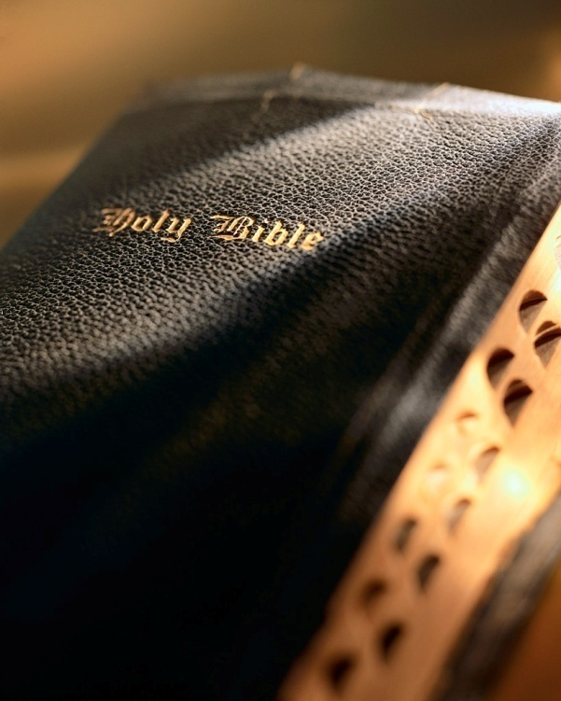

Slide 2
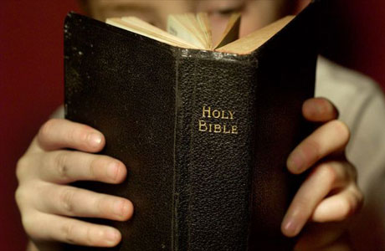
The First, First Principles Romans 1:18-32

Slide 3
Introduction
“first principles of the oracles of God” Hebrews 5:3
“elementary principles of Christ” Hebrews 6:1-2
But, there are “First, First Principles” that precede these and require a degree of understanding and appreciation or the “elementary principles of Christ” will not be fully understood or applied correctly.
2

Slide 4
I
II
III
IV
Behaviors, Attitudes &
Practices
thus
Man behaves,
practices, or lives
according to his…
Many, if not all, the problems in the religious world today are the result of man’s incorrectly held concepts.
Practice:
Gross immorality
Romans 1:20-32
produce
therefore
Conclusions
Incorrect concept of God resulted in them drawing the wrong conclusion concerning morality
Concepts are the soil from which we draw conclusions.
Belief or Concept
Concepts
Low Estimate of Deity
(wrong concept)
Acts 17:16-32
Proverbs 4:23: Keep your heart with all diligence, For out of it spring the issues of life.
Proverbs 23:7: For as he thinks in his heart, so is he.
The CONCEPT must be corrected FIRST!
e.g.
Start Here
A concept is a mental picture of something.
CONCLUSION: 1. If our CONCEPT is wrong, conclusions will be wrong; and behavior/practices cannot be right.
2. We need to keep going back to “the old paths” (Jer. 6:16); asking, “Do I have the right concept?”
AND REMEMBER: 3. It is what we think we know already, that often prevents us from learning.
Notes:
You may, or may not, remember this chart, but I once used it here at Flint. This chart illustrates something very basic, but quite profound. It illustrates a basic principle that affects every realm of our lives, but it is critical in the spiritual realm as we seek to know and serve God.
Let’s start at the bottom left hand corner (Start Here). What is a “Concept”? A concept is a mental picture of something; a concept is your basic view of something whether it be your view of politics, economics, or religion. Concepts are immensely important because “concepts are the soil from which we draw conclusions.” And the conclusions we draw produce our “Behaviors & Practices.” Thus, “Man behaves, practices, or lives according to his “Belief or Concept.”
This being true, it is no wonder the wise man said, “Keep your heart with all diligence. For out of it spring the issues of life.” And, “…as a man thinks in his heart, so is he.”
This brings us to an important issue as we consider God: “Many, if not all, the problems in the religious world today are the result of man’s incorrectly held concepts.” Therefore, if we ever expect to view God as He really is and serve Him in the way He specifies our “concept must be corrected first”! It is absolutely useless and impossible to try to get someone to change a wrong practice or behavior by a direct assault on the wrong practice or behavior. To change the practice or behavior you must first change the concept(s) that led them into that wrong practice or behavior. Change the concept first!
Let’s look at a Biblical example: In Acts 17:16-32 we read: “Now while Paul waited for them at Athens, his spirit was provoked within him when he saw that the city was given over to idols. 17 Therefore he reasoned in the synagogue with the Jews and with the Gentile worshipers, and in the marketplace daily with those who happened to be there. 18 Then certain Epicurean and Stoic philosophers encountered him. And some said, "What does this babbler want to say?“ Others said, "He seems to be a proclaimer of foreign gods," because he preached to them Jesus and the resurrection. 19 And they took him and brought him to the Areopagus, saying, "May we know what this new doctrine is of which you speak? 20 For you are bringing some strange things to our ears. Therefore we want to know what these things mean." 21 For all the Athenians and the foreigners who were there spent their time in nothing else but either to tell or to hear some new thing. 22 Then Paul stood in the midst of the Areopagus and said, "Men of Athens, I perceive that in all things you are very religious; 23 for as I was passing through and considering the objects of your worship, I even found an altar with this inscription: TO THE UNKNOWN GOD. Therefore, the One whom you worship without knowing, Him I proclaim to you: 24 God, who made the world and everything in it, since He is Lord of heaven and earth, does not dwell in temples made with hands. 25 Nor is He worshiped with men's hands, as though He needed anything, since He gives to all life, breath, and all things. 26 And He has made from one blood every nation of men to dwell on all the face of the earth, and has determined their preappointed times and the boundaries of their dwellings, 27 so that they should seek the Lord, in the hope that they might grope for Him and find Him, though He is not far from each one of us; 28 for in Him we live and move and have our being, as also some of your own poets have said, 'For we are also His offspring.' 29 Therefore, since we are the offspring of God, we ought not to think that the Divine Nature is like gold or silver or stone, something shaped by art and man's devising. 30 Truly, these times of ignorance God overlooked, but now commands all men everywhere to repent, 31 because He has appointed a day on which He will judge the world in righteousness by the Man whom He has ordained. He has given assurance of this to all by raising Him from the dead. “ 32 And when they heard of the resurrection of the dead, some mocked, while others said, "We will hear you again on this matter."
The Gentiles in Paul’s day had the wrong concept of God: They had a low estimate deity. Recall: concepts are the soil from which we draw conclusions and we will behave or live according to our beliefs and concepts. Since the gentiles had an incorrect concept of God they were bound to draw incorrect conclusions concerning morality. Their wrong concept of God led to gross immorality (Rom. 20-32): “For since the creation of the world His invisible attributes are clearly seen, being understood by the things that are made, even His eternal power and Godhead, so that they are without excuse, 21 because, although they knew God, they did not glorify Him as God, nor were thankful, but became futile in their thoughts, and their foolish hearts were darkened. 22 Professing to be wise, they became fools, 23 and changed the glory of the incorruptible God into an image made like corruptible man — and birds and four-footed animals and creeping things. 24 Therefore God also gave them up to uncleanness, in the lusts of their hearts, to dishonor their bodies among themselves, 25 who exchanged the truth of God for the lie, and worshiped and served the creature rather than the Creator, who is blessed forever. Amen.
The Gentiles misconception of deity caused them to draw the wrong conclusion concerning morality. In turn, their wrong conclusion about morality led them into all the vices and gross immorality described in Romans 1:20-32.
26 For this reason God gave them up to vile passions. For even their women exchanged the natural use for what is against nature. 27 Likewise also the men, leaving the natural use of the woman, burned in their lust for one another, men with men committing what is shameful, and receiving in themselves the penalty of their error which was due. 28 And even as they did not like to retain God in their knowledge, God gave them over to a debased mind, to do those things which are not fitting; 29 being filled with all unrighteousness, sexual immorality, wickedness, covetousness, maliciousness; full of envy, murder, strife, deceit, evil-mindedness; they are whisperers, 30 backbiters, haters of God, violent, proud, boasters, inventors of evil things, disobedient to parents, 31 undiscerning, untrustworthy, unloving, unforgiving, unmerciful; 32 who, knowing the righteous judgment of God, that those who practice such things are deserving of death, not only do the same but also approve of those who practice them.”
If our CONCEPT is wrong, our conclusions will be wrong; and our behavior and practices cannot be right. We need to keep going back to “the old paths”; and asking, “Do I have the right concept?”
Today’s lesson has everything to do with “concepts”! What is your concept of God? Your concept of God will drive everything you believe and practice in religion. If your concept of God is wrong there is no possibility you will serve Him acceptably and make it to heaven.

Slide 5
Introduction
Romans 1:18-32: For the wrath of God is revealed from heaven against all ungodliness and unrighteousness of men, who suppress the truth in unrighteousness, 19 because what may be known of God is manifest in them, for God has shown it to them. 20 For since the creation of the world His invisible attributes are clearly seen, being understood by the things that are made, even His eternal power and Godhead, so that they are without excuse, 21 because, although they knew God, they did not glorify Him as God, nor were thankful, but became futile in their thoughts, and their foolish hearts were darkened. 22 Professing to be wise, they became fools, 23 and changed the glory of the incorruptible God into an image made like corruptible man — and birds and four-footed animals and creeping things.
4

Slide 6
Introduction
Romans 1:18-32: 24 Therefore God also gave them up to uncleanness, in the lusts of their hearts, to dishonor their bodies among themselves, 25 who exchanged the truth of God for the lie, and worshiped and served the creature rather than the Creator, who is blessed forever. Amen.
26 For this reason God gave them up to vile passions. For even their women exchanged the natural use for what is against nature. 27 Likewise also the men, leaving the natural use of the woman, burned in their lust for one another, men with men committing what is shameful, and receiving in themselves the penalty of their error which was due.
5

Slide 7
Introduction
Romans 1:18-32: 28 And even as they did not like to retain God in their knowledge, God gave them over to a debased mind, to do those things which are not fitting; 29 being filled with all unrighteousness, sexual immorality, wickedness, covetousness, maliciousness; full of envy, murder, strife, deceit, evil-mindedness; they are whisperers, 30 backbiters, haters of God, violent, proud, boasters, inventors of evil things, disobedient to parents, 31 undiscerning, untrustworthy, unloving, unforgiving, unmerciful; 32 who, knowing the righteous judgment of God, that those who practice such things are deserving of death, not only do the same but also approve of those who practice them.
6

Slide 8
Discussion
Eternal power and deity
Obligations to Our Creator
Significance of sin
Remedy for sin
7

Slide 9
Eternal Power & Deity
Psalm 19:1-3
1 The heavens declare the glory of God;
And the firmament shows His handiwork.
2 Day unto day utters speech,
And night unto night reveals knowledge.
3 There is no speech nor language
Where their voice is not heard.
8

Slide 10
Eternal Power & Deity
Material Universe
Universal principle: something cannot come from nothing
Every effect must have a cause
There had to be something prior to the material universe
To bring into existence requires power
That power had to exist before the material universe existed
9

Slide 11
Eternal Power & Deity
Power had to exist prior to the material universe
Thus, it had to be a power that could exist independent of time, space and matter
Eternal power
Existence of the material universe attests to the existence of a power that is an eternal power
This eternal power is also deity
The order of intelligence must be of a different classification than the things it brought into existence
10

Slide 12
Eternal Power & Deity
Creator vs. Creature
Potter is superior to the clay in both terms of power and intelligence
Potter vs. Clay
Analogous to the difference between the potter and the clay (Rom. 9)
Anyone who objectively examines the material universe understands this!
No excuse for not knowing an eternal power and deity exists
Acts 14:17
11

Slide 13
Eternal Power & Deity
Do we fully appreciate God’s superiority to man?! Consider the vastness of our amazing universe:
Dimensions of “known universe” (Gen. 1:16)
Do you feel a bit dizzy?!
VY Canis Majoris is really big!
Now, how big am I?
12

Slide 14
He made the stars also.
Genesis 3:16
.
.
.
.
.
.
Hubble “Deep Field”
Before

Slide 15
He made the stars also.
Genesis 3:16
.
7.5 X 10¹⁸ grains of sand
7.0 X 10²¹ stars
More H₂O molecules in 20 drops of water than both combined!
.
.
.
.
.
Hubble “Deep Field”
Before

Slide 16
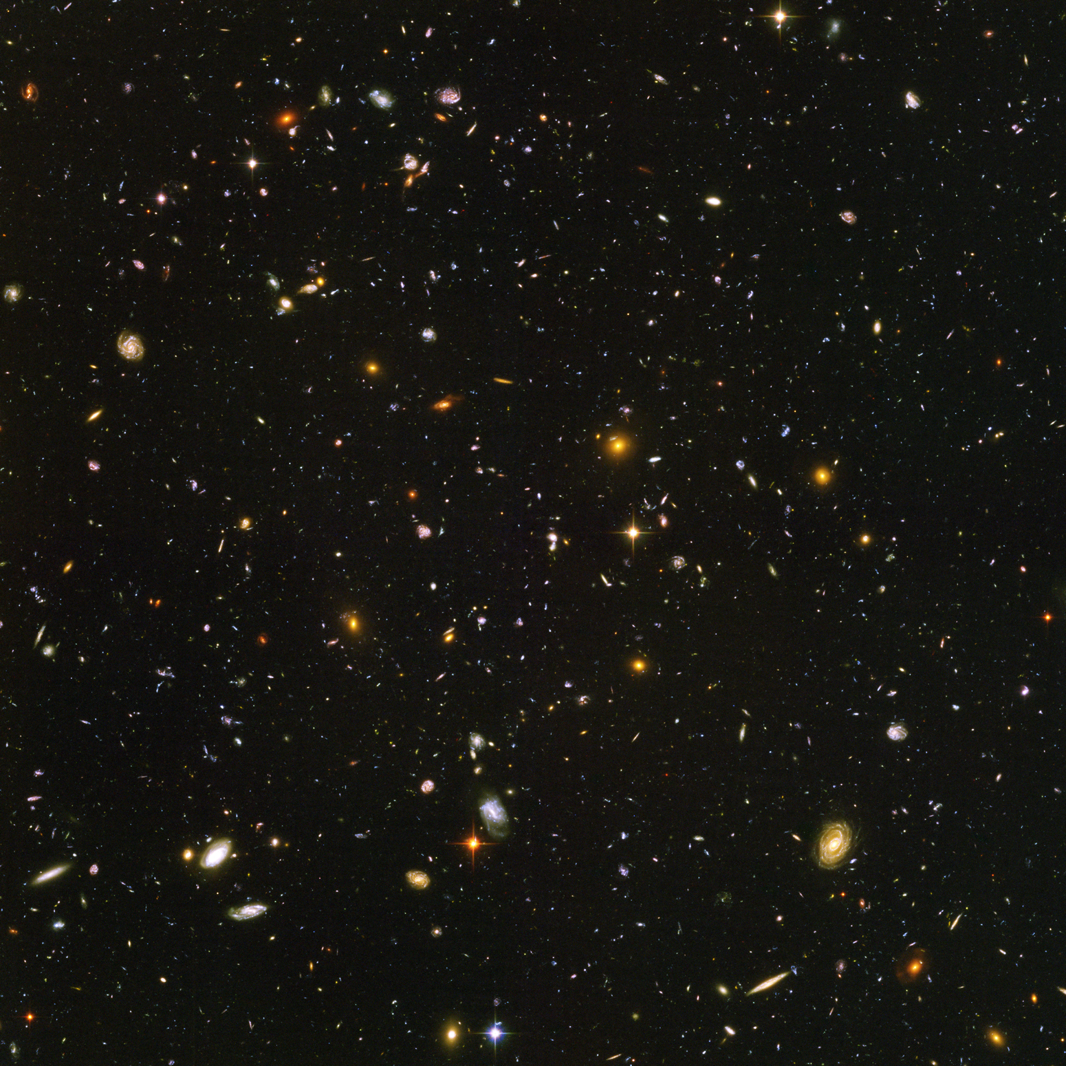
“He calls them all by name.
Psalm 147:4
Hubble “Deep Field”
After

Slide 17
Eternal Power & Deity
Do we fully appreciate God’s superiority to man?! Consider the vastness of our amazing universe:
Dimensions of “known universe” (Gen. 1:16)
Do you feel a bit dizzy?!
VY Canis Majoris is really big!
Now, how big am I?
15

Slide 18
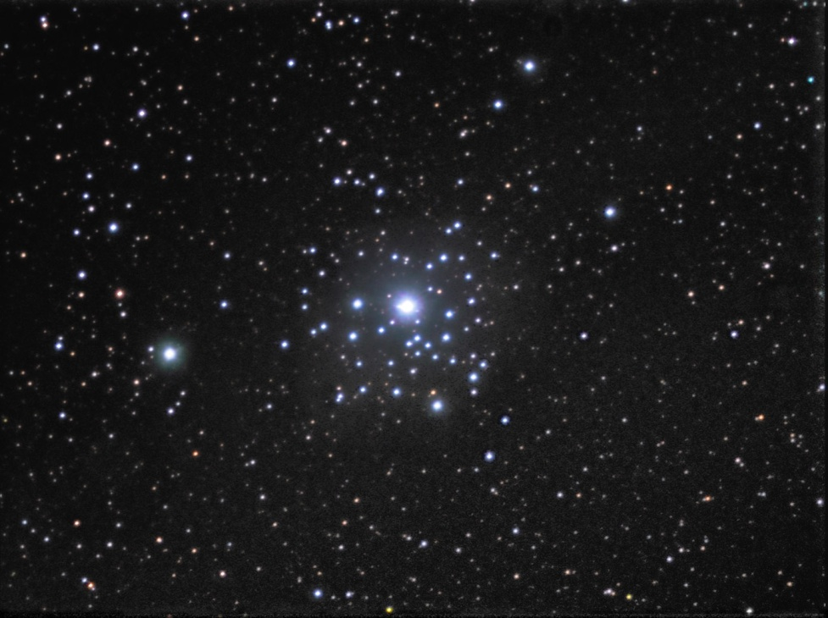
VY Canis Majoris

Slide 19
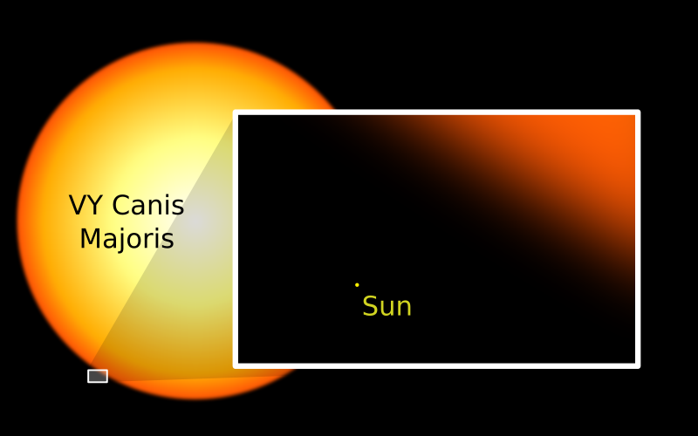
VY Canis Majoris

Slide 20
VY Canis Majoris
How big am I?

Slide 21
Eternal Power & Deity
Do we fully appreciate God’s superiority to man?! Consider the complexity of our amazing universe:
Homeostasis, we take it for granted!
Human body consists of ~100 trillion cells, 10⁻⁶ meters thick, human hair 1,000 times wider!
Physiology of vision, we take it for granted too!
18

Slide 22
Discussion
Eternal power and deity
Obligations to Our Creator
Significance of sin
Remedy for sin
19

Slide 23
Obligations to Our Creator
“did not glorify Him as God”
“nor were they thankful”
“but became futile in their thoughts”
“and their foolish hearts were darkened”
“professing to be wise”
“they became fools”
20

Slide 24
Obligations to Our Creator
Because there is an eternal power which is deity:
We must look up to God and be both awed and bowed in His presence.
We must recognize our complete and total dependence upon Him which should produce thankfulness on our part!
What was the case then and now? v. 21
21

Slide 25
Obligations to Our Creator
“There are only two possible explanations as to how life arose: Spontaneous generation arising to evolution or a supernatural creative act of God…There is no other possibility. Spontaneous generation was scientifically disproved 120 years ago by Louis Pasteur and others, but that just leaves us with only one other possibility…that life came as a supernatural act of creation by God, but I can’t accept that philosophy because I do not want to believe in God. Therefore I choose to believe in that which I know is scientifically impossible, spontaneous generation leading to evolution.”
(p. 46 of Darwin’s Demise; Dr. George Wald, professor emeritus of neurobiology at Harvard University received the Nobel Prize in 1967 for work in the biology of vision.)
22

Slide 26
Obligations to Our Creator
“There are only two possible explanations as to how life arose: Spontaneous generation arising to evolution or a supernatural creative act of God…There is no other possibility. Spontaneous generation was scientifically disproved 120 years ago by Louis Pasteur and others, but that just leaves us with only one other possibility…that life came as a supernatural act of creation by God, but I can’t accept that philosophy because I do not want to believe in God. Therefore I choose to believe in that which I know is scientifically impossible, spontaneous generation leading to evolution.”
(p. 46 of Darwin’s Demise; Dr. George Wald, professor emeritus of neurobiology at Harvard University received the Nobel Prize in 1967 for his work in the biology of vision.)
22

Slide 27
Obligations to Our Creator
Failure to look up and enthrone God and be thankful results in God allowing us to “stew in our own juice”!
“…God…gave them up” (v. 24)
“…God gave them up” (v. 26)
“…God gave them over” (v. 28)
Judicial wrath of God!
23

Slide 28
Discussion
Eternal power and deity
Obligations
Significance of sin
Remedy for sin
24

Slide 29
Significance for sin
What is sin?
“sin is the transgression of the law” 1 Jn. 3:4
But, no codified law here!
Law here existed since creation and was passed down orally by the patriarchs.
25

Slide 30
Significance for sin
All sin is first and foremost against God!
The existence of eternal power and deity implies law.
Potter vs. clay, but God created man with a free will.
When you sin what comes to your mind? Social consequences or obligation to God? Lk. 15:18, 21
26

Slide 31
Remedy for sin
As we consider the remedy for sin we must remember:
Our smallness, our absolute spiritual bankruptcy, our total dependence upon God for sin’s remedy! Rom. 5:10; 2 Cor. 5:10-11
The supreme value of God’s gift! Jn. 1:1-3; Col. 1:16-18; Heb. 11:3; Rom. 5:8-10
Spectrum of our existence: dust mite to supreme focal point of God’s love! Rom. 8:17
27

Slide 32
Conclusion
Matthew 13:45-46: “Again, the kingdom of heaven is like a merchant seeking beautiful pearls, 46 who, when he had found one pearl of great price, went and sold all that he had and bought it.”
28

