Slide 1
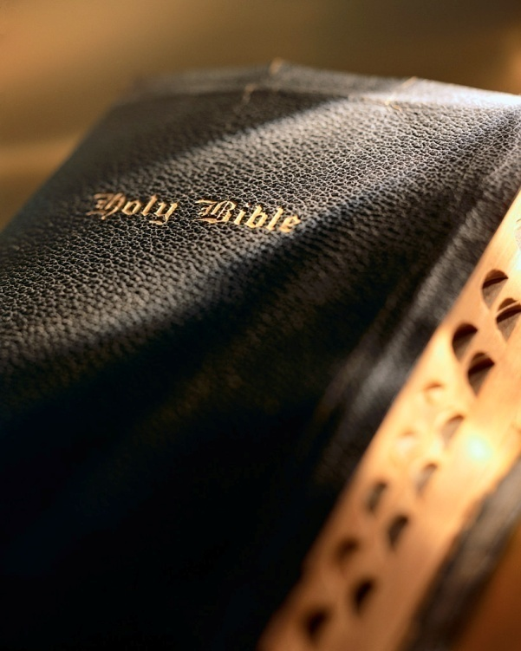

Slide 2

Opportunities
Galatians 6:10

Slide 3
Introduction
Decades old controversy: “individual” vs. “church” responsibility.
Liberal view: Gal. 6:10 and Jas. 1:27 authorized church support of institutions (e.g., orphan’s home, old folk’s homes).
Conservative (scriptural view): Gal. 6:10 and Jas. 1:27 define responsibilities of individual Christians.
2

Slide 4
Introduction
“Orphan-haters”?
3

Slide 5
Why the Epithet?
A condemnation designed to cloud and charge the issue with emotions.
“How else will the work get done?”
Really good question! How will the work get done?
4

Slide 6
Why the Epithet?
Very simple: The work gets done when, by faith, every Christian firmly takes hold of their individual responsibility per Gal. 6:6-10 and Jas. 1:27 and does what needs to be done.
We as individuals just need to do what the Lord tells us as individuals to do!
5

Slide 7
Why the Epithet?
I (you) cannot:
  Relieve every widow.
  Provide a home for every orphan.
  Help support every preacher.
  Meet every man’s need.
6

Slide 8
Why the Epithet?
But, I (you) can “as we have opportunity”:
  Relieve some widow.
  Provide a home for some orphan.
  Provide some support for some preacher.
  Meet some man’s need.
7

Slide 9
Are There Any Opportunities?
Galatians 6:6-10: Let him who is taught the word share in all good things with him who teaches. 7 Do not be deceived, God is not mocked; for whatever a man sows, that he will also reap. 8 For he who sows to his flesh will of the flesh reap corruption, but he who sows to the Spirit will of the Spirit reap everlasting life. 9 And let us not grow weary while doing good, for in due season we shall reap if we do not lose heart. 10 Therefore, as we have opportunity, let us do good to all, especially to those who are of the household of faith. Cf. 2 Cor. 9:6; Matt. 6:19-21
8
Notes:
“With specific reference to this context, the proverb refers to the use of one’s financial resources. God will not be mocked in this regard. There is a relationship between the use of our money and the harvest that shall be reaped. The words of Jesus in this regard help explain this verse, ‘Lay not up for yourselves treasures upon earth, where moth and rust doth corrupt, and where thieves break through and steal: But lay up for yourselves treasures in heaven, where neither moth nor rust doth corrupt, and where thieves do not break through nor steal’ (Matt. 6:19-20).”
“This proverb warns that one cannot reap the happiness in heaven when he improperly uses his money.”
pp. 284-285 Mike Willis Truth Commentary on Galatians

Slide 10
Are There Any Opportunities?
Many never seem to find opportunities to obey Gal. 6:6-10 and Jas. 1:27.
  Find plenty of opportunities for other things (latest fashion, vacations, recreation, gadgets, careers, million other things).
  But nothing for widows, orphans, gospel preachers or persons in need.
9

Slide 11
Are There Any Opportunities?
Sir Francis Bacon
“A wise man will make more
opportunities than he finds.”
Jesus Christ
“For where your treasure is,
there your heart will be also.”
10

Slide 12
Are There Any Opportunities?
Could I have “heart trouble”? 1 Jn. 3:17; Rom. 12:13; Jas. 4:17 (Matt. 6:21).
  Stinginess? Apathy? Inattentiveness? Fear of getting involved?
  Cannot delegate any of our individual responsibilities to others!
  Sunday collection does not mean we’ve met all our obligations (cf. Matt. 25:31-46; Jas. 1:27; Gal. 6:6, 10; 2 Cor. 9:6).
11

Slide 13
The Solution
Commands of Gal. 6:6-10 and Jas. 1:27 no less important than those of Mk. 16:16; Acts 2:38; 17:30; Rom. 12:1-2; or 1 Cor. 11:28.
12

Slide 14
The Solution
If we believe 1 Pet. 4:11 and Col. 3:17 we have no right to pick and choose passages we’ll obey or not obey!
  One basis for our judgment: Matt. 25:31-46
  Let’s our light shine: Matt. 5:16
  We imitate our heavenly Father: Psa. 68:5
  One reason we work: Eph. 4:28
  We’ll find temporal and eternal blessings: Acts 20:35; Matt. 25:40
13

Slide 15
The Solution
God will not be “mocked” in how we use our financial resources! Gal. 6:7-8
If we believe 1 Pet. 4:11 and Col. 3:17 we have no right to pick and choose passages we’ll obey or not obey!
  One basis for our judgment: Matt. 25:31-46
  Let’s our light shine: Matt. 5:16
  We imitate our heavenly Father: Psa. 68:5
  One reason we work: Eph. 4:28
  We’ll find temporal and eternal blessings: Acts 20:35; Matt. 25:40
13

Slide 16
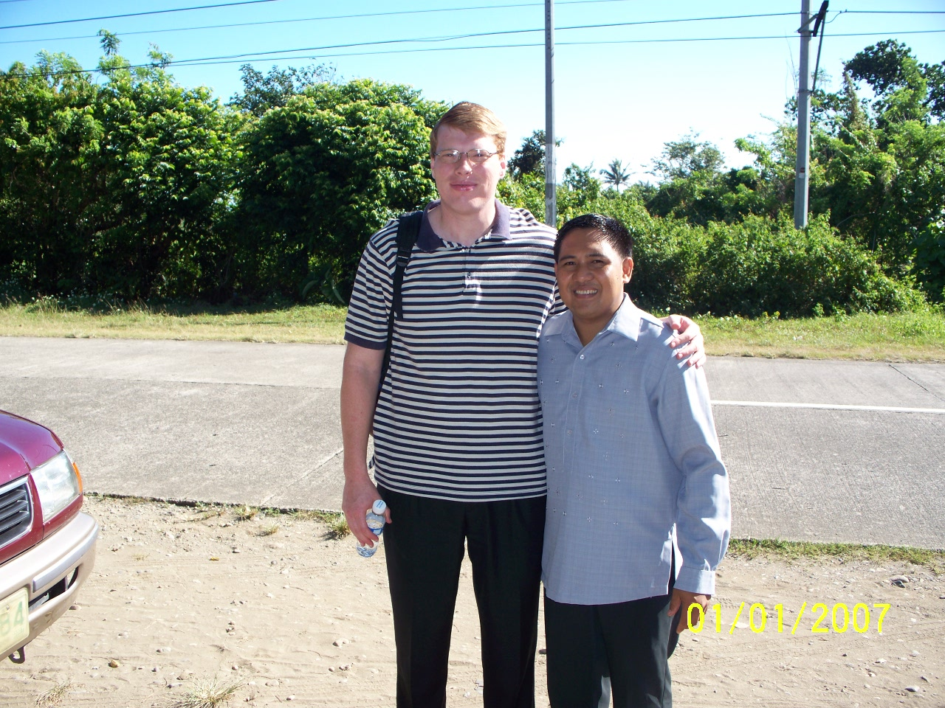
Are there any opportunities?
Acts 20:35
4/13/2010
14

Slide 17
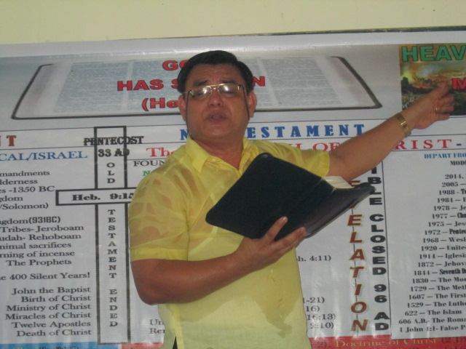
Are there any opportunities?
15

Slide 18
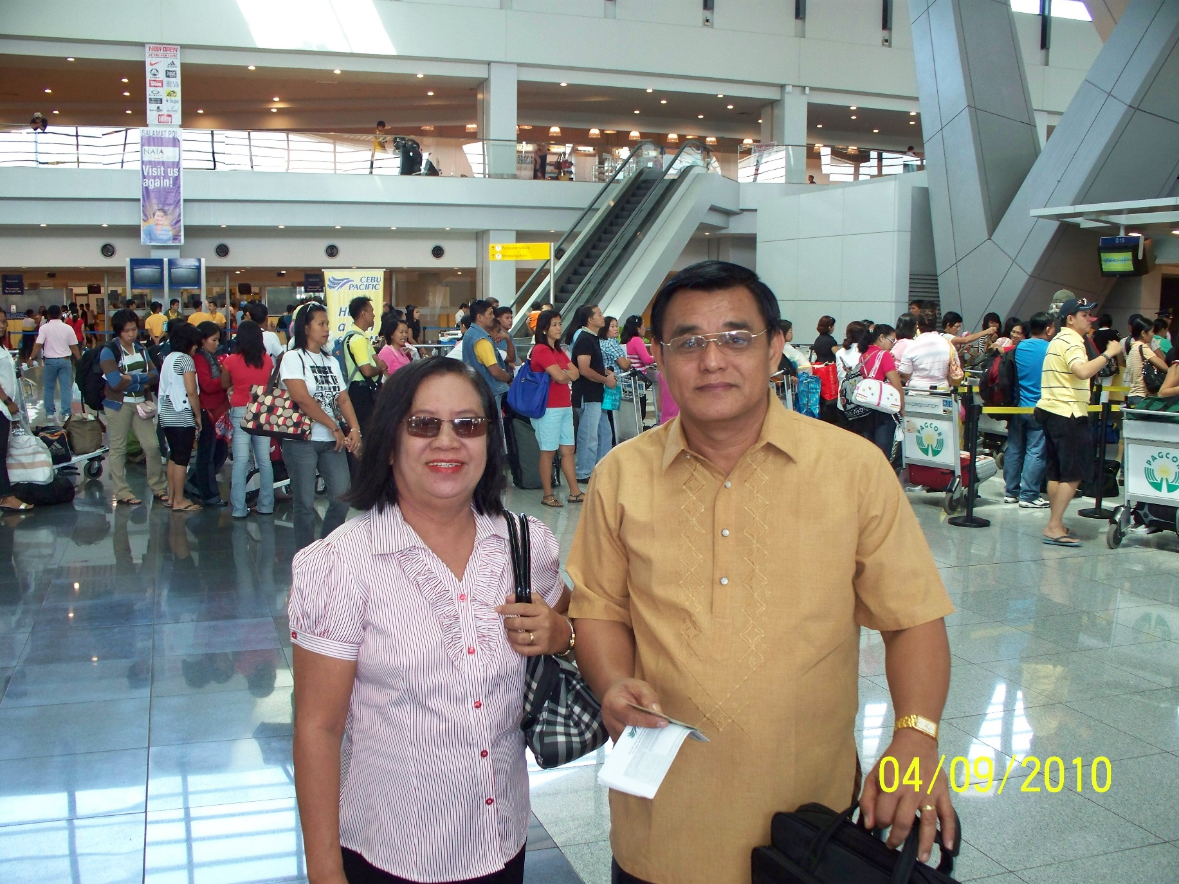
Are there any opportunities?
4/13/2010
16

Slide 19
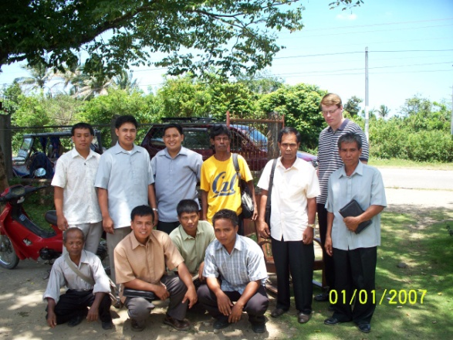
Are there any opportunities?
4/13/2010
17

Slide 20
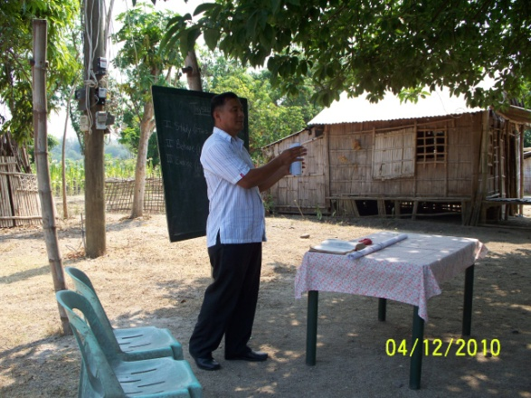
Are there any opportunities?
18

Slide 21
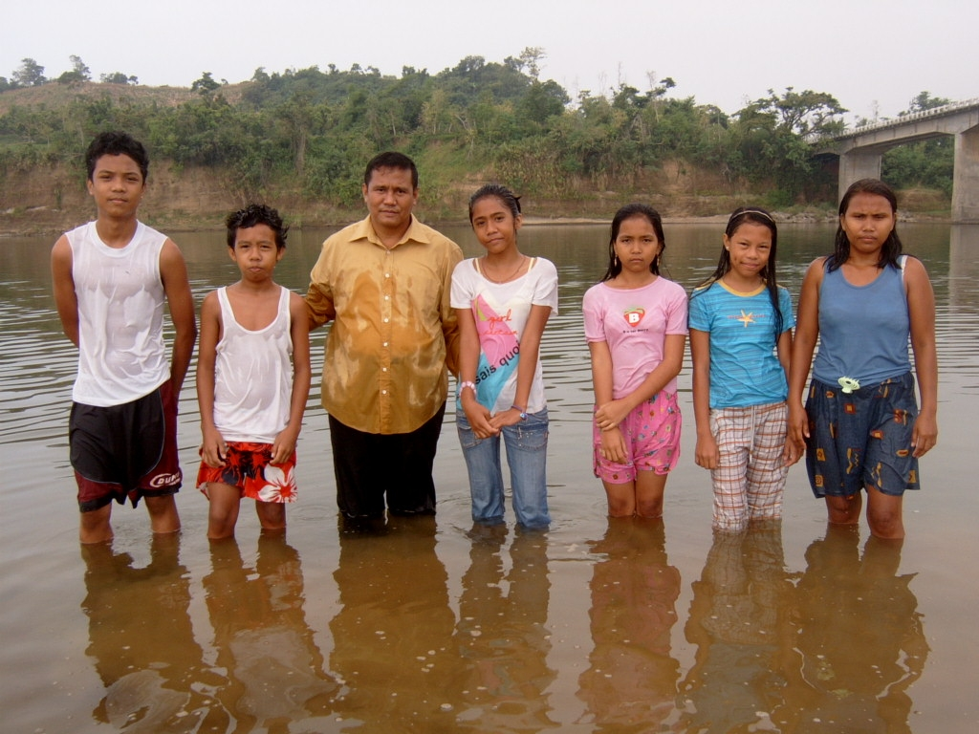
Are there any opportunities?
4/13/2010
19

Slide 22
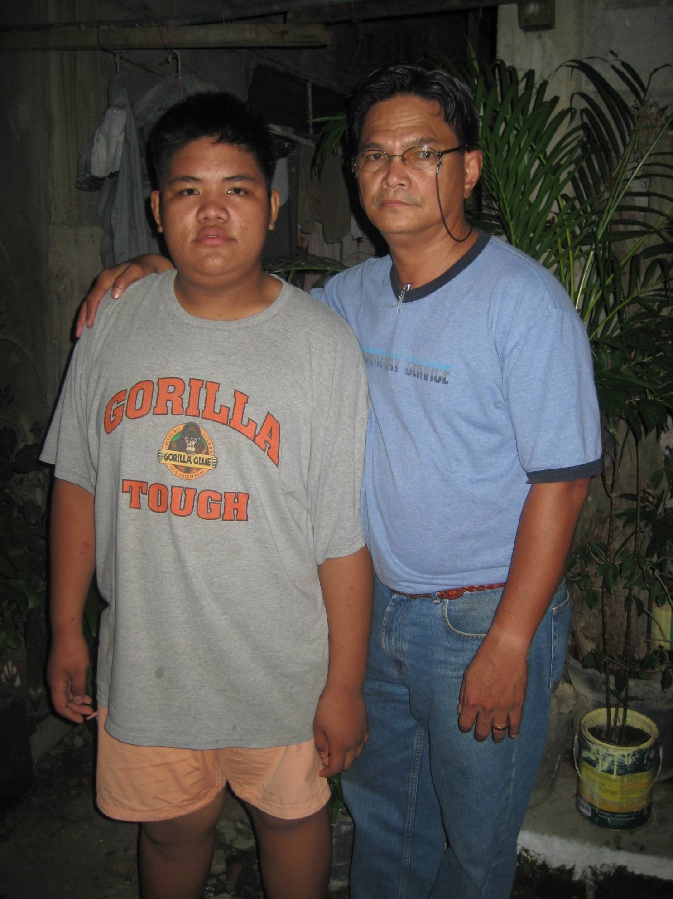
Are there any opportunities?
20

Slide 23
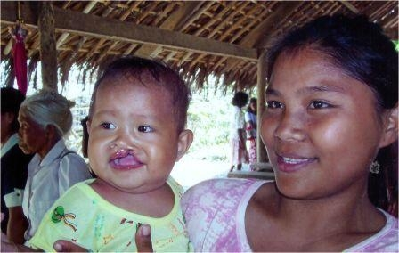
Are there any opportunities?
21

Slide 24
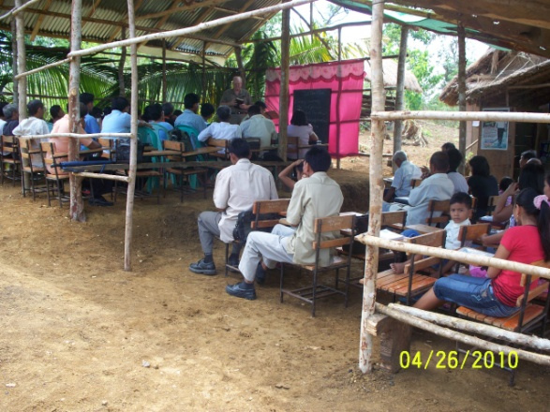
Are there any opportunities?
22

Slide 25
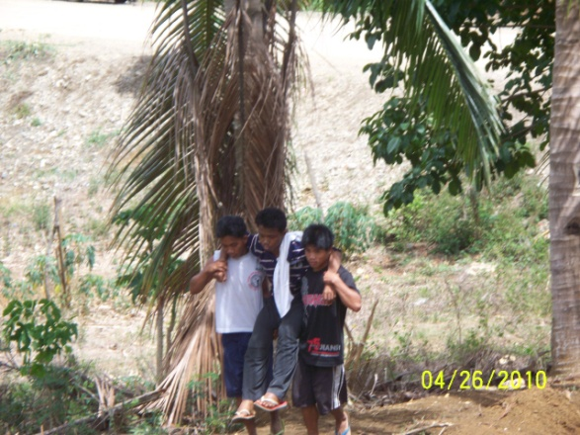
Are there any opportunities?
23

Slide 26
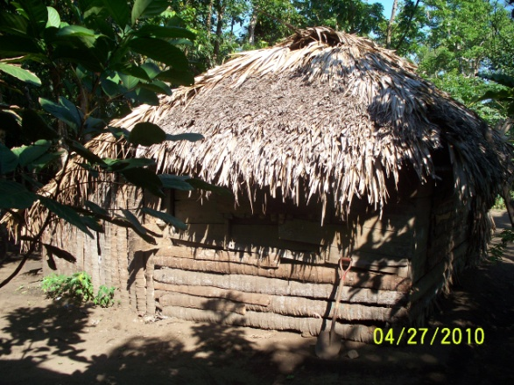
Are there any opportunities?
24

Slide 27
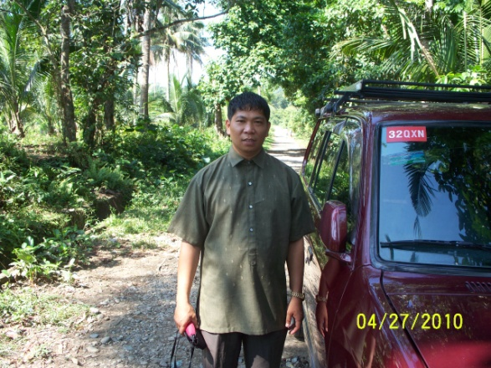
Are there any opportunities?
25

Slide 28
Are there any opportunities?
26

Slide 29
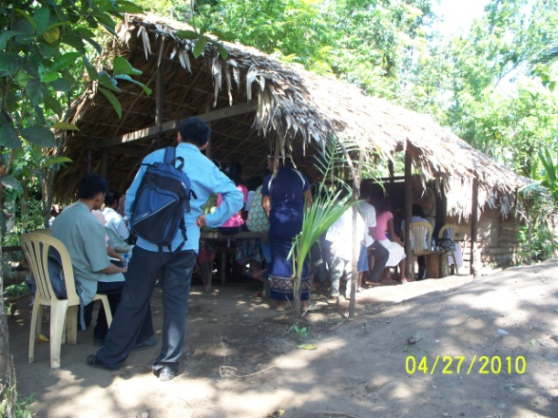
Are there any opportunities?
Who is the “rich” in 1 Timothy 6:17-19 in comparison to this sister in Christ?
27

Slide 30
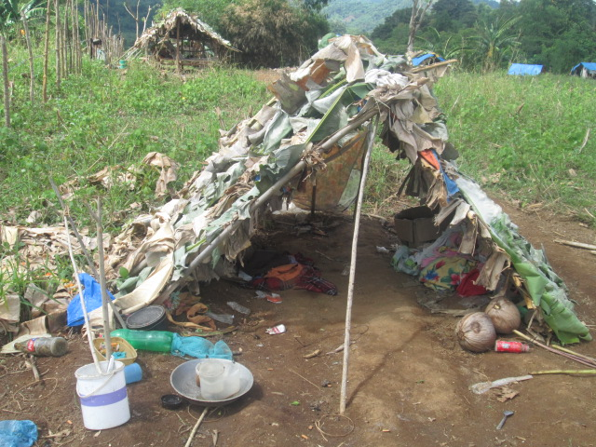
Are there any opportunities?
28

Slide 31
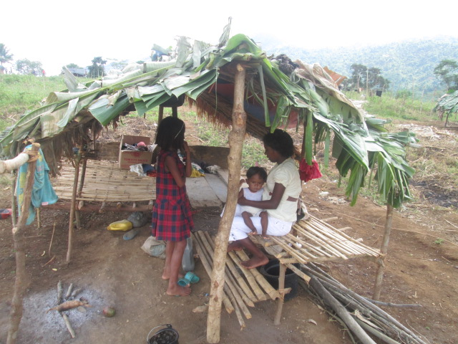
Are there any opportunities?
29

Slide 32
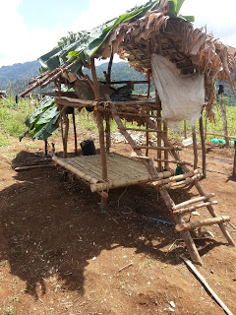
Are there any opportunities?
30

Slide 33
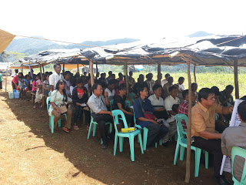
Are there any opportunities?
31

Slide 34
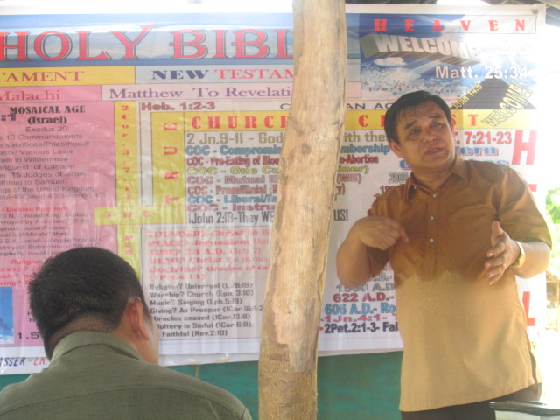
Are there any opportunities?
32

Slide 35
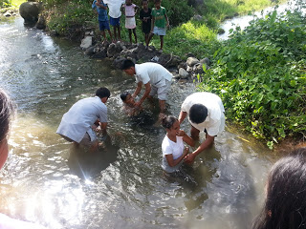
Are there any opportunities?
33

Slide 36
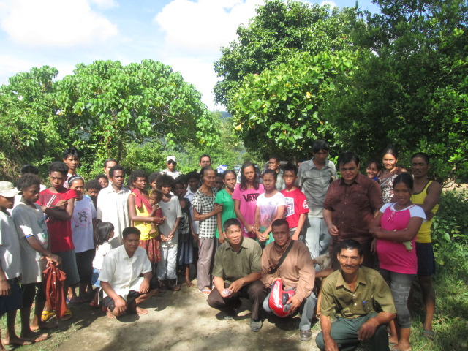
Are there any opportunities?
34

Slide 37
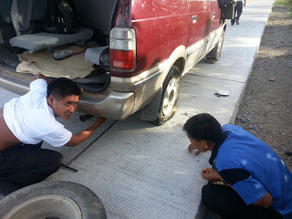
Are there any opportunities?
35

Slide 38
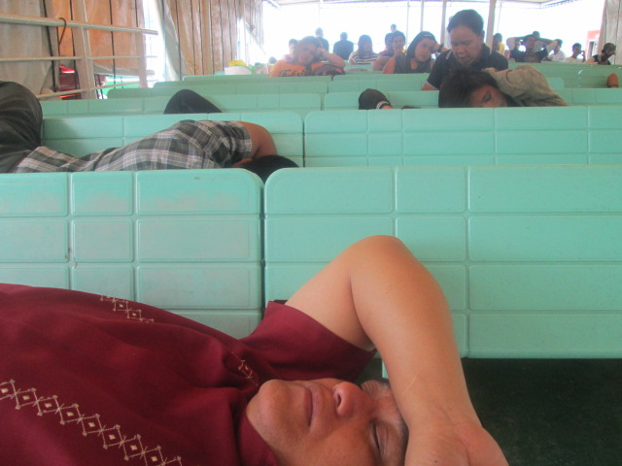
Are there any opportunities?
36

Slide 39
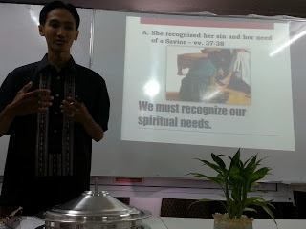
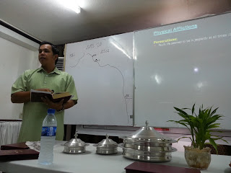
Are there any opportunities?
37

Slide 40
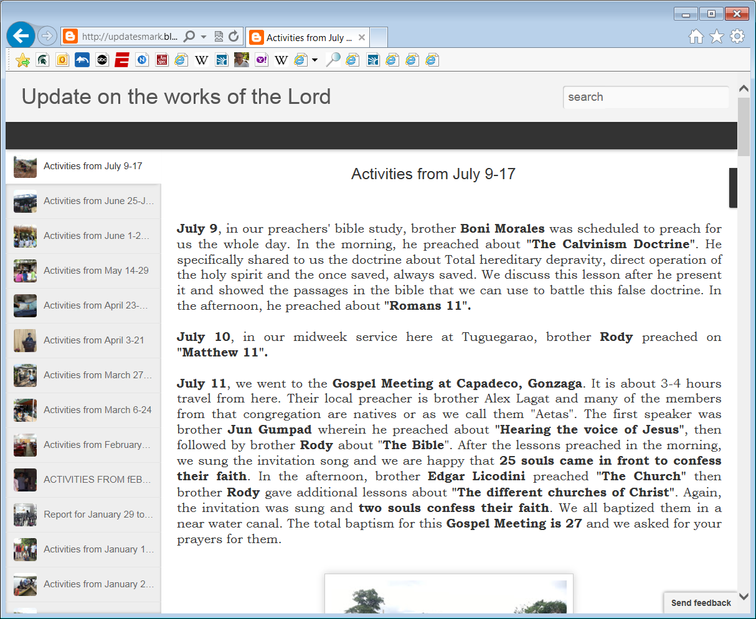
Are there any opportunities?
38

Slide 41
39

Slide 42
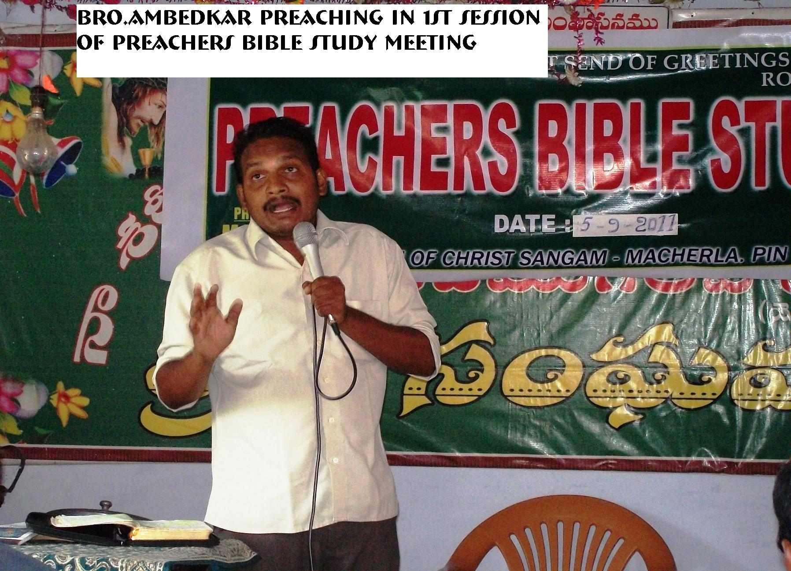
Are there any opportunities?
40

Slide 43
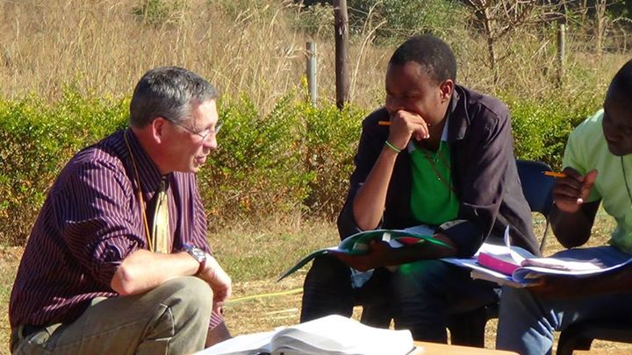
Are there any opportunities?
41

Slide 44
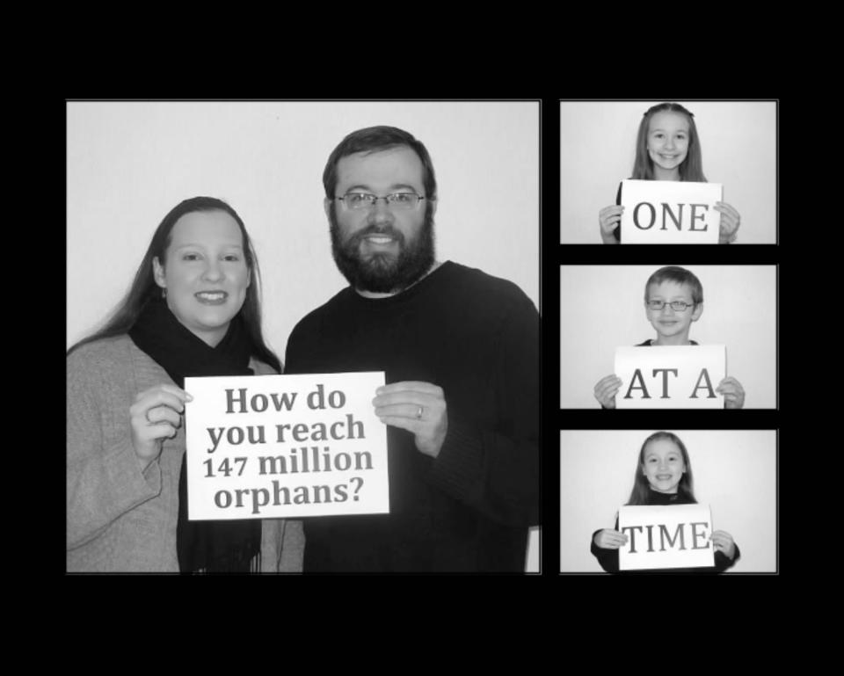
Are there any opportunities?
42

Slide 45

Are there any opportunities?
43

Slide 46
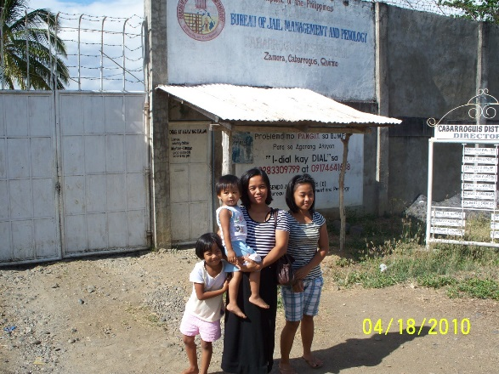
Are there any opportunities?
44

Slide 47
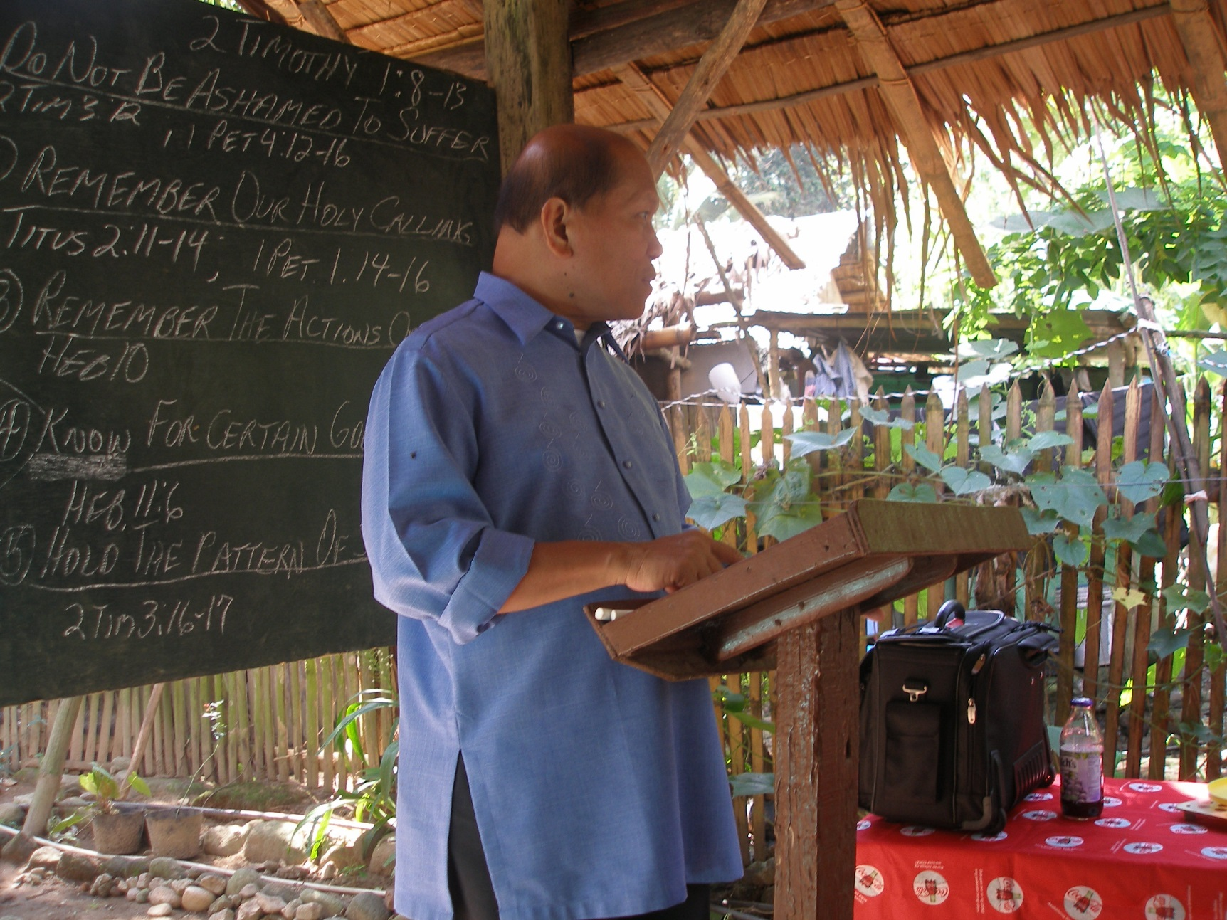
Are there any opportunities?
45

Slide 48
Conclusion
We must be more than just sympathetic to the needs of others!
“Emotion is no substitute for action.”
“The road to hell is paved with good intentions.”
What are you doing with your opportunities NOW?
46

Slide 49
Conclusion
“Then they also will answer Him, saying, ‘Lord, when did we see You hungry or thirsty or a stranger or naked or sick or in prison, and did not minister to You?’ Then He will answer them, saying, ‘Assuredly, I say to you, inasmuch as you did not do it to one of the least of these, you did not do it to Me.’ And these will go away into everlasting punishment, but the righteous into eternal life.”
Matthew 25:44-46
Cf. 2 Cor. 8:7; Acts 20:35
47

Slide 50
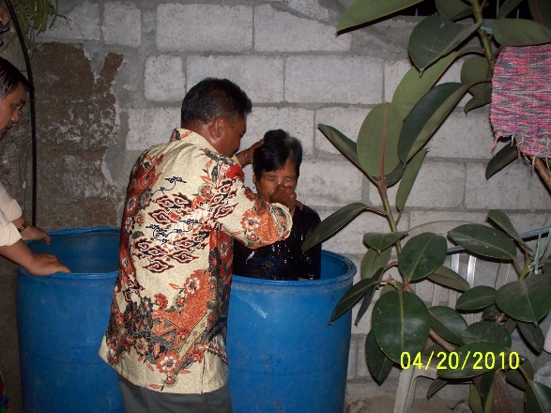
Are there any opportunities?

Slide 51
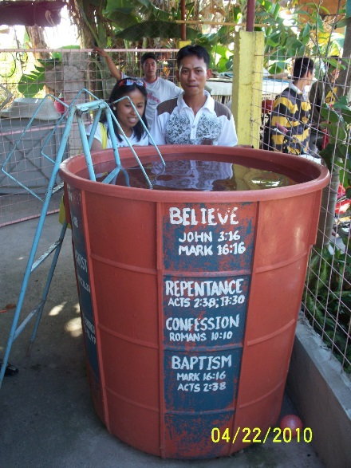
Are there any opportunities?

Slide 52
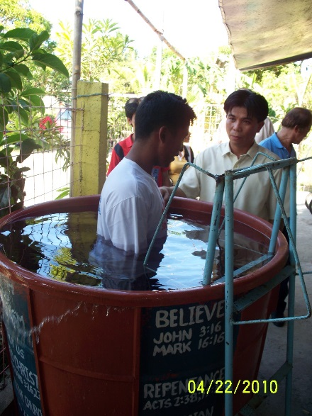
Are there any opportunities?

