Slide 1
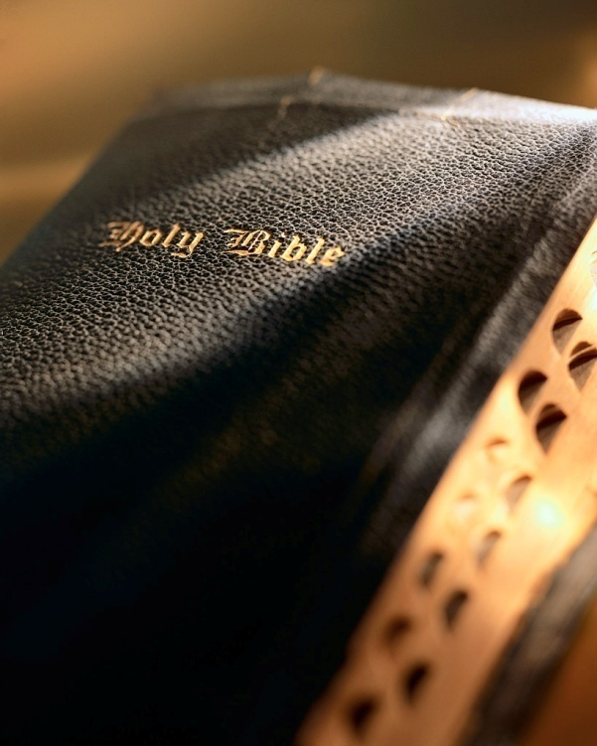

Slide 2
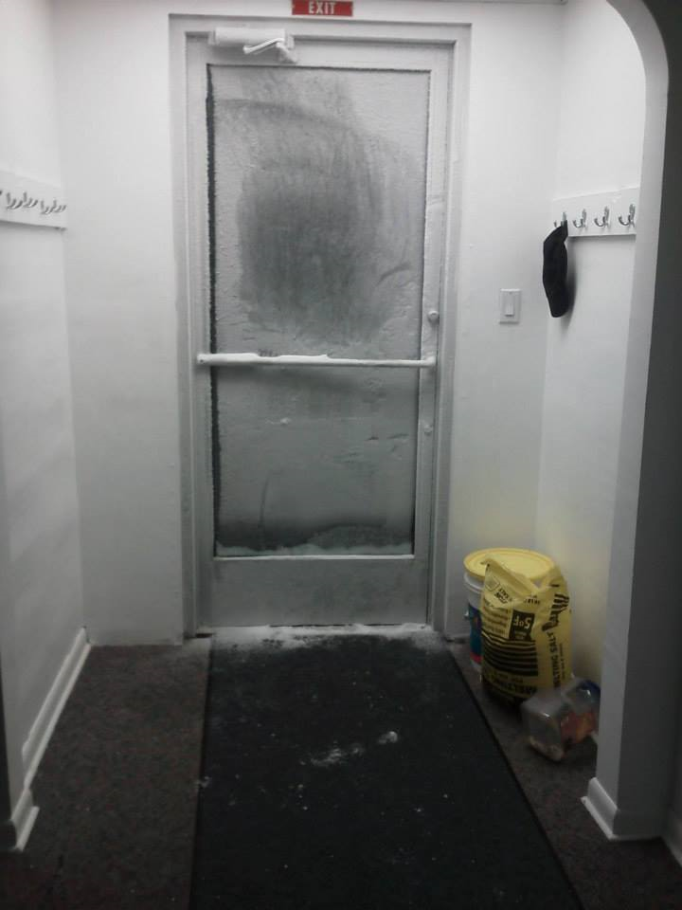

Slide 3
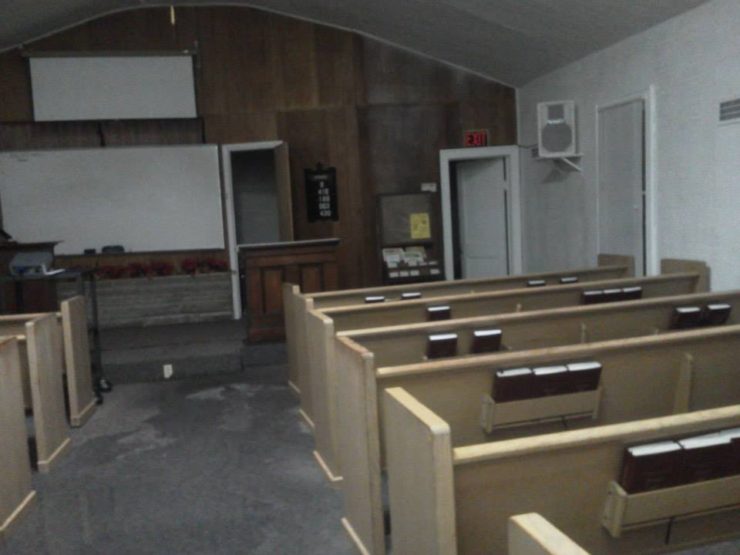

Slide 4
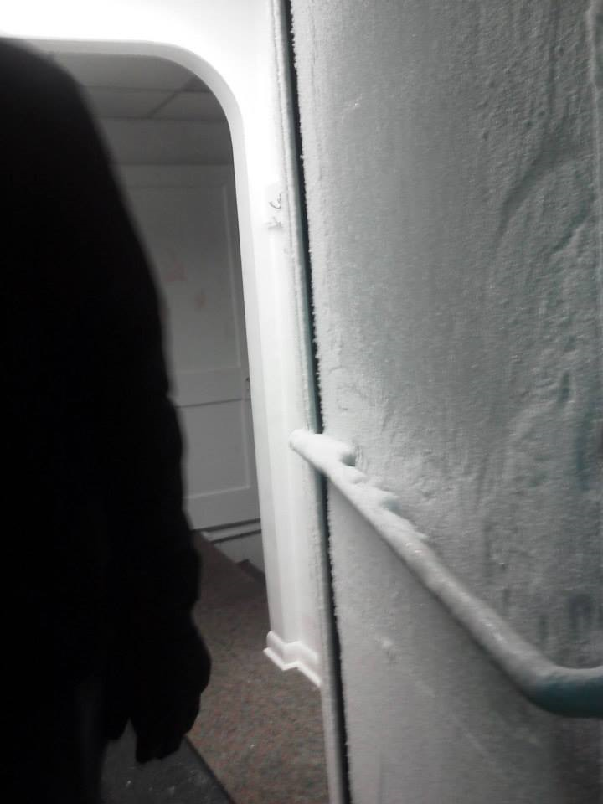

Slide 5
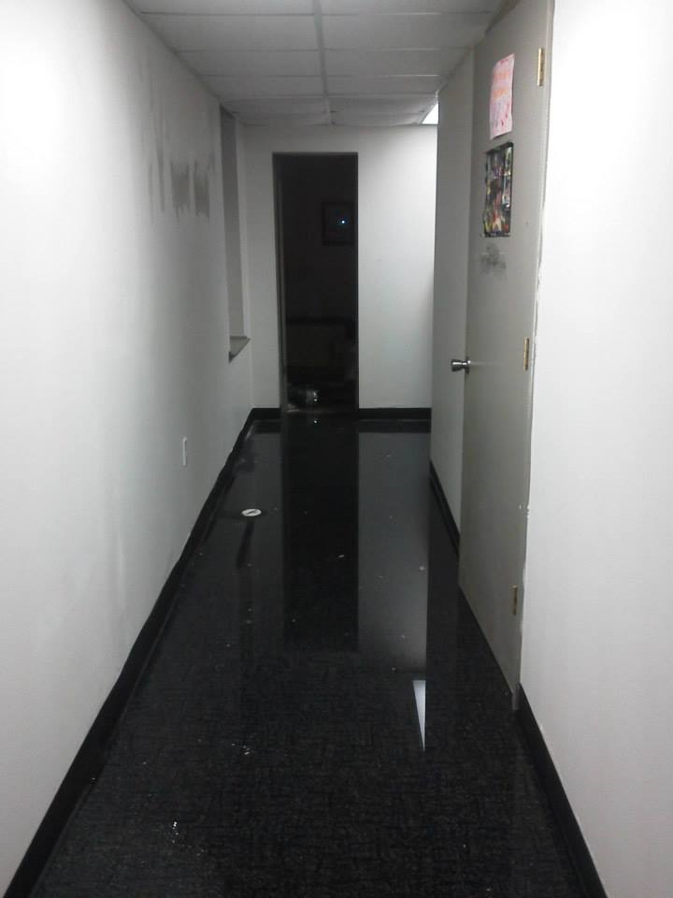

Slide 6
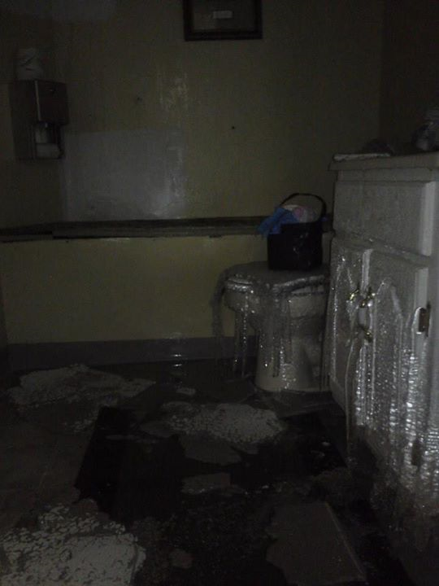

Slide 7
Our Last Appointment Hebrews 9:27

Slide 8
Introduction
It was the evening of April 14th.
The President was running late, besieged by last minute callers.
He made time for an old friend, George Ashmun, who was accompanied by the Speaker of the House and Judge Daly.

Slide 9
Introduction
The President had served in Congress with Ashmun twenty years earlier.
The President spent a few minutes with this party then had to hastily leave for another appointment.

Slide 10
Introduction
But before he left, the President hastily “scribbled on a card for Ashmun and Judge Daly:
‘Allow Mr. Ashmun & friend to come in at 9 A.M. tomorrow. A. Lincoln, April 14, 1865.’”
Luthin, Lincoln (p. 633)

Slide 11
Some appointments will never be kept.
The next day at 9 A.M. Lincoln was dead; the appointment would never be kept.
How often do we make plans and/or appointments; never considering we might not keep them?
Consider the rich man in Lk. 12:16-21 (cf. Jas. 4:13-15; 1 Cor. 16:5-8; 2 Cor. 1:15-16).
All of our plans depend upon the following principle:
“…if the Lord permit.”

Slide 12
One appointment we all will keep.
One day all our future appointments will be canceled, not merely postponed.
Ironically 47 years to the same day and hour the world’s greatest ship, touted as “unsinkable” sank.

Slide 13
One appointment we all will keep.
Let us reflect with all seriousness the profound words of Heb. 9:27.
What a sobering thought that this is one appointment everyone will keep!

Slide 14
Then we will have to give an account.
Our final “appointment” is an absolute certainty! Heb. 9:27
Our final appointment is for two reasons: death and judgment (2 Cor. 5:10; Rom. 14:11-12).
What then? How should we respond given we all face a common fate?

Slide 15
Then we will have to give an account.
We need to be “persuaded” of something “Knowing, therefore, the terror of the Lord” ! 2 Cor. 5:11
“to whom much is given, from him much is required” (Lk. 12:48; Heb. 10:28-31).

Slide 16
Then we will have to give an account.
On that day we will hear one of two things from Jesus:
“Well done, good and faithful servant…Enter into the joy of your lord.” (Matt. 25:23)
-or-
“You wicked and lazy servant…cast the unprofitable servant into the outer darkness. There shall be weeping and gnashing of teeth.” (Matt. 25:26-30)

Slide 17
Then we will have to give an account.
On that day we will hear one of two things from Jesus:
“Come, you blessed of My Father, inherit the kingdom prepared for you from the foundation of the world.” (Matt. 25:34)
-or-
“Depart from Me, you cursed, into the everlasting fire prepared for the devil and his angels.” (Matt. 25:41)

Slide 18
Then we will have to give an account.
We all need to contemplate Jesus’ words!
When doing so what do you feel?
Joy?
Dread?

Slide 19
Conclusion
The appointments Lincoln made on April 14, 1865 were never kept.
All his dreams and schemes vanished as the vapor of that cold night.
April 15th found his soul in eternity.
What are your plans for 1/13/14?
Remember, “…behold, now is the accepted time; behold now is the day of salvation.” (2 Cor. 6:2)
“Heaven is a prepared place for a prepared people.”
Are you making preparations?

