Slide 2
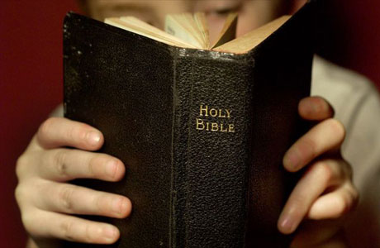
Lessons From the Flood Hebrews 11:7

Slide 3
Introduction
Extremely important to study the Old Testament: Rom. 15:4; 1 Cor. 10:5-12
Today we will consider lessons we can learn from the great flood in the time of Noah.
Flood is not a myth! (Matt. 24:36-39),
Flood demonstrates the tragic spiritual condition into which people can slip (Gen. 6:5-7, 11-13, 17).
Can the spiritual condition of our present world be far behind?

Slide 4
God Hates Sin: Gen. 6:5-7
God never treats sin lightly: Rom. 8:5-8
Only a few were/will be saved: 1 Pet. 3:20; Matt. 7:13-14, 21
Do we take sin seriously? 1 Thess. 5:22; Rom. 12:9

Slide 5
God Is Longsuffering: 2 Peter 3:9
God has always given men chance after chance to repent: 2 Pet. 3:9
No one will be able to blame God if they are lost: Ezek. 33:11; Matt. 23:37
We can’t let God’s longsuffering lull us into procrastination concerning right living! 2 Pet. 3:9-12

Slide 6
God’s Patience Can Be Exhausted: Romans 6:1
Most think they can continue in sin with impunity…not so: Rom. 6:1; Num. 32:23
God is longsuffering, but His patience ultimately runs out:
Antediluvian world (Gen. 6-9)
Sodom & Gomorrah (Gen. 18)
The Jews (Matt. 23:31-39; 24; 27:25; Deut. 30:17-19)
We cannot hide our sin from God: Heb. 4:11-13; Prov. 29:1

Slide 7
No Second Chance: Gen. 7:17-24
How much longer will God give us opportunity to make our lives right with Him? Rom. 13:11; Jas. 4:14
Our last chance can come suddenly, without warning: Lk. 12:16-21; 2 Cor. 6:2
Heaven is a prepared place for a prepared people: Matt. 16:26
Great gulf fixed: Lk. 16:19-31
One day all opportunities for salvation will be gone: Heb. 9:27; Matt. 25:1-13; Heb. 12:17

Slide 8
The Severity of God: Rom. 11:22
God is love, but God is also just and exercises His wrath against sin: Gen. 6:7; Rom. 3:25-26; Heb. 10:29
Everyone who turns his back on God will pay a huge price: 2 Thess. 1:7-9
God can’t be fooled: Isa. 55:8-9; Rom. 11:33-34; 1 Cor. 1:20; 3:18-20; Gal. 6:7-8
God is fair: Deut. 32:4; Gen. 18:25; Gen. 6:3; 1 Pet. 3:19-20
Someday the severity of God will burst forth on an unrepentant world! Rev. 20:14

Slide 9
God’s Promises Are Sure: 2 Pet. 3:5-6; Gen. 8:21-22; 9:11-13
Impossible for God to lie: Heb. 6:18; Num. 23:19
Thus, we can absolutely trust His word: Prov. 19:21; Matt. 24:35; e.g., Mk. 16:16
Most believe in “eternal life,” but not in “everlasting punishment”: Matt. 25:46
God fulfilled His promises to Noah and will fulfill His promises to mankind: 2 Pet. 3:1-10

Slide 10
Noah Did Something: Heb. 11:7
Noah knew the world was coming to an end and did something about it: Gen. 7:5; Heb. 11:7
Likewise, in view of judgment, God tells us to do something: 2 Pet. 3:11-12; Heb. 2:1-3
We must also do something for others: Acts 17:30-31; Ezek. 33:1-9
Noah did his job and so must we: 2 Pet. 2:5; Jer. 20:9; 2 Cor. 5:10-11a

Slide 11
Conclusion: Many important lessons from the flood.
God hates sin,
God is longsuffering,
God’s patience can be exhausted,
No second chance,
The severity of God,
God’s promises are sure,
Noah did something.

