Slide 1
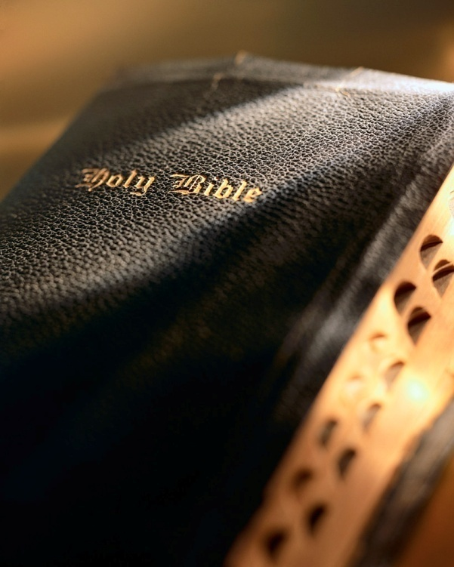

Slide 2
God’s Laws of Harvest Galatians 6:7-9

Slide 3
Introduction
When God created the Universe He formulated a set of laws to govern it.
Fixed and Constant: e.g., gravity.
For Our Good: God is not a “cosmic kill-joy” (1 Jn. 5:3).
In this lesson we want to consider a “family” of God’s laws: “God’s Laws of Harvest.”

Slide 4
You Reap What Sow
Physical reaping:
Farmer who plants is the farmer who reaps the harvest.
Spiritual reaping:
Absolutely true: Gal. 6:7
Harvest is the souls of men: Jn. 4:35-36
Day of harvest is judgment day: 2 Cor. 5:10; Matt. 25:31-46; Rom. 14:12; Rev. 20:12-15; Acts 10:35; Rom. 2:5-10

Slide 5
You Reap in a Different Season From When You Sow
Physical reaping:
Farmers are the most patient and optimistic people on earth (Eccl. 3:1-2; Jas. 5:7-8).
Spiritual reaping:
Harvest always ultimately comes: Gal. 6:7-10
Our “deeds” are “seeds”! 2 Cor. 5:10; Rom. 14:10-12; Heb. 9:27

Slide 6
You Reap the Same Kind as You Sow
Physical reaping:
All farmers know corn yields corn, not soybeans or alfalfa (Gen. 1:11-22).
Spiritual reaping:
Jesus knew this: Matt. 7:16; Prov. 11:18; Eph. 6:8; Job 4:8
Jacob experienced it: Gal. 6:8
Day of harvest is judgment day: 2 Cor. 5:10
Vast majority ignore this harvest: Matt. 7:13-14; Deut. 29:18-20

Slide 7
You Reap More Than You Sow
Physical reaping:
One kernel of corn yields ~600 fold!
Spiritual reaping: “good news, bad news”!
Just ask the Jews: Hos. 8:7-8; Deut. 28; Isa. 17:11
Just ask David: Gal. 6:8; 2 Sam. 11-18
Some don’t understand it or believe it: Rom. 2:4-11

Slide 8
You Eat the Fruit of Your Harvest
Physical reaping:
Farmer’s reward is to eat of his harvest (2 Tim. 2:6).
Spiritual reaping:
How will your life “taste”? Isa. 3:10
A big bite of a sour apple?! Prov. 1:28-31; Lk. 12:16-21

Slide 9
Conclusion
If God’s harvest came today; what would you reap?
If you’re sowing “to…the flesh” you’ll “reap corruption” (Gal. 6:8).
If you’re sowing “to the Spirit” you’ll “reap everlasting life” (Gal. 6:8).
What are you sowing?

