Slide 1
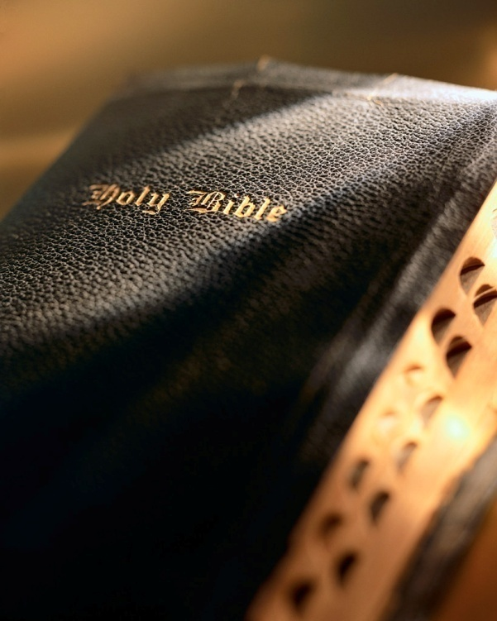

Slide 2
Overcoming Sin (9): Fear 2 Timothy 1:7

Slide 3
Introduction
What are your fears?
Claustrophobia:
Fear of confined spaces
Altophobia:
Fear of heights
Aviophobia:
Fear of flying
Hydrophobia:
Fear of water
Arachnophobia:
Fear of spiders
Ophidiophobia:
Fear of snakes
Glossophobia:
Fear of public speaking

Slide 4
Introduction
What are your fears?
Brontophobia:
Fear of thunder & lightening
Coulrophobia:
Fear of clowns
Dendrophobia:
Fear of trees
Pentheraphobia:
Fear of mother-in-law
Phronemophobia:
Fear of thinking
Eccleisiophobia:
Fear of church

Slide 5
Introduction
What are your fears?
Homilophobia:
Fear of sermons
Panobia:
Fear of everything
Bible uses “fear” in two ways:
Respect: Eccl. 12:13; Prov. 1:7; Acts 10:35
Cowardice: 2 Tim. 1:7

Slide 6
What is wrong with fear?
It keeps one from confessing Christ:
Confessing Christ is a prerequisite of salvation: Matt. 10:32; Rom. 10:9-10; Acts 8:36-37
Fear can keep one from making this confession: Jn. 12:42-43

Slide 7
What is wrong with fear?
It keeps our faith a secret:
Remember Joseph of Arimathea? Jn. 19:38
Are you a “secret” disciple of Jesus?
How many will face judgment unprepared because you were afraid?

Slide 8
What is wrong with fear?
You Never Mentioned Him To Me
When in the better land, before the bar we stand,
How deeply grieved our souls will be,
If any lost one there, should cry in deep despair,
‘You never mentioned Him to me.’
O let us spread the word, where-eer it may be heard,
Help groping souls the light to see,
That yonder none may say, you showed me not the way,
‘You never mentioned Him to me.’

Slide 9
What is wrong with fear?
“You are the light of the world. A city that is set on a hill cannot be hidden. 15 Nor do they light a lamp and put it under a basket, but on a lampstand, and it gives light to all who are in the house. 16 Let your light so shine before men, that they may see your good works and glorify your Father in heaven.”
Matthew 5:14-16
You Never Mentioned Him To Me
A few sweet words may guide, a lost one to His side,
Or turn sad eyes on Calvary,
So work as days go by, that yonder none may cry
‘You never mentioned Him to me.’
You never mentioned Him to me
Nor help me the light to see
You met me day by day and knew I was astray
You never mentioned Him to me.

Slide 10
What is wrong with fear?
It keeps one from obeying God:
Remember King Saul? 1 Sam. 15:3
What did Saul do and why? 1 Sam. 15:24
Fear paralyzes many when faced with obstacles or responsibilities: Matt. 25:25; 2 Thess. 1:8; Rev. 21:7-8

Slide 11
What is wrong with fear?
It makes one’s life miserable:
Remember King Saul? 1 Sam. 16:14
But fear is not what God has in mind for us! 2 Tim. 1:7
Fear erodes our God-given “sound mind” making life miserable: 1 Jn. 4:18; Rom. 8:37

Slide 12
What is wrong with fear?
It renders one useless in his service to God:
Remember Gideon? Judges 7:2-3
Why did God chose fear to thin the ranks? Deut. 20:8
If we’re overcome with fear we are of no use to the Lord or the brethren!

Slide 13
What is wrong with fear?
It causes one to lose his soul:
Make a list of things that cause one to be lost. What would be your “top ten”? Rev. 21:8
Do you think cowardice is a serious matter?
What did God put at the head of the list?

Slide 14
How to overcome fear?
Learn to trust in God: Prov. 29:25
Trusting God is the solution: Lk. 12:4-7; Rom. 8:31-39
Bondage in sin brings fear while divine adoption removes it! Rom. 8:15
We need the conviction Paul had: 2 Tim. 1:12

Slide 15
How to overcome fear?
Learn to live in the presence of God:
A child’s trust of parents is absolute.
We should have similar feelings toward God: Heb. 13:5-6
Remember Elisha’s servant? 2 Kgs. 6; Psa. 46:1-2

Slide 16
How to overcome fear?
Sanctify the Lord in our heart: 1 Pet. 3:13-15
Filling our heart with God pushes out fear!
Sanctifying the Lord leaves on room for anything else!
Requires our total focus and effort! Matt. 5:6; 13:46

Slide 17
How to overcome fear?
Learn to use our spiritual armor:
Are you “always…ready”? 1 Pet. 3:15
Requires more than knowledge! Matt. 16:26; 13:46
But knowledge is the key for confidence.
God’s armor only protects us if we put it on and know how to use it! Eph. 6:10-17; Heb. 4:12-13; 1 Pet. 1:25

Slide 18
How to overcome fear?
Pray:
The key to making God’s armor effective: Eph. 6:18
If inspired apostles needed prayer, I surely do too! Acts 4:29-31
Eliminates fear, brings peace of mind: Phil. 4:6-7; Psa. 55:4-5, 16-17, 22
How about you? Lk. 18:1-8

Slide 19
Conclusion
A problem with fear is not insignificant!
It will keep us from pleasing God, serving Him and going to heaven.
Remember 2 Tim. 1:7
Let us put on the whole armor of God and lean upon Him in prayer!

