Slide 2
The Message that Changed the World
Acts

Slide 3
The Message that Changed the World
To the Jew first Rom 1:16
Jerusalem- Jews and proselytes Acts 2
from Crucifiers to Christians
Samaria- Mixed race and religion Acts 8
from Conned to Converted
Ethiopian Eunuch- Proselyte Acts 8
from Confused to Convinced
Saul- a Hebrew of Hebrews Phil 3:4-6
from Persecutor to Preacher

Slide 4
The Message that Changed the World from Persecutor to Preacher
Discussion of Saul’s Conversion
Acts 9: Luke’s historical account
Acts 22: Paul’s defense fellow Jews after his arrest
Acts 26: Paul’s defense to King Agrippa
Gal 1: Explanation of where he received the gospel
Phil 3: Gain counted loss for Christ
1 Tim 1: Thanksgiving for grace, mercy, and patience

Slide 5
The Message that Changed the World: from Persecutor to Preacher
Prior to Damascus Trip
aided in Stephen’s stoning
ravaged, imprisoned the church
breathed threats and murder
cast vote against Christians
tortured to force blasphemy
pursued to foreign cities
headed to Damascus to punish
After Damascus Trip
preached Jesus in synagogue
preached around the world
wrote about ½ of N.T. books
gave up Jewish advantages
stoned, yet kept preaching
suffered so much for Christ
died as a martyr

Slide 6
The Message that Changed the World: from Persecutor to Preacher
Neither the Jews nor the Christians could believe the
CHANGE
in Saul
Acts 9:21-23, 26

Slide 7
The Message that Changed the World: from Persecutor to Preacher
How Do You Explain:
Such a Sudden Change?
Such an Enduring Change?

Slide 8
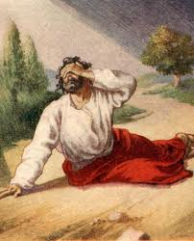
The Message that Changed the World: from Persecutor to Preacher
How Do You Explain:
Such a Sudden Change?
Such an Enduring Change?
Saul Saw the Lord on the Road!
Acts 9:27-28, 22:6-16, 26:12-20

Slide 9
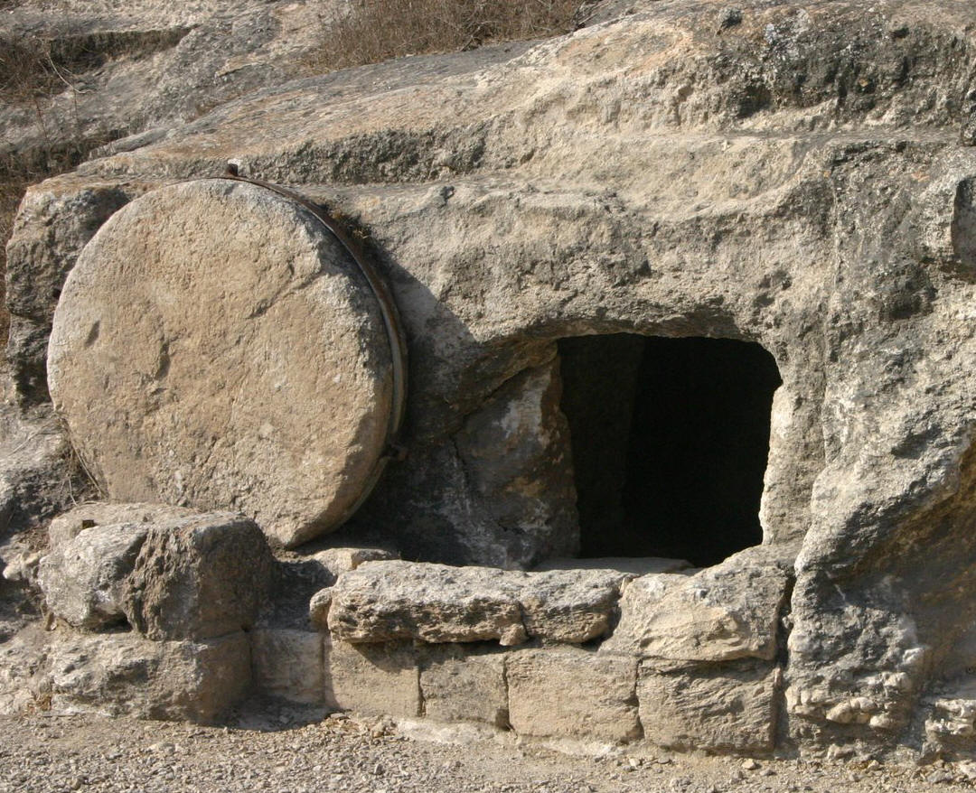
The Message that Changed the World: from Persecutor to Preacher
How Do You Explain:
Such a Sudden Change?
Such an Enduring Change?
Jesus Rose from the Dead! He is Alive!

Slide 10
The Message that Changed the World: from Persecutor to Preacher
In Paul’s Conversion We See:
evidence for our faith in Jesus 1 Cor 15:8
the power of Jesus’ resurrection Phil 3:10
Lord’s amazing grace & perfect patience 1 Tim 1:12-17

Slide 11
The Message that Changed the World: from Persecutor to Preacher
Let the message that changed Saul change you!
Let the message that saved Saul and made him useful, save you and make you useful!
Then live the rest of your life driven
by the power of Jesus’ resurrection!

