Slide 2
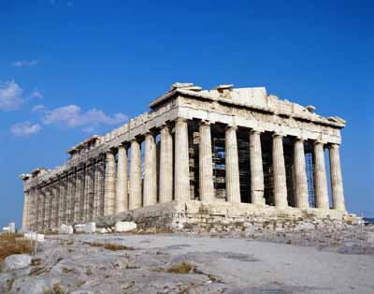
The Message that Changed the World
Athens:
Knowing the Unknown God Makes All the Difference
Acts 17:16-34

Slide 3
Paul’s spirit was provoked within him as he was observing the city full of idols. Acts 17:16-21
-Petronius, a contemporary of Paul
(quoting a man named Quartilla)
Our region is so full of deities that you may more frequently meet with a god than a man.

Slide 4
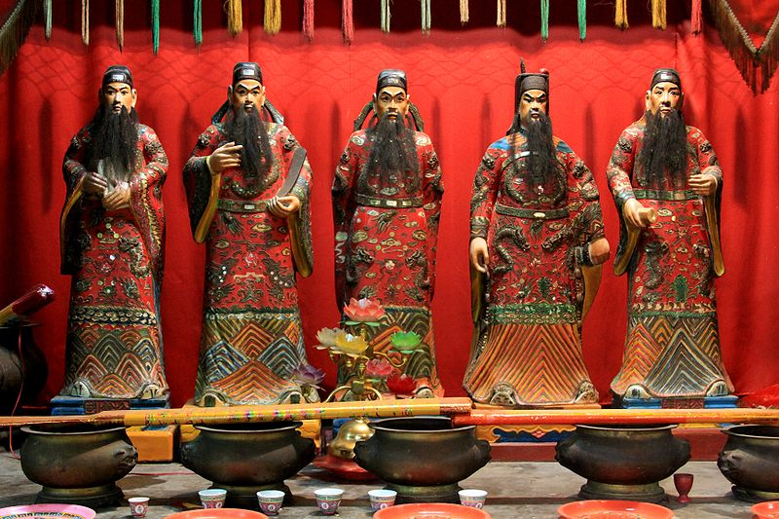
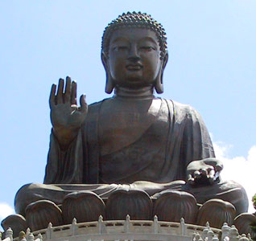
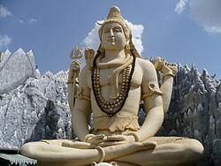
Billions of Idolaters in the World Today
Shiva Five Officials Buhdda
Hinduism Chinese Traditional Buddhism
1.1 Billion 394 Million 376 Million

Slide 5
Epircurean philosophy has led to another “god”, both in 1st century Athens and 21st century America
“Wherefore we call pleasure the Alpha and Omega of
a blessed life. Pleasure is our first and kindred good.
It is the starting point of every choice and aversion,
and to it we come back, inasmuch as we make feeling
the rule by which to judge every good thing.”
– Epicurus (341-270 B.C.)
“Lovers of pleasure rather than lovers of God”
2 Tim 3:4

Slide 6
We’re Not “Preaching to the Synagogue” As Much Anymore Acts 17:17
46% of Americans believe in Creationism Gallup Poll 2012
30% of Americans believe Bible is inspired word for word
Gallup Poll 2012
Lack of belief in God and the Bible has opened the door for pleasure to become “god” and to govern morals.

Slide 7
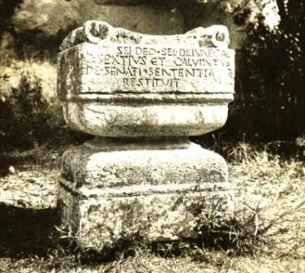
Paul Preached What We Need to Preach: The Unknown God Acts 17:22-23

Slide 8
The Message that Changed the World Knowing the Unknown God Makes All the Difference
Creator
Lord
Provider
Father
Judge
Authority/
Oversight
Blessings
Relationship
Accountability
Obey/
Accept Will
Praise & Thank
Seek Him
Repent
Notes:
Creator: God who made the world and all things in it vs. 24;
Heb 3:4; Rom 1:18-20; Ps 19:1-6
Lord: Lord of heaven and earth vs. 24: authority cp. Isa 45:9;
oversight: made nations and determined time and place of existence vs. 26
Provider: gives life, breath and all things vs. 25; in Him we live, move, and exist
vs. 28- what we have , we have not because of us, but because of God-
we receive what we need and enjoy as blessings.
Father: We are offspring of the Divine Nature; we are His children vs. 28-29; we are
not just the top of the animal kingdom, we are related to God!
Judge: He has fixed a day in which He will judge the world in righteousness through
the Man He raised from the dead (Jesus)- He as expectations for us to meet
and will hold us accountable for how we have lived.
Our response: to Lord- obey Jer 10:23; Prov 3:5-7; accept His will Js 4:15;
to Provider- praise and thank Ps 100; to Father- seek God,
grope after Him to find Him vs. 27 - Heb 11:6; 1 Pet 1:14-15;
to Judge- repent- vs. 30; Acts 14:15; 26:17-18

Slide 9
Do You Believe in the Creator?: You will be a lover of God, rather than a lover of pleasure
You believe in a Lord:
You will obey Him and submit to His will for your life
You believe in a Provider:
You will praise and thank Him for His blessings
You believe in a Father:
You will seek Him and develop a relationship with Him
You believe in a Judge:
You will repent of your sins and prepare for Judgment

Slide 10
Three Responses in Athens Acts 17:32-34
Sneered
Willing to Hear More
Joined Paul and Believed
How will you respond?

