Slide 2
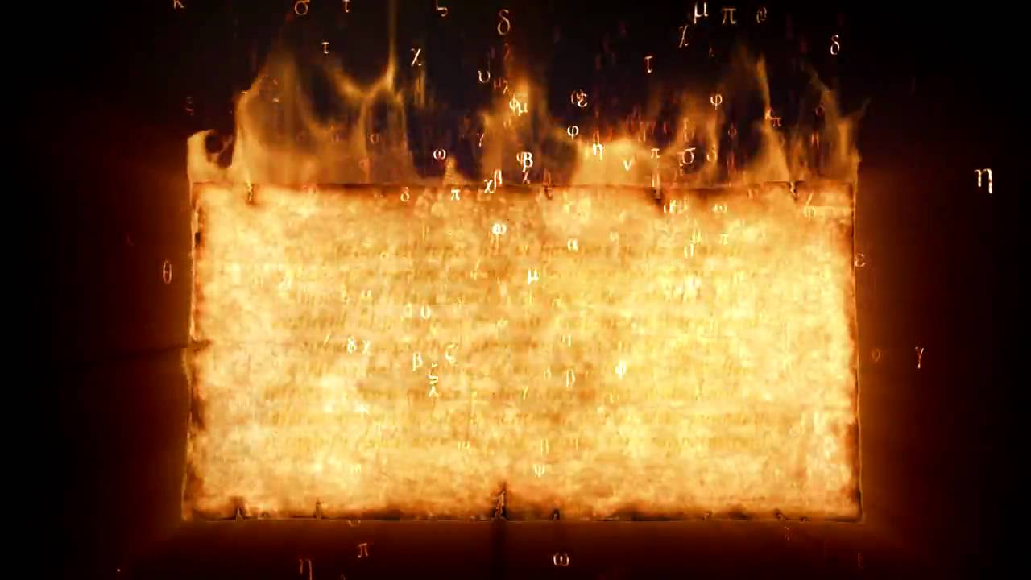
The Message that Changed the World
Ephesus:
When You Change You Burn Your Books
Acts 19:11-20

Slide 3
The Message that Changed the World Ephesus: When You Change You Burn Your Books
The gospel of Christ is a message backed up by miracles
Acts 19:11-16
Lk 4:33-37; Heb 2:1-4; Jn 20:30-31
What is this message? !!

Slide 4
The Message that Changed the World Ephesus: When You Change You Burn Your Books
True miracles were clearly distinguishable from men’s magic
Acts 8:5-13; 13:6-12
“The crowds with one accord were giving attention to what was said by Philip, as they heard and saw the signs…”
“Then the proconsul believed when he saw what had happened, being amazed at the teaching of the Lord.”

Slide 5
The Message that Changed the World Ephesus: When You Change You Burn Your Books
Demonstration of God’s power brought:
Fear Acts 19:17
Praise Acts 19:17
Conversion Acts 19:18-19

Slide 6
The Message that Changed the World Ephesus: When You Change You Burn Your Books
Emphasis in conversion of the Ephesians is their
Repentance
as was seen by their fruits
confessed and disclosed their practices
publicly burned their books

Slide 7
The Message that Changed the World Ephesus: When You Change You Burn Your Books
The religion of Christ is an exclusive religion; it has no place for other religions, philosophies, and human traditions Acts 4:12; Col 2:8-10
There is no room for man-authored creeds, whether written or unwritten, within the religion of Christ
Mt 28:18; Eph 4:5; Col 2:20-23
The teachings of men are not only invalid, but they are false and must be opposed 1 Jn 4:1,6; Rev 2:1-2, 6
Men who come to Christ must “burn” the teachings they once embraced, if not literally, at least figuratively.

Slide 8
The Message that Changed the World Ephesus: When You Change You Burn Your Books
In a figurative sense everyone has “books to burn”;
changes that they must make as they turn their lives over to
the control of Christ
There must be “fruit” for God and man to see
Lk 3:8, 10-14

Slide 9
The Message that Changed the World Ephesus: When You Change You Burn Your Books
From the Ephesians We Learn that
“Burning Your Books” Means:
Openly acknowledging your sin
Openly and completely rejecting your sinful practices
Completely and finally severing your ties with the past
Working to insure others do not follow your mistakes
Showing no concern for the cost of your repentance
Declaring that your sinful past is worthless

Slide 10
The Message that Changed the World Ephesus: When You Change You Burn Your Books
Burning Your Books”
is the result of the power of God’s Word
An indication that it is growing mightily and prevailing in you
Acts 19:20

Slide 11
The Message that Changed the World Ephesus: When You Change You Burn Your Books
The message has been confirmed by miracles
Do you believe the message?
Will you repent and “burn your books”?
Will you be baptized for the remission of your sins?
Christian, do you need to repent & “burn some books”?

