Slide 1
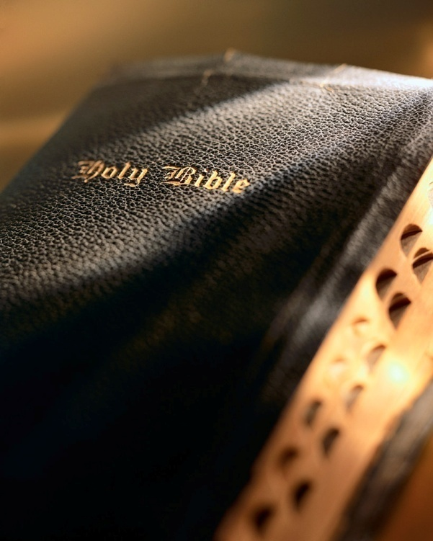

Slide 2
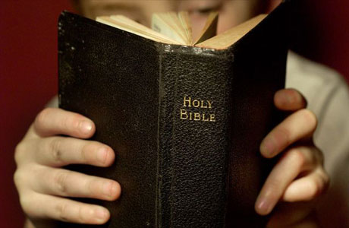
Believing a Lie 1 Kings 13:20-26

Slide 3
Introduction
Proposition:
Hypothesis that sincere belief equals safety is only held in religion:
Business: Edsel, New Coke, Pepsi Clear.
Finance: Lincoln Savings & Loan, Bernie Madoff
Military: Napoleon and Waterloo, Hitler and Stalingrad, America and Vietnam
Travel: Titanic
“If you sincerely believe something religiously, if you believe it with all your heart and if you honestly follow the convictions of your beliefs it will result in a home in heaven. It will result in safety as far as the eternal home of your soul is concerned.”
Believing a Lie

Slide 4
Introduction
Affirmation of this proposition is not found in God’s word: 2 Thess. 2:9-12
The “delusion” is not directly from God: Titus 1:2
Through free will God allows false teachers to spread their lies and influence: Gen. 3:3-6; 2 Cor. 11:3; 1 Tim. 2:14
Those believing a lie may well have a clear conscience: Acts 23:1; 26:9-11; 1 Tim. 4:2
God allows those not loving the truth to lose their soul: 2 Thess. 2:12; Mk. 4:24; Lk. 8:18
Believing a Lie

Slide 5
Background
United Kingdom: all 12 tribes united under one king (1095 BC – 975 BC).
Saul reigned 40 years,
David reigned 40 years,
Solomon reigned 40 years.
In his later years Solomon disobeyed God: 1 Kgs. 11:1-13
Believing a Lie

Slide 6
Background
Divided Kingdom: after Solomon’s death:
Reheboam (Solomon’s son): ruled the Southern Kingdom (Judah: 2 tribes).
Jereboam (no relation to Solomon): ruled the Northern Kingdom (Israel; 10 tribes).
Jereboam had a major political problem: 1 Kgs. 12:26-33
Believing a Lie

Slide 7
Scene #1: Jereboam’s glorious “grand opening”
For political convenience Jereboam set up a false religious system “which he had devised in his own heart.”
Jereboam had plans for a pompous and lavish “grand opening” for his altar: 1 Kgs. 13:1-4a
Instead of arrest, notice what unfolds: 1 Kgs. 13:4b-7
Believing a Lie

Slide 8
Scene #1: Jereboam’s glorious “grand opening”
Critical juncture in the story; Judean prophet faces his first temptation: 1 Kgs. 13:7-10
Judean prophet committed to the truth: “I wouldn’t come for half your house.”
Judean prophet: Was he weak or strong? Faithful or unfaithful?
Believing a Lie

Slide 9
Scene #1: Jereboam’s glorious “grand opening”
He was determined to follow God’s simple commands: 1 Jn. 5:3; Eph. 3:4
His preaching and miracle had made its intended effect.
He bravely “fulfilled his ministry” and resisted the temptation of Jereboam’s reward…weak or strong? Faithful or unfaithful?
Believing a Lie

Slide 10
Scene #2: Old prophet enters the picture
We learn of another prophet, an old prophet who lives in Bethel: 1 Kgs. 13:11-14
Old prophet gives Judean prophet his second temptation: 1 Kgs. 13:15-17
Old prophet shows his true colors: 1 Kgs. 13:18
Believing a Lie

Slide 11
Scene #2: Old prophet enters the picture
When God says something, He means it! Gal. 1:6-9
Judean prophet makes a grave mistake, he believes the old prophet.
Was the Judean prophet dishonest? Could he be bought? No! But he believed the lie!
Does believing a lie carry consequences? Does sincere belief of a thing bring safety? Phil. 2:12; 1 Jn. 4:1; Rom. 16:18; 2 Pet. 2:1-3; Acts 17:11
Believing a Lie

Slide 12
Scene #3: Dinner party at old prophet’s house
1 Kgs. 13:19-22
Consequences of believing a lie are announced by the old prophet from Bethel: the Judean prophet is going to die!
Can you imagine how he felt? Do you suppose he finished his dinner?
Imagine how the old prophet must have felt?
Believing a Lie

Slide 13
Scene #4: Judean prophet’s tragic death
1 Kgs. 13:23-25
Lions don’t kill fast…ever wonder about the last thoughts of the Judean prophet?
Why such an unusual scene? also v. 28
An important lesson needed to be learned!
Believing a Lie

Slide 14
Scene #5: The old prophet’s statement
Recall our proposition:
Did believing a lie have consequences for the Judean prophet? Yes! Why!
1 Kgs. 13:26: “Now when the prophet who had brought him back from the way heard it, he said, ‘It is the man of God who was disobedient to the word of the LORD. Therefore the LORD has delivered him to the lion, which has torn him and killed him, according to the word of the LORD which He spoke to him.’”
“If you sincerely believe something religiously, if you believe it with all your heart and if you honestly follow the convictions of your beliefs that it will result in a home in heaven. It will result in safety as far as the eternal home of your soul is concerned.”
Believing a Lie

Slide 15
Scene #5: The old prophet’s statement
How can I make sure I don’t believe a lie?
Follow the men that wrote God’s book! Jn. 16:13; 1 Cor. 2:1-13; Jn. 14:15; 1 Jn. 2:3-5
Love the truth, don’t believe it unless it’s in God’s book! Acts 17:11; 1 Pet. 4:11; Gal. 1:6-9
The better it sounds, the smoother it flows the more you need to check it out! 1 Jn. 4:1
Believing a Lie

Slide 16
Which is error and which is truth? Which is a lie?
Man says
God says
Universe and man came
to be via ‘Big Bang’ and evolution.
Which is error and which is truth?
Which is a lie?
Gen. 1 & 2
One church is as good as another.
Matt. 16:18; Acts 2; Eph. 1:22-23; 4:4; 5:23
All are going to heaven, we’re just traveling different roads.
Matt. 7:13-14; Jn. 14:6
Believing a Lie

Slide 17
Which is error and which is truth? Which is a lie?
Man says
God says
Which is error and which is truth?
Which is a lie?
Peter first pope, pope head of the church.
Eph. 1:22-23; Acts 20:28; Matt. 8:14; 1 Cor. 9:5
Observe religious holidays (e.g., Easter, Christmas).
Col. 3:17; 1 Pet. 4:11
Believing a Lie

Slide 18
Which is error and which is truth? Which is a lie?
Man says
God says
Which is error and which is truth?
Which is a lie?
Saved by faith only
Jas. 2:24
Baptism not necessary for salvation
Gal. 2:26-27; Mk. 16:16; 1 Pet. 3:21
Believing a Lie

Slide 19
Conclusion
What are the consequences of believing a lie? Ask the Judean prophet!
Recall our proposition:
A great experiment was conducted long ago, its results were: Eccl. 12:13-14
We must persuade men who believe lies with the truth from God’s book!
“If you sincerely believe something religiously, if you believe it with all your heart and if you honestly follow the convictions of your beliefs it will result in a home in heaven. It will result in safety as far as the eternal home of your soul is concerned.”
Believing a Lie

