Slide 1
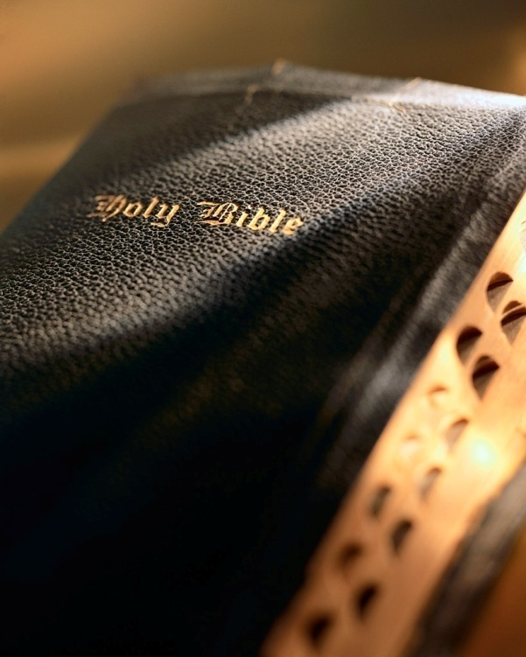

Slide 2
Introduction
The gospel is for all: Mk. 16:15; Matt. 28:19; Rev. 22:17; Rom. 1:16
Book of Acts shows “the power of God unto salvation for everyone who believes” in action:
Jews (Ch. 2),
Gentiles (Chs. 10 & 11),
Deluded half-breeds (Ch. 8),
Govt. official (Ch. 8),
Murderous zealot (Ch. 9),
Military officer (Ch. 10 & 11),
Prison guard (Ch. 16),
Depraved sinners (Ch. 18),
Pagan idolaters (Ch. 19),
Governor & king (Ch. 24),
Businesswoman (Ch. 16).

Slide 3
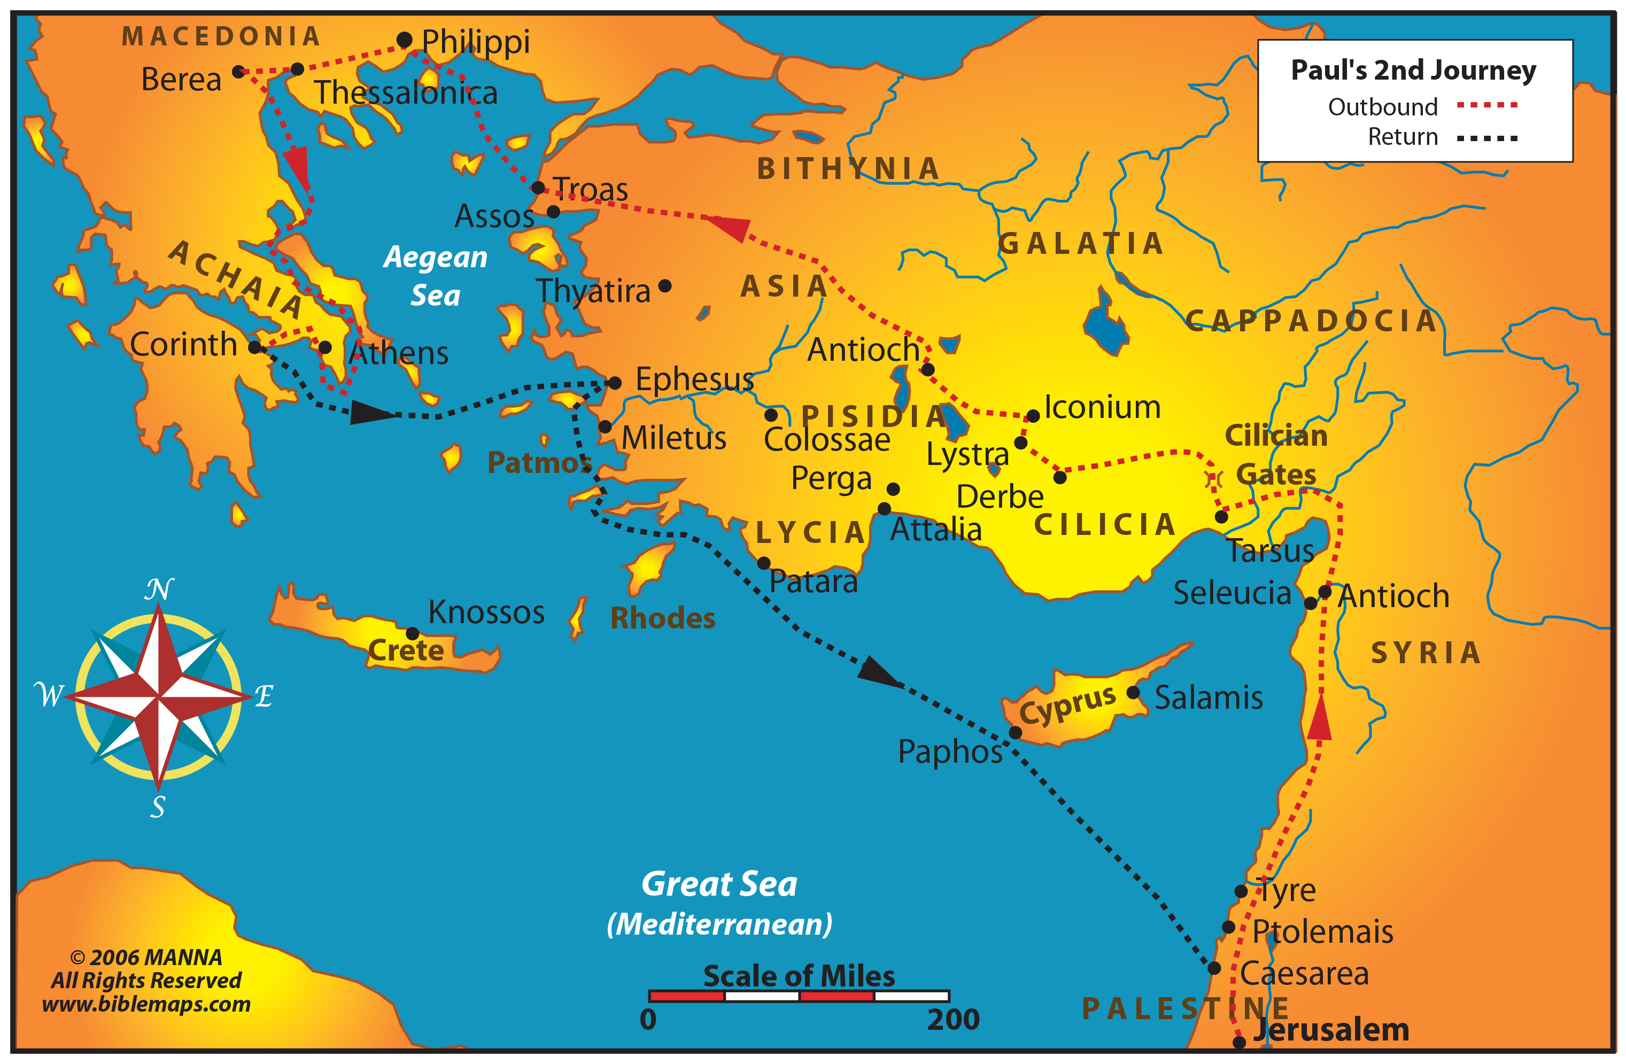

Slide 4
God Opened Lydia’s Heart Acts 16:6-15

Slide 5
God’s Providence
God’s providence assisted them: Acts 26:9
Providence seen as they begin journey to Troas: v. 11; cf. 20:6
Usually see God’s providence only in hindsight: 20:6; chapters 17 & 18
God Opened Lydia’s Heart

Slide 6
God’s Providence
Lydia’s case similar to Ethiopian eunuch (Acts 8:26, 29) and Cornelius (Acts 10:9-20).
Eunuch: God told the preacher where to go (Acts 8:26, 35).
Cornelius: God told the preacher where to go (Acts 10:34-43; 11:13b-14).
Preachers→people with “noble and good hearts” (Lk. 8:4-15; Acts 17:27).
No “direct operation” of the Holy Spirit!
Rom. 10:17; 1 Cor. 1:21
God Opened Lydia’s Heart

Slide 7
Lydia
Lydia an unusual woman:
Business woman
Native of Thyatira
Seller of purple
Very religious
Receptive heart
God Opened Lydia’s Heart

Slide 8
Lydia
Lydia’s heart “opened” to receive the gospel (Acts 16:13b-14).
Intellect: by instruction, through teaching the “facts” of the gospel (Deut. 4:9; Ezra 7:10; Psa. 86:11; Jn. 6:44-46; 1 Cor. 15:1-8).
Emotions: also a part of the “heart” (Acts 2:37; 2 Cor. 5:14; 5:11).
Will: obedience is evidence of a changed will (2 Cor. 7:10; Acts 2:37-38, 41; Rom. 10:17).
Summary
Intellect: educated by things “spoken by Paul” (v. 14).
Emotions: stirred by words preached that “opened her heart” (v. 14).
Will: activated to “heed” (i.e., obeyed) as she was “baptized” (v. 15)
God Opened Lydia’s Heart

Slide 9
Final Thoughts
Why does God have to open men’s hearts? Matt. 13:14-16 (Isa. 6:9-10)
Who’s responsible, God or man? Isa. 53:6; Acts 28:17-29
If a heart is closed, who closes it? Jas. 1:13-15
God gives us free will: Rom. 6:16-17; 10:8; Lk. 8:4-15; Rom. 10:9-15; Mk. 16:15; 2 Thess. 2:13-14; Jas. 1:18; Rom. 1:16
God Opened Lydia’s Heart

Slide 10
Conclusion
Need rest from your sins? Matt. 11:28-30
Judgment is coming! 2 Cor. 5:10-11a; Rom. 14:12; 2 Thess. 1:7-9

