Slide 1
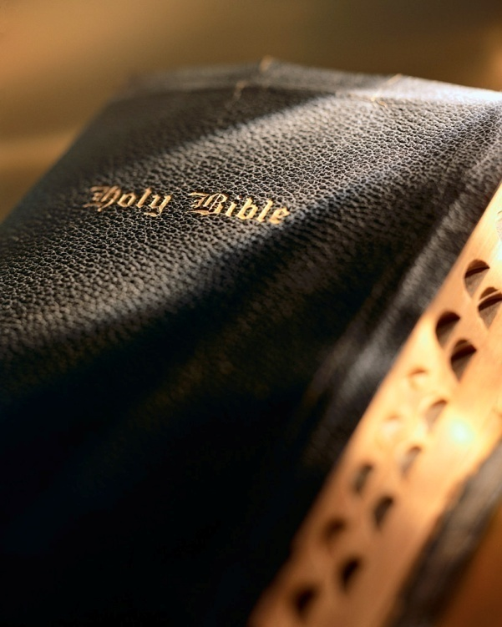

Slide 2
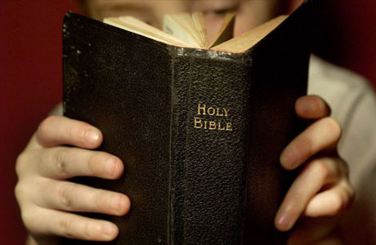
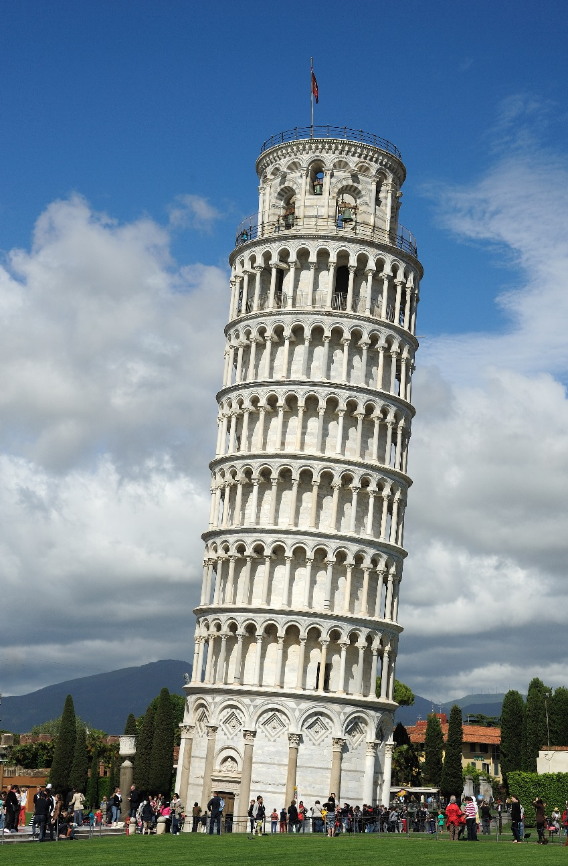
Introduction
What’s the most important part of a building? The foundation!
If the foundation is wrong, the building will never be right!

Slide 3
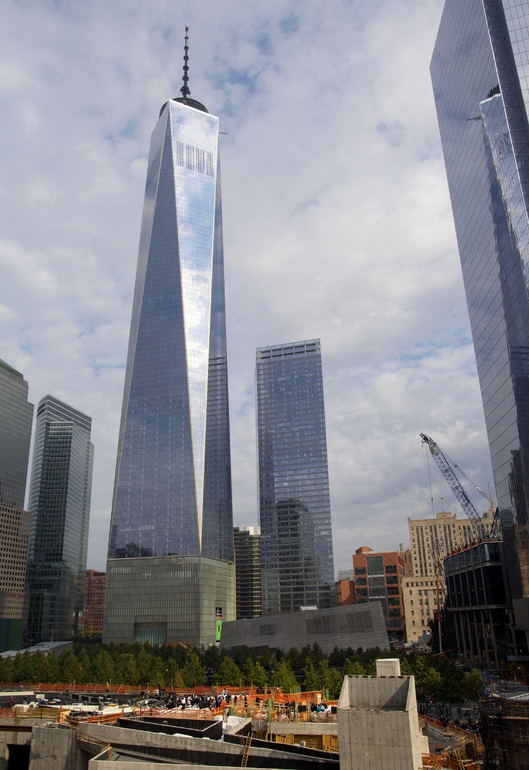
Introduction
Foundation extends 110’ below street level to solid bedrock.
1 million cubic yards of fill, 28 new acres of prime real estate.
Cubic concrete and steel pedestal 187’ high by 200’.
Foundation has 24 steel columns each 60’ tall and weighing 70.5 tons.
One World Trade Center

Slide 4
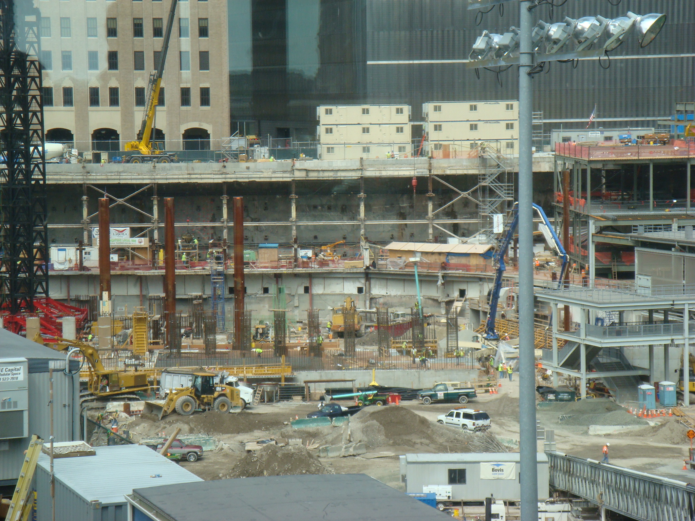

Slide 5
Introduction
Like One WTC, Christ’s church is built upon a “sure foundation” (Isa. 28:16) of bedrock; “upon this rock I will build My church” (Matt. 16:18).
The identification of this “rock” is “one of the storm-centres of New Testament interpretation” (William Barclay).
What did Jesus mean by this figure of speech? Who or what is the “rock” upon which He built His church?

Slide 6
Part 6: The Foundation of the Church
Isaiah 28:16; 1 Corinthians 3:9-11
The New Testament Church

Slide 7
Historical Views
The disciple interpretation
The confession interpretation
The Catholic interpretation
The Christological interpretation
Foundation of the Church

Slide 8
Catholic Interpretation
Claim is based on the word play (in the original Greek) in Matthew 16:18.
“…thou art Peter (petros: stone) and upon this rock I will build my church…”
Foundation of the Church

Slide 9
Catholic Interpretation
Fellow apostles didn’t agree: Matt. 18:1; 20:20-28; Mk. 10:35-41
Semantically Peter doesn’t fit:
“Peter” (i.e., Gr. petros) masculine for “isolated rocks, small stones.”
“rock” (i.e., Gr. petra) feminine for “large solid rock, bedrock.”
“‘The demonstrative pronoun ‘this’ logically should refer to something other than the speaker or the one spoken to and would be appropriate only if Jesus were speaking about Peter in the third person and not speaking directly to him’ (Garland, 170)’” (Chumbley, The Gospel of Matthew, p. 299)
Pronouns must agree with their antecendents. The pronoun “this” does not agree with its antecedent “rock.” “This” is a demonstrative pronoun referring to a thing, it is not a personal pronoun which refers to people.
Foundation of the Church

Slide 10
Catholic Interpretation
Historically Peter doesn’t fit: “church fathers”
17: “rock” is Peter,
44 “rock” is the faith Peter confessed,
16 “rock” as Christ,
8 “rock” the apostles.
68 of 85 (80%) believed Peter was not the “rock.”
Interesting? Yes! Conclusive? No!
Foundation of the Church

Slide 11
Catholic Interpretation
Historically Peter doesn’t fit: too late
No reference in NT of Peter as the “rock.”
Peter argument as the “rock” does not appear until Leo I was bishop of Rome (A.D. 440-461).
According to one well-recognized NT scholar (Luz) Peter as the “rock” “did not become dominant in Roman Catholic exegesis until the sixteenth and seventeenth centuries.”
“Anglican scholar George Salmon scarcely understates the matter when he writes of such exegesis, ‘It takes one’s breath away to read a commentary which finds so much more in a text than lies on the surface of it. If our Lord meant all this, we may ask, why did He not say it?’ (Infallibility of the Church, 334 in Chumbley, The Gospel of Matthew, p. 298)
Foundation of the Church

Slide 12
Catholic Interpretation
Logically Peter doesn’t fit:
Would Jesus found His indestructible church on a man? A man with many weaknesses? Col. 1:21-22
Lack of faith when attempting to walk on water (Matt. 14:22-33).
Cowardice by denying the Lord three times (Matt. 26:69-75).
Caved to political pressure by refusing to eat with the Gentiles (Gal. 2:11-14).
“Can one who, in the words of Paul, walked ‘not uprightly according to the truth’ be a sure foundation for the church (Matt. 14:22-33; 26:69-75; Gal. 2:11-14)?” (Stauffer, The Church: A Biblical Perspective, p. 29)
Foundation of the Church

Slide 13
Catholic Interpretation
“The Christ, God’s Son—who and what he is—is the ‘rock’ upon which the church is built. He, both prophecy and New Testament teaching confirm, is the sure foundation, tried stone, precious stone, and chief cornerstone. Anyone or anything else is sand.” (Stauffer, The Church: A Biblical Perspective, p. 29)
Contextually Peter doesn’t fit: What is the topic being discussed in Matthew 16:13ff ?
It is not Peter or who Peter is.
Subject concerns the identity of Jesus!
“…He asked His disciples, saying, ‘Who do men say that I, the Son of Man, am?’” (Matt. 16:13).
“He said to them, ‘But who do you say that I am?’” (Matt. 16:15).
Foundation of the Church

Slide 14
Catholic Interpretation
Other:
No evidence Peter established the church in Rome.
Catholics claim Peter went to Rome in A.D. 42 and was martyred there in A.D. 67.
No evidence in New Testament to support this (Rom. 15:22-24; 1:10-11; Acts 8:18).
All evidence suggests no apostle visited Rome until at least after ~A.D. 60 (Rom. 1:10-11; Acts 8:18).
Foundation of the Church

Slide 15
Catholic Interpretation
Other:
Parallel passages to Matthew 16:18 don’t include the “rock” statement (Mk. 8:27-31; Lk. 9:18-20).
Peter doesn’t fit man-made qualifications to be a Catholic bishop (1 Pet. 5:1-4; Acts 20:17, 28; 1 Tim. 3:2; Titus 1:6; Matt. 8:14; Mk. 1:30; Lk. 4:38; Acts 10:25-26)
Peter did not elevate himself or accept worship (Acts 10:25-26).
Figurative use of “rock” in OT (~40 times) is never applied to a man (see Deut. 32).
Peter wrote of the church’s foundation and never identifies himself as the “rock” (1 Pet. 2:4-8; Acts 4:10-11).
Peter had no successor! 2 Pet. 1:13-15 (cf. Acts 1:22)
Foundation of the Church

Slide 16
Catholic Interpretation
Keys of the kingdom: Matt. 16:19
Metaphorically a key symbolizes authority.
Peter opened the door to God’s kingdom (Acts 2, 10).
Authority not exclusive to Peter (Matt. 18:18).
God’s will already determined! Psa. 119:89
Neither Matthew 16:19 or 18:18 gave Peter, or any of the apostles, the authority claimed for the Pope by the RCC.
Matthew 16:19: “I will give you the keys of the kingdom of heaven; and whatever you bind on earth shall have been bound in heaven, and whatever you loose on earth shall have been loosed in heaven.” (NASV)
To be continued…
Foundation of the Church

Slide 17
Christological Interpretation
Prophecy: Isa. 28:16; 8:14
Stone/Jesus: Rom. 9:30-33; 10:1-13; Eph. 2:19-22
Zion/Church: Psa. 2:6-7; 110:1-2; Acts 2:33-36; Rev. 17:14; Heb. 12:22-24
Tried Stone: Acts 2:22
Character tested: Heb. 4:15; Matt. 4:1-11; 1 Jn. 2:15-17; Jn. 8:46; 1 Pet. 2:22
Will tested: Heb. 10:7; Jn. 4:34; Matt. 26:39; Lk. 22:44; Phil. 2:8; Heb. 12:2
Foundation of the Church

Slide 18
Christological Interpretation
Prophecy: Isa. 28:16; 8:14
Claim tested: Jn. 9:35-37; 8:58; 5:36; 20:30-31; Matt. 16:18; Psa. 16:10; Acts 2:27
“the Savior of the body”: Eph. 5:23; Heb. 6:19-20; Rom. 6:9; 2 Cor. 1:9-11; 2 Tim. 2:10; 1 Jn. 2:25; 5:11
Overcoming death the greatest test: Rom. 1:4; Rev. 1:17-19; Heb. 2:14; Jn. 6:40
Resurrection proved His claim & revealed His true identity: Rom. 1:4
Foundation of the Church

Slide 19
Christological Interpretation
Theme of the first gospel sermons was the identity of Jesus!
Peter: Acts 2:22-36
Vv. 22-24: Facts of the case concerning “Jesus of Nazareth,”
Vv. 25-31: Qualifications to be “the Christ” set forth by OT prophecy,
V. 32: “Jesus of Nazareth” met these qualifications,
Vv. 33-36: Peter’s conclusion.
Paul’s first sermon: Acts 9:20-22
Acts 5:42: And daily in the temple, and in every house, they did not cease teaching and preaching Jesus as the Christ.
Acts 9:22: But Saul increased all the more in strength, and confounded the Jews who dwelt in Damascus, proving that this Jesus is the Christ.
Acts 18:28: for he vigorously refuted the Jews publicly, showing from the Scriptures that Jesus is the Christ.
Foundation of the Church

Slide 20
Christological Interpretation
“no other foundation”: 1 Cor. 3:9-11
Why did Paul write this?
Church was rejecting the one “sure foundation”: 1 Cor. 1:12; 3:3, 5
What “foundation” did Paul lay in Corinth? 1 Cor. 2:2; Acts 18:5
“foundation” laid (Acts 18:5) was exactly what Peter confessed in Matthew 16:16: “Thou are the Christ, the Son of the living God.” cf. Isa. 28:16; 1 Cor. 3:11; Acts 4:11-12
Foundation of the Church

Slide 21
Conclusion
Jesus Christ is “the Savior of the body,” which is His “church” (Eph. 5:23; 1:22).
His identity is the “sure foundation” God laid at “Zion” (Isa. 28:16) the “rock” upon which He built His church (Matt. 16:18).
Jesus’ identity was the topic of discussion in Matthew 16:13, 15.
Peter confessed His identity in Matthew 16:16.
This is the identity all must confess to be saved: Rom. 10:10-11; Acts 8:37

Slide 22
Conclusion
Paul preached Jesus’ true identity: “…that Jesus is the Christ…” (Acts 18:5).
His resurrection proved His claim to that identity (Rom. 1:4).
If Jesus not who he claims to be: 1 Cor. 15:17-19
He did not rise from the dead and He cannot save!
He could not be “the Savior of the body” or the “sure foundation” laid at “Zion.”
But His claim IS true! Jn. 11:25-27

Slide 23
Conclusion
Do you believe this?

