Slide 1
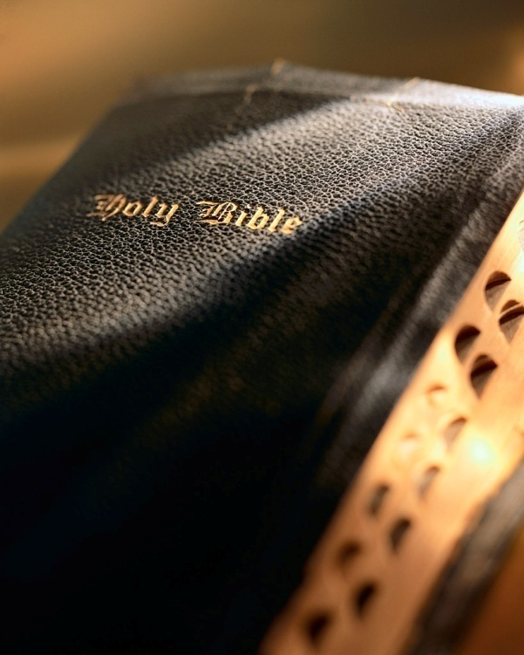

Slide 2
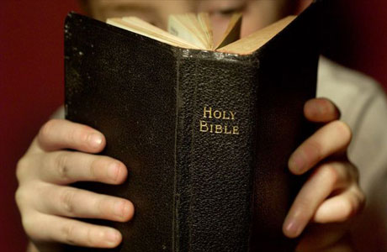
Introduction
John chapters 13-17 record the events that transpired during Jesus' final evening with the apostles:
John 17 records Jesus' prayer:
Asks the Father to glorify Him,
Speaks of eternal life; affirms His deity,
Asks for safe-keeping of His disciples,
Asks for unity of His people.

Slide 3
Introduction
John 17:20-23: "I do not pray for these alone, but also for those who will believe in Me through their word; 21 that they all may be one, as You, Father, are in Me, and I in You; that they also may be one in Us, that the world may believe that You sent Me. 22 And the glory which You gave Me I have given them, that they may be one just as We are one: 23 I in them, and You in Me; that they may be made perfect in one, and that the world may know that You have sent Me, and have loved them as You have loved Me."

Slide 4
Introduction
John 17:20-23: "I do not pray for these alone, but also for those who will believe in Me through their word; 21 that they all may be one, as You, Father, are in Me, and I in You; that they also may be one in Us, that the world may believe that You sent Me. 22 And the glory which You gave Me I have given them, that they may be one just as We are one: 23 I in them, and You in Me; that they may be made perfect in one, and that the world may know that You have sent Me, and have loved them as You have loved Me."

Slide 5
Introduction
Before we desire and work for something we must first become acquainted with its nature.
What is the nature of this unity?
Jesus describes it by paralleling it with the oneness (i.e., unity) He enjoys with the Father.
John 17:20-21: I do not pray for these alone, but also for those who will believe in Me through their word; that they all may be one, as [same manner] You, Father, are in Me, and I in You; that they also may be one in Us,

Slide 6
Introduction
Therefore, as we learn about the unity of the Father and the Son, we learn about the unity we, as His people, must desire and work for.
One in Will
One in Word
One in Work

Slide 7
Part 15: Unity John 17:20-23
The New Testament Church

Slide 8
One in Will
Could you ever imagine an argument between the Father and the Son?
Why can't you visualize that?
Because the Father and the Son are "one in will"!
How do we know that?
Unity

Slide 9
One in Will
Because:
John 4:34: Jesus said to them, "My food is to do the will of Him who sent Me, and to finish His work."
John 5:30: "I can of Myself do nothing. As I hear, I judge; and My judgment is righteous, because I do not seek My own will but the will of the Father who sent Me."
John 6:38: "For I have come down from heaven, not to do My own will, but the will of Him who sent Me."
Unity

Slide 10
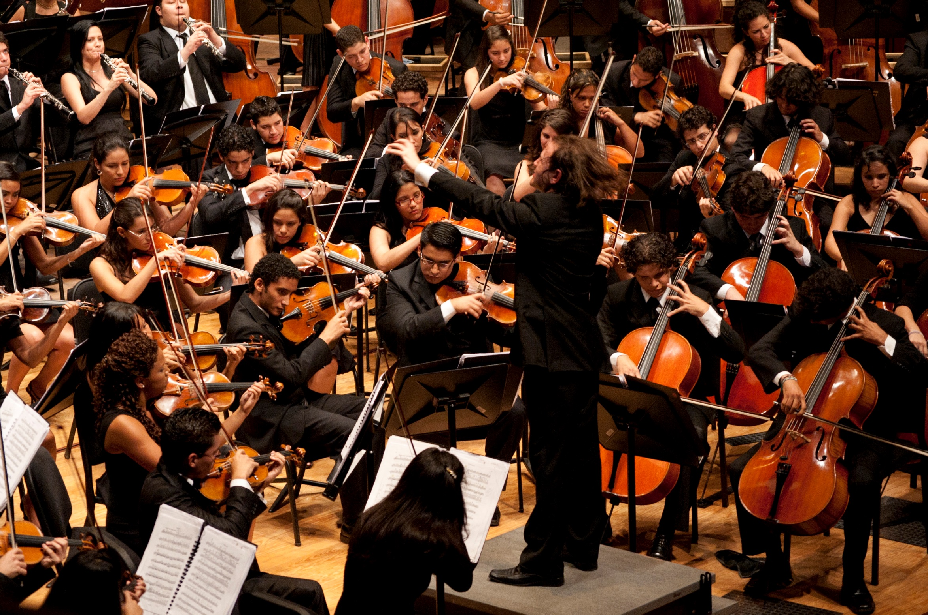
One in Will
How can we be one in will?
We submit our wills to a common standard: the Truth!
John 17:20: "I do not pray for these alone, but also for those who will believe in Me through their word..."
We become believers through the apostle's word (Jn. 16:13; 17:17).
We "unite" in the same exact way!
If I want (will) only what "their word" says, and you only want (will) what "their word" says, we have a basis for true unity.

Slide 11
One in Will
Put Paul's command into action!
Union
is not
Unity!
Colossians 3:17: And whatever you do in word or deed, do all in the name of the Lord Jesus, giving thanks to God the Father through Him.
Unity

Slide 12
One in Will
We must submit our will completely to His will!
Which describes us?
Matthew 7:21-23
or
Colossians 3:17?
Matthew 7:21-23: "Not everyone who says to Me, 'Lord, Lord,' shall enter the kingdom of heaven, but he who does the will of My Father in heaven. 22 Many will say to Me in that day, 'Lord, Lord, have we not prophesied in Your name, cast out demons in Your name, and done many wonders in Your name?' 23 And then I will declare to them, 'I never knew you; depart from Me, you who practice lawlessness!'"
Colleen Cerak
Unity

Slide 13
One in Word
Can you imagine the Son saying one thing and the Father saying something else?
John 3:34: "For He whom God has sent speaks the words of God, for God does not give the Spirit by measure."
John 14:24: "He who does not love Me does not keep My words; and the word which you hear is not Mine but the Father's who sent Me."
Unity

Slide 14
One in Word
Can you imagine the Son saying one thing and the Father saying something else?
The Father and Son are united because they speak the same thing!
John 17:7-8: "Now they have known that all things which You have given Me are from You. For I have given to them the words which You have given Me; and they have received them, and have known surely that I came forth from You; and they have believed that You sent Me."
Unity

Slide 15
One in Word
Consider the solution to the division at Corinth:
1 Corinthians 1:10: Now, I plead with you, brethren, by the name of our Lord Jesus Christ, that you all speak the same thing, and that there be no divisions among you, but that you be perfectly joined together in the same mind and in the same judgment.
Unity

Slide 16
One in Word
How do we speak the same thing?
The answer is simple!
1 Corinthians 2:9-13; Isaiah 8:20; Matthew 15:13-14; 7:21-23
1 Peter 4:11: If anyone speaks, let him speak as the oracles of God.
John 17:7-8: Now they have known that all things which You have given Me are from You. 8 For I have given to them the words which You have given Me; and they have received them, and have known surely that I came forth from You; and they have believed that You sent Me.
Unity

Slide 17
One in Word
Even Jesus and the Holy Spirit follow the principle of 1 Peter 4:11:
John 8:26: …I speak to the world those things which I heard from Him.
John 12:49: For I have not spoken on My own authority; but the Father who sent Me gave Me a command, what I should say and what I should speak.
Unity

Slide 18
One in Word
Even Jesus and the Holy Spirit follow 1 Peter 4:11: Jn. 8:26; 12:49
If Jesus and the Holy Spirit follow this principle, who am I not to do so?!
John 14:10: The words that I speak to you I do not speak on My own authority; but the Father who dwells in Me does the works.
John 16:13: However, when He, the Spirit of truth, has come, He will guide you into all truth; for He will not speak on His own authority, but whatever He hears He will speak ; and He will tell you things to come.
Unity

Slide 19
One in Word
Applying 1 Peter 4:11:
Music?
Ephesians 5:19: speaking to one another in psalms and hymns and spiritual songs, singing and making melody in your heart to the Lord,
Unity

Slide 20
One in Word
Applying 1 Peter 4:11:
Lord's Supper?
Acts 20:7: Now on the first day of the week, when the disciples came together to break bread, Paul, ready to depart the next day, spoke to them and continued his message until midnight.
Unity

Slide 21
One in Word
Applying 1 Peter 4:11:
Baptism?
1 Peter 3:21: The like figure whereunto even baptism doth also now save us (not the putting away of the filth of the flesh, but the answer of a good conscience toward God,) by the resurrection of Jesus Christ:
Unity

Slide 22
One in Work
John's gospel makes it crystal clear the Father and Son are one in work!
Never any disagreement between the Father and Son over work to be done!
John 4:34: Jesus said to them, "My food is to do the will of Him who sent Me, and to finish His work."
John 9:4: "I must work the works of Him who sent Me while it is day; the night is coming when no one can work."
John 17:4: "I have glorified You on the earth. I have finished the work which You have given Me to do."
Unity

Slide 23
One in Work
"I marvel that ye are so soon removed from him that called you into the grace of Christ unto another gospel: 7 Which is not another; but there be some that trouble you, and would pervert the gospel of Christ. 8 But though we, or an angel from heaven, preach any other gospel unto you than that which we have preached unto you, let him be accursed. 9 As we said before, so say I now again, If any man preach any other gospel unto you than that ye have received, let him be accursed. 10 For do I now persuade men, or God? or do I seek to please men? for if I yet pleased men, I should not be the servant of Christ."
Galatians 1:6-10
Don't overlook context of John 17:20-23:
We cannot sweep doctrinal differences under the rug and expect them to go away or think we have "dealt" with them!
Includes us…Christians today in His prayer (Jn. 17:20).
He is describing the kind of unity He wants us to have even today!
The same unity as He has with the Father!
Unity

Slide 24
One in Work
Listen to Jesus again!
John 17:20-23: I do not pray for these alone, but also for those who will believe in Me through their word; 21 that they all may be one, as You, Father, are in Me, and I in You; that they also may be one in Us, that the world may believe that You sent Me. 22 And the glory which You gave Me I have given them, that they may be one just as We are one: 23 I in them, and You in Me; that they may be made perfect in one, and that the world may know that You have sent Me, and have loved them as You have loved Me.
Unity

Slide 25
One in Work
Listen to Jesus again!
A church shattered and fractured by division has little to no chance of reaching the lost with the gospel!
John 17:20-23: I do not pray for these alone, but also for those who will believe in Me through their word; 21 that they all may be one, as You, Father, are in Me, and I in You; that they also may be one in Us, that the world may believe that You sent Me. 22 And the glory which You gave Me I have given them, that they may be one just as We are one: 23 I in them, and You in Me; that they may be made perfect in one, and that the world may know that You have sent Me, and have loved them as You have loved Me.
Unity

Slide 26
Achieving Unity
There is something we must do as:
Families: Deut. 4:9; Rev. 1, 2, 3; Acts 20:28-31; 2 Tim. 4:3-4
Congregation: 1 Tim. 3:15; 2 Tim. 4:1-4; Eph. 5:11; 2 Cor. 10:3-5; 1 Pet. 4:11; 1 Cor. 1:10; 2 Jn. 9-11; Rom. 16:17-18; Matt. 15:9, 13-14; Col. 4:6; Eph. 4:15; 2 Cor. 10:3-5; 1 Tim. 3:15; Isa. 8:20
Individuals: 2 Cor. 10:5; Eph. 4:3; Jn. 12:48-49; Gal. 2:20
Unity

Slide 27
Achieving Unity
Unity begins with the individual believer! 1 Jn. 1:7; Eph. 4:1-6 Unity requires:
The seven "ones" of verses 4-6 are meaningless without the attitudes described in verses 1-3!
"walking worthy…with all lowliness and gentleness, with longsuffering"
"bearing with one another in love"
"endeavoring to keep the unity of the Spirit in the bond of peace"
Unity

Slide 28
Achieving Unity
Unity begins with the individual believer! 1 Jn. 1:7; Eph. 4:1-6 Unity requires:
Phil. 1:27: "conduct worthy of the gospel" involves unity!
Our pursuit of unity involves one activity:
"stand[ing] fast in one spirit, with one mind striving together for the faith of the gospel" (Eph. 4:5; Jude 3; Phil. 1:28).
Unity

Slide 29
Achieving Unity
To pursue unity we must understand several important things: Phil. 2:1-4
Phil. 2:1: The grounds for pursuing unity:
"consolation in Christ"; Heb. 1:2; Matt. 28:18; Jn. 12:48; Col. 3:17
"comfort of love"; 1 Jn. 2:3-5; Jn. 15:10
"fellowship of the Spirit"; 1 Cor. 2:9-10; Eph. 2:18
"affection and mercy"; 1 Thess. 2:1-9
Unity

Slide 30
Achieving Unity
To pursue unity we must understand several important things: Phil. 2:1-4
Phil. 2:2: Attitudes essential to unity:
"being like-minded"; Amos 3:3
"having the same love"; Matt. 5:6; Jn. 14:15
"being of one accord" ("united in spirit")
[being] "of one mind" ("intent on one purpose")
Unity

Slide 31
Achieving Unity
To pursue unity we must understand several important things: Phil. 2:1-4
Phil. 2:3-4: To perfect unity requires:
"Let nothing be done through selfish ambition or conceit"
"…in lowliness of mind let each esteem others better than himself"
"Let each of you look out not only for his own interests, but also for the interests of others"
Unity

Slide 32
Achieving Unity
To make these pillars effective requires we put others first! Phil. 2:3-4; 1 Cor. 4:7; Rom. 12:3
Phil. 2:3-4 is a "filter" through which we must require every thought, word, and action to pass!
Phil. 2:5-8: We can only accomplish this if we emulate the humility of Christ!
It is truly a rare quality of character requiring our fullest measure of diligence.
Ironically, this level of humility is something we admire and praise in our heroes, but so few are willing to emulate.
Unity

Slide 33
Conclusion
One final time:
John 17:20-23: "I do not pray for these alone, but also for those who will believe in Me through their word; 21 that they all may be one, as You, Father, are in Me, and I in You; that they also may be one in Us, that the world may believe that You sent Me. 22 And the glory which You gave Me I have given them, that they may be one just as We are one: 23 I in them, and You in Me; that they may be made perfect in one, and that the world may know that You have sent Me, and have loved them as You have loved Me."

Slide 34
Conclusion
Jesus and the Father are:
One in Will
One in Word
One in Work

Slide 35
Conclusion
Jesus provides the only prescription for the religious division and strife so rampant in the world.
We submit our will to His will.
We follow only His word and not our wants and desires.
We forsake what we think needs to be done and do only what He says is to be done and do it only in the way He says to do it.

Slide 36
Conclusion
How about us?
1 Timothy 3:15
"The word of God must be our pillar of cloud by day, and of fire by night; we move when it moves, and stop when it stops."
J.W. McGarvey

