Slide 2
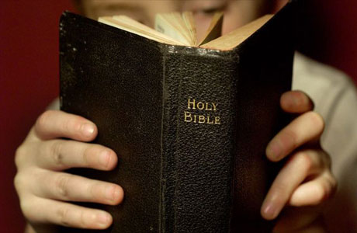
Introduction
Life is tough! Job 14:1; Gen. 3:17-19; Eccl. 12:1-8; 2:17; 9:11; 1 Pet. 3:1-2; 4:3-4; 2 Tim. 3:12
Problems cause despair! Job 10:18-22; Heb. 10:25; Matt. 19:9
Need a godly strategy to deal with hard times 1 Pet. 5:7-8; Psa. 34:15; 2 Kgs. 6:8-18

Slide 3
Chariots of Fire 2 Kings 6:8-23

Slide 4
We’re Surrounded By The Enemy
1 Pet. 5:8; 1 Jn. 2:15-17; Jas. 4:4; 1 Jn. 4:1; Eph. 4:11-14
“Alas…what shall we do?”
If we fail to prepare we are preparing to fail!
Only one answer: Acts 4:12; Matt. 11:28-30; Phil. 4:7

Slide 5
We’re Surrounded By The Enemy
Do all that is required to “put on Christ” !
Obey the gospel! Gal. 3:26-27
Whole armor of God! Job. 1:9; Eph. 6:11-18
Obedience to Christ! Heb. 5:9; Matt. 7:24-27
Love Christ! Jn. 14:15; 1 Jn. 2:3-5
Run the race with patience! Heb. 12:1-4; 2 Tim. 4:7-8
Diligent study and prayer! Heb. 4:15; Matt. 4:1-11; 1 Thess. 5:17; Lk. 18:1-8

Slide 6
God Is Greater Than The Enemy
Elisha’s servant was dismayed at the odds, because he didn’t include God!
Despite the odds we can overcome in Christ! 1 Jn. 4:4
There is more to the material universe than what we can see, touch, smell, hear, or taste! 2 Cor. 4:16-5:1

Slide 7
God Is Greater Than The Enemy
We don’t necessarily see God’s providence with our physical senses working in our lives.
But we are guaranteed it is there working if we:
Put our complete faith and trust in Him! Isa. 45:22; Jn. 6:68; Heb. 7:25; Rom. 8:31 -39
“seek first the kingdom of God and His righteousness”! Matt. 6:25-33; 2 Kgs. 19:14
Walk by faith! Phil. 4:13; 2 Cor. 11:23-28; Psa. 23:4; 2 Cor. 5:1; 1 Cor. 15; 2 Tim. 4:6-8

Slide 8
God Will Deliver Us
Trust: 2 Kgs. 6:16; Isa. 40:1-31
Pray: 2 Kgs. 6:17; 1 Pet. 3:12; Jas. 5:16; Lk. 18:1-8; 1 Thess. 5:22; Eph. 3:20; Lk. 18:7-8a
Faith: Mk. 11:22-23; Lk. 18:8; Rom. 10:17; 2 Pet. 1:5; 2 Tim. 2:15; 2 Kgs. 6:17; 1 Cor. 10:13
Obedience: Jas. 2:18-26; Matt. 7:24-27

Slide 9
Conclusion
How did Elisha’s ‘hard time’ turn out?
We too can weather ‘hard times’ if we “wait on the Lord” ! Psa. 27:14
Are you prepared for ‘hard times’?

