Slide 1
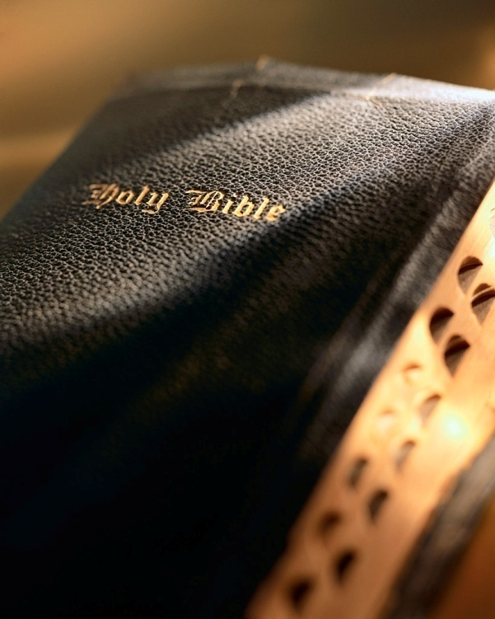

Slide 2
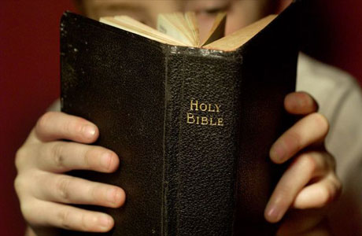
Introduction
Tobacco is a product prepared from the leaves of the tobacco plant.
It is smoked in cigarettes, cigars, pipes and consumed as snuff, chewing tobacco and dipping tobacco.
National Institute on Drug Abuse: “In 2013, almost 55.8 million Americans (21.3% of population) were current cigarette smokers; 12.4 million smoked cigars; more than 8.8 million used smokeless tobacco; and over 2.3 million smoked tobacco in pipes.

Slide 3
Eight Reasons Why a Christian Should Not Use Tobacco 1 Corinthians 6:19-20

Slide 4
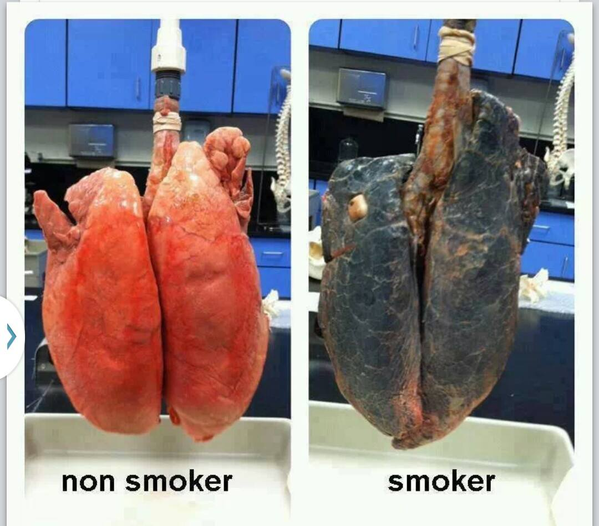
It harms the body
Cigarette smoking accounts for about 1/3 of all cancers; 90% of lung cancers.
Don’t Use Tobacco

Slide 5
It harms the body
Cigarette smoking accounts for about 1/3 of all cancers; 90% of lung cancers.
Smokeless tobacco (chewing tobacco and snuff) also increases risk of cancer.
Don’t Use Tobacco

Slide 6
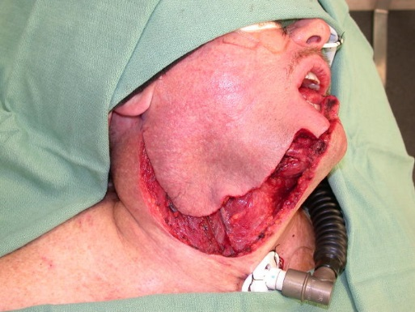
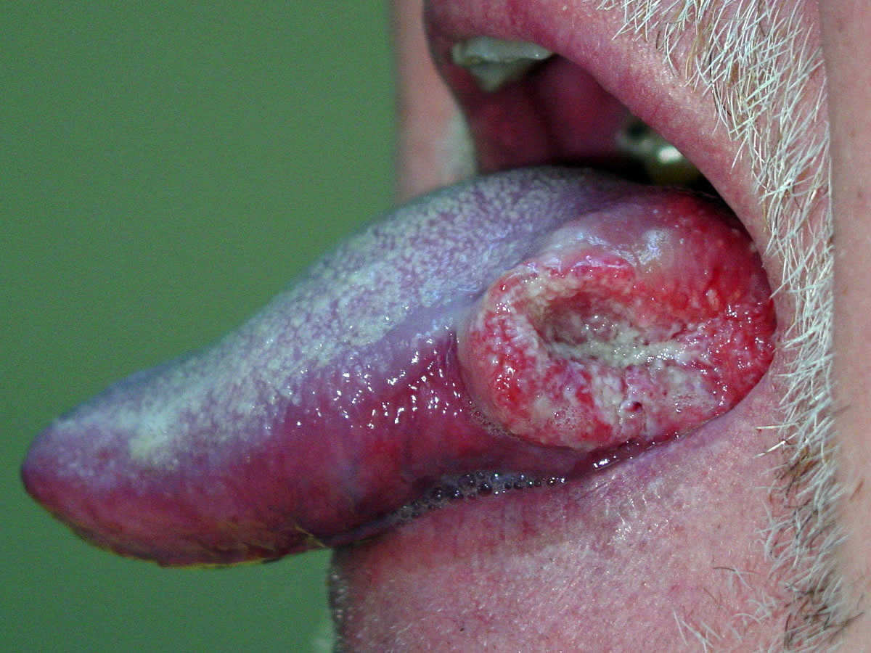
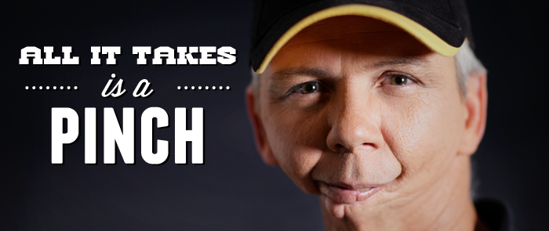
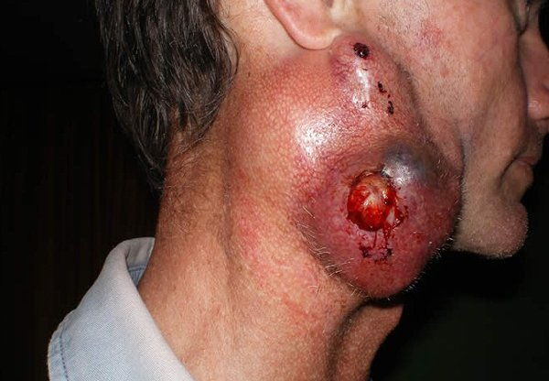
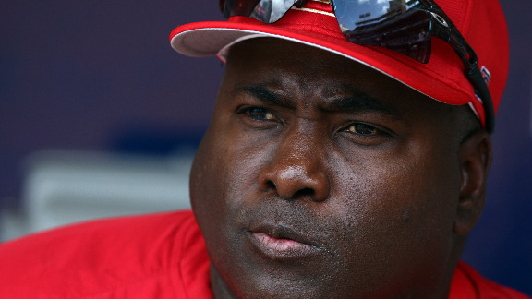

Slide 7
It harms the body
Cigarette smoking accounts for about 1/3 of all cancers; 90% of lung cancers.
Smokeless tobacco (chewing tobacco and snuff) also increases risk of cancer.
Christians are to honor and properly use their physical bodies: 1 Cor. 6:19-20
Don’t Use Tobacco

Slide 8
It brings premature death
CDC: “Tobacco use is the leading cause of preventable death in the U.S.
Cigarette smoking →480,000 premature deaths per year in U.S.; 1 in every 5 deaths; another 16 million suffer from serious illness.
In the past 50 years, 20 million people in U.S. died prematurely due to smoking; more than the population of the five largest U.S. cities combined.
Don’t Use Tobacco

Slide 9
It brings premature death
For every person who dies from smoking 30 more suffer from at least one tobacco-related illness (CDC).
Top 10 serious tobacco-related illness (American Lung Association).
CDC: Life expectancy for smokers is at least 10 years shorter than for nonsmokers.
Life is short enough! Psa. 90:10; Jas. 4:14
Premature death has a tremendous impact on the survivors!
Don’t Use Tobacco

Slide 10
It inflicts harm on others
Secondhand smoke causes 41,000 nonsmokers to die annually from tobacco-related diseases (National Institute on Drug Abuse).
How does that fit in with the “golden rule” or “love thy neighbor”? Matt. 7:12; 22:39; Phil. 2:4
Cigarette residue can ruin your home and belongings.
Don’t Use Tobacco

Slide 11
It is addicting
Surgeon General: “Nicotine is the drug in tobacco that causes addiction.”
Electronic cigarettes can be addictive and contain carcinogens.
E-cigarette use has exploded among young people.
Nicotine exposure may cause lasting harm to brain development, etc.
Recall what Paul said?! 1 Cor. 6:12; 16:15
Don’t Use Tobacco

Slide 12
It is costly
In addition to health costs, the economic cost of tobacco products and use is staggering.
>$325 B per year; $170 B in direct medical care; $156 B in lost productivity (CDC).
Average cost for a pack of cigarettes is $6.36.
Average health-related costs per pack of cigarettes is $35!
Think of all the gospel preachers that could be supported?!
Don’t Use Tobacco

Slide 13
It is a gateway drug
NIH: “A new study shows how tobacco products could act as gateway drugs, opening the door to use of illicit drugs.”
Nicotine makes the brain more susceptible to cocaine addiction.
Cigarette and alcohol use raise risk of later use of marijuana and cocaine.
90% of adult cocaine users (age 18-34) smoked cigarettes before using cocaine: Prov. 6:27-28
Don’t Use Tobacco

Slide 14
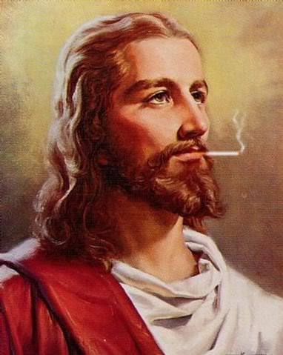
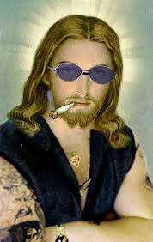
It wasn’t used by the Lord
Don’t Use Tobacco

Slide 15
It undermines one’s influence for good
Titus 2:6-8 Is tobacco use evidence of “showing yourself to be a pattern of good works”?
Where does tobacco use fit into being “the salt of the earth” and “the light of the world”? Matt. 5:13-16
Does tobacco use positively or negatively affect your “example”? 1 Tim. 4:12
If Paul and Timothy were alive today, what do you think would be Paul’s advice to Timothy concerning tobacco use?
Don’t Use Tobacco

Slide 16
Conclusion
Tobacco use is a nasty, highly addictive and expensive habit.
Tobacco use will destroy your health and your good influence.
Only a fool would let tobacco cost him/her their soul!

