Slide 1
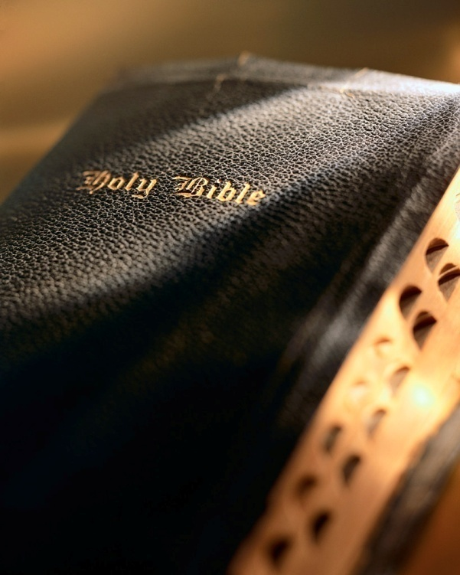

Slide 2
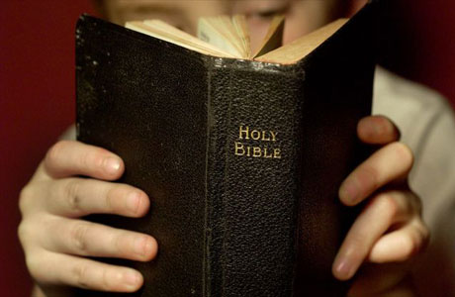
Introduction
Alcoholic beverages are everywhere in our society.
Alcohol use is advertised widely; it is commonplace.
Society thinks you’re strange if you don’t drink alcohol: 1 Pet. 4:3-4
Remember Mattie Ross in the film True Grit? “I would not put a thief in my mouth to steal my brains!”

Slide 3
20 Reasons Why a Christian Should Not Drink Alcoholic Beverages Proverbs 23:29-35

Slide 4
Makes one a fool
1
Proverbs 20:1
Alcohol affects our inhibitions; overrides the “governor” of our behavior.
We will do, say, think things when drinking alcohol we wouldn’t normally.
What was David counting on alcohol to do to Uriah? 2 Sam. 11:13
Don’t Drink Alcohol

Slide 5
Leads to poverty
2
Proverbs 21:17; 23:21
Excessive alcohol consumption costs the U.S. $223.5 billion per year!
A DUI arrest will cost you $5,000 to $12,000.
Do you think Proverbs 21:17 doesn’t apply to you?
If so, you’re a fool!
Don’t Drink Alcohol

Slide 6
Produces woe
3
Proverbs 23:29-30
Question: Who has woe?
Answer: Those who drink alcohol!
Bonus: You get a “hangover” the next day!
Alcohol is deceptive! Prov. 23:31
It looks good, but its effects are bad! Prov. 23:32-35
Don’t Drink Alcohol

Slide 7
Bites and stings
4
Proverbs 23:32
Alcohol can kill you in many ways!
Alcohol also inflicts mental pain!
Do you want to carry around the baggage alcohol produces for the rest of your life?!
Don’t Drink Alcohol

Slide 8
Fills mind with impure & perverse thoughts
5
Proverbs 23:33
Remember “beer goggles”?
Alcohol can make you think some really stupid, bad things!
Christians are supposed to have “good” thoughts: Phil. 4:8
Don’t Drink Alcohol

Slide 9
Brings danger and insecurity
6
Proverbs 23:34
Alcohol is single biggest cause of accidents in the home.
Alcohol a major factor in many traffic accidents.
Don’t have to be at or above the “legal limit” to be affected.
Only a fool would risk the odds!
Don’t Drink Alcohol

Slide 10
Makes one insensible and is habit-forming
7
Proverbs 23:35
Why engage in something that masks real danger?!
Christians are not to be enslaved to “bad habits”! 1 Cor. 10:23
Can you honestly say that alcohol use “edifies”?
Don’t Drink Alcohol

Slide 11
Woe is to them that drink
8
Isaiah 5:11
Isa. 5:22
The drunkards of Ephraim: Isa. 28:1-3
“Woe” is translated “destruction” in NLT.
What can happen if one plays with fire?
Don’t Drink Alcohol

Slide 12
A companion of carnal living
9
Isaiah 22:13
Is an attitude of iniquity: Isa. 22:14
Evidence of a “carnal mind”: Rom. 8:7
Only a fool would want to be God’s enemy!
Don’t Drink Alcohol

Slide 13
Causes one to err and stumble
10
Isaiah 28:7
It amazes me that so many justify and rationalize drinking no matter how ugly it really is.
Where does drinking alcohol fit in with Matt. 5:6 and Matt. 6:33?
Don’t Drink Alcohol

Slide 14
Brings foolish optimism and vain hope
11
Isaiah 56:12
What does the song say? Our “hope is built on nothing less than Jesus’ blood and righteousness.”
The hope brought by alcohol is nothing but a “mirage.”
Hold onto to your real hope: Heb. 6:20
Don’t Drink Alcohol

Slide 15
Joined w/immorality and enslavement of heart
12
Hosea 4:11
Christians are not to be enslaved to “bad habits”: 1 Cor. 10:23
Most “drinking men” end up on “the prowl.”
What did Paul say in 1 Cor. 6:18? Does alcohol help us do this?
Don’t Drink Alcohol

Slide 16
Brings shame
13
Habakkuk 2:15-16
Nobody wants to bring shame on self, parents, family, or on the church.
By avoiding alcohol we deprive Satan of a tool!
Why give the devil an edge?! 1 Pet. 5:8
Don’t Drink Alcohol

Slide 17
We are to walk honestly
14
Romans 13:13
Alcohol use does not promote honesty.
Alcohol users “live a lie.”
Living with a clean conscience makes for sound mental health.
Don’t Drink Alcohol

Slide 18
Is a work of the flesh
15
1 Corinthians 6:9-10; Galatians 5:19-21
“But, I just drink socially.” “I just drink a glass of wine now and then.”
Good for you! Where did every alcoholic get his start?
What about your “example”? Matt. 18:6
Don’t Drink Alcohol

Slide 19
Is a “be not”
16
Ephesians 5:18
How much clearer must God’s word be?!
But you’re too strong; alcohol poses no danger to you!
It must be nice to be so confident! 1 Cor. 10:12
Don’t Drink Alcohol

Slide 20
We are to be sober
17
1 Thessalonians 5:6-7
The notion one can remain “sober” after even one drink is ludicrous.
Go to Youtube and search the “effects of alcohol [driving].”
Mixing any alcohol and driving is dangerous!
Don’t Drink Alcohol

Slide 21
Leads to other sins
18
Consider:
Noah: Gen. 9:20-26
Lot: Gen. 19:30-38
Remember David and Uriah? 2 Sam. 11:13
Don’t Drink Alcohol

Slide 22
We are to maintain self-control
19
1 Corinthians 9:24-27
The word for “discipline” in v. 27 is very strong! hupopiazo
Sounds like Paul was quite serious about self-control!
Can you imagine Paul ending a busy day of preaching by “unwinding” with a couple of Budweisers?!
Don’t Drink Alcohol

Slide 23
Drinking alcohol at any level condemned
20
1 Peter 4:3-4
This passage condemns three levels of drinking alcohol:
“drunkenness”: out and out drunk.
“revelries”: carousing, merrymaking after supper.
“drinking parties”: would include what we might call “social drinking.”
Don’t Drink Alcohol

Slide 24
Conclusion
Drinking alcohol trumps reason, distorts judgment, severs the connection between behavior and consequences, ruins marriages, friendships and careers, injures, costs lives and leaves children neglected.
Don’t be deceived! Alcohol is something a Christian should avoid at all cost!

