Slide 2
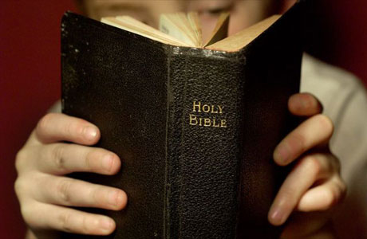
Introduction
Story of Joseph is one of the most interesting, thought-provoking and instructive stories in the Old Testament: Gen. 30-50.
Years after Joseph’s death the Bible says more concerning his bones: Ex. 13:19; Josh. 24:32; Acts 7:15-17; Heb. 11:22

Slide 3
Lessons From a Dead Man’s Bones Genesis 50:24-26

Slide 4
God’s promises are sure and certain
God’s promises ~230 years old when Joseph gave instructions concerning his bones: Gen. 12:1-3; 15:13-21; 26:3-4; 28:13-15
Joseph didn’t give it a second thought!
To the human mind there were too many obstacles: Heb. 11:11, 12
Despite the obstacles “All came to pass” : Josh. 21:43-45; 2 Pet. 1:10-11
Lessons From a Dead Man’s Bones

Slide 5
God’s revealed word is true
Joseph only knew God’s promises through His revelation.
Because God had spoken it, Joseph knew it was true, therefore, it would “surely” come to pass: Gen. 50:24-26
He knew God’s word is inviolate, unchange-able and immutable: Matt. 24:35; Num. 23:19; Psa. 19:9; Heb. 6:18
Lessons From a Dead Man’s Bones

Slide 6
Time of no consequence to God’s word or promises
Time made no difference to Joseph in regards to his trust in God’s word and promises.
Time was no hindrance to any of the patriarchs: Heb. 11:13; 2 Pet. 3:3-4, 8, 10
The discouraged Hebrew Christians in the NT needed to learn this lesson: Heb. 10:19-12:29
If God has said it, if He has promised it, “God will surely” do it! Time is no factor!
Lessons From a Dead Man’s Bones

Slide 7
Faith has confidence and assurance in God’s word
Joseph’s eye of faith could see what his fleshly eye could not see: Heb. 11:22; Acts 27:25
Joseph learned his faith from his fathers: Rom. 4:18-21
Mary, Peter and Paul had similar faith as Joseph: Lk. 1:34, 38; Lk. 5:5, 6, Acts 27:23-44, 47
Let us burn into our hearts:
“be it unto me according to thy word”
“Nevertheless…at thy word I will”
“I believe God, that it shall be even as it was told me”
Lessons From a Dead Man’s Bones

Slide 8
Application
God’s promises are sure and certain: 1 Thess. 4:17; 2 Pet. 3:10; 1 Cor. 10:13
God’s word is true: Jn. 18:38; 17:17; Eph. 4:14; Psa. 119:89; Heb. 6:18
Time is of no consequence to the truth of God’s word or the fulfillment of His promises: 2 Pet. 3:8; Isa. 40:31; Psa. 27:14
Faith has confidence and assurance in God’s word: Heb. 11:22; Lk. 1:38; 5:5; Acts 27:25
Lessons From a Dead Man’s Bones

Slide 9
Application
Examples:
Majority’s desire to deny God’s word will not change it! Mk. 16:16; Acts 2:38; 22:16; Gal. 3:27; 1 Pet. 3:21; Matt. 16:18; Acts 2:41, 47; Col. 1:18; Eph. 4:4; Matt. 19:9
No matter how weak our faith we cannot frustrate the ultimate fulfillment of God’s word: 1 Cor. 10:13; 2 Cor. 5:10; Rom. 2:16; 1 Cor. 4:5; 2 Pet. 3:10-11
Lessons From a Dead Man’s Bones

Slide 10
Application
Examples:
God expects us to do ALL of His will! Jas. 2:10; Mk. 16:16 vs. 1 Jn. 3:17; Jas. 1:27
No matter how weak our faith, God really does care! 1 Pet. 5:6-7; Eph. 3:20; Rom. 5:8-10; 8:31-39
Regardless of our circumstances we can live the abundant life! Jn. 10:10; Phil. 4:7
Lessons From a Dead Man’s Bones

Slide 11
Conclusion
How about you? Do you…
Believe: God’s promises are sure and certain?
Believe: Revealed word of God is true?
Believe: Time is of no consequence to the truth of God’s word or its fulfillment?
Faith has confidence and assurance in the word of God?
First three are settled! Only the fourth is an issue! Heb. 11:6

