Slide 1
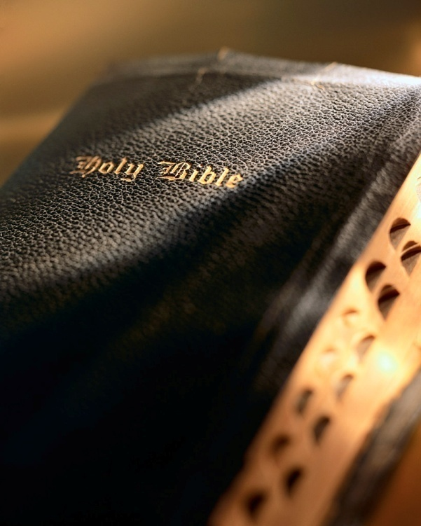

Slide 2
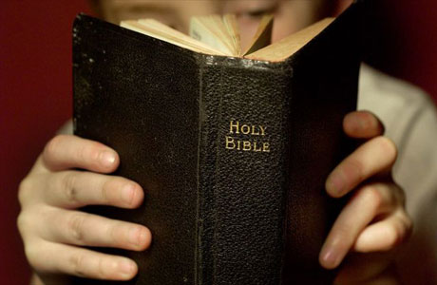
Introduction
What is the greatest motivation in the life of a Christian?
Desire for better life here: love, joy, peace? Gal. 5:22-25
Desire for God’s approval? Heb. 11:6
Desire to do what is right? 2 Tim. 2:15; 2 Pet. 1:5
Good reasons, but not the best. The best motivation is to live beyond this mortal life.
Once discovered, we must desire to not miss out on this one great opportunity!

Slide 3
Stand, Stay, Abound 1 Corinthians 15:50-58

Slide 4
Stand steadfast
Steadfast “denotes ‘seated’; metaphorical of moral fixity” (Vine).
Synonyms: resolute, persistent, committed.
The goal of heaven requires total commitment! Rom. 6:1-4; Eph. 4:17-32; Col. 3:1-10
Requires total obedience to God’s Word: Matt. 7:21; 1 Tim. 4:13, 15-16; Jas. 1:17-22
No wavering or turning back: Lk. 9:62; 1 Cor. 9:24-27; Heb. 2:1-3; 10:35-39; 2 Cor. 7:1
Stand, Stay, Abound

Slide 5
Stay immovable
To be “immovable” means to be “righteously stubborn.”
Most float through life without being anchored; Christians must be stubborn at times; esp. over the truth: Prov. 23:23; Jn. 8:31-32.
The world is always trying to “move” the Christian from his/her “anchor”: Acts 20:29-31; Gal. 1:6-12.
The world is full of temptations Satan uses to move us: 1 Jn. 2:15-17; Col. 4:14; 2 Tim. 4:10.
To be “immovable” we must put on God’s armor and stand fast! Eph. 6:10-18
Stand, Stay, Abound

Slide 6
Always abounding
Is your life providing you with “enough”?
Our society provides us more than enough materially.
But material things cannot lead us to the victory we seek: Lk. 12:13-21.
We need to seek to “abound” in our spiritual pursuits: Jn. 15:1-8; Gal. 5:22-23.
Our whole heart: Mk. 12:30
All that we are: Rom. 12:1-2
Complete devotion to His will: Col. 3:17
Does Paul’s description of abounding “in the work of the Lord” describe yours and mine? Col. 1:9-14
Stand, Stay, Abound

Slide 7
Conclusion
What is your motivation in life?
Here and now?
Heaven?
If we follow God’s plan He guarantees us the victory! “your labor is not in vain in the Lord.”
But we must live a life “steadfast, immovable, and always abounding in the work of the Lord”!
Does that describe your/my life?

