Slide 2
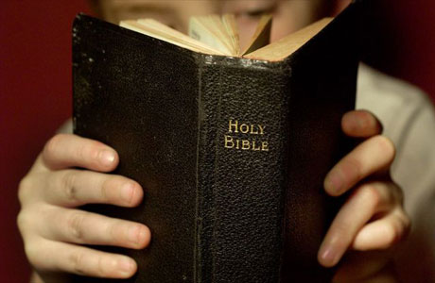
Introduction
Paul tells us the value of the Old Testament: Gal. 3:24; Rom. 15:4; 1 Cor. 10:11
Israel’s history provides us with many valuable lessons worthy of our study.
One I would like to consider is just after the return of the Jews from the Babylonian Captivity.
The Jews sailed past “Redemption Point” during the reign of Manasseh: 1 Kgs. 24:2-4

Slide 3
Introduction
Israel taken into captivity by the Assyrians in 722 B.C.
About a 100 years later Judah was taken into captivity by the Babylonians (606, 596, and 587 B.C.).
Israel never returned, but Judah returned (536, 458, and 444 B.C.).
Cyrus allowed the Jews to return to Jerusalem and he financed the rebuilding of the temple: Jer. 29:10; 2 Chron. 36:22-23; Ezra 1:1-4

Slide 4
Introduction
In the first return (536 B.C.) ~50,000 Jews returned and within a year began rebuilding the temple: Ezra 2:64-65
When work started on the temple it was a joyful and a sad time: Ezra 3:10-11, 12-13
There was much resistance to the work: Ezra 4:1-5, 17-23
When work on the temple halted the people selfishly focused on building their own houses: Hag. 1:4
Haggai and Zechariah come on the scene to stir up the people to resume the work: Hag. 2:1-9
They are depressed, dejected and on the verge of quitting: Zech. 4:6-10
God works through small things!
“For who has despised the day of small things? For these seven rejoice to see The plumb line in the hand of Zerubbabel. They are the eyes of the Lord, Which scan to and fro throughout the whole earth."
Zechariah 4:10

Slide 5
A Day of Small Things Zechariah 4:8-10

Slide 6
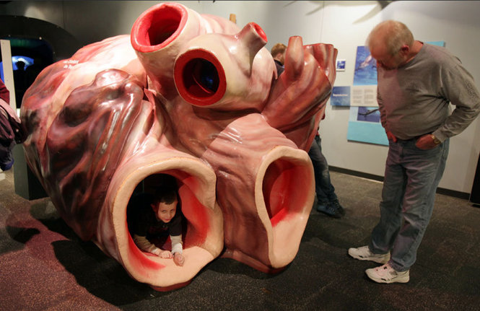
God accomplishes big things through small steps
Big things are accomplished through small steps: Prov. 6:6-8
Man discounts “small things” and wants a “big show.”
God doesn’t’ measure things by their size: Matt. 20:40-42; 25:31-46
There are many “small things” we can do that have an enormous impact: Jn. 4:24-42; Isa. 55:11; 1 Pet. 3:20; Matt. 5:13-16
A Day of Small Things

Slide 7
God chooses to work through things the world overlooks
Recall what Paul wrote? 1 Cor. 1:27-29
God often doesn’t use the “mighty” to accomplish His plans: Matt. 11:25
Gideon: Judg. 6-8; Isa. 31:1
Noah: Gen. 6; 1 Pet. 3:20
Abraham: Gen. 13:16
Moses
David: 1 Sam. 16ff
Unnamed faithful saints: Heb. 11:32-40
That God uses “small things” to accomplish His will is the rule, not the exception! 2 Cor. 12:7-10
A Day of Small Things

Slide 8
God’s people have never been numerous
Often God’s people are called a “remnant”: 1 Kgs. 19:14-18; Isa. 37:31-32; Rom. 11:1-6
What’s in store for Westside?
A firm determination to believe, follow and teach the truth.
A total dedication to do all we can to help one another make it to heaven.
An unshakeable commitment to share the gospel with as many people as we can.
An unyielding conviction to help as many needy people as we can within the scope of our ability and opportunity.
Whatever “size” Westside becomes is immaterial: 1 Cor. 3:7; Rev. 3:8-12
A Day of Small Things

Slide 9
We may be small and despised, but there is a mighty big God behind us
Consider Psa. 119:141; 1 Cor. 4:13
The world and most “Christians” don’t think very highly of NT Christians: Lam. 3:45
Regardless, we are important to God: 1 Pet. 5:7; Psa. 34:15; 142:4-7
Whatever level our “talents” might be (or not be) no one is unimportant in the brotherhood: 1 Cor. 12:14-26
A Day of Small Things

Slide 10
Conclusion
How do you eat an elephant? One bite at a time!
How do we succeed spiritually? One small step at a time!
Let us pursue spiritual success and bring glory to God in small things.

