Slide 1
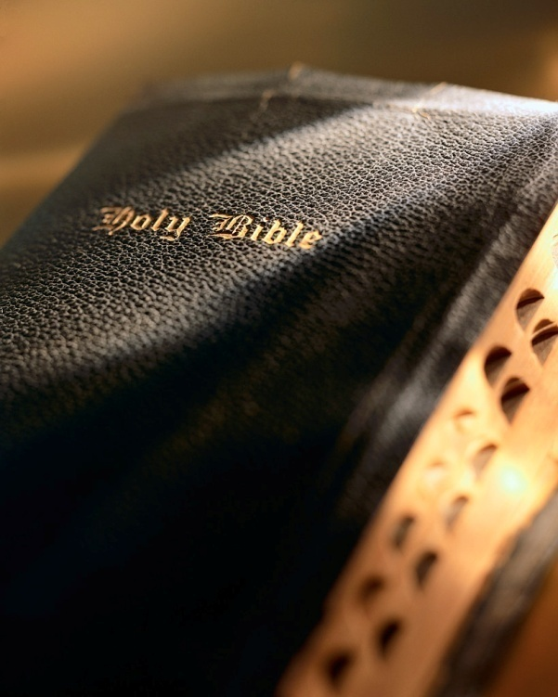

Slide 2
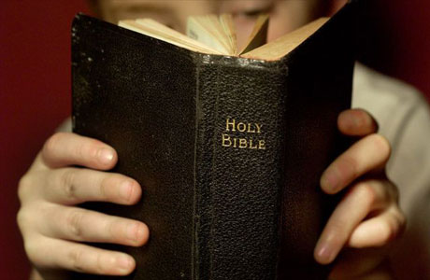
Introduction
Have you ever felt depressed, distressed or alone?
What can you do to get out of that dark place?
The Bible gives us a good example in the case of David.
David was victorious over Goliath, many victories over the Philistines, a man after God’s own heart: 1 Sam. 17
Saul’s jealousy and hatred drove him to try to kill David: 1 Sam. 18:11
David fled and hid in caves; lived as a refugee and outcast; lived in constant fear for his life.
David sneaks up on Saul and cuts off the corner of his robe: 1 Sam. 24:1-7

Slide 3
Introduction
During this time David was in an emotional “dark place.”
David wrote Psalm 57 and 142 while in the caves hiding from Saul.
David was distressed and said: “My soul is bowed down.” Psalm 57:6
David was sorrowful: “Attend to my cry, for I am brought very low; deliver me from my persecutors, for they are stronger than I. Bring my soul out of prison.” Psa. 142:6-7
Have you ever felt so depressed that you felt like you were in prison?

Slide 4
Introduction
Though David was depressed, he knew God would deliver him.
Even though his night was full of despair, David believed he would awaken to a new day.
“My soul is among lions; I lie among the sons of men who are set on fire, whose teeth are spears and arrows, and their tongue a sharp sword. 8 Awake, my glory! Awake, lute and harp! I will awaken the dawn.” Psa. 57:4, 8
“For His anger is but for a moment, His favor is for life; weeping may endure for a night, but joy comes in the morning.” Psa. 30:5; cf. Eccl. 3:4

Slide 5
Awaken the Dawn! Psalm 57:4-11

Slide 6
Attitude
David was forced into hiding: 1 Sam. 22:1-2; 24:1-7
He had everything in the world going for him, yet he ended up being fugitive hiding in a cave! Acts 13:22
David was troubled and distressed to the point of being overwhelmed: Psa. 142:3
Despite his fix, he considered God his refuge: Psa. 142:4-5
Despite his sorrow, he trusted in God to deliver: Psa. 142:6-7
His attitude helped him look beyond his sorrow, grief and fear to lean on God: Psa. 57:4, 8; 30:5
In our cave of sorrow we must do the same: Psa. 50:15; Dan. 3:17-18; 2 Cor. 1:9-10; Eph. 3:20
Awaken the Dawn!

Slide 7
Action
David wasn’t idle in the cave, feeling sorry for himself; he was praising God! 1 Sam. 57:1-3; 142:1-2
When depressed we are tempted to feel sorry for ourselves and push God away instead of drawing closer to Him.
David remained in control of his actions and kept his behavior above reproach: 1 Sam. 24:4-7
David showed complete faith in God to deliver him according to His way and timing: 2 Sam. 2
When in our “cave of sorrow” we need to imitate David: Psa. 142:5, 7
Satan will do his best to convince us God doesn’t care; don’t take the bait! Rom. 8:31-32
Awaken the Dawn!

Slide 8
Look ahead
In the midst of depression and sorrow it’s easy to wallow in the present and fail to see into the future, David didn’t do that! Psa. 57:1, 4, 8; 30:5
Very importantly, in his “cave of darkness” David continued to praise God: Psa. 57:9-11
When in our “cave of darkness” we must look ahead to the “dawn” the Lord provides! 2 Cor. 4:17; 1 Thess. 4:16-18
We must suffer through the darkness of the night to see the brightness of the new dawn!
When in our “cave of sorrow” we need to imitate David: Phil. 3:13-15
Awaken the Dawn!

Slide 9
Conclusion
David survived the “cave of darkness” to become the greatest king of Israel!
Despite his “cave of darkness” David maintained his faith in God.
When we experience our “cave of darkness” let us:
Have an attitude of trust in God for deliverance!
Act honorably despite our troubled feelings!
Look beyond the “weeping of night” to the “joy of dawn”! Psa. 30:5b; Jas. 4:10

