Slide 1
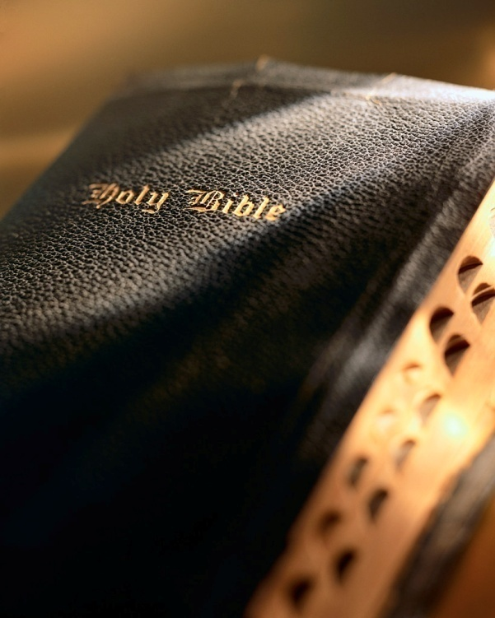

Slide 2
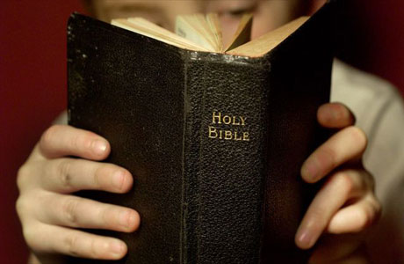
Introduction
Preaching the cross means preaching all the crucifixion of Christ means:
To preach the cross is to preach the gospel: 1 Cor. 1:17
To preach the cross is to preach Christ crucified: 1 Cor. 1:23
To preach the cross is to preach Christ paid the penalty for our sins: 1 Cor. 15:3
To preach the cross is to preach Christ destroyed the power of the devil: Heb. 2:4; 1 Jn. 3:8
To preach Christ is to preach Christ purchased the church: Acts 20:28; Eph. 5:25
To preach the cross is to preach man can be reconciled to God in the body of Christ: Eph. 2:13, 16; Rom. 5:10
The cross is God’s supreme declaration to man.

Slide 3
Things the Cross Declares 1 Corinthians 1:18-25

Slide 4
The Law of Moses done away
Col. 2:14-17; Eph. 2:13-16
Why? Gal. 3:19, 16
Failure to recognize this declaration is a major source of religious error: Gal. 5:4
No one will be justified by the law: Gal. 2:16; Heb. 10:1-4
Things the Cross Declares

Slide 5
The fulfillment of prophecy
Jesus fulfilled 353 Old Testament prophecies: Matt. 5:17; Lk. 24:44-47
Fulfillment of prophecy was a main feature of most early gospel sermons: Acts 2:22-26
The probability of one man fulfilling just 8 prophecies is 1 in 10¹⁷; fulfilling 48 is 1 in 10¹⁵⁷ (there are only 10⁸⁰ electrons in the known Universe!)
The cross declares God is able to fulfill His plan of salvation regardless of what Satan or man does: Psa. 2:4
Things the Cross Declares

Slide 6
The heinousness of sin
Bible defines sin in 1 Jn. 3:4.
Sin “is, lit. ‘a missing of the mark.’” Pretty “clinical”!
The cross gives us a much more vivid picture of the heinousness of sin: Lk. 23:33; Mk. 15:22
Consider His suffering:
Scourging: Matt. 27:26; Jn. 19:1
Mocking and crown of thorns: Mk. 15:16-20
Carries His own cross: Jn. 19:17
Things the Cross Declares

Slide 7
The heinousness of sin
Consider His suffering:
Crucifixion: Matt. 27:32-56; Mk. 15:21-41; Lk. 23:26-49; Jn. 19:17-37
Soldiers man-handle Jesus as they nail Him to the cross
Soldiers drive the nails into His hands and feet
Soldiers haul the cross to its upright position…thunk!
He hangs in absolute agony; He is in hemorrhagic shock
Dr. C. Truman Davis describes His agony
Things the Cross Declares

Slide 8
Man’s guilt
Christ died on the cross for my sins! For your sins! Isa. 53:6, 12; 1 Pet. 2:24
We all are guilty! Rom. 3:23
Thankfully God doesn’t give us what we deserve: Rom. 6:23; Psa. 59:10, 17
Things the Cross Declares

Slide 9
Man’s helplessness
The cross declares something must be done for man’s sins if he is to be saved: Rom. 3:24-25; 1 Jn. 4:10
Man cannot save himself: Jer. 10:23
God’s grace sent His Son to die for our sins: 1 Cor. 15:3; 1 Pet. 1:18-19
The cross tells us we cannot be saved without God’s grace: Eph. 1:7; 2:8; Lk. 17:10
Things the Cross Declares

Slide 10
God’s power to save
Cross says, “God alone has the power to do something about the guilt of our sins.”
God placed His “power” to save in the gospel: Rom. 1:16
Why? Rom. 1:17
The cross and subsequent resurrection allowed Jesus to validate His claims: 1 Cor. 15:1-3
What does it say when we tinker with the gospel? Gal. 1:6-9
Things the Cross Declares

Slide 11
God’s love for man
What a great irony: the painful and shameful death of Christ on the cross demonstrates the great love God has for us! Jn. 3:16
Would you die for an ungodly person? e.g., At the Battle of Iwo Jima 27 CMH’s awarded.
God deserves a CMH and then some! Rom. 5:6-8
Things the Cross Declares

Slide 12
Necessity of man’s obedience
Christ learned obedience…how? Heb. 5:8
Ramifications for us? Heb. 5:9
Obedience not a priority for most: Eph. 2:8-9, 10
Salvation impossible without obedience! 2 Thess. 1:8-9; Matt. 7:21
Things the Cross Declares

Slide 13
Conclusion
Cross declares obedient believers have hope: 1 Jn. 2:25; Titus 1:2; 1 Pet. 1:4-5
No cross, no hope!
The cross is at the very center of our hope: 1 Pet. 3:18
Paul said he gloried in the cross (Gal. 6:14); how about you?!

