Slide 1
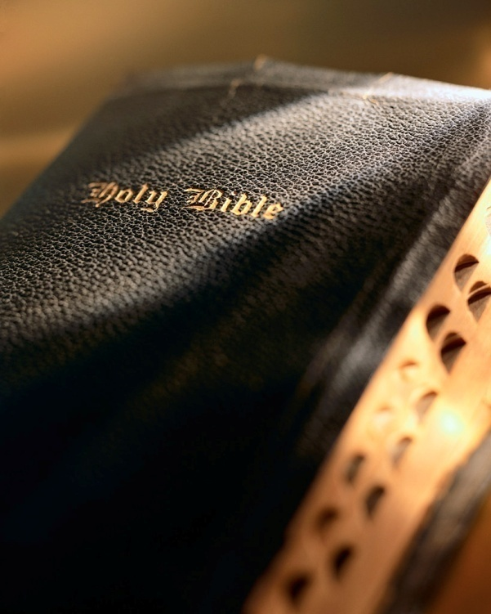

Slide 2
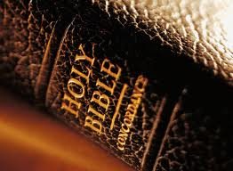
INTRODUCTION
True repentance absolutely necessary for salvation.
Theme of 1 Corinthians is rebuke of sin and error; 2 Corinthians is commendation for repentance (2 Cor. 7:10)
Repentance: change of heart leading to change of action, change the course of one’s life:
“sorrow of the world”→regret→”death” (Matt. 27:3-4)
“godly sorrow”→”repentance”→correction of sin and error→”salvation” (2 Cor. 7:10)
We must repent! Acts 17:30-31
Repentance Leading to Salvation

Slide 3
Repentance Leading to Salvation
www.westsidecoc.org
2 Corinthians 7:8-12

Slide 4
Necessity of repentance
Repentance prepared Jews to receive Jesus: Matt. 3:1-2; Mk. 1:14-15
Alien sinner must repent to be saved: Acts 2:22-23, 24-36, 37, 38; 3:13, 19
Repentance necessary for Christians who sin to receive forgiveness: Acts 8:22
Repentance Leading to Salvation

Slide 5
Nature of repentance
Psalm 51 records David’s plea for pardon.
David plead for God to search his heart: Psa. 139:23-24
David plead to God to cleanse and guard his thoughts, words, and deeds: Psa. 19:12-14
Good description of a repentant soul: Isa. 66:2
CHANGE!
Repentance Leading to Salvation

Slide 6
Difficulty of repentance
Sin exerts a tremendously strong grip! Rom. 7:15; 1 Cor. 9:24-27
Hebrew writer addresses this problem and gives us a solution: Heb. 12:1-2
Repentance an absolute requirement: Acts 17:30
God gives us tools to overcome: 1 Cor. 10:13; 1 Jn. 1:7-9; 2:1; Acts 8:22
We need to hate sin as God hates it! 1 Pet. 1:18; Heb. 4:15-16; Eph. 3:20; 1 Jn. 1:9; Acts 8:22; Matt. 18:22
Repentance Leading to Salvation

Slide 7
Time for repentance
Very simple: “Today” is always the “day of salvation: 2 Cor. 6:2; Heb. 3:13
Only a fool puts off repentance: Prov. 27:1
Yet, many still procrastinate! Isa. 55:6-7; Rom. 13:14
Repentance Leading to Salvation

Slide 8
Result of repentance
Change of heart produces fruit in a changed life: Matt. 3:8; Acts 26:20
Consider the example of those obeying the gospel in Corinth: 1 Cor. 6:9-11
Consider the example of the erring Corinthian Christians: 2 Cor. 7:9-11
True repentance always produces fruit! Titus 2:11-14; 1 Cor. 6:11; Matt. 3:8; Lk. 19:8
“fruits worthy of repentance”
Kidnapping? Keep the one kidnapped?
Theft? Keep the stoleny stolen?
Adulterous marriage? Remain in the marriage?
Murder? We can’t restore life!
Repentance Leading to Salvation

Slide 9
No hypocritical repentance
Jesus scathingly rebuked hypocritical religious leaders: Matt. 3:7-9
Jesus didn’t let up on hypocrites: Matt. 23:25-28
How many will be lost because they are turned off by hypocritical “Christians”? Rev. 21:8
Repentance Leading to Salvation

Slide 10
CONCLUSION
Repentance is a must! Acts 17:30
Involves a change of heart leading to a change of life:
“sorrow of the world”→regret→”death” (Matt. 27:3-4).
“godly sorrow”→”repentance”→correction of sin and error→”salvation” (2 Cor. 7:10)
Alien sinner must repent to be saved: Acts 2
Christian who sins must repent to receive forgiveness: Acts 8;22-23
True repentance always produces “fruit worthy of repentance”: Matt. 3:8
Repentance Leading to Salvation

