Slide 1
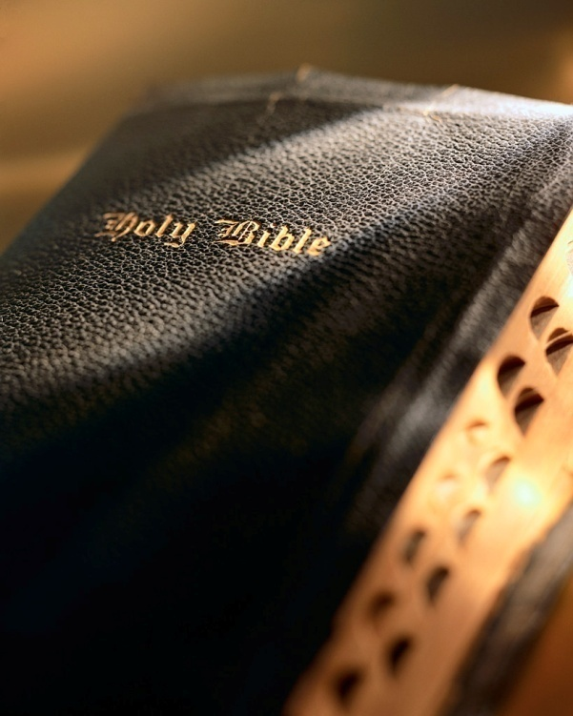

Slide 2
"grow in the grace
and knowledge
of the Lord"
2 Peter 3:18
Much misunderstanding and false teaching concerning Christ’s 2nd coming and the end of the world.
Many guilty of interpreting figurative passages literally and/or “wresting” the Scriptures.
Best way to understand is to read and study the simple and clear Bible passages that deal with the subject.

Slide 3
Then Cometh the End
“Then cometh the end…” 1 Cor. 15:24
Christ Will Return
The Dead Will Be Raised
We Will Be Changed
Present World Brought to an End
The Judgment
The Kingdom Will Be Delivered Up to God
The Reign of Christ Will End

Slide 4
Then Cometh
the End
1. Christ will return
“Then cometh the end…” 1 Cor. 15:24
Most believe Christ is coming back to set up a kingdom and reign on Earth for a thousand years: Acts 1:11
Bible never states Christ will come back and set foot on Earth and establish a thousand year reign: Heb. 9:27-28; Mk. 13:32; 1 Thess. 4:16-18

Slide 5
Then Cometh
the End
2. The dead will be raised
“Then cometh the end…” 1 Cor. 15:24
Many believe death is the “end”: Eccl. 9:5; 1:14
The Bible teaches differently: Gen. 1:26; Jn. 4:24; Lk. 24:39; Matt. 10:28; Acts 2:27; Jas. 2:26; Eccl. 12:7; 2 Cor. 5:1; Lk. 16:22-25; Matt. 22:31-32
What happens to the dead? Lk. 16:19-31; Jas. 2:26; Acts 2:31; Heb. 9:27
When Christ comes again there will be a resurrection of ALL the dead! Jn. 5:28-29; Matt. 25:31-46; Rev. 20:13; 1 Thess. 4:16-17; Rev. 20:14-15

Slide 6
Then Cometh
the End
3. We will be changed
“Then cometh the end…” 1 Cor. 15:24
Man has always wondered about life beyond this “mortal coil”: Job 14:14
We cannot inherit God’s eternal kingdom in our present form: 1 Cor. 15:50
Our bodies are mortal and corruptible, but the spiritual body will be immortal and incorruptible: 1 Jn. 3:2; Phil. 3:21
All will be resurrected and given new bodies: 1 Cor. 15:35-54; 1 Jn. 3:2; Phil. 3:21

Slide 7
Then Cometh
the End
4. Present world brought to an end
“Then cometh the end…” 1 Cor. 15:24
Like our bodies, this Earth is only temporary: 2 Pet. 3:10
God never intended for the Earth to last without end: 2 Pet. 3:10
Since this is the case, Peter encourages and warns us with sobering words: 2 Pet. 3:11

Slide 8
Then Cometh
the End
5. The judgment
“Then cometh the end…” 1 Cor. 15:24
Everyone will be there! No one will escape the judgment! Matt. 25:32; 2 Cor. 5:10; Rev. 20:12
Everyone will give an account of their life: Eccl. 12:13-14; 2 Cor. 5:10; Rom. 14:11-12
Christ will be the judge: Jn. 5:22; Acts 17:30-31
Christ will use His “word” as the standard of judgment: Jn. 12:48; Rom. 2:16

Slide 9
Then Cometh
the End
6. The kingdom delivered up to God
“Then cometh the end…” 1 Cor. 15:24
At the end, Christ delivers the kingdom back to God: 1 Cor. 15:24; Matt. 16:18-19; Col. 1:13; Eph. 5:27
Kingdom spiritual, not physical: Jn. 18:36; Phil. 3:20
All this defeats the theories of the premillennialist: Jn. 16:28; Lk. 24:512; Dan. 7:13-14; Jn. 3:3-5; Col. 1:13

Slide 10
Then Cometh
the End
7. The reign of Christ will end
“Then cometh the end…” 1 Cor. 15:24
Christ’s reign on God’s throne is temporary: 1 Cor. 15:24-28
Christ given the kingdom when He ascended into heaven: Lk. 1:32-33; Jn. 13:3; Acts 2:36; Dan. 7:13-14; Matt. 28:18; Eph. 1:19-23
He rules “till” the last enemy is destroyed: 1 Cor. 15:24-26

Slide 11
Then Cometh
the End
Conclusion
“Then cometh the end…” 1 Cor. 15:24
From the time we first obeyed the gospel we must:
Put first things first (Matt. 6:33),
Add to our faith (2 Pet. 1:5-11),
Keep ourselves unspotted from the world (Jas. 1:27),
Show faithfulness in all things (Prov. 20:6),
Be diligent students of God’s Word (2 Tim. 2:15),
Meet our responsibilities (Rom. 14:12),

Slide 12
Then Cometh
the End
Conclusion
“Then cometh the end…” 1 Cor. 15:24
From the time we first obeyed the gospel we must:
Discharge our God-given roles in the family (Mk. 10:6-8),
Not be led astray by false doctrine (Matt. 22:29),
Closely watch our attitudes (Prov. 23:7),
Understand the nature of the one true church (Matt. 16:18),
Rightly handle the word of truth (2 Tim. 2:15),
Prepare for the inevitable judgment (1 Cor. 15:24).

