Slide 1
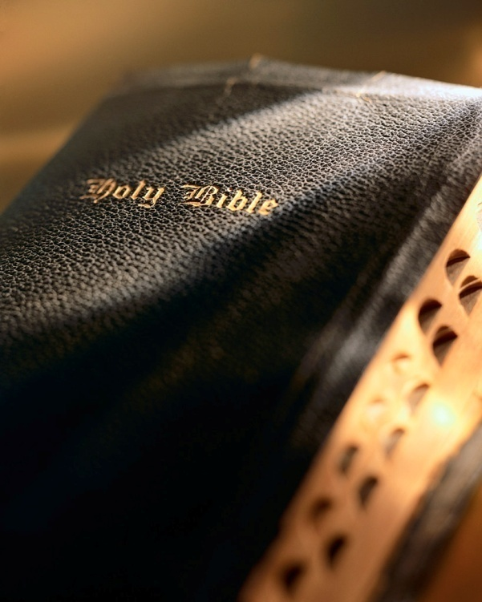

Slide 2
Introduction
We live in the most wealthy and free society on Earth; but we still need answers to life’s biggest questions:
How did I get here?
Why am I here?
What’s life really all about?
Let’s take a few minutes to address these ques-tions and consider…

Slide 3
Is It Worth Investigating God? Romans 1:18-25

Slide 4
How did I get here?
Only 2 paradigms to explain the origin of life: evolution and creation.
Evolution: “molecules to man” theory.
Creation: designed and created by a supernatural, all-powerful divine being.
Evolution claims to hold the “scientific high ground.”
Consider creationists on par with flat earthers; accuse us of following “blind faith”: Heb. 11:1
Is It Worth Investigating God?

Slide 5
Who’s unscientific?
Where did the Universe come from?
“Big bang”: 13.7 billion years ago?
Stephen Hawking: in the beginning space, time, & matter compacted into ‘zero’ volume: the singularity.
Where did the singularity come from? What was its cause?
The materialist’s explanation for the origin of the Universe violates the Law of Cause and Effect which is the foundation of all the sciences.
Is It Worth Investigating God?

Slide 6
Who’s unscientific?
“The Universe, and everything that has happened in it since the beginning of time, are a grand effect without a known cause. An effect without a known cause? That is not the world of science; it is a world of witchcraft, of wild events and the whims of demons, a medieval world that science has tried to banish. As scientists, what are we to make of this picture? I do not know.”
Robert Jastrow, founder & director of NASA Goddard Institute for Space Studies
Creationists have no problem with the Law of Cause and Effect: Heb. 3:4
Universe is the grand Effect, God the grand Cause: Gen. 1:1
Evolutionist’s dilemma: no house builds itself!
Law of Causality demands there had to be a cause and a beginning for the Universe.
Evolution’s conundrum: a grand effect with no cause?! Who’s being unscientific?
Is It Worth Investigating God?

Slide 7
Who’s unscientific?
Evolution requires abiogenesis be true…it’s not!
Without abiogenesis there is no starting point for evolution.
Empirical evidence unequivocally invalidates the notion of abiogenesis.
If evolution were true, abiogenesis would have to be true and occurred billions and billions of times!
Who’s being unscientific?!
Is It Worth Investigating God?

Slide 8
Who’s unscientific?
“The notion that not only biopolymers but the operating program of a living cell could be arrived at by chance in a primordial organic soup here on earth is evidently nonsense of a high order.”
Sir Fredrick Hoyle, famous English
astronomer and evolutionist
“The likelihood of the formation of life from inanimate matter is 1 to a number with 40,000 noughts after it (10^{40,000})…It is big enough to bury Darwin and the whole theory of evolution. There was no primeval soup, neither on this planet nor any other, and if the beginnings of life were not random, they must therefore have been the product of purposeful intelligence.”
Sir Fredrick Hoyle, famous English
astronomer and evolutionist
Well-respected evolutionists recognize the insurmountable hurdle of the origin of life.
Is It Worth Investigating God?

Slide 9
Who’s unscientific?
“The probability for the chance of formation of the smallest, simplest form of living organisms known is 1 to 10^{340,000,000}…the size of this figure is truly staggering, since there are only supposed to be approximately 10⁸⁰ electrons in the whole Universe!” (from Energy Flow in Biology)
Dr. Harold Morowitz, evolution apologist in McLean v. Arkansas trial
Well-respected evolutionists recognize the insurmountable hurdle of the origin of life.
Dr. Carl Sagan put the odds of the spontaneous generation of life at 10^{2,000,000,000}!
Dr. Emile Borel, father of modern probability: occurrence of any event where chances beyond 10⁵⁰ just won’t happen!
Despite insurmountable odds and a disproven theory; evolutionists cling to their flawed theory.
Is It Worth Investigating God?

Slide 10
Who’s unscientific?
“There are only two possible explanations as to how life arose: Spontaneous generation arising to evolution or a supernatural creative act of God…There is no other possibility. Spontaneous generation was scientifically disproved 120 years ago by Louis Pasteur and others, but that just leaves us with only one other possibility…that life came as a supernatural act of creation by God, but I can’t accept that philosophy because I do not want to believe in God. Therefore, I choose to believe in that which I know is scientifically impossible, spontaneous generation leading to evolution.” (“Origin, Life and Evolution” in Scientific American, 1978)
Dr. George Wald, evolutionist, Nobel Prize (1967)
Why do evolutionists cling to a false theory?
Darwin’s Doubts: The Explosive Origin of Animal Life and the Case For Intelligent Design (Stephen Meyer)
Darwin’s Black Box: The Biochemical Challenge to Evolution (Michael Behe)
Darwin’s Demise ( J. White and N. Comninellis)
Signature in the Cell: DNA and the Evidence of Intelligent Design (Stephen Meyer)
Who’s being unscientific?
Is It Worth Investigating God?

Slide 11
Does God exist?
Law of Causality: something (Universe) cannot come from nothing.
Matter is not eternal, thus there must have been a grand Cause to bring the Universe into existence.
The grand Cause was something beyond the bounds of space, time and matter.
Design in the Universe demands a designer (Natural Theology, William Paley): Heb. 3:4
Is It Worth Investigating God?

Slide 12
Does God exist?
That design demands a designer is admitted by evolutionists and creationists.
Contact: a fictional book by evolutionist Carl Sagan.
About SETI scientists (Search for Extraterrestrial Intelligence).
Radio message: 2, 3, 5, 7, 11, 13, 17, 19, 23, 29, 31, etc.
Recall basic math? Prime numbers.
SETI scientists were very excited because the radio signal showed signs of intelligence.
Is It Worth Investigating God?

Slide 13
Does God exist?
“One gram of DNA can store 700 terabytes of data. That’s 14,000 50-gigabyte Blu-ray discs… in a droplet of DNA that would fit on the tip of your pinky. To store the same kind of data on hard drives — the densest storage medium in use today — you’d need 233 3TB drives, weighing a total of 151 kilos.” (Harvard University)
“Not only is the amount of information in cellular DNA staggering, it’s also incredibly compact. We marvel at computer storage disks with ever greater capacity. Yet the quantity of information that could be stored in a pinhead’s volume of DNA is equivalent to the content of paperback books spanning the distance from the earth to the moon 500 times—each book being unique from the others.”
Werner Gitt, information scientist
Let’s make application of Dr. Sagan’s hypothesis:
DNA contains the coded information needed for every molecule, tissue, organ, organ system, etc. of the ~100 trillion cells in the human body.
The same is true for every living organism.
How could DNA arise from the random collision of lifeless, unintelligent molecules? Specified complexity
Sagan, et al. attribute a string of 26 prime numbers to intelligence, but deny intelligence responsible for the vastly more complex DNA. Who’s being unscientific?!
Is It Worth Investigating God?

Slide 14
Has God revealed Himself?
Yes! See material Universe & Law of Causality:
Every effect has a cause, thus, the Universe has a cause.
Universe not eternal, thus, demands something prior.
To bring into existence requires power.
Thus, a power existed prior to Universe.
Such a power had to be independent of time, space and matter.
This eternal power also had to possess intelligence far superior to man.
“…what may be known of God is manifest in them [i.e., to human beings, cvt], for God has shown it to them. For since the creation of the world His invisible attributes are clearly seen, being understood by the things that are made, even His eternal power and Godhead…”
Romans 1:19-20
Is It Worth Investigating God?

Slide 15
Has God revealed Himself?
God reveals Himself and His will in the Bible.
Bible highly criticized and marginalized in today’s society.
Bible deserves our careful consideration.
It is the most reliable book of antiquity.
<50 years between autographs and earliest mss.
>25,000 early manuscripts.
No other book of antiquity even comes close by either measure or reliability.
“to be skeptical of the resultant text of the New Testament books is to allow all the classical works of antiquity to slip into obscurity, for no documents of the ancient period are as well attested bibliographically as the New Testament.”
John Warwick Montgomery, PhD, ThD, LLD
Is It Worth Investigating God?

Slide 16
Conclusion
Is it worth investigating God?
Hear: Rom. 10:17
Believe: Heb. 11:6; Jn. 8:24
Confess: Rom. 10:10; Acts 8:37
Repent: Acts 17:30
Baptism: Acts 22:16; Gal. 3:26-27
Saved: Acts 2:47; Col. 1:20-23

