Slide 1
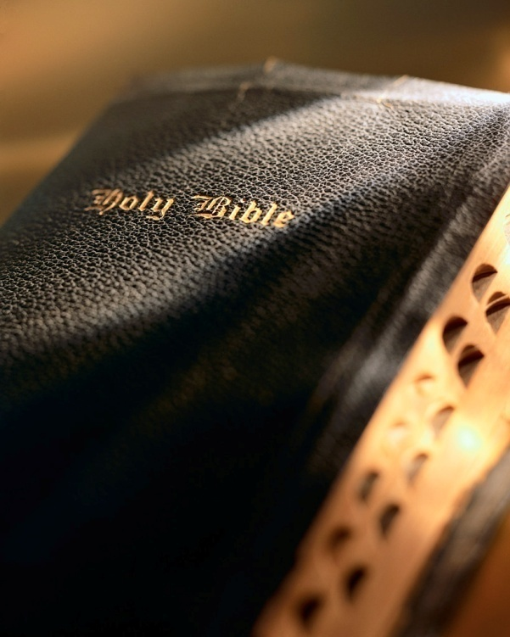

Slide 2
Introduction
We should obey the laws of the land “for the Lord’s sake”: 2 Pet. 2:13
Whatever we do “for the Lord’s sake,” we should also do “for our own sake.”
Most believe God is some kind of twisted, control freak. Not so! Rom. 6:21-22; Isa. 3:10-11; Deut. 6:24; Matt. 11:28-30; Jer. 29:11; 1 Jn. 5:3
All we are asked to do “for His sake,” is in our best interest!
For God's Sake and For Ours

Slide 3
For the Lord’s Sake and For Ours
www.westsidecoc.org
Colossians 1:9-14

Slide 4
Attend worship services
Why do you attend, or not attend, as regularly as you should? Psa. 95:6-7; Matt. 4:10; Jn. 4:24
Paul gives many good reasons to worship: Eph. 1:3, 4, 5, 6, 7, 11
God is the Creator and Sustainer of all physical and spiritual life: Col. 1:16-22
To not have a burning desire to worship Him is the height of apathy and ingratitude: Mal. 1:13
What about worshiping Him “for our own sake”?
To show we are not ingrates!
Respect for our brethren: Heb. 10:24-25
To remember the Lord’s sacrifice: 1 Cor. 11:26
To examine ourselves: 1 Cor. 11:28; Jas. 1:25
To mutually edify one another: Eph. 5:19
What will the lost think about the worship services they chose to miss?
Happy? Sad? Regret?
For God's Sake and For Ours

Slide 5
Choose a good mate
First criteria is to pick someone who meets the Lord’s criteria; i.e., “for the Lord’s sake”: Matt. 19:9
Many Christians make the mistake of using the “Matthew 19:9 test” as their only criteria.
Our choice in a mate should also be done in light of what is best for our own souls; i.e., “for our own sake”:
We should chose a mate that will be our closest friend and greatest ally in life!
A mate who is not just a Christian, but is totally committed to Christ!
Must also use the “Luke 9:23 test”!
For God's Sake and For Ours

Slide 6
Make good moral choices
We should make good moral choices that reflect spiritual-mindedness, “for the Lord’s sake”: Phil. 3:20; Titus 2:14; Rom. 8:5-8; 13:13-14
It should be part of our gratitude toward God for all He’s done for us: Matt. 6:33; 5:6; Rom. 12:11; 2 Cor. 5:9; Col. 1:9-10
But we also make these choices “for our own sake”:
“works of the flesh” vs. “fruit of the Spirit”: Gal. 5:19-26
The sake of our prayers: 1 Jn. 3:22
The sake of our children: 1 Tim. 4:12
The sake of our soul: 2 Cor. 5:9-11a
For God's Sake and For Ours

Slide 7
Oppose error
On of our missions “for the Lord’s sake” is to oppose error: Eph. 5:11; Jude 3-4; 1 Pet. 3:15
Like the faithful of all times; we must defend the truth “for the Lord’s sake”:
Noah: 2 Pet. 2:5; Gen. 6:3
Elijah: 1 Kgs. 18
Paul: Phil. 1:17; Gal. 2:5; 2 Tim. 4:7
But we must battle error “for our own sake”:
We can be led astray: Eph. 4:14; 2 Pet. 3:17
Protect the weak in the faith: Rom. 16:17-18
Protect the church: 1 Tim. 3:15; Eph. 4:4; Col. 1:21-22; Isa. 6:8-9a; Acts 20:27
For God's Sake and For Ours

Slide 8
Love others
“For the Lord’s sake” we are admonished to “let brotherly love continue”: Heb. 13:1
We are to love as He loved us: Jn. 13:34
We should also love the brethren “for our own sake”: Rom. 12:9
We imitate Christ: Phil. 2:1-5
We allow God to abide is us: 1 Jn. 3:17
We lay up treasure in heaven: Mk. 10:21
We become perfect like our Father in heaven: Matt. 5:43-48
For God's Sake and For Ours

Slide 9
CONCLUSION
Every decision we make should be “for the Lord’s sake.”
He is always our first priority: Matt. 6:33
But, everything done “for the Lord’s sake” is also in our own best interest! 1 Jn. 5:3; 2 Tim. 4:6-8; 1 Pet. 1:9
Are you pleasing the Lord by your life? Col. 1:10
For God's Sake and For Ours

