Slide 1
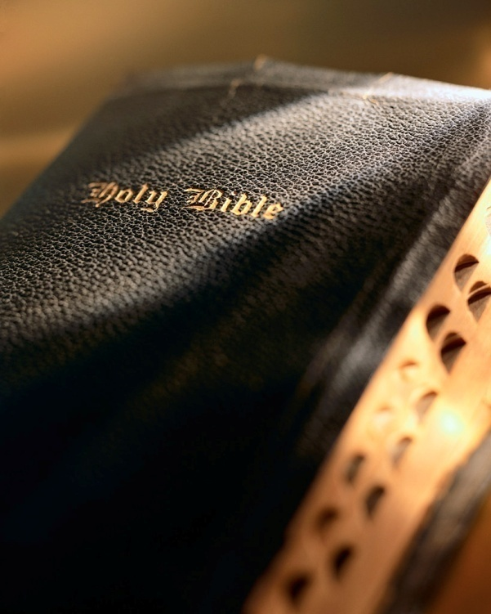

Slide 2
Introduction
Many passages in the Bible provide us with comfort and build our faith, trust and confidence in God: Jn. 3:16; 2 Pet. 1:3-4; Eph. 3:20
Some call these “refrigerator verses.”
We all could benefit by writing a key verse down on a piece of paper. Carry it with us. Read it often. Memorize it. Meditate on it.
“No temptation has overtaken you except such as is common to man; but God is faithful, who will not allow you to be tempted beyond what you are able, but with the temptation will also make the way of escape, that you may be able to bear it.”
1 Corinthians 10:13
No Temptation Has...

Slide 3
No Temptation Has…
www.westsidecoc.org
1 Corinthians 10:13

Slide 4
Temptation
We must remember:
Temptation is inevitable:
We are in the world, but not of the world: Jn. 17:14-15; 1 Jn. 2:15-17
Satan works 24/7, 365 days per year: 1 Pet. 5:8
Satan is smart: Eph. 6:11
Satan owns the world: 1 Jn. 5:19; 1 Jn. 3:10; Matt. 25:41; 2 Pet. 2:4; Jude 6
Satan forever plots and changes strategy: Lk. 4:13
Satan is no joke and can never be taken lightly!
No Temptation Has...

Slide 5
Temptation
We must remember:
Our temptations are not unusual:
It’s a temptation to think otherwise: 1 Cor. 10:13
Many have experienced what we experience: 1 Pet. 5:9
No personal “pity party”: Prov. 15:13; 17:22
No Temptation Has...

Slide 6
Temptation
We must remember:
Temptation serves a useful purpose:
Gain God’s approval: Jas. 1:12
Purify our faith: 1 Pet. 1:6-9
Build our hope: Rom. 5:3-4
No Temptation Has...

Slide 7
Temptation
We must remember:
We must be ready for temptation:
Inevitability and commonness demands readiness!
Must exercise “due diligence” insofar as temptation concerned:
Sobriety & diligence: 1 Pet. 5:8
Be “watchful”: 2 Tim. 4:5; 1 Pet. 4:7
Put up a fight: 1 Pet. 5:9; Jas. 4:7
Couple resistance w/obedience: Jas. 4:8; 1 Jn. 4:4
No “provision for the flesh”: Rom. 13:14
No Temptation Has...

Slide 8
Temptation
We must remember:
Never, ever underestimate Satan:
Satan had the courage to take on Jesus one-on-one: Matt. 4:1-11
Even though he failed, he didn’t give up: Lk. 4:13
No Temptation Has...

Slide 9
God is no respecter of persons
God is not our enemy! Ezek. 33:11; Rom. 8:32; Eccl. 7:29
God does not single us out regarding temptation: Jas. 1:13-15
Think! If God tempted us, He would be a cruel, sadistic monster. God forbid! Matt. 18:6
We are made of flesh and subject to temptations of the flesh: 1 Jn. 2:16
Despite our struggles we need to remember: 1) God is not “out for us,” 2) God doesn’t tempt us more than He does others (Rom. 8:32; Eph. 3:20; Psa. 84:11).
No Temptation Has...

Slide 10
God is faithful
Centerpiece of the verse: “God is faithful.”
We are used to men not keeping their word, but God ALWAYS keeps His word: Deut. 7:9
He is 100% totally and completely reliable: Lam. 3:23; 2 Thess. 3:3; 2 Tim. 2:13; Titus 1:2; Heb. 6:18
We take it for granted the sun rises every morning and sets every evening. Sometime that will cease.
But God has always been and always will be: Mal. 3:6; Heb. 13:8
No Temptation Has...

Slide 11
God is in control
Nobody enjoys chaos; everyone desires stability.
God does not tempt us; He is greater than the tempter and exercises authority over him: Jas. 1:13-15; Matt. 12:28-29; Job 1:11-12; 2:5-6
God allows temptation, but limits its degree: 1 Cor. 10:13
Satan is extremely powerful: Hitler, Stalin, Mao, 9/11
God is infinitely more powerful! Jn. 1:1-3; Heb. 11:3; Col. 1:16-17; Acts 2:24; Heb. 2:14; Matt. 12:29; 1 Cor. 15:26, 54
The power of the resurrection is available to us: Eph. 1:16-20; 1 Jn. 4:4
No Temptation Has...

Slide 12
God knows our limitation
The automaker or airplane manufacturer knows precisely the limitations of its product.
So it makes sense God, as our Maker, knows our limita-tions: Gen. 1:26-27
God allows temptation, but limits its degree: 1 Cor. 10:13
Example of Paul:
Multiple persecutions: 2 Cor. 11:24-27
Thorn in the flesh: 2 Cor. 12:7-10
God knows how much adversity we can handle and how much we need: 1 Pet. 1:6-7; Rom. 5:3; Jas. 1:2-3; 1:4
No Temptation Has...

Slide 13
God is our deliverer
No temptation beyond our ability to resist AND always a means of deliverance from every temptation.
We are fools to “go it alone”! Jer. 10:23; Prov. 14:12; Psa. 121
God is a great Deliverer!
Noah: Gen. 6-8; 1 Pet. 3:20
Lot: Gen. 19
Jews: Ex. 3:8; Ezra 9:13; Est. 4:14
Shadrach, Meshach and Abed-Nego: Dan. 3:17
Daniel: Dan. 6:22
No Temptation Has...

Slide 14
God is our deliverer
Peter uses Noah and Lot’s deliverance to make a critical point we must learn about temptation: 2 Pet. 2:4-9
God provides deliverance from every temptation, but we must:
Have enough faith to look for “the way of escape”: 1 Cor. 10:13
Have enough faith, courage, trust, and determination to take it!
We must look for and take “the way of escape”! How?
Knowledge of God’s Word: Matt. 4:1-11
Diligence in prayer: Matt. 26:36-46
Soberness, vigilance, watchfulness: 1 Pet. 5:8; Rom. 13:14
No Temptation Has...

Slide 15
CONCLUSION
God has given us so many “great and precious promises”: 2 Pet. 1:4
1 Corinthians 10:13 proffers one of God’s greatest promises.
Are you taking full advantage of God’s “great and precious promises”?
No Temptation Has...

