Slide 1
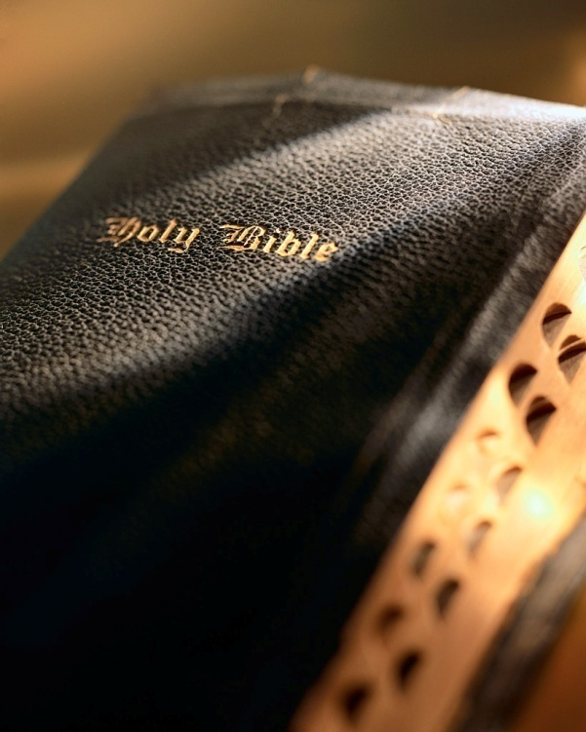

Slide 2
Today we continue studying the greatest
sermon by the greatest preacher…
Sermon
on the
Mount
Matthew 5-7

Slide 3
Introduction
Kingdom Righteousness
Matt. 5:20: For I say to you, that unless your righteous-ness exceeds the righteousness of the scribes and Pharisees, you will by no means enter the kingdom of heaven.
Jesus gives us several concrete examples of the superior righteousness required in His kingdom.
Jesus helps those with good and honest hearts (i.e., Matt. 5:3-6) to see themselves as God sees them.
Jesus gets to the “heart” of true righteousness for that is where it begins…the heart! Matt. 15:17-20
The Sermon on the Mount

Slide 4
Introduction
Religious righteousness…
Threats to kingdom righteousness:
Materialism
Trust
Charitable deeds done to glorify God and not ourselves (vv. 1-4)
Proper attitude in prayer; not to be seen of men; not to draw attention to ourselves (vv. 5-8)
Jesus’ gives us a model prayer (vv. 9-13)
He addresses our need to forgive others (vv. 14-15)
Fasting not to be seen of men; not to draw atten-tion to ourselves (vv. 16-18)
The Sermon on the Mount

Slide 5
Introduction
Kingdom Righteousness
Kingdom Righteousness
Matt. 5:20: For I say to you, that unless your righteous-ness exceeds the righteousness of the scribes and Pharisees, you will by no means enter the kingdom of heaven.
“poor in spirit” (5:3) | “mourn” (5:4)
“meek” (5:5) | “hunger and thirst for righteousness” (5:6)
“merciful” (5:7) | “pure in heart” (5:8)
“peacemakers” (5:9) | “persecuted for righteousness sake” (5:10)
Kingdom righteousness should challenge us to the core of our being.
Kingdom righteousness grows naturally out of the character traits required of all kingdom citizens; they are absolute and enduring requirements.
The Sermon on the Mount

Slide 6
Righteousness
of the
Kingdom
Matthew 6:19-34

Slide 7
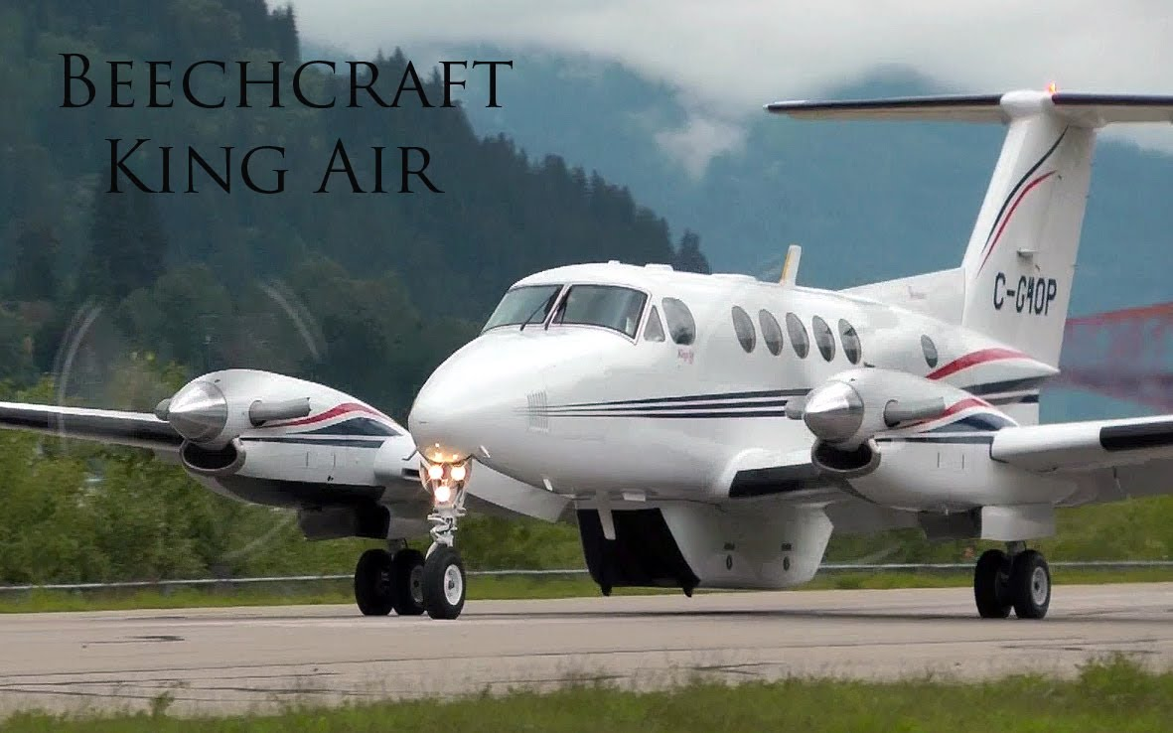
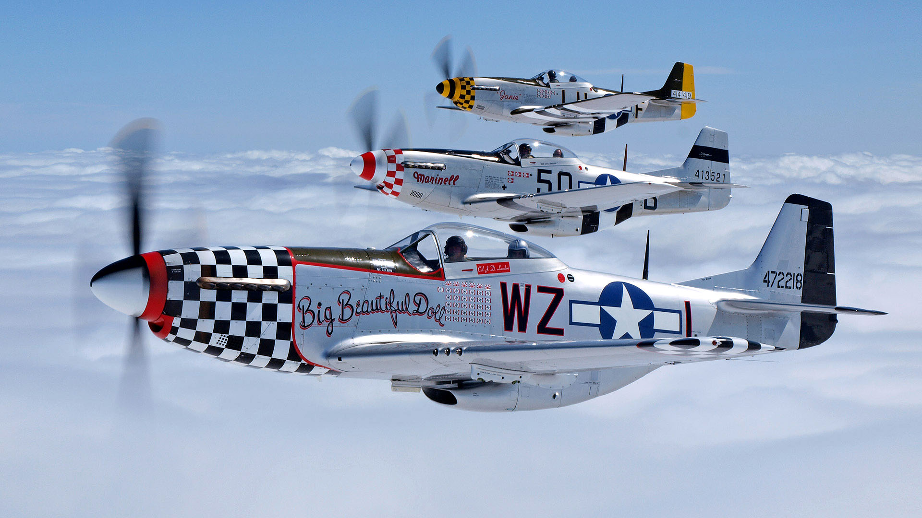
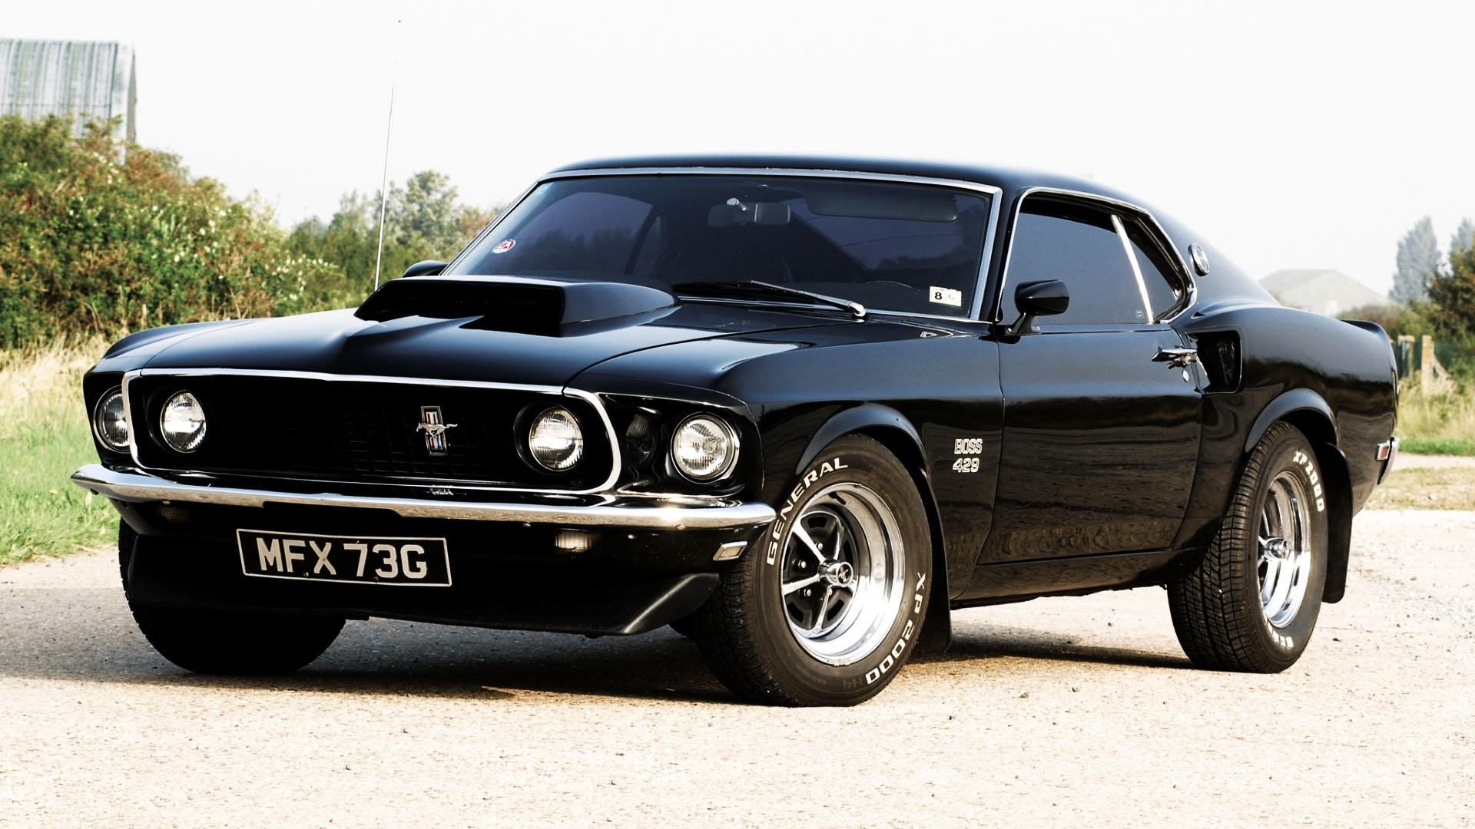
9. Materialism
Matthew 6:19-24
Kingdom citizens are to be different than people of the world:
We are in the world, but not of the world: Jn. 15:19; 17:14-15
We understand and appreciate the things of the world are temporary: 1 Jn. 2:15-17; 2 Pet. 3:10
But we still live in the flesh and in a society that puts a great deal of emphasis on material things.
The Sermon on the Mount

Slide 8
9. Materialism
Matthew 6:19-24
That’s why Jesus says: “Do not lay up for yourselves treasures on earth, where moth and rust destroy and where thieves break in and steal; 20 but lay up for yourselves treasures in heaven, where neither moth nor rust destroys and where thieves do not break in and steal.”
We are eternal beings: Eccl. 3:11
Material things are a major distraction: 6:21
It’s foolish to tether our heart’s devotion to the things of the earth: Lk. 12:15-21; Gen. 1:28ff; 1 Tim. 6:17-19; Eccl. 9:9
The Sermon on the Mount

Slide 9
9. Materialism
Matthew 6:19-24
“It is foolish for a disciple to tether his heart’s devotion to the things of the earth.” (Smith, p. 60)
Earthly possessions don’t last: 6:19-20
Love of “things” leads to temptation: 1 Tim. 6:10
Earthly treasure inherently incapable of satisfying our deepest need: Eccl. 5:10
We can only enjoy so much earthly treasure, hence, its pursuit is vanity: Eccl. 5:11
We can’t “take it with us,” someone will inherit our earthly possessions: Eccl. 5:15; 2:18-19
The Sermon on the Mount

Slide 10
9. Materialism
Matthew 6:19-24
To emphasize material things is spiritually deadly!
Our emphasis in life reveals the true nature of our “heart”: 6:21
“The one great thing we have to invest in life is our life…” Lk. 9:24-25
Jesus’ figure of the “eye” emphasizes the danger of a heart focused on the material: 6:22-23
To have a “good” eye is to have a heart set on heaven, an understanding that one’s life should be prioritized on the things of God.
The Sermon on the Mount

Slide 11
9. Materialism
Matthew 6:19-24
To emphasize material things is spiritually deadly!
A “single eye” understands material things are a means to an end, not an end in and of themselves.
Material things serve us as we serve God, and we use them to help others: v. 33; Eph. 4:28; 1 Jn. 3:17
The “bad eye” describes a heart that pursues earthly treasure to the hurt of spiritual needs.
To pursue the earthly to the detriment of the spiritual means our “eye” is focused on the wrong thing. It blocks the light from entering our soul! v. 23
The Sermon on the Mount

Slide 12
9. Materialism
Matthew 6:19-24
“Mammon, n. The god of the world’s leading religion.”
“the Almighty Dollar”
Unforgettable verse emphasizing Jesus’ point about the dangers of materialism: ”No one can serve two masters; for either he will hate the one and love the other, or else he will be loyal to the one and despise the other. You cannot serve God and mammon.” 6:24
“…an old Aramaic word that meant wealth, property, or riches. These things can become the treasure of a person’s life and thus gain control of his heart’s affection. In Colossians 3:5 Paul equates this attitude with idolatry!” (Smith, p. 61)
He says we “cannot” serve two masters. Not that we “shouldn’t,” not that we “must not.” We “cannot,” it’s an impossibility!
What is “mammon” ?
The Sermon on the Mount

Slide 13
9. Materialism
Matthew 6:19-24
Marching Orders:
God | Mammon
Walk by faith | Walk by sight
Poor in spirit | Haughty in spirit
Affections in heaven | Affections on earth
Look to the unseen | Look to the visible
Share with others | Hoard for self
Citizenship in heaven | Citizenship on earth
Pursue the eternal | Pursue the temporal
Self-less | Self-centered
The Sermon on the Mount

Slide 14
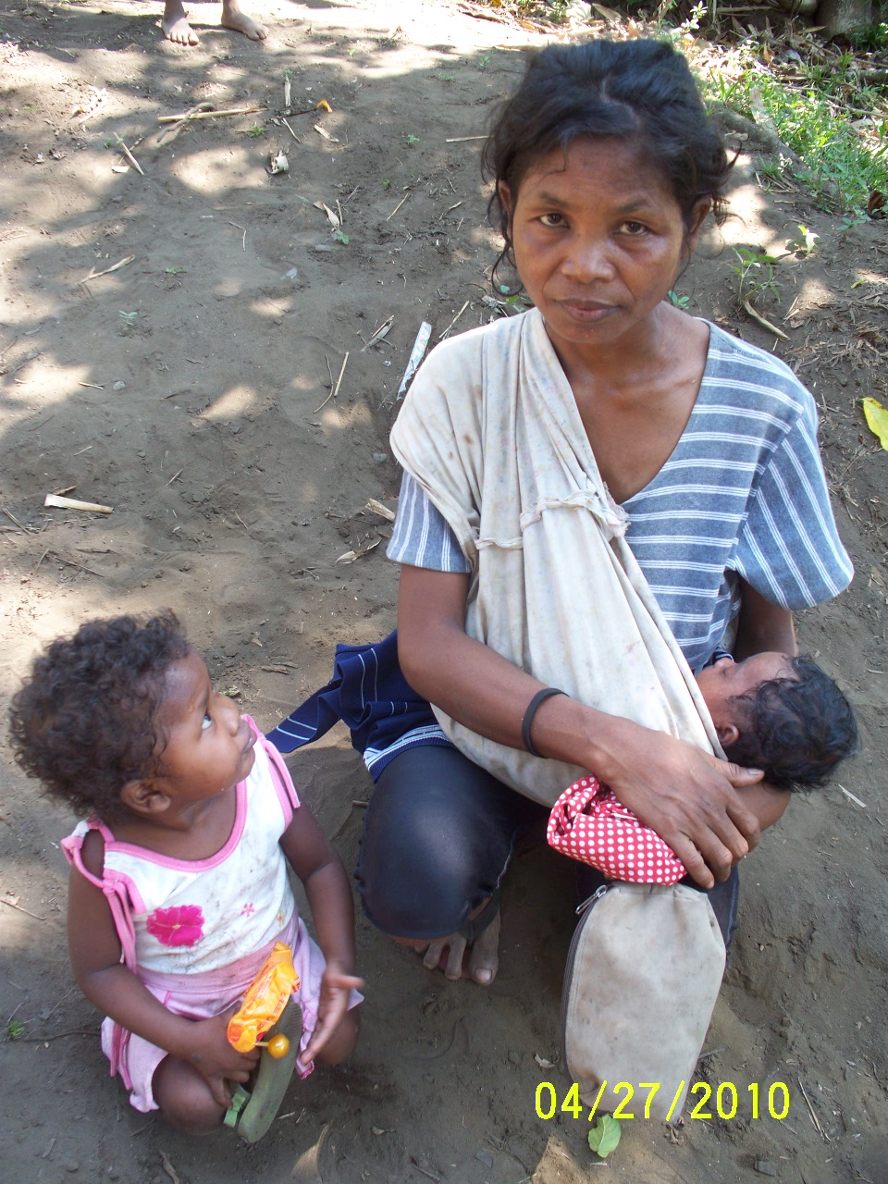
9. Materialism
Matthew 6:19-24
Impossible to meet God’s standards while pursuing the demands of the world: Jas. 4:4
“There is an ‘Armageddon’ going on under the hat of every man—a crucial and decisive battle for the ultimate control of the heart! Anyone who divides allegiance between God and mammon has already given in to mammon as Jehovah can only be served with entire devotion (Matt. 10:37-39; 16:24-26; 22:37).” (Smith, p. 62)
“The one great thing we have to invest in life is our life…”
Chumbley, p. 128
“I’m not rich! I can’t possibly be serving mammon!”
It’s easy to get caught up by material things.
We don’t have to be rich to have a problem with “mammon.”
We can never forget who we are and where we are going! Heb. 11:13-16
The Sermon on the Mount

Slide 15
Lord willing, we’ll finish Matthew 6 next week.

Slide 16
10. Trust
Matthew 6:25-34
Jesus begins this section with a key word: “therefore”:
“Therefore I say unto you, do not worry about your life, what you will eat or what you will drink; nor about your body, what you will put on. Is not life more than food and the body more than clothing?”
Our focus on material things, even on the neces-sities of life, can easily turn legitimate concern into anxious worry indicating a lack of trust and confidence in God.
The Sermon on the Mount

Slide 17
10. Trust
Matthew 6:25-34
Worry is the favorite pastime of many, but it is fraught with dangers. It takes a severe toll, both physically and spiritually.
“Worry is faith in the negative, trust in the unpleasant, assurance of disaster and belief in defeat…wasting today’s time to clutter up tomorrow’s opportunities with yesterday’s troubles.” (Smith, p. 69)
The Sermon on the Mount

Slide 18
10. Trust
Matthew 6:25-34
Jesus gives us four reasons not to be anxious over the necessities of life.
God’s providential care: vv. 26-30; Matt. 7:11
Worry is unproductive: v. 27; 2 Thess. 3:10
Worry is paganistic: v. 32; Phil. 4:6; 1 Pet. 5:7; Eph. 3:20
Worry is needless: v. 32; Heb. 13:5
The Sermon on the Mount

Slide 19
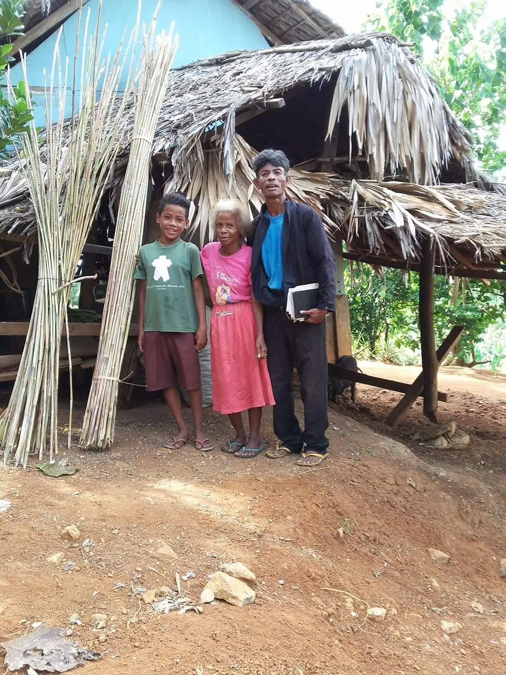
10. Trust
Matthew 6:25-34
We are tools of God’s providence.
1 John 3:17
Matthew 25:31-46
Are you a “sheep” or a “goat”?
To reach heaven we must suppress our material desires so they serve only our spiritual needs.
By “seeking the kingdom,” Jesus goes far beyond attending services on Sunday or even being “a member of the Lord’s church.” cf. Lk. 17:21; Matt. 5:5; 6:10; Rom. 14:17-18
To“seek first the kingdom of God and His right-eousness” is ‘all or nothing,’ it requires our undivided loyalty and faithful obedience.
Otherwise we have no expectation of God’s providential care.
The Sermon on the Mount

Slide 20
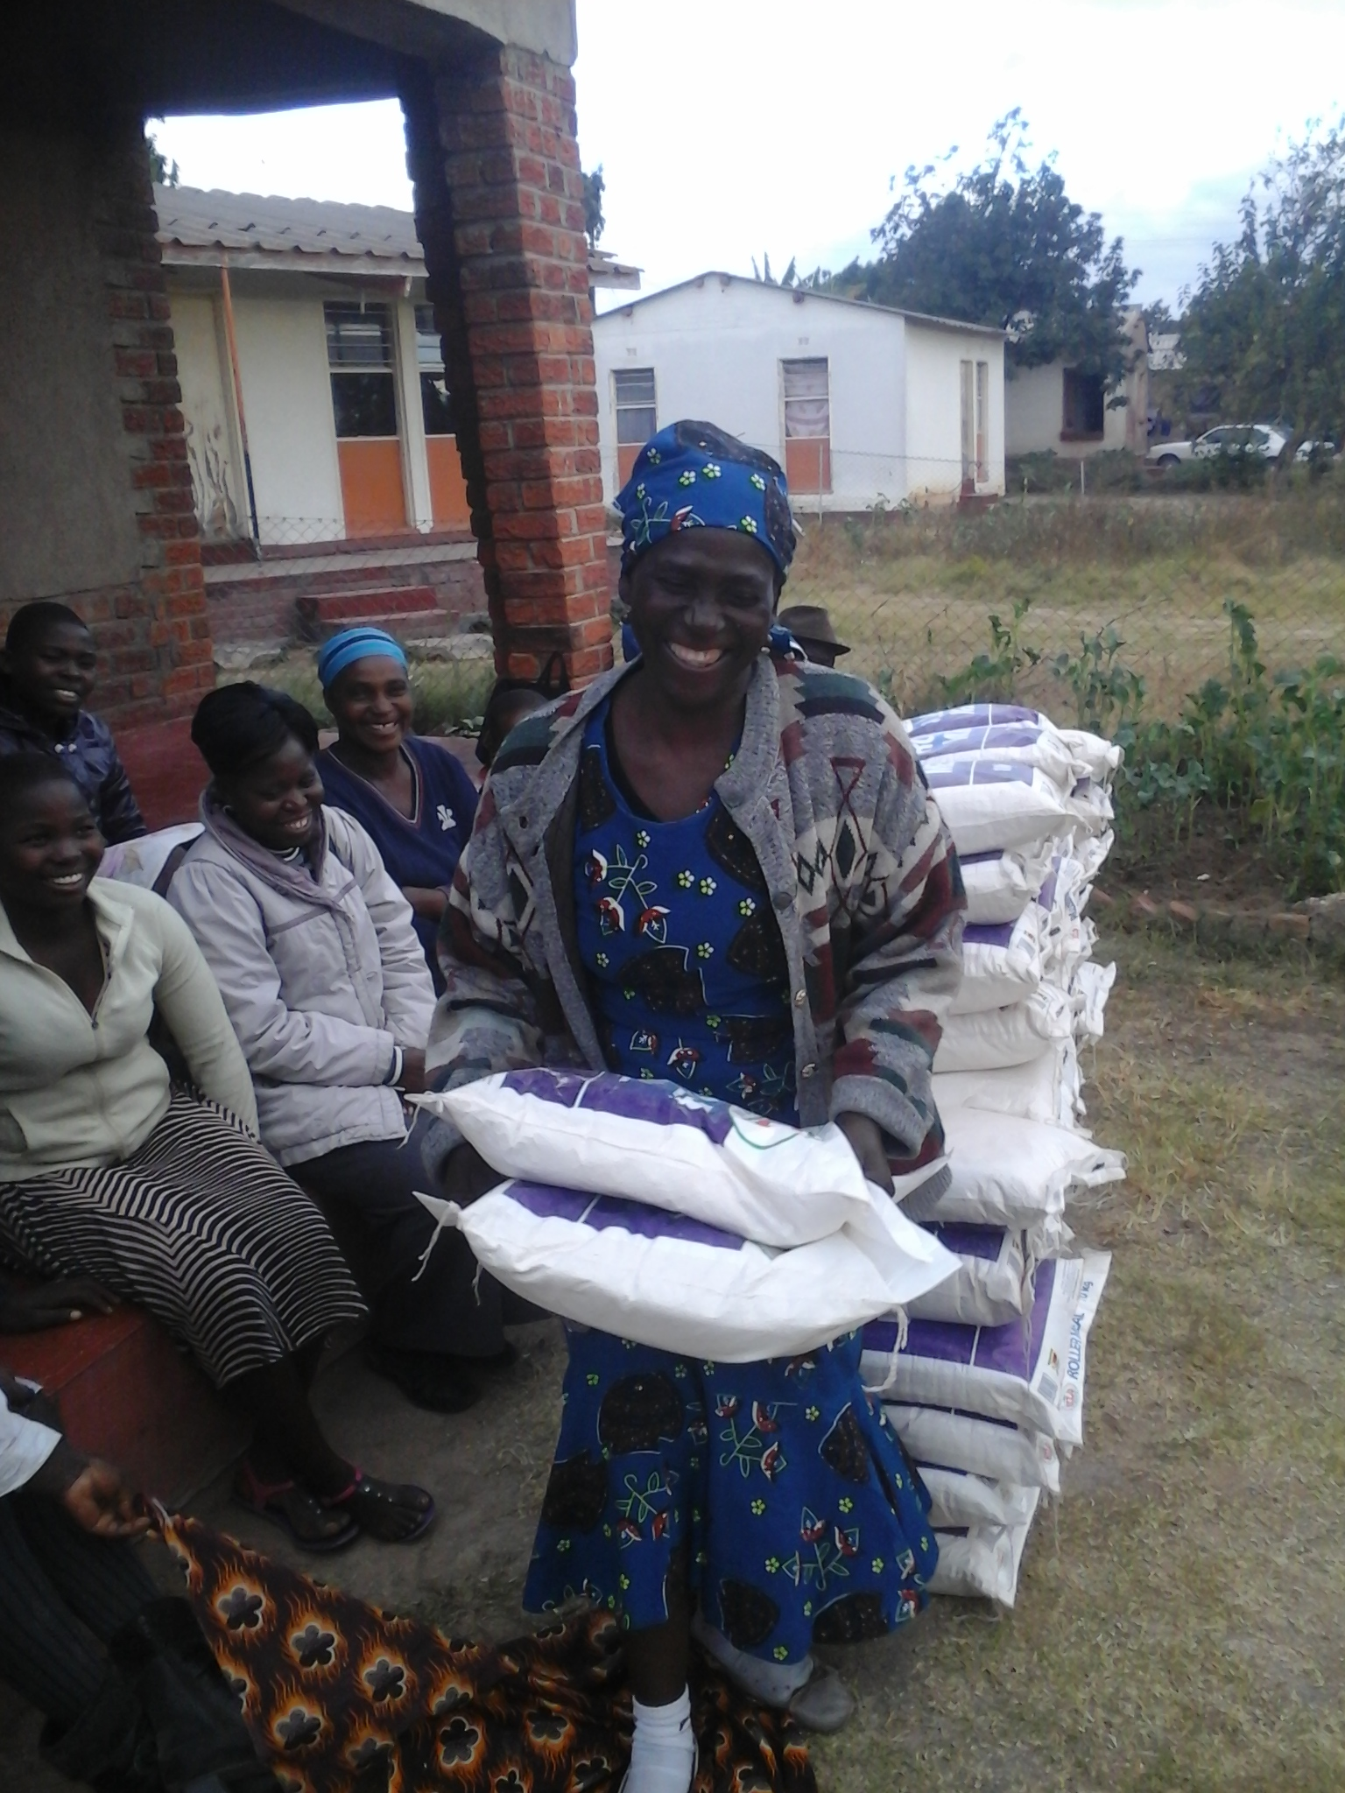
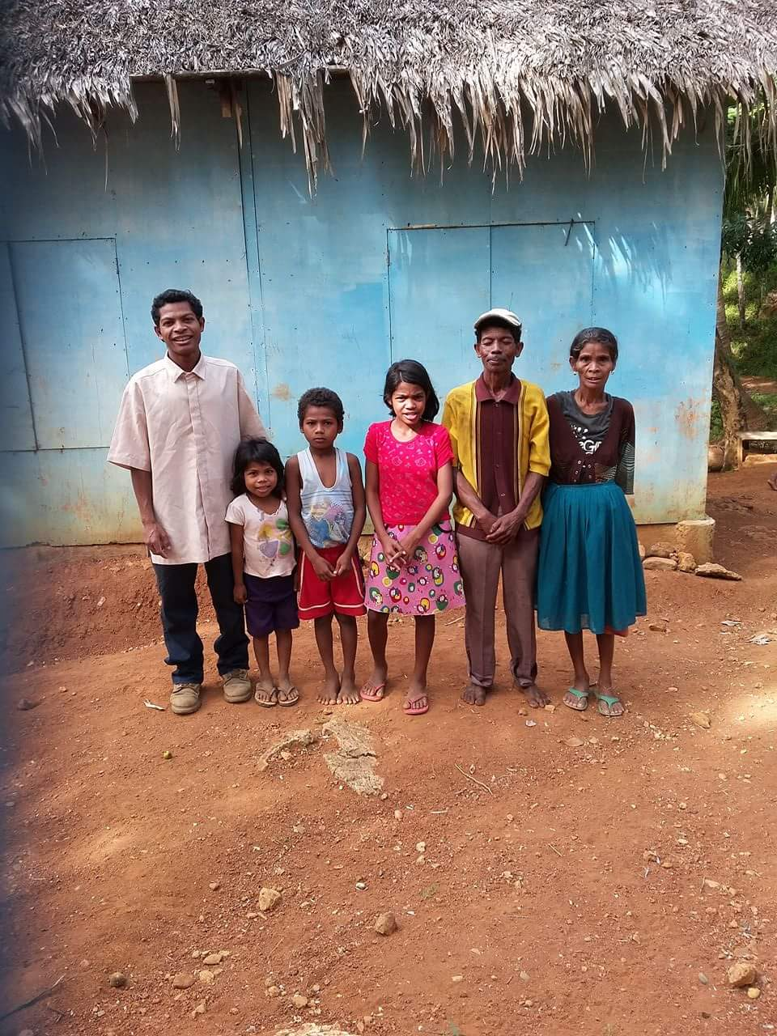
10. Trust
Matthew 6:25-34
You will never regret getting involved in helping the needy: Acts 20:35
The Lord requires it: 1 Jn. 3:17; Matt. 25:31-46
The Lord appreciates it: Prov. 19:17; Isa. 58:7-8; 1 Tim. 6:17-19
“Oh, Paul is describing someone else, not me.”
“If you can’t feed a hundred people, then feed just one.” —Mother Teresa
Acts 20:35
Acts 20:35
The Sermon on the Mount
Acts 20:35

Slide 21
10. Trust
Matthew 6:25-34
Jesus ends with a practical command:
“Therefore do not worry about tomorrow, for tomorrow will worry about its own things. Sufficient for the day is its own trouble.”
God makes this guarantee because He loves us and wants our minds and energy free to “seek first the kingdom of God and His righteousness.”
“Today is the tomorrow we worried about yesterday. Each day that passes proves the worry for the previous day was unnecessary.”
The Sermon on the Mount

Slide 22
“One major thing wrong with being anxious ‘for the morrow’ is that ‘Anxiety focuses on the future (‘the morrow’) to the detriment of the present. To counter this we must ‘acquire the art of living one day at a time’ (Barclay, I, 261). Worry cannot solve tomorrow’s problems, but it can compound today’s by draining the spiritual and emotional resources needed to tackle present difficulties. …So don’t borrow trouble. ‘Today’s trouble is enough for today’ (NRSV). Things are bad enough as they are; don’t add to your present stress by anticipating future problems (Lam. 3.22-23).” (Chumbley, p. 132)

Slide 23
Conclusion
Lord willing, we will continue our study on the Sermon on the Mount.
What is your investment in life?
Christ’s teaching here is a clear challenge for us to examine our level of devotion to God.
Where is my treasure? In heaven, or on earth?
Is my life consistent with my claim?
I may fool you, but I will never fool God: Gal. 6:7
“The one great thing we have to invest in life is our life.” Lk. 9:24-25
The Sermon on the Mount

