Slide 1
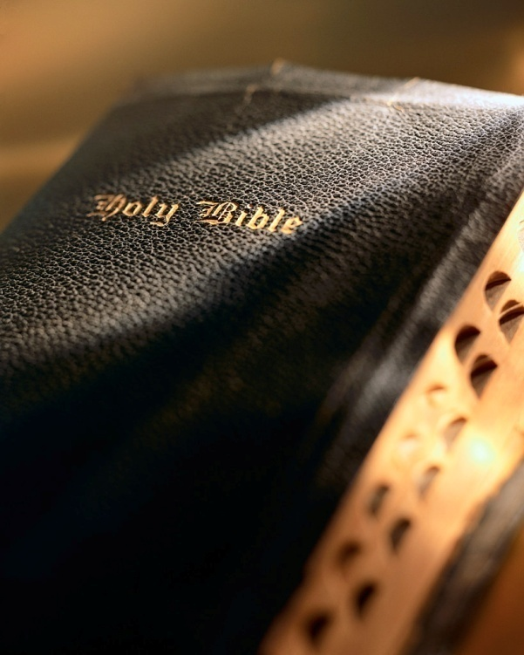

Slide 2
Introduction
God expects His people to make a difference in the world: Matt. 5:13, 14-16; Phil. 2:15
There are so many worthy saints in the Bible who set a good example:
Enoch: Gen. 5:24; Heb. 11:5
Noah: Gen. 6:8; Heb. 11:7
Abraham: Rom. 4:3; Heb. 11:16
Joseph: Gen. 39:8-9; Heb. 11:22
David: 1 Sam. 13:14
Esther: Est. 4:14
Nehemiah: Neh. 1:4
Peter: Mk. 14:72
Paul: 1 Tim. 1:15

Slide 3
Introduction
The ultimate example for us to follow is our Lord Jesus Christ: Rom. 8:29
We are instructed to “put” Him on, follow His example: Rom. 13:14
If we remain faithful to His example, we have a glorious fate! Phil. 3:21

Slide 4
Conformed
to the Image
of Christ
Romans 8:28-30

Slide 5
Conformed to the Image of Christ
Obeyed His parents : Lk. 2:42, 51; Eph. 6:1
Was baptized : Lk. 3:21; Matt. 3:15-16; Acts 2:38; 1 Pet. 2:22; Mk. 16:16; Gal. 3:27
Resisted the Devil : Lk. 4:1-13; 1 Jn. 2:16; Psa. 119:11; Jas. 4:7-8
Taught and preached : Lk. 4:15, 32; 8:1; Acts 8:4; 1 Thess. 1:8
Read the Scriptures : Lk. 4:16; 1 Tim. 4:13; 2 Tim. 3:16-17; Eph. 4:3; Rev. 1:3; Rom. 1:16
Fulfilled the Scriptures : Lk. 4:16ff; Isa. 61:1-2; Lk. 4:21; Matt. 1:22; Lk. 24:44

Slide 6
Conformed to the Image of Christ
Cast out devils : Lk. 4:31-46; 16:28-30, 33-36; 2 Cor. 10:4-5; 2:16
Healed the sick : Matt. 8:14-15; Lk. 4:38-40
Prayed : Lk. 5:16; Matt. 14:23; Lk. 6:12; 1 Thess. 5:17; Matt. 6:9-13; Lk. 18:8
Chose twelve apostles : Lk. 6:12-13; 9:1-2
Forgave sins : Lk. 5:20-24; 7:37-38, 48; Matt. 9:2; Jn. 5:14; 8:11; Eph. 4:32; Col. 3:13; Matt. 6:14-15

Slide 7
Conformed to the Image of Christ
Raised the dead : Eph. 2:1; Jas. 5:19-20
Widow of Nain’s son : Lk. 7:11-16
Jairus’ daughter : Matt. 9:18-19
Lazarus : Jn. 11:1-44
Calmed the storm : Matt. 8:23-27; Lk. 8:23-24; 2 Cor. 1:3-4; Gal. 6:2
Fed the multitudes : Matt. 14:13-21; 15:32-39; Lk. 9:17; Mk. 8:8; 1 Jn. 3:17

Slide 8
Conformed to the Image of Christ
Gave thanks : Jn. 6:11, 23; Matt. 15:36; Lk. 22:17; Matt. 11:25; Jn. 11:41; 1 Thess. 5:18; Eph. 5:20; Phil. 4:6; Col. 3:17; Heb. 13:15; Jas. 1:17; Rom. 1:21; Psa. 107:31
Was transfigured : Matt. 17:1-5; Lk. 9:28-35; 2 Pet. 1:17; Heb. 1:1-3; Matt. 28:18-20; 5:16; 1 Pet. 2:12
Wept : Lk. 19:41-44; Matt. 24:21-22; Jn. 11:35-36; Matt. 1:23; 9:36; Prov. 19:17; Heb. 13:16; Jn. 4:35
Cast some out of the temple : Jn. 2:13-22; Matt. 21:13; Jn. 2:17; Lk. 19:47; Jn. 3:19-21; 2 Cor. 2:16

Slide 9
Conformed to the Image of Christ
The Father’s will : Lk. 22:42; Matt. 26:38-44
Spoke in parables : Matt. 13:10-17; 2 Cor. 8:9; Matt. 16:25
Walked on water : Matt. 14:22-33; Jn. 6:21; Matt. 14:30-32; Eph. 3:20
Forgave His enemies : Lk. 23:34; Matt. 5:11-12, 43-48; 2 Cor. 2:16
Gave Himself for us : Titus 2:14; 1 Tim. 2:6; Rom. 5:8; Phil. 2:17; 2 Cor. 12:15; Phil. 2:3-9
Rose from the grave : 1 Cor. 15:4; Rom. 1:4; Matt. 16:18; Acts 2:36; Heb. 12:2; 1 Cor. 15; Phil. 2:5-11

Slide 10
Conformed to the Image of Christ
Appeared : Mk. 16:9, 12, 14; 1 Cor. 15:5-8; Acts 1:3; Lk. 1:3-4; 2 Pet. 1:16
Ascended to heaven : Lk. 24:51; Acts 1:9; 1 Thess. 4:16-17; Matt. 25:21; 2 Tim. 4:8; Rev. 21:4
Sat down on the right hand of God : Heb. 1:3; 10:12; Acts 2:33; Rom. 8:17; Col. 1:21-23
Set a good example : Jn. 13:15; 1 Pet. 2:21; Phil. 3:10; Rom. 8:29; Phil. 3:21

Slide 11
Conclusion
This topic is almost endless: Jn. 21:25
Peter expressed all Jesus did in four short words, He “…went about doing good…” : Acts 10:38
Let us be determined to follow His example, if we do, we’ll receive the same eternal glory! Phil. 3:21

