Slide 1
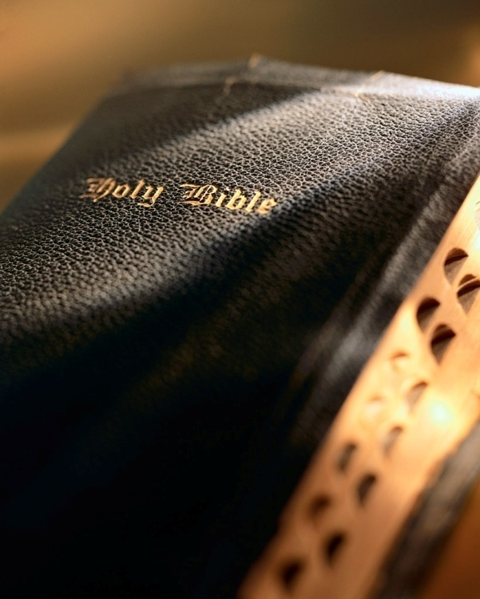

Slide 2
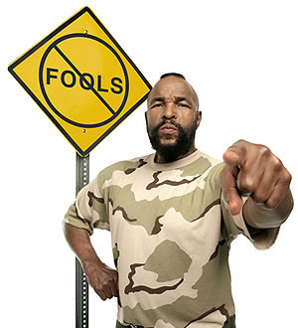
“Acting A Fool”

Slide 3
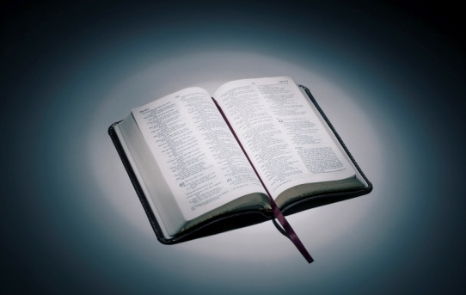
◆ The Fool Says There Is No God
Psalm 10:4
The wicked, through the pride of his countenance, will not seek after God: God is not in all his thoughts.
Psalm 14:1
The fool hath said in his heart, There is no God. They are corrupt, they have done abominable works, there is none that doeth good.
Genesis 1:1
In the beginning God created the Heaven and the earth.
“Acting A Fool”

Slide 4
◆ The Fool Says There Is No God
Acts 17:28
For in him we live, and move, and have our being; as certain also of your own poets have said, For we are also his offspring.
Psalm 19:1
The heavens declare the glory of God; and the firmament sheweth his handywork.
Romans 1:20
For the invisible things of him from the creation of the world are clearly seen, being understood by the things that are made, even his eternal power and Godhead; so that they are without excuse.
“Acting A Fool”

Slide 5
◆ The Fool Says There Is No God
Genesis 2:7
And the Lord God formed man of the dust of the ground, and breathed into his nostrils the breath of life; and man became a living soul.
Genesis 1:26-27
²⁶And God said, Let us make man in our image, after our likeness: and let them have dominion over the fish of the sea, and over the fowl of the air, and over the cattle, and over all the earth, and over every creeping thing that creepeth upon the earth. ²⁷So God created man in his own image, in the image of God created he him; male and female created he them.
“Acting A Fool”

Slide 6
◆ The Fool Says There Is No God
Ecclesiastes 12:7
Then shall the dust return to the earth as it was: and the spirit shall return unto God who gave it.
Matthew 25:46
And these shall go away into everlasting punishment: but the righteous into life eternal.
“Acting A Fool”

Slide 7
❖ The Fool Leaves God Out of His Plans
Luke 12:15-20
¹⁵And he said unto them, Take heed, and beware of covetousness: for a man's life consisteth not in the abundance of the things which he possesseth. ¹⁶And he spake a parable unto them, saying, The ground of a certain rich man brought forth plentifully: ¹⁷And he thought within himself, saying, What shall I do, because I have no room where to bestow my fruits? ¹⁸And he said, This will I do: I will pull down my barns, and build greater; and there will I bestow all my fruits and my goods. ¹⁹And I will say to my soul, Soul, thou hast much goods laid up for many years; take thine ease, eat, drink, and be merry. ²⁰But God said unto him, Thou fool, this night thy soul shall be required of thee: then whose shall those things be, which thou hast provided?
“Acting A Fool”

Slide 8
❖ The Fool Leaves God Out of His Plans
Matthew 6:19-21
¹⁹Lay not up for yourselves treasures upon earth, where moth and rust doth corrupt, and where thieves break through and steal: ²⁰But lay up for yourselves treasures in heaven, where neither moth nor rust doth corrupt, and where thieves do not break through nor steal: ²¹For where your treasure is, there will your heart be also.
Luke 12:21
So is he that layeth up treasure for himself, and is not rich toward God.
“Acting A Fool”

Slide 9
⬥ The Fool Does Not Study His Bible
Ephesians 5:17
Wherefore be ye not unwise, but understanding what the will of the Lord is.
Proverbs 3:13
Happy is the man that findeth wisdom, and the man that getteth understanding.
Proverbs 18:2
A fool hath no delight in understanding, but that his heart may discover itself.
“Acting A Fool”

Slide 10
⬥ The Fool Does Not Study His Bible
Jeremiah 4:22
For my people is foolish, they have not known me; they are sottish children, and they have none understanding: they are wise to do evil, but to do good they have no knowledge.
2 Timothy 2:15
Study to shew thyself approved unto God, a workman that needeth not to be ashamed, rightly dividing the word of truth.
“Acting A Fool”

Slide 11
 The Fool Despises His Father Instructions
Proverbs 15:5
A fool despiseth his father's instruction: but he that regardeth reproof is prudent.
Ephesians 6:1-3
¹Children, obey your parents in the Lord: for this is right. ²Honour thy father and mother; (which is the first commandment with promise;) ³That it may be well with thee, and thou mayest live long on the earth.
“Acting A Fool”

Slide 12
 The Fool Trusts In His Own Heart
Proverbs 28:26
He that trusteth in his own heart is a fool: but whoso walketh wisely, he shall be delivered.
Proverbs 21:2
Every way of a man is right in his own eyes: but the Lord pondereth the hearts.
Isaiah 55:8-9
⁸For my thoughts are not your thoughts, neither are your ways my ways, saith the Lord. ⁹For as the heavens are higher than the earth, so are my ways higher than your ways, and my thoughts than your thoughts.
“Acting A Fool”

Slide 13
 The Fool Trusts In His Own Heart
Proverbs 14:12
There is a way which seemeth right unto a man, but the end thereof are the ways of death.
Jeremiah 10:23
O Lord, I know that the way of man is not in himself: it is not in man that walketh to direct his steps.
“Acting A Fool”

Slide 14
 The Fool Gets Angry Too Easily
Ecclesiastes 7:9
Be not hasty in thy spirit to be angry: for anger resteth in the bosom of fools.
James 1:19-20
¹⁹Wherefore, my beloved brethren, let every man be swift to hear, slow to speak, slow to wrath: ²⁰For the wrath of man worketh not the righteousness of God.
“Acting A Fool”

Slide 15
 The Fool Gets Angry Too Easily
Ephesians 4:26, 31
²⁶Be ye angry, and sin not: let not the sun go down upon your wrath...³¹Let all bitterness, and wrath, and anger, and clamour, and evil speaking, be put away from you, with all malice.
“Acting A Fool”

Slide 16
 The Fool Talks Too Much
Ecclesiastes 5:2-3
²Be not rash with thy mouth, and let not thine heart be hasty to utter any thing before God: for God is in heaven, and thou upon earth: therefore let thy words be few. ³For a dream cometh through the multitude of business; and a fool's voice is known by multitude of words.
Proverbs 17:27-28
²⁷He that hath knowledge spareth his words: and a man of understanding is of an excellent spirit. ²⁸Even a fool, when he holdeth his peace, is counted wise: and he that shutteth his lips is esteemed a man of understanding. (cf. Job 32:7; 12:12-13)
“Acting A Fool”

Slide 17
 The Fool Hears The Word But Does It Not
Matthew 7:24-27
²⁴Therefore whosoever heareth these sayings of mine, and doeth them, I will liken him unto a wise man, which built his house upon a rock: ²⁵And the rain descended, and the floods came, and the winds blew, and beat upon that house; and it fell not: for it was founded upon a rock. ²⁶And every one that heareth these sayings of mine, and doeth them not, shall be likened unto a foolish man, which built his house upon the sand: ²⁷And the rain descended, and the floods came, and the winds blew, and beat upon that house; and it fell: and great was the fall of it.
“Acting A Fool”

Slide 18
 The Fool Hears The Word But Does It Not
James 1:23-25
²³For if any be a hearer of the word, and not a doer, he is like unto a man beholding his natural face in a glass: ²⁴For he beholdeth himself, and goeth his way, and straightway forgetteth what manner of man he was. ²⁵But whoso looketh into the perfect law of liberty, and continueth therein, he being not a forgetful hearer, but a doer of the work, this man shall be blessed in his deed.
“Acting A Fool”

