Slide 1
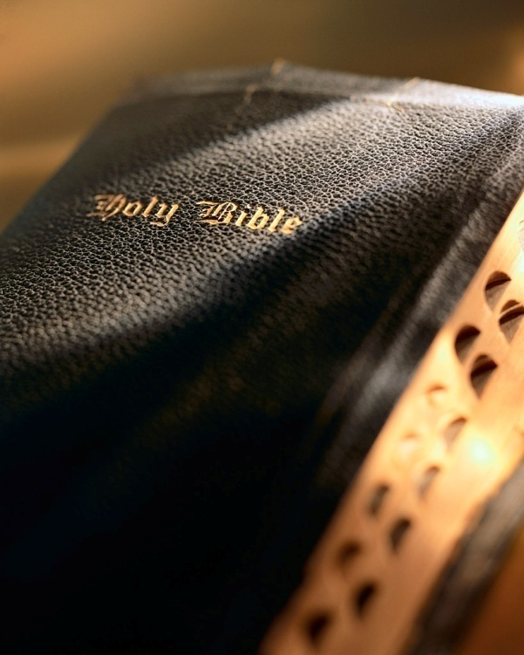

Slide 2
Introduction
Jehoshaphat:
Fourth king of Judah; reigned 25 years: 1 Kgs. 22:41
Son of Asa, contemporary of Ahab: 1 Kgs. 22:41
He was mostly a ‘good’ king:
Did “what was right in the eyes of the Lord”: 1 Kgs. 22:43
Banished “the perverted persons”: 1 Kgs. 22:46
Brought peace to Judah and built forts: 1 Chr. 17:12
Made significant religious reforms: 1 Chr. 17:9; 2 Chr. 20:1-30

Slide 3
Introduction
He wasn’t perfect:
Allied with wicked king Ahab: 1 Kgs. 22:44, 48; 1 Chr. 18:1
Religious reforms did not stick: 1 Kgs. 22:43; 2 Chr. 17:6; 20:33
Overall God was pleased with him:
2 Chr. 17:3-6: “Now the Lord was with Jehoshaphat, because he walked in the former ways of his father David; he did not seek the Baals, 4 but sought the God of his father, and walked in His commandments and not according to the acts of Israel. 5 Therefore the Lord established the kingdom in his hand; and all Judah gave presents to Jehoshaphat, and he had riches and honor in abundance. 6 And his heart took delight in the ways of the Lord…”

Slide 4
Delight 2 Chronicles 17:1-6

Slide 5
1. Broken heart: Psa. 51:16-17
For many years I was naïve about teaching people the gospel:
Does the Lord delight in your heart?
“receive with meekness the implanted word, which is able to save your souls”
—James 1:21
It is just a matter of the right “presentation.”
It just requires a bit of “massaging the message.”
People are impervious to the gospel if their heart is not broken! Rom. 1:16-17
Jesus told us this in the beatitudes: Matt. 5:3-5
Jesus told us this in the parable of the ‘sower and the seed’: Lk. 8:11-15
God has always required a broken heart: Isa. 66:2
Delight

Slide 6
2. Obedience: 1 Sam. 15:22-23
Obedience naturally flows from one who:
Is “of a contrite spirit, and…trembles at My word” : Isa. 66:2
Is “poor in spirit”; “mourn [s]” over sin; who “receive[s] with meekness the implanted word” : Matt. 5:3-5; Jas. 1:21
We know the bullheadedness of the Israelites: Num. 14; Jer. 11:11; Ezek. 3:7; Jn. 8:43; Matt. 23:37-38
You and I would never make that mistake! 1 Jn. 2:3-6
Is obedience on your conscious mind? Psa. 119:15-16; Phil. 4:8-9
We will not consistently obey without making a conscious, determined effort: 2 Pet. 1:10-11; Matt. 7:13-14
Delight

Slide 7
3. Honesty: Prov. 11:1; 12:22; 16:13
Honesty in the obvious:
Lying, cheating, stealing, etc.
Easy to rationalize cutting corners when everyone else is doing it (e.g., cheating on income taxes).
We must be honest in all things, at all cost: Rom. 12:17; 2 Cor. 8:21; 1 Pet. 2:12
We must be honest with ourselves in our personal relationship with God: Gal. 6:3-4; Jas. 1:22; Gal. 6:7
Delight

Slide 8
4. Prayers: Prov. 15:8
We all know we need to pray more, but do we?
The Bible tells us to “pray without ceasing” ; do we even pray at least once a day? 1 Thess. 5:17
~25 prayers of Jesus are recorded in the gospels.
Just imagine: The Creator and Sustainer of the Universe wants to communicate with YOU! Heb. 4:15-16
Let’s all “delight” God by praying more, with more faith: Jas. 1:5-6
Delight

Slide 9
5. Sincere worship: Isa. 1:11
The Lord cured Israel’s idolatry in “the furnace of affliction” : Isa. 48:10
It didn’t cure them of taking the Lord for granted: Mal. 1:6-10
We need to take advantage of every oppor-tunity to worship God and “delight” in it! 2 Pet. 3:9; Jas. 4:14
Delight

Slide 10
5. Sincere worship: Isa. 1:11
Some things I should consider when worshiping:
Life’s most important activity & greatest privilege: Matt. 22:37
I am a participant, not a spectator: Eph. 5:19
God’s magnificence: Psa. 29:2
Our basic relationship with Him: Psa. 95:6
No casual attitude: Psa. 96:9
Recognizing His holiness: Psa. 99:9; Matt. 18:20
He is our life-giver and sustainer: Acts 17:25, 29
Delight

Slide 11
5. Sincere worship: Isa. 1:11
So much more could be said.
If worship here and now doesn’t “trip my trigger”; why would I ever think I would be happy in heaven? Rev. 5:1-14
If I don’t worship Him now with joy; the time will come when I will be forced to worship Him in sorrow and shame: Phil. 2:9-11
Delight

Slide 12
6. Hope: Psa. 147:10-11
Hope is the “anchor of the soul” : Heb. 6:19-20
Gives us courage to press on despite pain and sorrow: Psa. 31:24; 2 Cor. 4:16-18
Gives us reason to rejoice: Rom. 5:1-2
Gives us no disappointment: Rom. 5:3-5
“For we through the Spirit eagerly wait for the hope of righteousness by faith” : Gal. 5:5
Delight

Slide 13
6. Hope: Psa. 147:10-11
What is “the hope of the righteousness by faith” ?
The “hope of His calling” : Eph. 1:18
The “one hope” : Eph. 4:4
The “hope…laid up for you in heaven” : Col. 1:5
The “hope of the gospel” : Col. 1:23
The “hope of glory” : Col. 1:27
The “hope of eternal life” : Titus 1:2; 3:7
The “living hope” : 1 Pet. 1:3
The “hope…we shall be like Him” : 1 Jn. 3:2-3
Delight

Slide 14
6. Hope: Psa. 147:10-11
The hope of the “resurrection of life” : Jn. 5:29
Hope of a changed body: 1 Cor. 15:52-53
Hope of a transformed body: Phil. 3:20-21
Hope of a body conformed to His body: Phil. 3:20-21
Hope of being with Him forever: 1 Thess. 4:17
God takes great delight giving us this fantastic hope!
What does that say about His character?
What should be our attitude and response?
Delight

Slide 15
Conclusion
Before the Lord can delight in us, we must delight in Him:
Psalm 37:4: “Delight yourself also in the Lord, and He shall give you the desires of your heart.”
To delight in the Lord we must delight in His Word, in His commandments, in His laws:
Psalm 119:174: “I long for Your salvation, O Lord, and Your law is my delight.”
What is your delight?

