Slide 1
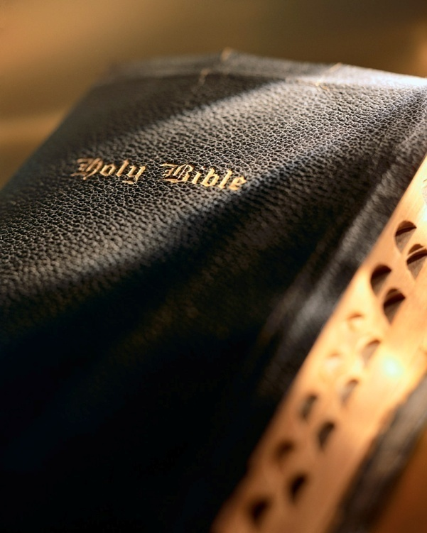

Slide 2

Introduction
The Barna Group is a “leading research organization focused on the intersection of faith and culture.”
They did a survey (2006) on the impact of Christianity has on people’s lives.
Survey showed 51% agreed they had been transformed by their “faith.”
A sad commentary given what the Lord says about Christians: Matt. 18:3; Jn. 3:3-5
Another survey showed many “Christians” do not practice what they claim to believe.

Slide 3
Introduction
Evangelicals
The Bible is accurate.
They feel personally responsible to share their faith.
Their faith is very important in their life.
Jesus Christ did not sin.
God is the Creator and Ruler of the Universe.
Satan is a real being.

Slide 4
Introduction
Born Again Christians
Accept Jesus as their Savior.
Bible is not completely accurate.
Do not always accept a personal responsibility to share their faith with others.
Do not always believe Jesus was holy.
Do not always believe God is the Creator and Ruler of the Universe.
Believe Satan is symbolic.

Slide 5
Introduction
Nominal Christians
Gambling
Cohabitation
Lustful thoughts
Abortion
Fornication
Pornography
Profanity
Getting drunk
Homosexuality
Drug use
Consider themselves Christians, but don’t profess personal faith in Jesus as their Savior.
Atheist/Agnostic
Deny God exists (atheist).
Don’t think God exists, but not certain (agnostic).

Slide 6
Evangelicals
Gambling: 27%
Cohabitation: 12%
Lustful thoughts: 15%
Abortion: 7%
Fornication: 7%
Pornography: 5%
Profanity: 7%
Getting drunk: 8%
Homosexuality: 5%
Drug use: 6%

Slide 7

Have You Changed?
Romans 12:1-2

Slide 8
1. Fundamentally changed
Born again: Jn. 3:2-5; 2 Cor. 5:17
Have you ever dreamed of being born someone else than who you are?
Morally, ethically, spiritually we cease being the “old man” and become the “new man.”
Newness of life: Rom. 6:1-6; 1 Cor. 6:9-11
Baptism is a death, burial and resurrection.
Die to sin, raised that we “should walk in newness of life.”
That “we should no longer be slaves of sin.”
Have You Changed?

Slide 9
1. Fundamentally changed
Conversion: Matt. 18:3-5; Acts 3:19
What would your profile look like if you answered the Barna survey?
In conversion, one thing is changed into another.
We are changed from “sinner” to “saint.”
Synonymous with “born again”; “died to sin”; raised to “walk in newness of life.”
Is your/my life consistent with being:
“born again” ?
“converted” ?
“dead to sin” ?
“new creature” ?
“walk in newness of life” ?
Have You Changed?

Slide 10
2. Change our habits
All of us have some bad habits: 1 Jn. 1:10
Three Keys
Avoid people, places, situations where temptation lurks: Rom. 13:14
Don’t worry what your old worldly friends think: 1 Pet. 4:4
With God on your side you can overcome any bad habit: 1 Jn. 4:4
“Bad habits are like a comfortable bed, easy to get into, but hard to get out of.”
Fundamental change doesn’t mean we don’t struggle to beat bad habits: Rom. 7:22-23; 2 Cor. 13:5; Rom. 12:1-2
How? Rom. 12:1-2
“present your bodies a living sacrifice”: Matt. 22:37
“which is your reasonable service”: 2 Pet. 1:3-9; 1 Pet. 1:3-4
“do not be conformed to this world”: 2 Pet. 2:22
“be transformed by the renewing of your mind”: Psa. 119:11, 50, 133; Jas. 1:21-25
Have You Changed?

Slide 11
3. We don’t change instantly
I’m not trying to offer an excuse: 1 Pet. 4:1-4
Habits die hard, especially bad habits.
God requires us to grow, so He allows us to grow: Prov. 4:18; Eph. 2:19-22; 4:15; 2 Cor. 3:18; 1 Pet. 2:2; Heb. 5:11-14
The day comes to “fish or cut bait,” must “get with the program.”
We must not abuse God’s “second law of pardon”: 1 Jn. 1:9; Acts 8:22
In 1 John 2:1 the word “sin” is aorist tense, not present tense.
A “snapshot” () versus a “movie” ( ); we’re not to “keep on sinning”!
God expects us to rely on Him to overcome our bad habits: 1 Pet. 4:1-4; Eph. 6:10-18
Have You Changed?

Slide 12
4. Goal is perfection
Paul talks about this perfection: Eph. 4:13; Col. 1:28-29
The word “perfect” means to reach the end desired, to reach maturity, to be fully grown.
Christians are “works in progress,” striving to be “conformed to the image” of Christ: Rom. 8:29
Peter expresses similar thoughts in his epistle: 1 Pet. 1:13-16
Recall the WWJD movement?
There is an important kernel of truth in it.
Think of WWJD as a “filter” through which we sift every thought, attitude and action.
It would serve us well to imitate Paul in this regard: Gal. 2:20
Have You Changed?

Slide 13
Conclusion
I hope this lesson stepped on all our toes.
Let us therefore, “examine yourselves as to whether you are in the faith. Test yourselves.” 2 Cor. 13:5
God is not looking down on us from heaven as a stern taskmaster.
He is on our side! Rom. 8:31-32; Eph. 3:20
God will not leave us “in the lurch”!

