Slide 2
Introduction
“Best” and “worst” lists are very popular.
“Not every one that saith unto me, ‘Lord, Lord,’ shall enter into the kingdom of heaven; but he that doeth the will of my Father which is in heaven. 22 Many will say to me in that day, ‘Lord, Lord, have we not prophesied in thy name? and in thy name have cast out devils? and in thy name done many wonderful works?’ 23 And then will I profess unto them, ‘I never knew you: depart from me, ye that work iniquity.’” (KJV)
Matthew 7:21-23
Such lists remind me of an old sermon I’ve preached here: “Saddest Words in the Bible”
“Some mocked”: Acts 17:32
“We will not walk therein”: Jer. 6:16
“Who concerning the truth have erred”: 2 Tim. 2:17-18
“Concerning the faith have made shipwreck”: 1 Tim. 1:19-20
“And the door was shut”: Matt. 25:10
“Depart from me”: Matt. 7:21-23; 25:10
“Go thy way for this time”: Acts 24:25
“Almost thou persuadest me”: Acts 26:28

Slide 3
The Worst Words You’ll Ever Hear Matthew 7:21-23

Slide 4
1. When they will be heard
In verse 22 Jesus says, “Many will say to Me in that day…” : 1 Cor. 15:24
Not just any day, but “that day” !
The Day of Judgment!
These are the worst words because they are spoken on the “last day” !
No more time for change! No more “do overs”!
Perhaps if we had heard these words earlier!
Life requires “navigation…”
Worst Words We'll Ever Hear

Slide 5
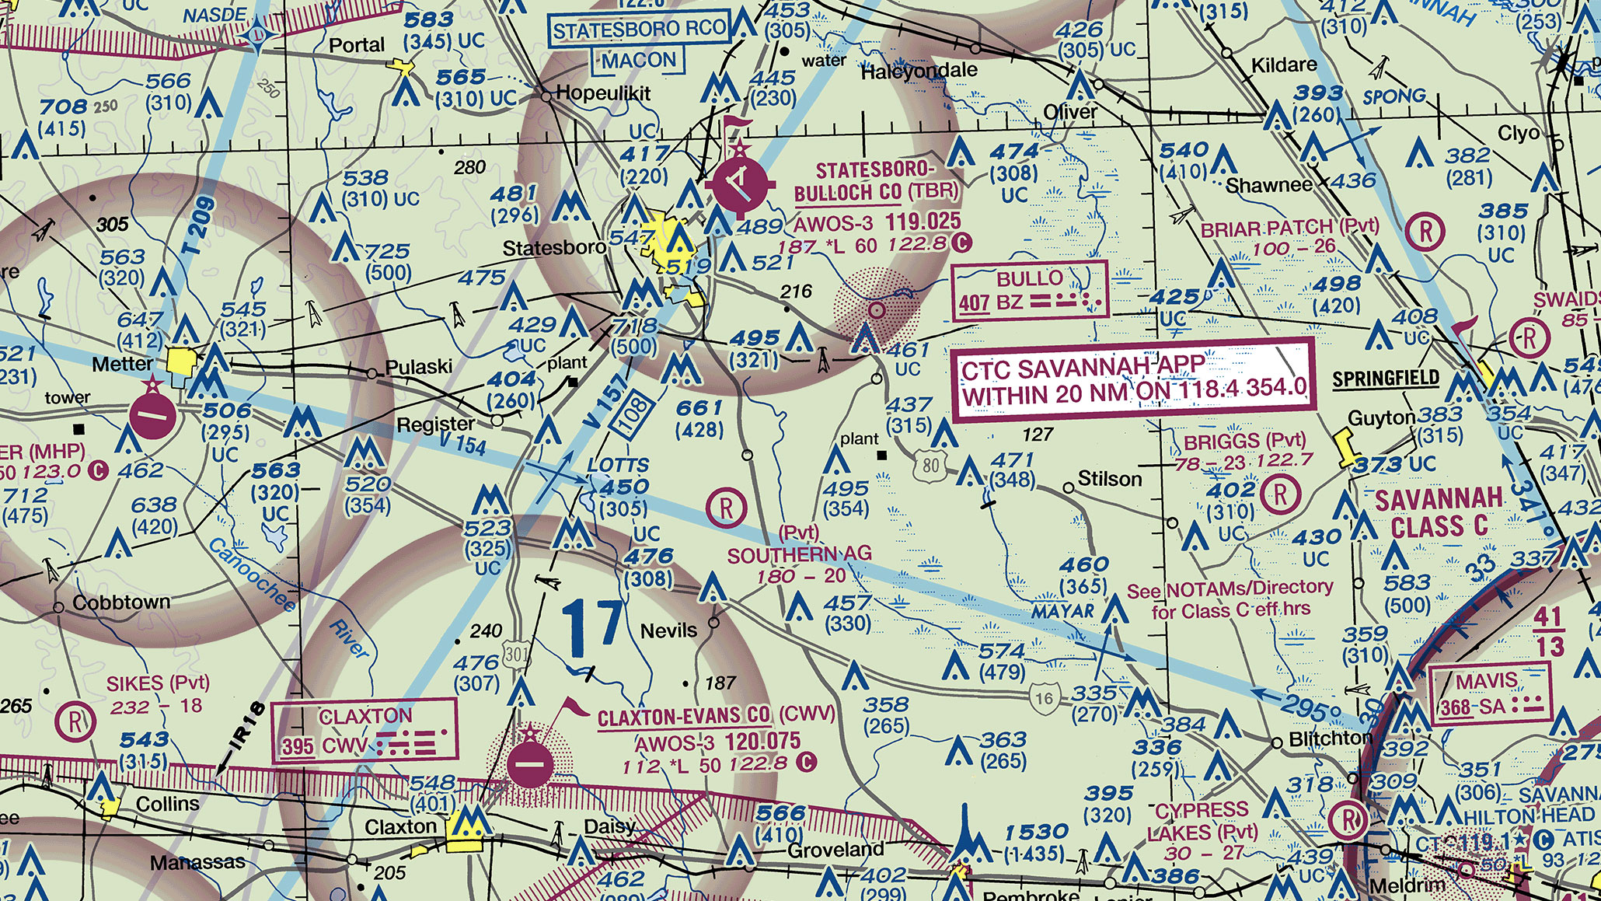
1 Thessalonians 5:6
1 Corinthians 16:13
1 John 1:7
2 Corinthians 13:5
Hearing these words will mean a lifetime wasted; mean it’s too late to do anything about it; mean eternally condemned by the Lord.

Slide 6
2. Who will say them
The importance of words spoken are in proportion to the importance of the person speaking them.
Parents, boss, teacher, policeman; child, spouse, etc.
But the words we’re considering were spoken by Jesus! Jn. 1:1-4; Acts 17:31; 1 Tim. 6:15; Jn. 8:58; Rev. 1:8
Words of castigation and condemnation!
The most devastating words you’ll ever hear!
The most dreadful and terrifying words you’ll ever hear!
Words that will make your heart melt and tremble!
Worst Words We'll Ever Hear

Slide 7
3. What is said
Jesus said two things, both of which are shocking and condemning:
“I never knew you.” : Lk. 9:23; Jn. 14:15; 15:14; 1 Jn. 2:3-5
“Depart from Me..” : Jn. 14:2-3
We can play the game, talk the talk, and put on a happy face; but if we do not truly “seek first the kingdom of God and His righteousness”; we will hear the words: “I never knew you; depart from Me…”
Worst Words We'll Ever Hear

Slide 8
4. Everyone will hear
I don’t mean the words “I never knew you; depart from Me” will be personally directed at every single person.
The vast majority will certainly hear those words directed at them personally: Matt. 7:13-14
I mean that if those words are personally directed at me, EVERYONE will know it, and know why!
We know of God’s omniscience: Heb. 4:12-13; Psa. 44:21; Rom. 2:16
Plus, all my “badness” will be on display unless my life is hidden in Christ: Matt. 25:31-33; Rev. 20:12; Col. 3:3; 1 Cor. 4:5; Eccl. 12:14
Worst Words We'll Ever Hear

Slide 9
5. Their finality
Those in Matthew 7 stake their claim to righteous-ness in verse 22.
But the Lord does not accept their claim; He knows they are guilty…He is the Judge! Acts 17:31; Matt. 7:23
They have no “comeback”; they make no further attempts at self-justification: Psa. 63:11
Imagine bearing all the shame of your sins, all your ugly deeds and ugly words: Job 8:22
Worst Words We'll Ever Hear

Slide 10
Imagine yourself walking down that lonely road with the multitude headed for eternal torment! Imagine yourself in that pitiful line of lost souls! What are your thoughts?! Your feelings?!

Slide 11
Conclusion
The worst words are: “I never knew you; depart from Me, you who practice lawlessness!”
The door to eternity is opened, your eternal fate is sealed, the door is shut…forever! Matt. 25:13
You’re lost forever! And, it didn’t have to be!
The Lord will direct these words at you if you don’t put Him at the center of your life.
Do you get it?! Rom. 9:33

