Slide 1
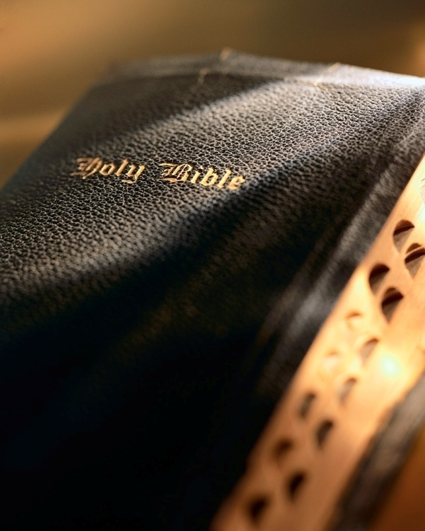

Slide 2
Introduction
There are many sad statements in the Bible:
24 “And after certain days, when Felix came with his wife Drusilla, which was a Jewess, he sent for Paul, and heard him concerning the faith in Christ. 25 And as he reasoned of righteousness, temperance, and judgment to come Felix trembled, and answered, Go thy way for this time; when I have a convenient season, I will call for thee.”
Acts 24:24-25 (KJV)
Athenians: Acts 17:25, 30-31, 32
Israelites: Jer. 6:16; Matt. 27:25
Herod Agrippa II: Acts 26:2
Luke records a very sad statement in Acts 24:25; made by the Roman governor Felix.
There is no record that Felix ever found that “convenient season” and obeyed the gospel.
Sadly, many are like Felix and put off obedience, thinking ‘there’s time, time, time enough yet’: Matt. 20:1-16

Slide 3
Don’t Wait Until It’s Too Late! Acts 24:24-26

Slide 4
1. No remedy
Sometimes really sick people refuse treatment.
They wait too long, until it’s too late. How sad!
The warning signs were there all along, but they went ignored.
This happened to the Jews in the days of Jeremiah: 2 Chr. 36:6-20
Don’t let it happen to you! 2 Pet. 3:9-11
Don't Wait Until It's Too Late!

Slide 5
2. Heart is darkened
That’s how Paul described the Gentile world: Rom. 1:21; Eph. 4:17-19
Have you ever been in ‘total darkness’? Very scary! Matt. 8:12; 22:13; 25:30
Without God we are in ‘total spiritual darkness’: Psa. 119:105; Jer. 10:23
There’s no true peace of mind: Phil. 4:7
Don’t let it happen to you! Acts 28:27; Isa. 6:9-10; Matt. 13:14; 25:30
Don't Wait Until It's Too Late!

Slide 6
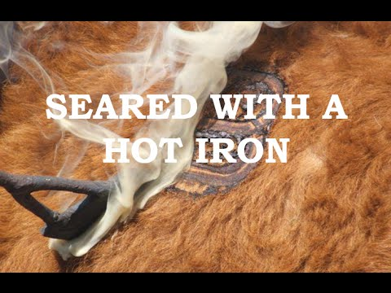
3. Conscience is seared
Paul issues a very clear warning: 1 Tim. 4:1-2
“Sear” is Greek word we get our word “cauterize,” Cauterized flesh is insensitive: 1 Tim. 1:5, 19
Ephesians 4:19 is a divine commentary on folks with a seared conscience.
“The chains of habit are generally too small to be felt until they are too strong to be broken.”
Don’t let it happen to you! Eph. 4:19
Don't Wait Until It's Too Late!

Slide 7
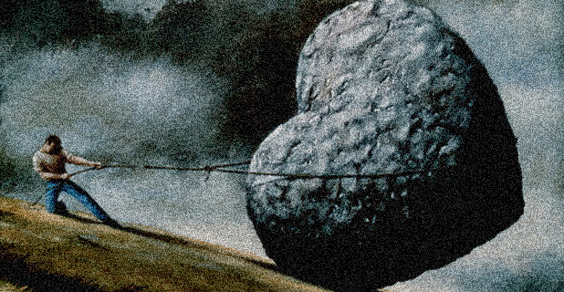
4. Heart is hardened
The Bible often refers to a “hardened heart” : Ex. 12-14
It’s “obstinate”; refuses to turn to the Lord: Dt. 2:30
Many are “obstinate” or “stubborn”: 2 Chr. 36:13
Obstinance is a cruel taskmaster! 2 Kgs. 25:5-7
Want to share Zedekiah’s epitaph?!
Don’t let it happen to you! Heb. 3:13; Lk. 8:15; Jas. 1:21; Heb. 3:8, 15; 4:7; 6:4-6; 10:26-29; Rom. 1:24, 26, 28; 2 Thess. 2:10-12
Don't Wait Until It's Too Late!

Slide 8
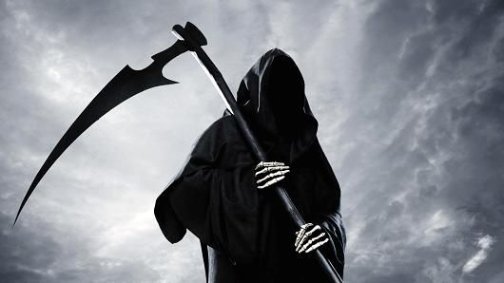
5. Death
We all have an appointment with death: Gen. 5:5; 1 Cor. 15:22; Heb. 9:27
“Death is a friend of ours; and he that is not ready to entertain him is not at home.” —Sir Francis Bacon
No way to know when it will come for you: Eccl. 9:12
The dead are powerless (Eccl. 8:8; 1 Cor. 15:43); death seals our eternal fate: Lk. 16:19-31; Heb. 1:1-2
Don’t wait until it’s too late! Lk. 16:26
Don't Wait Until It's Too Late!

Slide 9
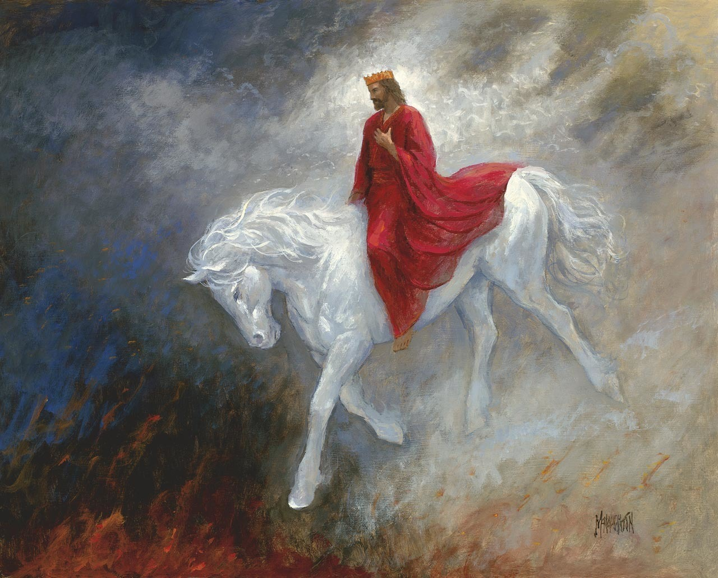
6. Christ comes
The Lord promised, “…I will come again…” : Jn. 14:3
His coming again is just as certain as death itself: Heb. 9:27-28; 2 Thess. 1:8-9; 2 Pet. 3:10; Matt. 24:36
He will judge us when He comes again: 2 Tim. 4:1; 2 Cor. 5:10; Rom. 14:10-12; Matt. 25:31-32, 46
When He comes again: “then cometh the end” : 1 Cor. 15:23-24 And, Rev. 20:12
Too late then! Rev. 20:15
Don't Wait Until It's Too Late!

Slide 10
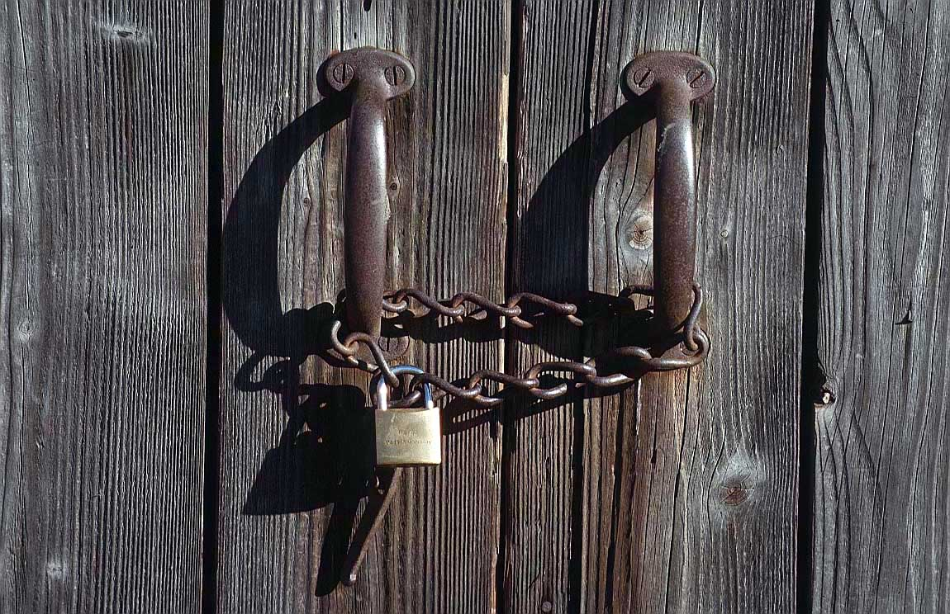
7. Door is shut
The “foolish” virgins waited too long: Matt. 25:1-13
When “the door is shut” you won’t have another opportunity! Sometimes it shuts before our death: Acts 24:25
The Lord pleads for us to come to Him NOW! 2 Cor.6:2; Matt. 11:28-30; Rev. 3:20
Don’t let that door be slammed in your face! Rev. 22:17
Don't Wait Until It's Too Late!

Slide 11
Conclusion
“We don’t know how much time we have left.”
How about you? Do those words “go in one ear and out the other”?
“And then one day you find ten years have got behind you, no one told you when to run, you missed the starting gun.” Time by Pink Floyd
Don’t wait until it’s too late! Acts 2:41; 16:33; Prov. 27:1; Lk. 12:16-20; Jas. 4:13-17; Rom. 5:10; 2 Cor. 7:10-11

