Slide 1
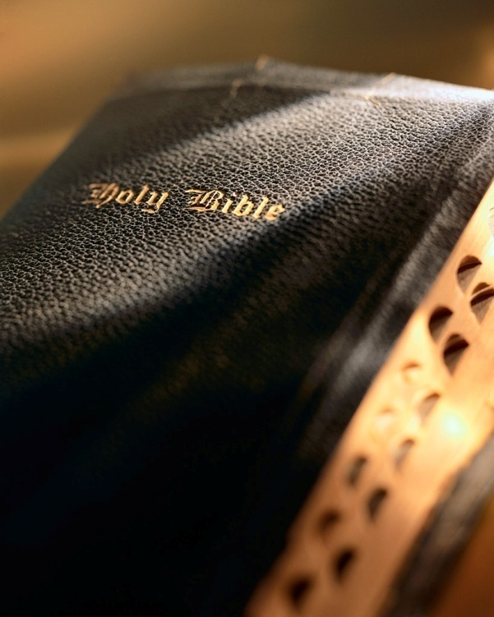

Slide 2
Introduction
The word precious occurs 77 times on the pages of inspiration.
Old Testament: 61 times; e.g., Gen. 24:53; Psa. 22:20
New Testament: 16 times; e.g., Mk. 14:3; 1 Pet. 1:7, 19
Something that is precious is costly, valuable, esteemed, beloved, etc.
We talk everyday about things that are precious to us: time, children, pets, memories, items, etc.

Slide 3
Precious Things 1 Peter 1:6-9

Slide 4
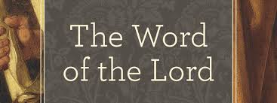
1. The Word of the Lord
“And the word of the Lord was precious in those days…” 1 Sam. 3:1
God’s Word is precious because of all it does:
Builds up: Acts 20:32
Begets Jas. 1:19
Faith: Rom. 10:17
Saves: Jas. 1:19
Reconciles: 2 Cor. 5:19
Growth: 1 Pet. 2:2
Sanctifies Eph. 5:26
Is God’s Word precious to you? What Bible book are you personally studying?
Precious Things

Slide 5
2. Death
What an irony! Death is “precious” ?
Yes! But only to “His saints” ! Psa. 116:15
Not all deaths are “precious…in the sight of the Lord” : Lk. 16:19-31
Only “the death of His saints...” 1 Cor. 1:2; 1 Pet. 2:9
For death to be “precious”; two things are a must:
“in Christ”: Eph. 1
“perfecting holiness”: 2 Cor. 6:16-7:1
Precious Things

Slide 6
3. Seed
Consider the power in a seed: 1 Cor. 15:37-38
37 “And what you sow, you do not sow that body that shall be, but mere grain — perhaps wheat or some other grain. 38 But God gives it a body as He pleases, and to each seed its own body.”
Precious Things

Slide 7
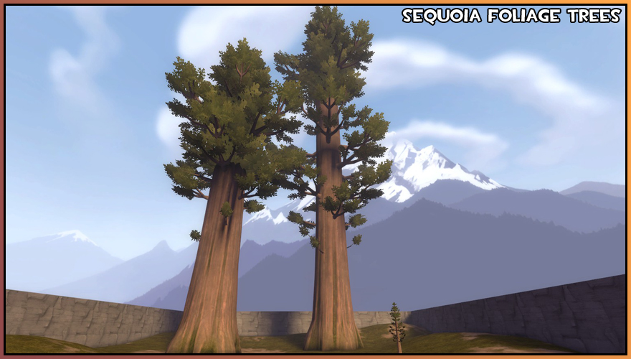
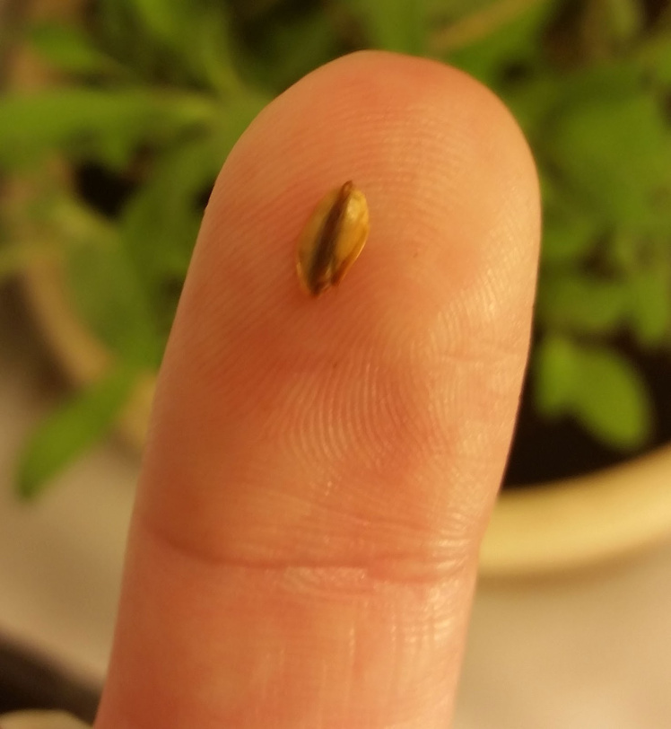
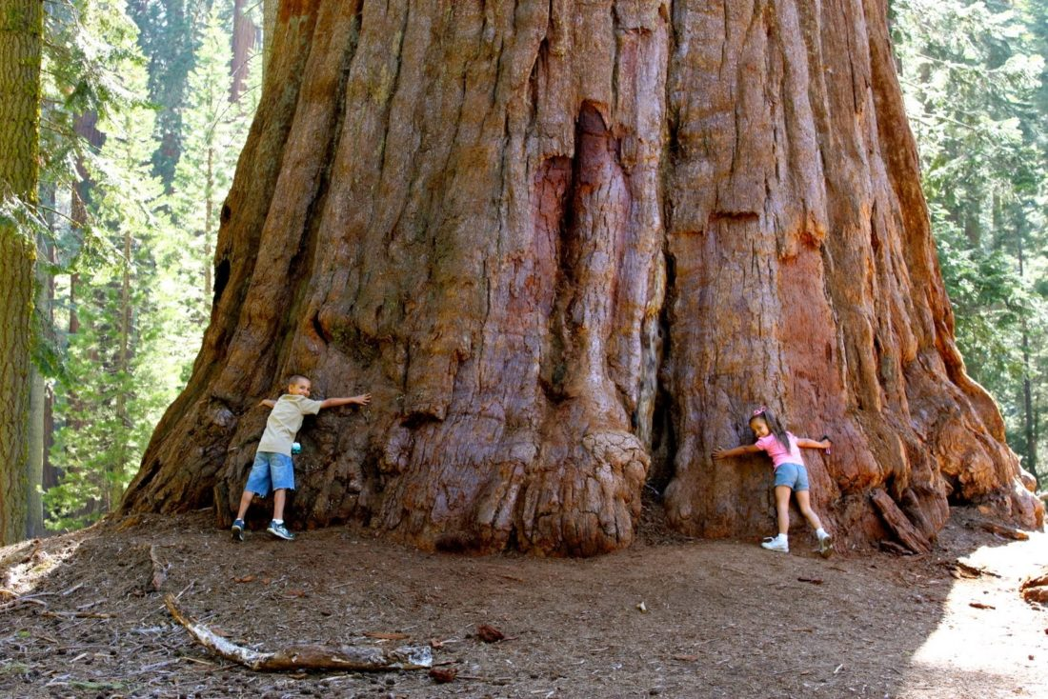

Slide 8
3. Seed
Consider the power in a seed: 1 Cor. 15:37-38
In the parable of the sower, “…The seed is the word of God” : Lk. 8:11
There is no more precious or powerful seed than the Word of God! 1 Pet. 1:23; Rom. 1:16-17; Job 23:12; Psa. 119:127
Are you allowing God’s precious seed to work its power in your life? Phil. 3:17-21
Precious Things

Slide 9
4. Unity
The Psalmist speaks of unity: Psa. 133:1-2
Unity is good, pleasant and precious; division is none of these things! Rom. 16:17-18; Gal. 5:19-21
The Psalmist not the only one who sings of unity:
Jesus: Jn. 17:20-21
Apostles: 1 Cor. 1:10
What contribution to unity do you make at Westside? Eph. 4:1-3
Precious Things

Slide 10
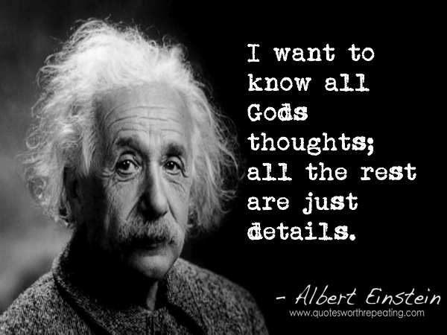
5. God’s thoughts
The Psalmist spoke of God’s thoughts: Psa. 139:17
God’s thoughts are higher than ours: Isa. 55:8-9
Man takes God for granted: Psa. 150:2; 147:4-5
Men scoff at God, marginalize, eliminate Him: Psa. 90:2; 2 Chr. 20:6; Psa. 2:8-9
You and I are at the center of God’s thoughts: Psa. 144:3-4; Gen. 1:26-27; 2 Pet. 1:3-4; Rom. 5:8; Jn. 3:16; Heb. 13:5; Rom. 8:32; Matt. 11:28-30
We need to learn and apply the lesson Job learned: Job 38:1-4; 40:1-2; 42:1-6
Precious Things

Slide 11
6. Wisdom
The wiseman spoke of wisdom: Prov. 3:15
How does one obtain wisdom? Prov. 9:10
The world rejects the “fear of the Lord” ; they’re too smart for that!
Will the real fool please stand up: Psa. 14:1; Rom. 1:21, 23
Our secular society does everything possible to deny Proverbs 9:10.
Evolution Gen. 1:1
Humanism Prov. 12:15; 1 Cor. 1:18ff
Is true wisdom precious to you? Prov. 1:7; 24:7
Precious Things

Slide 12
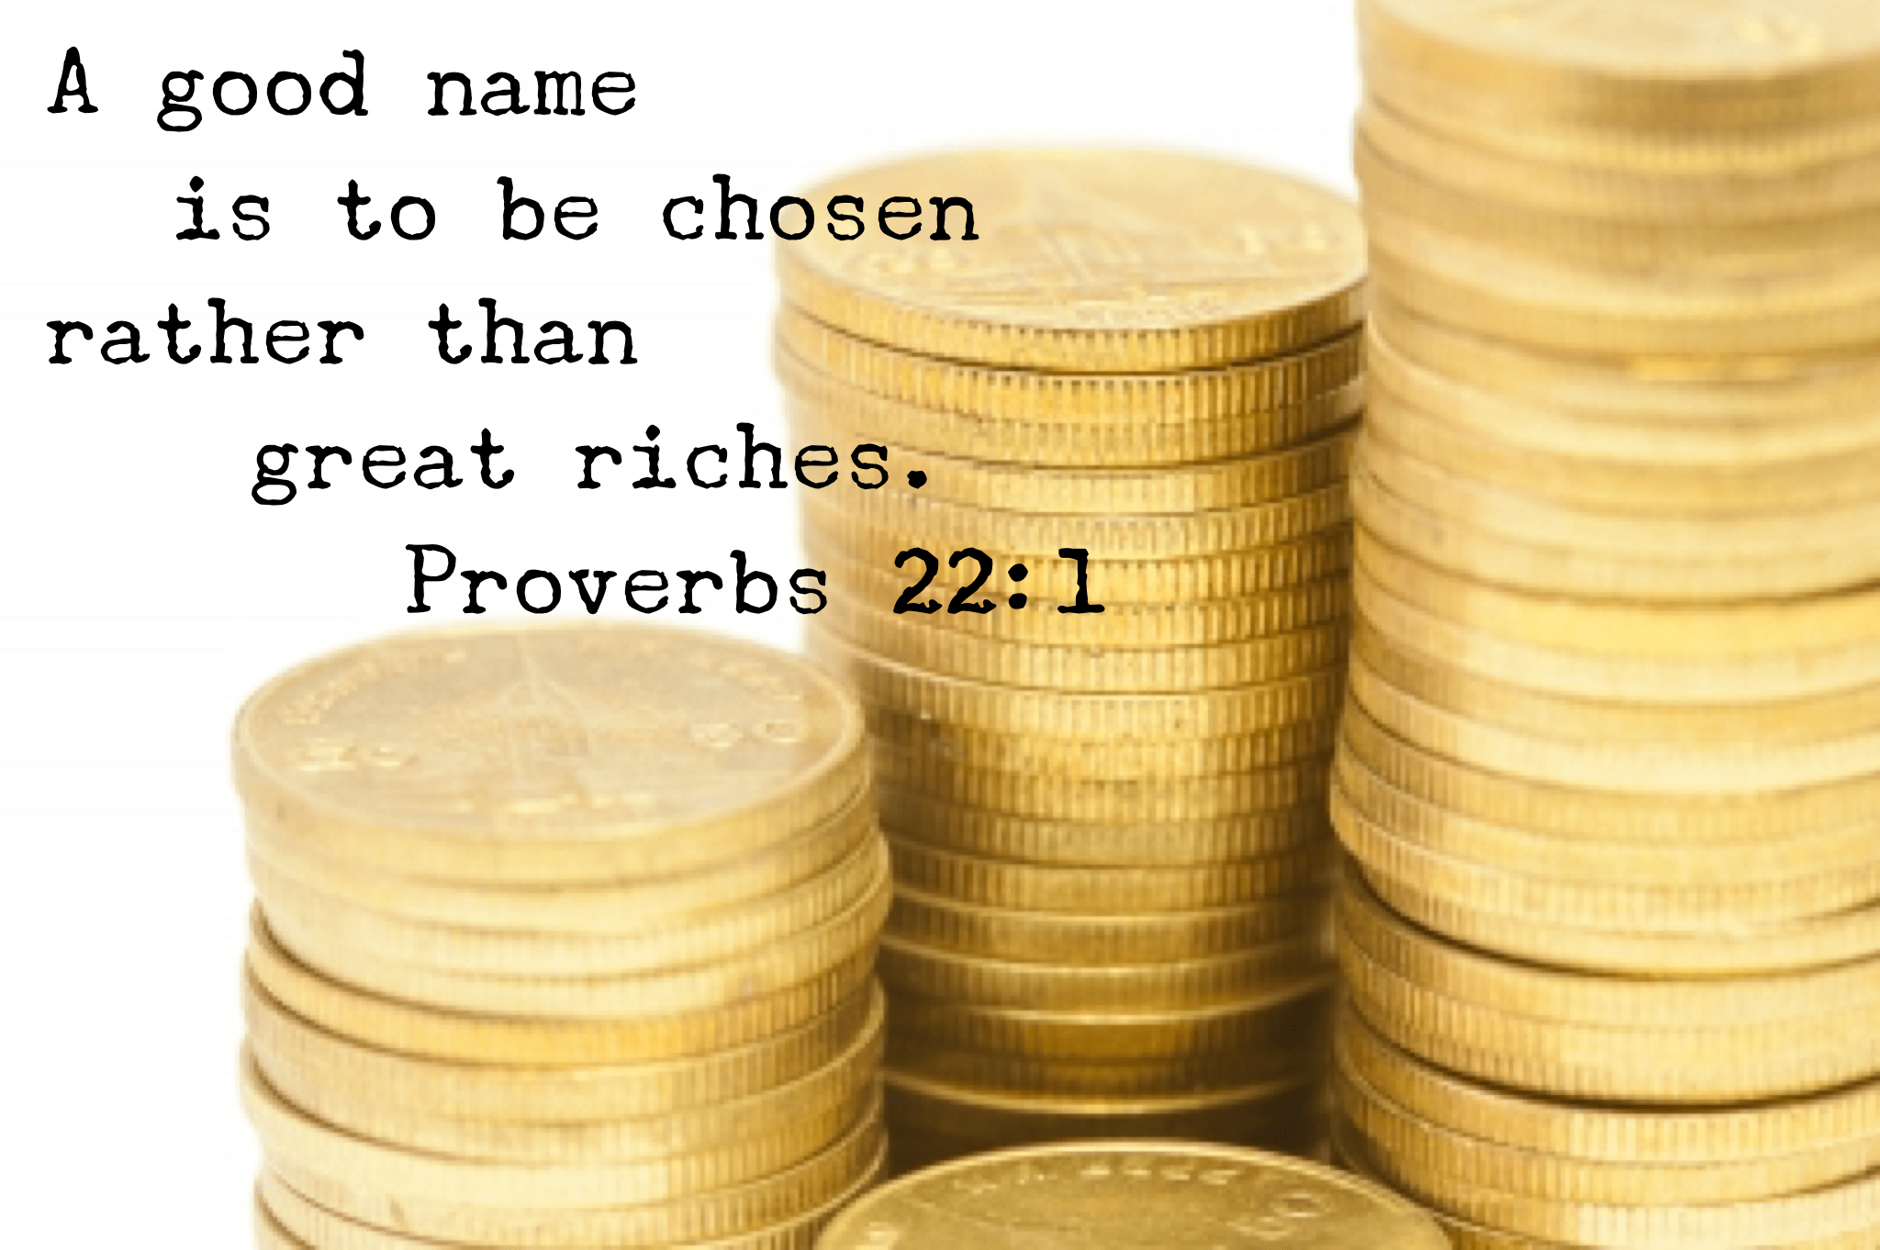
7. A good name
The wiseman spoke of a “good name”: Eccl. 7:1
Some scoff at the idea of a “good name”: Matt. 10:25; Acts 24:5; Matt. 10:26; 5:11-12
What comes to your mind when you hear these names?
Adolph Hitler
Charles Manson
Benedict Arnold
Jezebel
Judas Iscariot
Jim Jones
Precious Things

Slide 13
7. A good name
The same is true about our name when it comes to being a Christian: Acts 11:26
All of our behavior, words, and attitudes ultimately reflect on Christ!
On of the infidel’s favorite tools is trashing Christ and His religion for the “bad name” some of His supposed followers have given Him: 2 Pet. 2:2; 1 Pet. 1:13-16
Many trade away their “good name” for things of no value: Heb. 12:16; Titus 1:12; Jn. 1:46
What kind of name are you cultivating? Prov. 22:1; Matt. 5:14-16
Precious Things

Slide 14
8. Trial of our faith
Peter tells us this great truth in 1 Peter 1:6-7.
Gold is a precious metal with many properties that make it valuable.
Pure gold is rare; most often mined as an ore (1-5 ppm) that must be refined to extract the pure gold.
Our faith is like gold; it must be refined to make it pure, genuine, strong: Rom. 3:22; Eph. 2:8; Gal. 3:26; 2 Tim. 1:5
Precious Things

Slide 15
8. Trial of our faith
The Christians Peter wrote to were undergoing severe trials: 1 Pet. 3:14; 4:12
In times of trial we find out just how strong and genuine our faith is: 1 Pet. 4:13; Jas. 1:2-4; Rom. 5:1-5
The next time you face trials and temptations REJOICE! 2 Cor. 4:16-5:1
In the end it really pays off! 1 Pet. 1:9 How precious is your faith? 2 Pet. 1:3-11
Precious Things

Slide 16
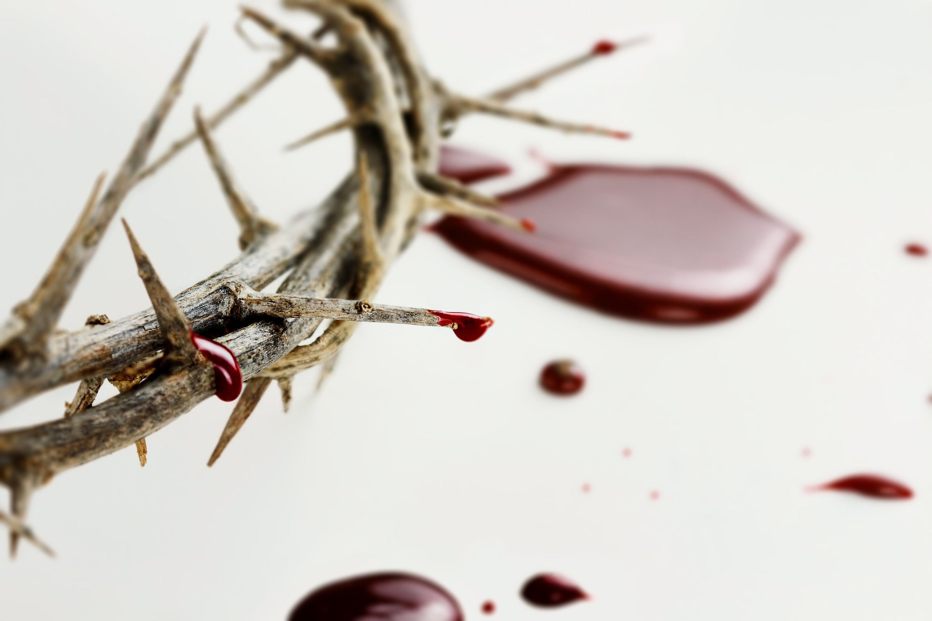
9. Blood of Christ
Would you be free from the burden of sin?
There’s pow’r in the blood, pow’r in the blood;
Would you o’er evil a victory win? There’s wonderful pow’r in the blood.
Refrain:
There is pow’r, pow’r, wonder-working pow’r
In the blood of the Lamb;
There is pow’r, pow’r, wonder-working pow’r
In the precious blood of the Lamb.
Would you be free from your passion and pride?
There’s pow’r in the blood, pow’r in the blood;
Come for a cleansing to Calvary’s tide;
There’s wonderful pow’r in the blood.
Would you be whiter, much whiter than snow?
There’s pow’r in the blood, pow’r in the blood;
Sin-stains are lost in its life-giving flow;
There’s wonderful pow’r in the blood.
Would you do service for Jesus your King?
There’s pow’r in the blood, pow’r in the blood;
Would you live daily His praises to sing?
There’s wonderful pow’r in the blood.
Peter teaches us about the blood of Christ: 1 Pet. 1:18-19; Jn. 19:34
Christ’s blood was:
Innocent blood: Matt. 27:4
Blood of the New Testament: Mk. 14:24
His own blood: Rev. 1:5; Heb. 2:14-16
We often sing There is Power in the Blood:
Precious Things

Slide 17
9. Blood of Christ
Do you ever stop to consider all that His blood does?
Purchases: Acts 20:28
Brings peace: Col. 2:20
Remits sins: Matt. 28:28
Sanctifies: Heb. 13:12
Justifies: Rom. 5:9
Cleanses: 1 Jn. 1:7
Redeems: Eph. 1:7
Washes: Rev. 1:5
Makes nigh: Eph. 2:13
Boldness: Heb. 10:19
Are you living a life worthy of His blood? Phil. 1:27; Heb. 10:29
Precious Things

Slide 18
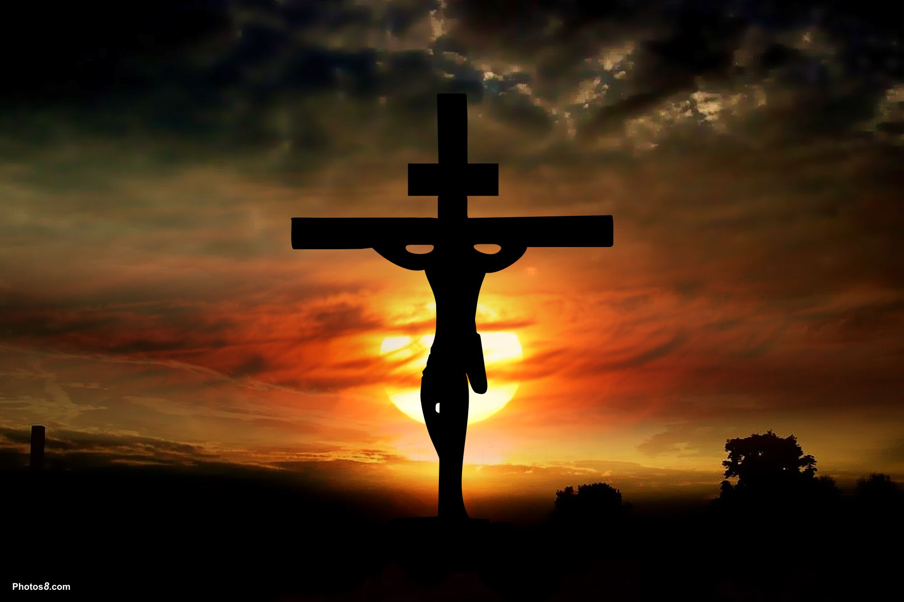
10. Christ
“For to me to live is Christ, and to die is gain.”
“For to me to live is , and to die is .”
If we put anything other than “Christ” in the first blank; our death will not be “gain.”
Isaiah prophesied about “a precious corner stone” : Isa. 28:16
Peter applies this prophecy to Christ: 1 Pet. 2:4-7
Christ is not precious to everyone; only to those who believe, and to believe is to obey.
Is Christ precious to you? Phil. 1:21
Precious Things

Slide 19
11. Faith
Peter begins his second epistle speaking of faith: 1 Pet.1:1
New Testament uses “faith” in two senses:
Objective: Jude 3; Acts 6:7; 14:22; 16:5; Rom. 1:5; 10:8
Subjective: Rom. 3:22; 4:13; 5:1; 1 Cor. 2:5; 15:14; Gal. 3:11, 26; Jas. 2:26; Heb. 11:6
Our “faith” is precious: Source (Rom. 10:17; 1 Cor. 2:5), Effect (Rom. 5:1; Eph. 2:8).
Your “faith” is your most precious possession! What is the state of your faith? Are you “giving all diligence” to strengthen your faith?
Precious Things

Slide 20
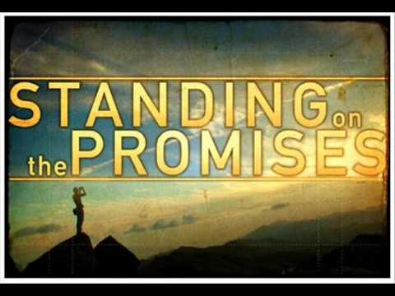
12. God’s promises
Peter speaks of God’s promises: 2 Pet. 1:3-4
God is a promise-making, promise-keeping God! Titus 1:2
Can anything be more precious to us than the “hope of eternal life” ? Rom. 8:24; 12:12; 15:13; Col. 1:5, 27
Our “hope” has the firmest foundation imaginable: Heb. 6:19-20
Such a “hope” is precious indeed! Do you have such a hope?
Precious Things

Slide 21
Conclusion
We have considered 12 precious things in this lesson:
Word of the Lord
A good name
Death
Trial of faith
Seed
Blood of Christ
Unity
Christ
God’s thoughts
Faith
Wisdom
God’s promises
Do you hold these things precious?

