Slide 2
Introduction
Every part of the human body is needed for us to function properly; e.g.,:
Circulatory system
Nervous system
Digestive system
If one part of our body is not functioning properly we don’t feel whole or well.
The New Testament uses the analogy of the human body to describe the church: Eph. 1:22-23

Slide 3
Introduction
The analogy of the human body describing the church expresses: 1 Jn. 1:1-4
Our intimate relationship with Christ.
Christ’s supremacy over the church.
Our intimate and vital connection with one another.
If one part of the “body of Christ” is not functioning properly it impacts the entire church.
Every member is needed! Every member has a “share” to contribute to the “growth of the body for the edifying of itself in love” : Eph. 4:15-16; 1 Cor. 12:22

Slide 4
Are You Needed? 1 Corinthians 12:12-31

Slide 5
Set a good example
“Few things are harder to put up with than the annoyance of a good example.”
—Mark Twain
“If you would convince a man that he does wrong, do right. But do not care to convince him. Men will believe what they see. Let them see.
—Henry David Thoreau
“Worry not that your child listens to you; worry most that they watch you .”
—Ronald A. Heifetz
“Imitate me, just as I imitate Christ.”
—1 Corinthians 11:1
Good examples are hard to come by these days!
Politicians? Hollywood?
Sports? Business?
Family?
The Bible exemplified in your life will make you a very, very unique individual: Matt. 5:13-16
Folks are reading you! What does your epistle say? 2 Cor. 3:2; 1 Tim. 4:12
Setting a good example quotes:
Are You Needed?

Slide 6
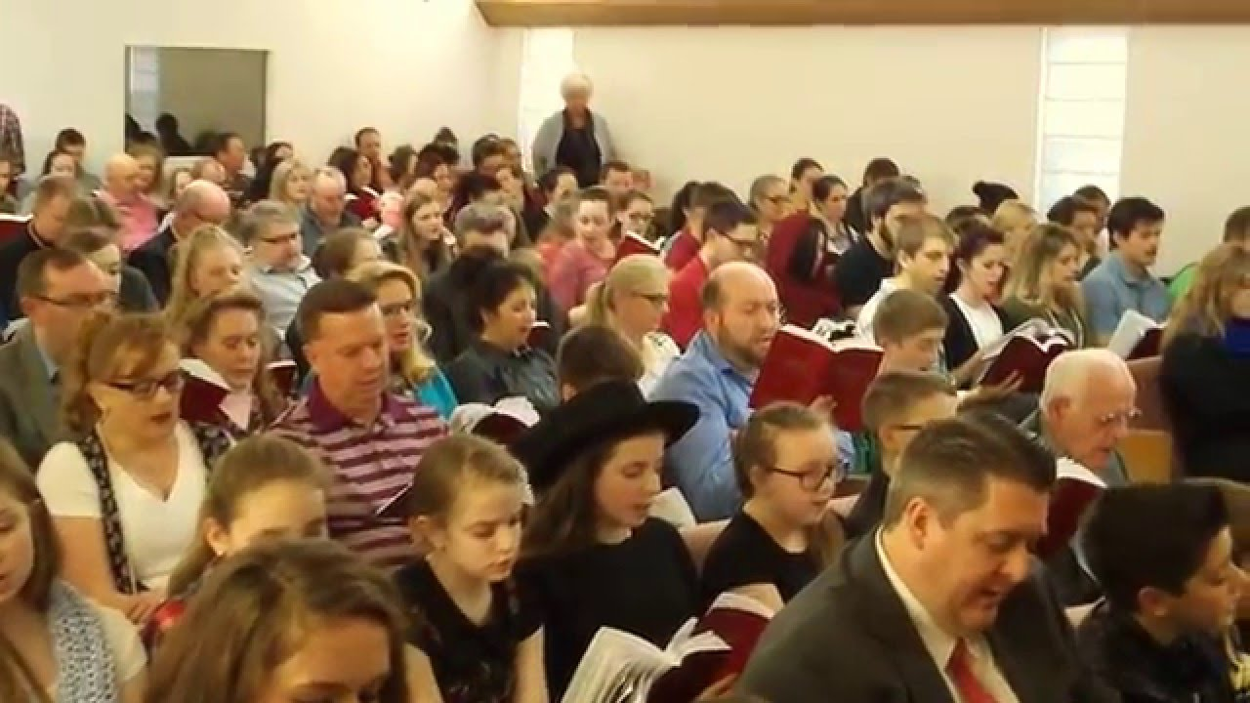
Attend services
Scripture teach us the value and necessity of local church membership: cf. Acts 9:26
A privilege and responsibility of local church membership is attending services: Heb. 10:24-31
What are our services designed to do? Heb. 10:24
What does my intentional absence, without a legitimate reason, say? Does it say I really care?
In the context of Hebrews 10 what is the “willful sin”? “forsaking the assembling of yourselves together”
Where does that leave us spiritually? Heb. 10:29, 31
Are You Needed?

Slide 7
Do personal work
Teaching others the gospel is not just the work of the elders or preacher; it is the obligation, honor and privilege of every Christian: 1 Pet. 3:15; Acts 8:4; 16:5
Sharing the gospel is the most important thing you can do for another person! Matt. 16:26; Jas. 5:20; Lk. 15:7
We all have a “sphere of influence” (e.g., family, friends, neighbors, co-workers).
I challenge you to be a Cornelius: Acts 10:24, 33
Schedule a Bible study in your home for yourself and/or others and I guarantee I’ll be there!
Are You Needed?

Slide 8
Good attitude
“Attitude is everything!” Just ask an astronaut.
“Attitude is where you are in relation to where you ought to be.” Is your attitude “where you ought to be”?
Way too many bad attitudes today; just watch the news for a few minutes.
It’s up to YOU to control your thinking: Prov. 23:7; Phil. 4:8
Envision a world where everyone had the “mind” or attitude of Christ: Phil. 2:5, 2-4
Are You Needed?

Slide 9
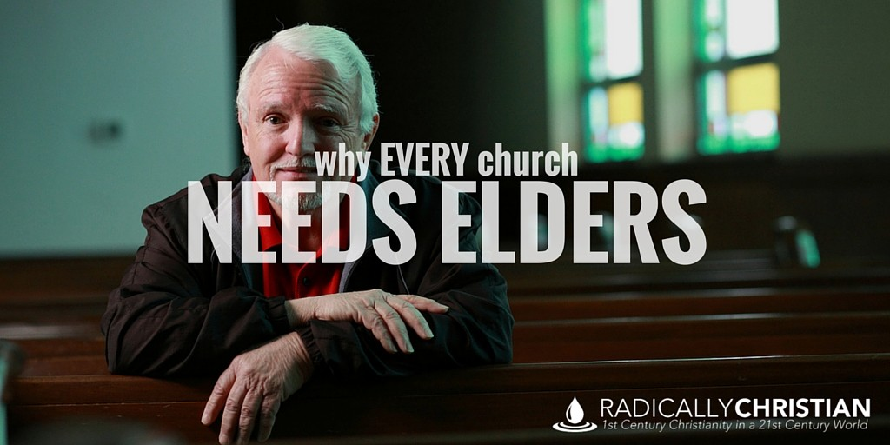
Evangelists, elders, teachers
Evangelists, pastors, teachers are “gifts” given by the Lord to build up the church: Eph. 4:11-12
There is always a shortage of men and women qualified and able to serve: 2 Tim. 2:2; Heb. 5:12
Aspire to be qualified: 1 Tim. 3:1-7, 11; Titus 1:5-11; Acts 20:28
We need more men and women dedicated to preaching/ teaching the gospel: Rom. 10:14; Acts 18:26; 2 Tim. 4:2-4; Isa. 6:8
Preaching the gospel is the greatest work a man can do and deserves our respect and support: 1 Tim. 4:16; 1 Cor. 9:14; Gal. 6:6
Are You Needed?

Slide 10
Promote unity
The Lord hates one who “sows discord among brethren” : Prov. 6:19; Rom. 16:17; Psa. 133:1
Unity is so important:
The Lord prayed for it: Jn. 17:20-21
The apostles pleaded for it: 1 Cor. 1:10
Unity requires:
Walk w/Lord: Eph. 4:1-2
Peace-keeping spirit: Rom. 14:19
Pursuit: Eph. 4:3
Humility: Phil. 2:1-4
Agreement: 1 Cor. 1:10; Phil. 3:16; 1:27; Col. 3:17
Are You Needed?

Slide 11
Do good works
A major criteria of our judgment will be “good works”: Matt. 25:31-46
“Good works” in the sense of how we have helped others less blessed: Acts 9:36; 4:36-37; 1 Tim. 5:10
Giving the needy a “pat on the back” and a “well, I hope things get better for you” just won’t cut it! Jas. 2:14-17
We need to get serious about helping those in need: 1 Jn. 3:16-17
Christ gave Himself for us to be a people “…zealous of good works” : Titus 2:14 Does this describe you?
Are You Needed?

Slide 12
Supply your part
Football team is analogous to the church.
Every member of the church has a “share” in the work: Eph. 4:16
The church at Laodicea is an example of some not doing their “share” : Rev. 3:15-17
Any church is handicapped from reaching its full potential when any one member does not do their “share.”
Look for ways to get involved! Ways to do your “share” ! 1 Cor. 15:58
Are You Needed?

Slide 13
Faith/obedience
Faith and obedience are dominant Bible themes:
Garden of Eden: Gen. 3:3
Nation of Israel: Deut. 30:15-16; Josh. 24:15
Babylonian captivity: Dan. 9:4-5
Jesus: Phil. 2:8
Hall of fame of the faithful: Heb. 11
God’s requirement for man can be boiled down to one simple, yet powerful and profound, statement: Hab. 2:4; cf. Rom. 1:17; Gal. 3:11; Heb. 10:38
Are you faithful and obedient? They are the same! Matt. 7:21; Heb. 5:9; 2 Cor. 7:1; 10:5
Are You Needed?

Slide 14
Conclusion
Remember, you are needed!
Set a good example
Attend services
Do personal work
Good attitude
Serve
Promote unity
Good works
Do your share
Faith/obey
We need YOU!

