Slide 1
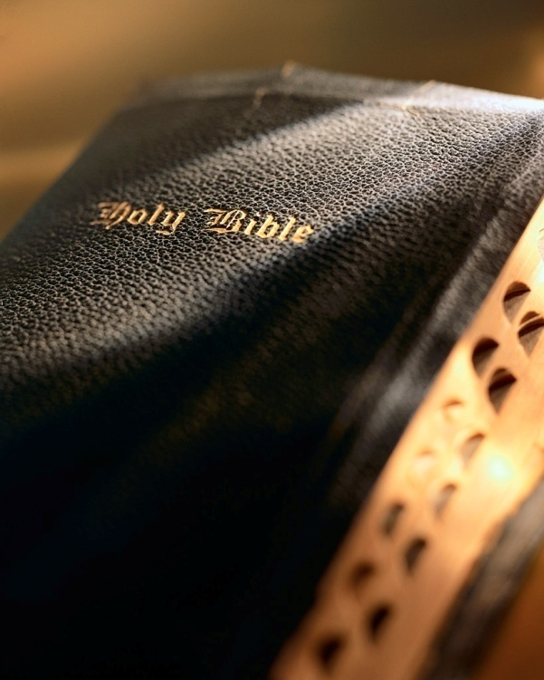

Slide 2
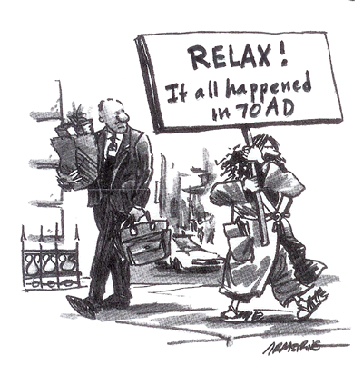
Introduction
Christ's second coming is past.
Final judgment is past.
End of the world is past.
Spiritual adultery.
Denies the resurrection of the dead.
Galatians 1:8-9: "But though we, or an angel from heaven, preach any other gospel unto you than that which we have preached unto you, let him be accursed. 9 As we said before, so say I now again, If any man preach any other gospel unto you than that ye have received, let him be accursed."
Examining Realized Eschatology

Slide 3
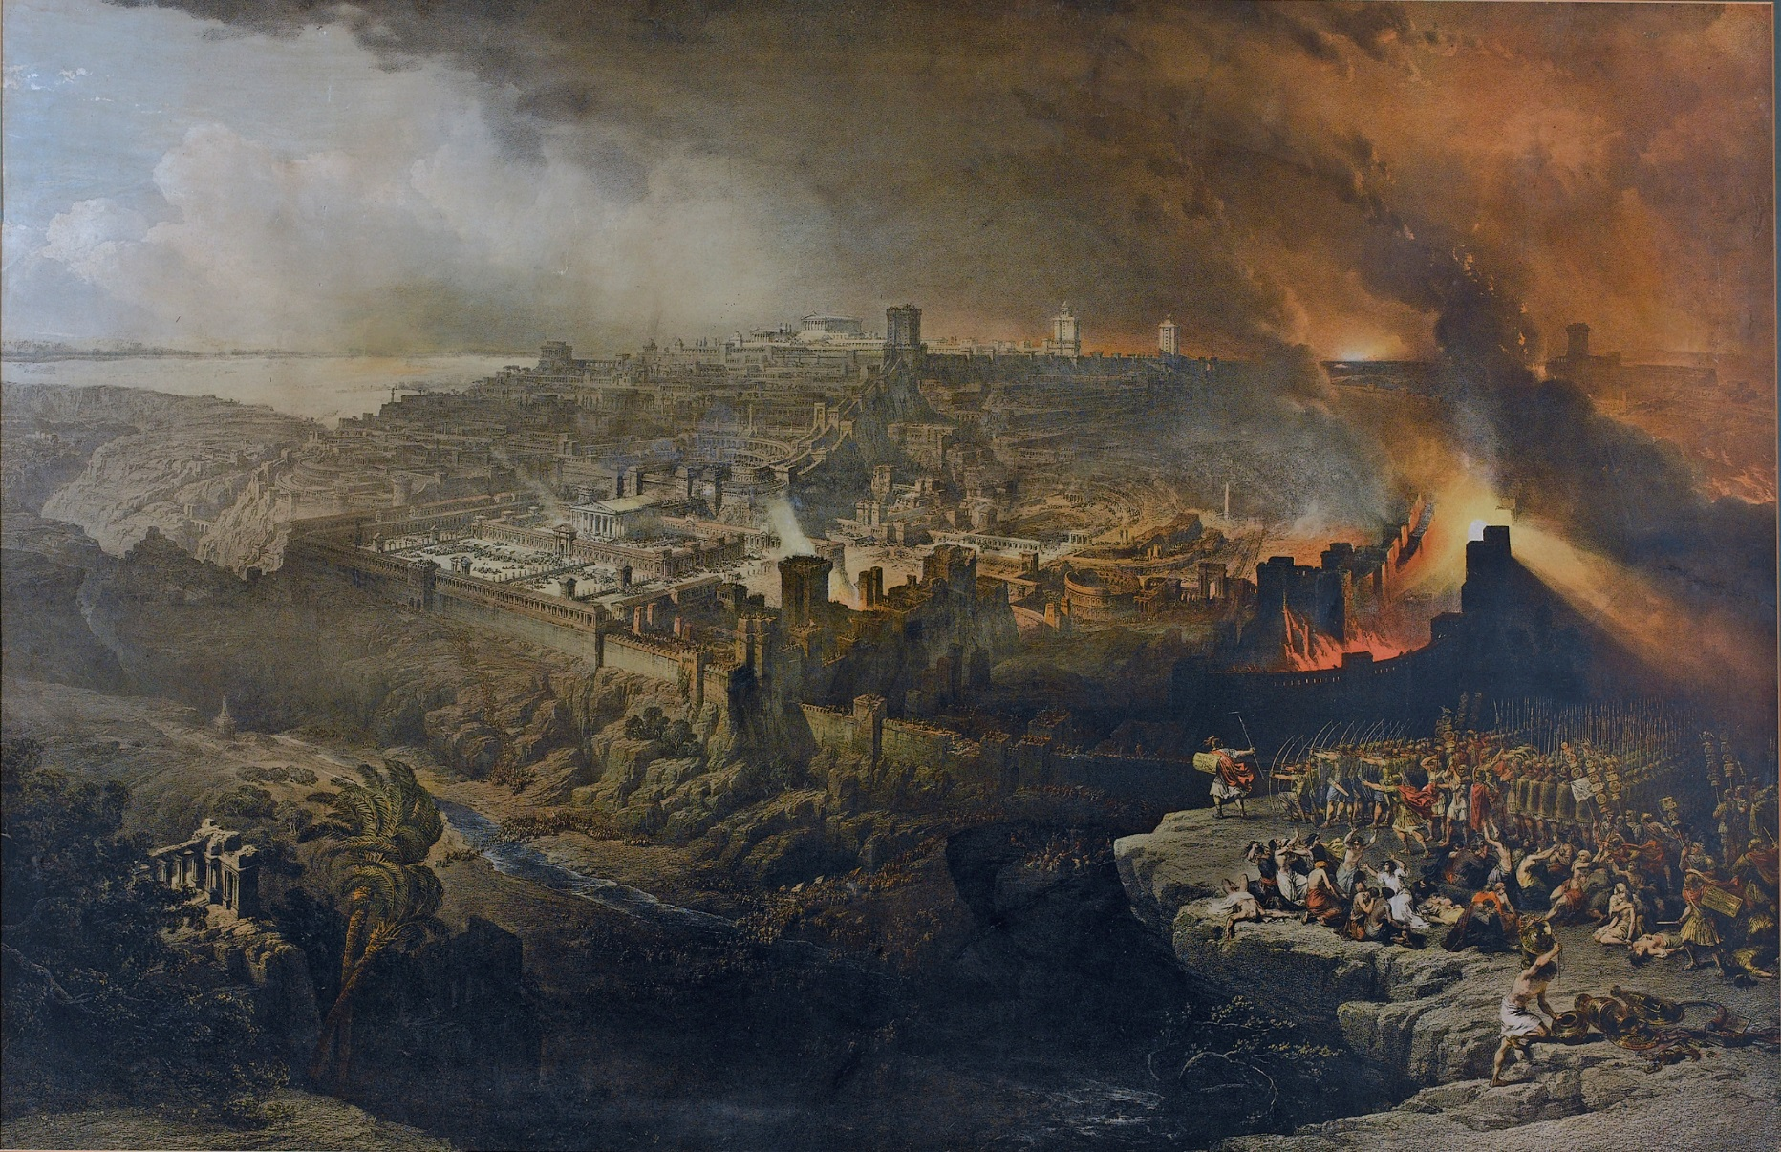
Examining Realized Eschatology
Part 4: The End of the World
2 Peter 3:1-18

Slide 4
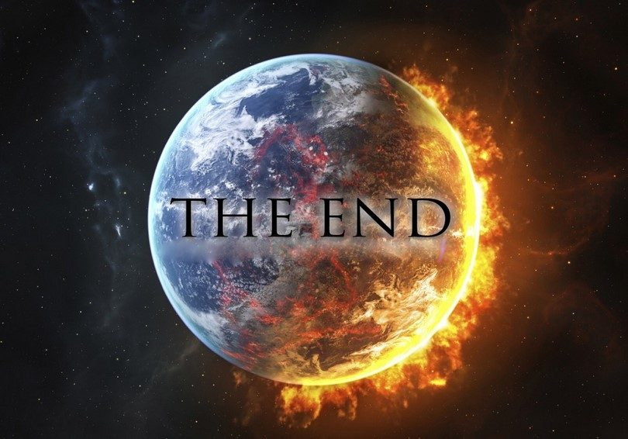
The end of the world
RE teaches the final judgment took place in 70 a.d.
“It is taken as fact by many that God will someday bring everything to a grinding halt. But this is not what the Bible says.”
King, SOP-2, p. 291
“Will this earth burn with fire someday? Will it pass away with a great noise? Just what is the destiny of the material universe that God created in the beginning? The Bible actually has little to say about the destiny of the space-time universe.”
King, SOP-2, p. 293
“The world marked for destruction in prophecy, the end of which involved the second coming of Christ and resulted in the true redemption of Israel, was the Jewish world. Therefore it is the end of the Jewish world and not this material earth we live on today.”
King, SOP-1, p. 83
“To suggest that the fate of the temporal universe is not the topic of Scripture is not to deny the ‘end of the age’ in the end times. The world or age that ended was the Old Covenant world.”
King, SOP-2, p. 293
RE teaches there will NOT be a universal judgment day at the end of time when all men will give an account of their lives and the material universe will come to an end.
Is this true?
Did Jesus' come and the world ended almost 2,000 years ago?
Examining Realized Eschatology

Slide 5
End of the world past?
Redefinition of terms
In RE the word world is almost always defined as Jewish/Mosaic age or Old Covenant.
So the world ended in 70 a.d., because the Law of Moses ended (end of eschaton ).
Like most false doctrines RE advocates have a serious case of ‘tunnel vision.’
Examining Realized Eschatology

Slide 6
End of what?
End of the Old Covenant?
End of the Law of Moses?
End of the Jewish system?
Examining Realized Eschatology

Slide 7
Matthew 13:24-30: “Another parable He put forth to them, saying: ‘The kingdom of heaven is like a man who sowed good seed in his field; 25 but while men slept, his enemy came and sowed tares among the wheat and went his way. 26 But when the grain had sprouted and produced a crop, then the tares also appeared. 27 So the servants of the owner came and said to him, ‘Sir, did you not sow good seed in your field? How then does it have tares?’ 28 He said to them, ‘An enemy has done this.’ The servants said to him, ‘Do you want us then to go and gather them up?’ 29 But he said, ‘No, lest while you gather up the tares you also uproot the wheat with them. 30 Let both grow together until the harvest, and at the time of harvest I will say to the reapers, ‘First gather together the tares and bind them in bundles to burn them, but gather the wheat into my barn.’”

Slide 8
Matthew 13:37-43: “He answered and said to them: ‘He who sows the good seed is the Son of Man. 38 The field is the world, the good seeds are the sons of the kingdom, but the tares are the sons of the wicked one. 39 The enemy who sowed them is the devil, the harvest is the end of the age, and the reapers are the angels. 40 Therefore as the tares are gathered and burned in the fire, so it will be at the end of this age. 41 The Son of Man will send out His angels, and they will gather out of His kingdom all things that offend, and those who practice lawlessness, 42 and will cast them into the furnace of fire. There will be wailing and gnashing of teeth. 43 Then the righteous will shine forth as the sun in the kingdom of their Father. He who has ears to hear, let him hear!”

Slide 9
End of what?
Sower of “the good seed” is Jesus; v. 37
The “field is the world”; v. 38
The “good seed” are the righteous; v. 38
The “tares” are the unrighteous; v. 38
The “enemy that sowed” the “tares” is “the devil” ; v. 38
The “harvest is the end of the world” ; v. 39
“and the reapers are the angels” ; v. 39
Examining Realized Eschatology

Slide 10
End of what?
Righteous and wicked allowed to coexist until “the end of the world” ; cf. KJV, ASV
Compare: Jn. 5:28-29; Matt. 25:31-46
Separation at“the end of the world” is a permanent and complete separation! v. 43
At that point forward the godly beauty of the righteous will no longer be blighted by the “tares” ; v. 43
Did this occur in 70 a.d.? NO!
Examining Realized Eschatology

Slide 11
Revelation 20:10-15: “The devil, who deceived them, was cast into the lake of fire and brimstone where the beast and the false prophet are. And they will be tormented day and night forever and ever. 11 Then I saw a great white throne and Him who sat on it, from whose face the earth and the heaven fled away. And there was found no place for them. 12 And I saw the dead, small and great, standing before God, and books were opened. And another book was opened, which is the Book of Life. And the dead were judged according to their works, by the things which were written in the books. 13 The sea gave up the dead who were in it, and Death and Hades delivered up the dead who were in them. And they were judged, each one according to his works. 14 Then Death and Hades were cast into the lake of fire. This is the second death. 15 And anyone not found written in the Book of Life was cast into the lake of fire.”

Slide 12
End of what?
In 70 a.d. did “small and great…stand before God” ? v. 10
In 70 a.d. was “devil…cast into the lake of fire” ? v. 10
In Revelation 20 “the earth and heaven fled away… and there was found no place for them” ; v. 11
Revelation describes a universal judgment; not a localized one like 70 a.d.
Were “Death and Hades…cast into the lake of fire” in 70 a.d.? 1 Thess. 4:16; Acts 1:11
Examining Realized Eschatology

Slide 13
Hebrews 1:1-12: “God, who at various times and in various ways spoke in time past to the fathers by the prophets, 2 has in these last days spoken to us by His Son, whom He has appointed heir of all things, through whom also He made the worlds; 3 who being the brightness of His glory and the express image of His person, and upholding all things by the word of His power, when He had by Himself purged our sins, sat down at the right hand of the Majesty on high, 4 having become so much better than the angels, as He has by inheritance obtained a more excellent name than they. 5 For to which of the angels did He ever say: ‘You are My Son, Today I have begotten You’? And again: ‘I will be to Him a Father, And He shall be to Me a Son’? 6 But when He again brings the firstborn into the world, He says: ‘Let all the angels of God worship Him.’”

Slide 14
Hebrews 1:1-12: “And of the angels He says: ‘Who makes His angels spirits And His ministers a flame of fire.’ 8 But to the Son He says: Your throne, O God, is forever and ever; A scepter of righteousness is the scepter of Your kingdom. 9 You have loved righteousness and hated lawlessness; Therefore God, Your God, has anointed You With the oil of gladness more than Your companions.’ 10 And: ‘You, Lord, in the beginning laid the foundation of the earth, And the heavens are the work of Your hands. 11 They will perish, but You remain; And they will all grow old like a garment; 12 Like a cloak You will fold them up, And they will be changed. But You are the same, And Your years will not fail.’”

Slide 15
End of what?
Unlike the angels, Jesus is God’s “Son” ; v. 5
Jesus is superior to angels; He is worshiped by the angels; v. 6
Unlike the angels “the Son” is “God” ; v. 8
As “God” “the Son” He is the one who possess “a scepter of righteous…the scepter of Your kingdom” ; v. 8
Discusses Christ’s role in the creation in v. 2 and expands on it in v. 10 by quoting Psalm 102.
Examining Realized Eschatology

Slide 16
End of what?
Draws a contrast between Christ, the Creator, and the material universe, the creation.
Christ the Creator is eternal, the material universe, the creation, is temporal.
RE says this passage is referring to the end of the “Jewish age.”
Once again, RE is guilty of ‘tunnel vision.’
Examining Realized Eschatology

Slide 17
“Let me ask you this. In verse 10 (Heb. 1:10, cvt) the record says, ‘And you, Lord, in the beginning did lay the foundation of the earth, and the heavens are the works of thy hands.’ Is there anybody in his right mind who is going to read this passage in the following fashion: ‘And you, Lord in the beginning of the Mosaic dispensation, did lay the foundation of the earth, that is, you established the law of Moses. And you formed the heavens, that is, the ordinances of the law; these are the works of your hands’? To interpret that as the Jewish law has to be one of the most ridiculous conglomerations of theological garbage ever devised. One hates to use such strong language of condemnation, but the circumstances warrant it.” (The A.D. 70 Theory, p. 98)
End of what?
Verse 11: “they will perish”
What “they will perish” ?
The things He created “in the beginning” : v. 10
What did He create “in the beginning” ? v. 10
He created “the earth” and “the heavens” : v. 11; Gen. 1 & 2
This passage very plainly says, “the earth…and the heavens…They will perish” ! Heb. 1:11
Examining Realized Eschatology

Slide 18
“The traditional idea of the end of the world is developed primarily from the text of 2 Peter 3:10-12, where Peter taught that the elements of the heavens would melt with fervent heat and the earth, along with its works, would be burned up. This is commonly interpreted in a literal sense, and is often quoted to support the end of the temporal universe as part of the end times. If this is the case, why is Peter the only one with this kind of arcane information about earth’s last night? Are not there numerous passages of Scripture showing other ways that the world is going to be destroyed? Aren’t these passages also inspired and valid in their teaching?” (SOP-1, p. 294; emphasis mine, cvt)
End of what?
2 Peter 3:1-13: The “clincher.”
I’ve defended this passage versus materialists (e.g., JWs).
Never dreamt I would have to defend it from false teachers among brethren.
I urge you to read 2 Peter 3:1-13 many times and think about it very carefully.
Examining Realized Eschatology

Slide 19
1 Beloved, I now write to you this second epistle (in both of which I stir up your pure minds by way of reminder), 2 that you may be mindful of the words which were spoken before by the holy prophets, and of the commandment of us, the apostles of the Lord and Savior, 3 knowing this first: that scoffers will come in the last days, walking according to their own lusts, 4 and saying, “Where is the promise of His coming? For since the fathers fell asleep, all things continue as they were from the beginning of creation.” 5 For this they willfully forget: that by the word of God the heavens were of old, and the earth standing out of water and in the water, 6 by which the world that then existed perished, being flooded with water. 7 But the heavens and the earth which are now preserved by the same word, are reserved for fire until the day of judgment and perdition of ungodly men. 8 But, beloved, do not forget this one thing, that with the Lord one day is as a thousand years, and a thousand years as one day. 9 The Lord is not slack concerning His promise, as some count slackness, but is longsuffering toward us, not willing that any should perish but that all should come to repentance.

Slide 20
10 But the day of the Lord will come as a thief in the night, in which the heavens will pass away with a great noise, and the elements will melt with fervent heat; both the earth and the works that are in it will be burned up. 11 Therefore, since all these things will be dissolved, what manner of persons ought you to be in holy conduct and godliness, 12 looking for and hastening the coming of the day of God, because of which the heavens will be dissolved, being on fire, and the elements will melt with fervent heat? 13 Nevertheless we, according to His promise, look for new heavens and a new earth in which righteousness dwells.

Slide 21
End of what?
Peter wrote to “stir up” the “minds” of the brethren.
Reminder needed because of the claims of “scoffers.”
The “scoffers” were, in effect, charging God’s people of preaching a lie.
But, the “scoffers” intentionally withheld something from their own knowledge: The Flood!
Examining Realized Eschatology

Slide 22
End of what?
The Flood is a type (shadow, parallel) of the destruction in store for the Universe.
The first judgment (flood) cleansed and purified the earth; the second and final judgment will literally dissolve the elements of the heavens and earth.
The coming destruction will totally and completely “melt” and “dissolve” the fundamental and elemental constituents of the heavens and earth.
Examining Realized Eschatology

Slide 23
End of what?
We remain “in the last days” because the “scoffers” are still with us and God still speaks “by His Son” : Heb. 1:1
The “scoffers” are uniformitarians who dismiss geological catastrophes (e.g., Noah’s flood) and believe “all things continue as they were from the beginning of creation” : 2 Pet. 3:4
The “scoffers” say it is “settled science” the Universe was not divinely created; we are misguided or candidates for the loony bin.
Examining Realized Eschatology

Slide 24
End of what?
Let’s read 2 Peter 3:1-13 using the scripture-wresting techniques of RE advocates.
Examining Realized Eschatology

Slide 25
1 Beloved, I now write to you this second epistle (in both of which I stir up your pure minds by way of reminder), 2 that you may be mindful of the words which were spoken before by the holy prophets, and of the commandment of us, the apostles of the Lord and Savior, 3 knowing this first: that scoffers will come in 70 a.d. but not thereafter, walking according to their own lusts, 4 and saying, “Where is the promise of His coming? For since the fathers fell asleep, all things continue as they were from the beginning of creation.” 5 For this they willfully forget: that by the word of God the heavens were of old, and the earth standing out of water and in the water, 6 by which the world that then existed perished, being flooded with water. 7 But the old covenant and law of Moses which are now preserved by the same word, are reserved for fire until the day of judgment and perdition of the Jewish system in 70 a.d.

Slide 26
8 But, beloved, do not forget this one thing, that with the Lord one day is as a thousand years, and a thousand years as one day. 9 The Lord is not slack concerning His promise, as some count slackness, but is longsuffering toward Jews, not willing that any Jew should perish but that all Jews should come to repentance.

Slide 27
10 But the day of the Lord will not come as a thief in the night but with the signs Jesus foretold in Matthew 24, in which the old covenant will pass away with a great noise, and the law of Moses will melt with fervent heat? both the Jewish system and the law they follow will be burned up. 11 Therefore, since all these old covenant things will be dissolved, what manner of persons ought you to be in holy conduct and godliness, 12 looking for and hastening the coming of the day of God in 70 a.d., because of which the old covenant will be dissolved, being on fire, and the elements of the law of Moses will melt with fervent heat? 13 Nevertheless we, according to His promise, look for the new covenant and a new religious system in which righteousness dwells.

Slide 28
End of what?
Well-established principle of biblical interpretation: take language literally unless context demands otherwise.
“Rule 1. All words are to be understood in their literal sense, unless evident meaning of the context forbids.—Figures are the exception, literal language the rule; hence we are not to regard anything as figurative until we feel compelled to do so by the evident import of the passage. And even here great caution should be observed. We are very apt to regard contexts as teaching some theory which we have in our minds.” (D. R. Dungan, Hermeneutics, p. 184)
Examining Realized Eschatology

Slide 29
“The problem of ‘tunnel-vision’ is…[insisting] on only one meaning of a word used in different contexts can lead to problems. As Joe Price observed, ‘The A.D. 70 doctrine would make every mention of the ‘coming of the Lord’ or ‘day of the Lord’ mean the same event, regardless of its usage in context’ (Price 593). Words and phrases can have different meanings and applications depending on the context. But if one has a predetermined template of a certain doctrine or timeline, then words are already defined and subjects are already arranged according to the template, regardless of how it may violate a context. Scripture is twisted to fit the predetermined theology in whatever manner is necessary, and then presented as biblical and sound. D. R. Dungan, in his standard text on hermeneutics, warned of this danger:
‘Many seem disposed to regard themselves as at liberty to make anything out of the Bible which their theology may demand or their whims require. And if, at any time, they find a passage that will not harmonize with that view, then the next thing is to find one or more words in the text used elsewhere in a figurative sense, and then demand that such be the Biblical dictionary on the meaning of that word, and hence that it must be the meaning in that place (Dungan 217).’”
End of what?
RE advocates grant, regarding the Flood, that words like “world,” “earth,” “heavens,” and “fire” are literal.
However, regarding the final dissolution of the Universe they claim the terms are figurative.
Consider Marc Gibson (The A.D. 70 Doctrine Examined, p. 14).
Examining Realized Eschatology

Slide 30
End of what?
Peter uses the Flood as a parallel for the final judgment and destruction of the Universe.
“the heavens of old, and the earth standing out of the water and in the water” (v. 5) Literal or figurative?
“the world that then existed perished, flooded by water” (v. 6) Literal or figurative?
Just read Genesis 7:17-24
Examining Realized Eschatology

Slide 31
End of what?
Peter uses the Flood as a parallel for the final judgment and destruction of the Universe.
“the heavens and the earth which are now preserved by the same word” (v. 7, “the present heavens and earth” ; NASV) Literal or figurative?
Peter did not magically shift gears from literal language to figurative language.
RE requires second “the present heavens and earth” to be figurative. i.e., Law of Moses, Old Covenant, etc.
Examining Realized Eschatology

Slide 32
End of what?
Also parallel are “water” and “fire.”
In Noah’s day God used “water” to destroy the earth; at the final judgment He will use “fire.”
One can never read of the Law of Moses being destroyed by “fire.”
It was “fulfilled” : Matt. 5:17-18
Then, “nailed…to the cross” : Col. 2:14
By doing so, Jesus made it inoperative or “obsolete,” and it “vanish [ed] away” : Heb. 8:7-13
Examining Realized Eschatology

Slide 33
End of what?
Peter uses the Flood as a type for the final judgment and destruction of the Universe.
The antitype (fulfillment) is always greater in magnitude, stature, glory, etc. than the type (e.g., Passover lamb vs. Christ).
In 2 Peter 3:1-13 Noah’s Flood is the type; according to RE, the destruction of Jerusalem is the antitype (fulfillment). Make sense? NO!
Examining Realized Eschatology

Slide 34
End of what?
Noah’s Flood was a universal event; every creature “in whose nostrils was the breath of…life” perished except those on the ark: Gen. 7:22
The destruction of Jerusalem, albeit devastating (Matt. 24:22), was a local event infinitesimally smaller and limited in scope.
Noah’s flood “prevailed exceedingly on the earth…and the mountains were covered” ; it killed “all flesh…that moved on the earth; birds and cattle…and every man” (Gen. 7:19-21).
Examining Realized Eschatology

Slide 35
End of what?
The word arcane means “known or understood by very few, myster-ious, secret, obscure, esoteric” (Dictionary.com).
Using that label is a calculating and deceitful attempt to plant the seed of doubt in people’s minds.
The passage is VERY straight forward and to the point; saying it is arcane is an indictment of the Holy Spirit’s ability to make the Bible understandable: 1 Cor. 2:9-10; Eph. 3:1-5
Examining Realized Eschatology

Slide 36
End of what?
The word elements is from the Greek word stoicheion and may refer to any fundamental principles or primary doctrines: cf. Heb. 5:12
RE advocates limit stoicheion to mean principles in 2 Peter 3:10, 12 in an attempt to limit it to the principles of the old covenant, the Law of Moses, the Jewish system.
Such quibbles are a tried and true technique of those seeking to avoid the force of scriptural truth.
Examining Realized Eschatology

Slide 37
End of what?
Vine/Thayer; their first definition of stoicheion is “any first thing.”
Thus, stoicheion can be “any first thing” and is not limited to mean first principles as asserted by RE advocates.
What “first thing” does it refer to in 2 Peter 3:10 & 12?
Refers to the elementary principles or “first things” of the material Universe: “both the earth and the works that are in it will be burned up.”
The Flood destroyed the antediluvian world and the destruction of 2 Peter 3 will destroy the material Universe.
Examining Realized Eschatology

Slide 38
Conclusion
Christians are guided by God’s Word (2 Tim. 3:16-17), not the “doctrines and commandments of men” : Matt. 15:9
RE is “a different gospel” a "damnable heresy" ! Gal. 1:6; 2 Pet. 3:1
Galatians 1:6
Ephesians 4:4-5
Jeremiah 616
Hebrews 9:28
Acts 17:31
Titus 2:13
Examining Realized Eschatology

