Slide 1
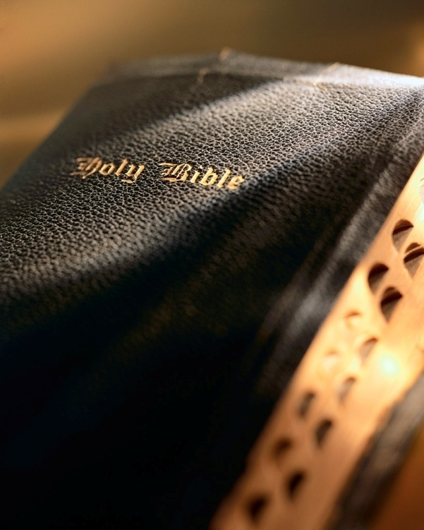

Slide 2
Introduction
James asked, “…For what is your life?” Jas. 4:14
Then he answered, “…It is even a vapour, that appeareth for a little time, and then vanisheth away.” Jas. 4:14
To impress upon our minds the brevity of life, I’m calling our attention to Bible words and phrases that express the shortness of our lives.

Slide 3
For What Is Your Life? James 4:13-16

Slide 4
For what is your life?
Like a vapor: Jas. 4:14; Acts 2:19
Swifter than a weaver’s shuttle: Job 7:6; Heb. 9:27
Like the wind: Job 7:7; Psa. 78:39
As a shadow: Job 8:9; 14:2; 1 Chr. 29:15; 2 Kgs. 20:9-11; Psa. 23:4
Swifter than a post: Job 9:25; Jer. 51:31; Job 12:9; Psa. 25:1
As the swift ships: Job 9:26
Precious Things

Slide 5
For what is your life?
As the eagle hasteth to the prey: Job 9:26
But a few days: Job 10:20; 14:1; Gen. 47:9
Like a flower: Job 14:2; Psa. 103:15-16
As an handbreadth: Psa. 39:5; Gen. 3:19
As a tale that is told: Psa. 90:9-10
As a moment: 2 Cor. 4:17; 1 Sam. 14:14; Lk. 16:26; Rev. 2:10
Precious Things

Slide 6
Since we’re here for only a short time?
Love who needs loving: Matt. 22:37, 39; Eph. 5:25; Titus 2:4; Jn. 13:34-35
Forgive who needs forgiving: Matt. 6:14-15; Eph. 4:32
Work what needs working: Eccl. 9:10; 1 Cor. 15:58; 2 Cor. 6:2; Jn. 9:4
Say what needs saying: Jas. 4:13-16; 2 Cor. 12:13; Matt. 18:15ff; Lk. 18:13; Acts 8:37; Lk. 15:21
Do what needs doing: Jas. 4:17; Rev. 22:14
Live a life worth living: Titus 2:12; Psa. 90:12; 2 Tim. 4:7-8
Precious Things

Slide 7
Conclusion
The only life that will endure,
Is one that’s kind and good and pure;
And so for God I’ll take my stand,
Each day I’ll lend a helping hand.
I’ll help someone in time of need,
And journey on with rapid speed;
I’ll help the sick and poor and weak,
And words of kindness to them speak.
We often sing a song A Beautiful Life (William M. Golden, 1918).
While going down life’s weary road,
I’ll try to lift some trav’ler’s load;
I’ll try to turn the night to day,
Make flowers bloom along the way.
Refrain:
Life’s evening sun is sinking low,
A few more days, and I must go
To meet the deeds that I have done,
Where there will be no setting sun.
Each day I’ll do a golden deed,
By helping those who are in need;
My life on earth is but a span,
And so I’ll do the best I can.
To be a child of God each day,
My light must shine along the way;
I’ll sing His praise while ages roll,
And strive to help some troubled soul.
Indeed, life’s evening sun is sinking low, a few more days, and I must go…
Are you ready? Heb. 9:27

