Slide 1
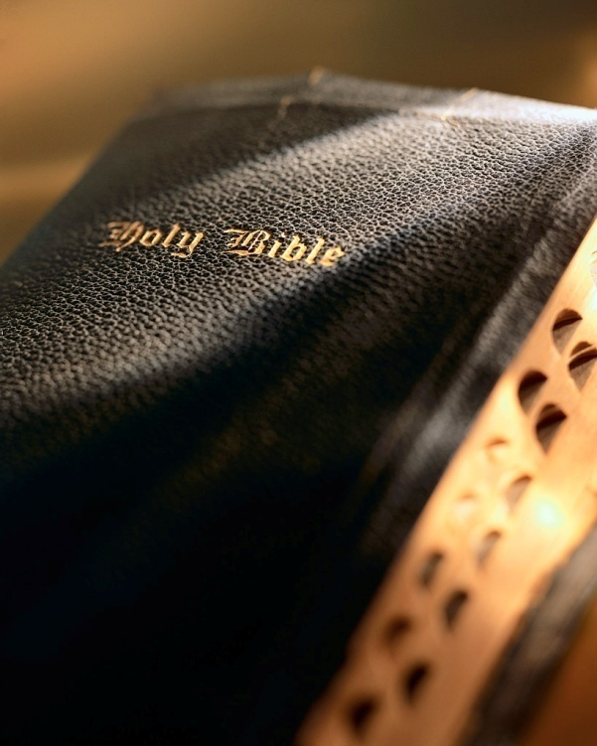

Slide 2
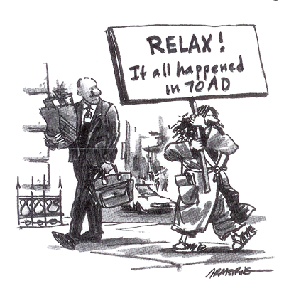
Introduction
Christ's second coming is past.
Final judgment is past.
End of the world is past.
Spiritual adultery.
Denies the resurrection of the dead.
Galatians 1:8-9: "But though we, or an angel from heaven, preach any other gospel unto you than that which we have preached unto you, let him be accursed. 9 As we said before, so say I now again, If any man preach any other gospel unto you than that ye have received, let him be accursed."
Examining Realized Eschatology

Slide 3
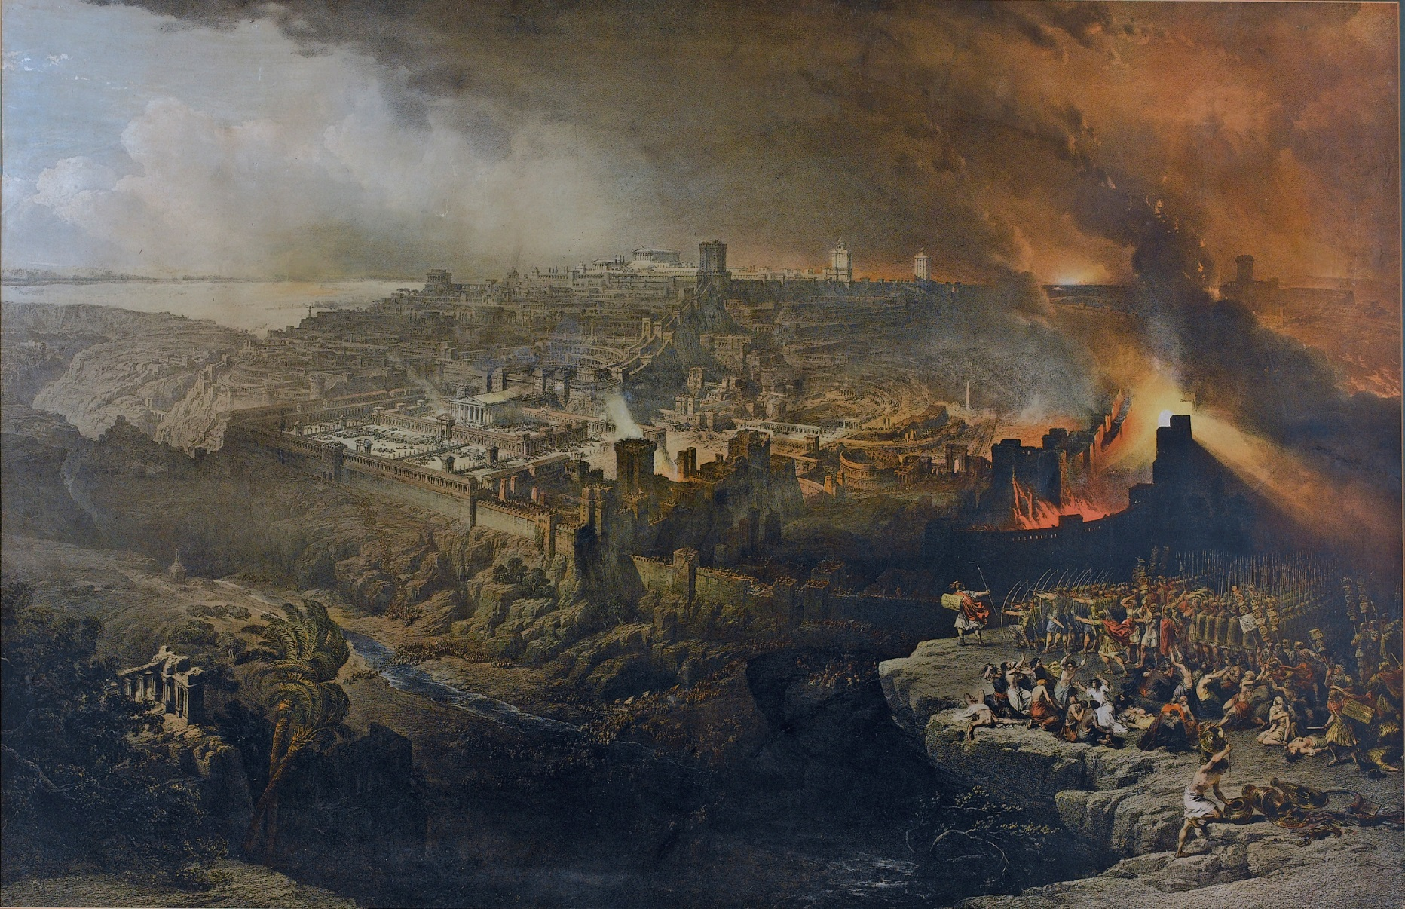
Examining Realized Eschatology
Part 6: The Resurrection
1 Corinthians 15

Slide 4
RE’s teaching
The second coming, judgment, end of the world and resurrection took place in 70 a.d. when Jerusalem was destroyed by the Romans.
Teaches there will NOT be a bodily resurrection of the dead when the Lord returns to judge the world: 1 Cor. 15; 2 Pet. 3:10; 2 Tim. 4:8; 1 Thess. 4:17
Quotes from RE champion Max King:
Examining Realized Eschatology

Slide 5
RE’s teaching
“…the expected eschatological resurrection was the translation of the children of God from the Old Covenant to the New Covenant (2 Cor. 3:18). The death from which we are corporately raised is from sin-death, or alienation from God. This is what it meant for Christ to be the firstfruits of the resurrection (1 Cor. 15:20, 23), the harvest to follow was the early church and all Israel (Jas. 1:18, cf. Revs. 14:4).” (SOP-2, p. 309)
Examining Realized Eschatology

Slide 6
RE’s teaching
“Is it possible that biblical resurrection is about a ‘corporate’ body (singular) versus individual bodies (plural)?” (SOP-2, p. 315)
In reference to the “dead” of 1 Cor. 15:12: “We (RE advocates, cvt) believe this class, ‘the dead, points to Old Testament Israel (under law).” (SOP-2, p. 345)
Examining Realized Eschatology

Slide 7
RE’s teaching
“The natural body that was sown answers to the fleshly or carnal system of Judaism in which existed prophecies, types, and patterns from which came the spiritual body designed by God. Judaism answers to the field or the world in which the good seed was sown (Matt. 13:37-38) this natural body receiving its death blow at the cross and beginning to wax old and decay (Heb. 8:13) became a nursery or seed body for the germination, growth and development of the spiritual body by means of the gospel. Thus, out of the decay of Judaism arose the spiritual body of Christianity that became fully developed or resurrected by the end time (i.e., 70 a.d., cvt). Hence, this is the primary meaning of Paul’s statement ‘it is sown a natural body, it is raised a spiritual body; there is a natural body, then there is a spiritual body.’” (SOP-1, p. 200)
Examining Realized Eschatology

Slide 8
RE’s teaching
“The fall of Jerusalem was the time of death’s destruction. Death and Hades were both cast into the Lake of Fire. Death, biblically speaking, is alienation from God, and the destruction of death is the end of that alienation…” (SOP-2, p. 289)
“The church was in the grave or casket of Judaism until the Roman army destroyed Jerusalem.” (King-Nichols debate, 1973)
“I deny that John 5:28 is a literal grave in the cemetery somewhere.” (King-Nichols debate, 1973)
Examining Realized Eschatology

Slide 9
RE’s teaching
“Here is the Max King view of the resurrection. The church came into existence on the day of Pentecost, Acts chapter 2, in the year A.D. 30. It is alleged that certain portions of the law of Moses were nailed to the cross that very year, but that the Mosaic system, in a sense, also continued in force until A.D. 70, so that, in reality, there were two systems operating at the same time—the Mosaic system and the Christian system.
Examining Realized Eschatology

Slide 10
RE’s teaching
Here was the situation, as they allege it. The Mosaic regime was hovering over, smothering, dominating, intimidating, and persecuting the Christian system, so that the kingdom, the church (in its power and glory) was not yet fully operative. However, in A.D. 70, when the Jewish nation was destroyed by the Romans, the church, or ‘the body’ was, in a manner of speaking, resurrected. It had, in effect, been ‘buried’ under Judaism for forty years, from A.D. 30 to 70. When the Jewish nation fell, though, in A.D. 70, there was at that time, effectually speaking, a resurrection of Christianity. It was a raising of the body of Christ, from that old suppressive, Judaistic system. So, according to the theology of Max King and his followers, when the Bible speaks of the resurrection of the body, it is not discussing the human body; rather, it is alluding to the resurrection of the church out of stifling Judaism.” (The A.D. 70 Theory, pp. 59-60)

Slide 11
RE’s teaching
The “translation of the children of God from the Old Covenant to the New Covenant.”
RE denies that the “resurrection of the dead” mentioned prominently in the New Testament is a literal resurrection of human beings: Matt. 22:23-33; Mk. 12:18-27; Lk. 20:27-40; Acts 23:6; 24:15; 1 Cor. 15; Phil. 3:10-11
The “harvest was the early church and all Israel.”
The resurrection is of a “corporate body” (singular) not “individual bodies” (plural).
“Christ was the firstfruits” of the resurrection, but Israel was “the harvest” of the resurrection.
Israel (“carnal system of Judaism”) was “the natural body that was sown” and the “spiritual body” that was raised is “Christianity,” and this resurrection occurred in 70 a.d.
The “church” was raised from the dead because it “was in the grave or casket of Judaism.”
Examining Realized Eschatology

Slide 12
Matthew 22:23-33
23 The same day the Sadducees, who say there is no resurrection, came to Him and asked Him, 24 saying: “Teacher, Moses said that if a man dies, having no children, his brother shall marry his wife and raise up offspring for his brother. 25 Now there were with us seven brothers. The first died after he had married, and having no offspring, left his wife to his brother. 26 Likewise the second also, and the third, even to the seventh. 27 Last of all the woman died also. 28 Therefore, in the resurrection, whose wife of the seven will she be? For they all had her.”
Examining Realized Eschatology

Slide 13
Matthew 22:23-33
29 Jesus answered and said to them, “You are mistaken, not knowing the Scriptures nor the power of God. 30 For in the resurrection they neither marry nor are given in marriage, but are like angels of God in heaven. 31 But concerning the resurrection of the dead, have you not read what was spoken to you by God, saying, 32 ‘I am the God of Abraham, the God of Isaac, and the God of Jacob’? God is not the God of the dead, but of the living.” 33 And when the multitudes heard this, they were astonished at His teaching.
Examining Realized Eschatology

Slide 14
Matthew 22:23-33
The Sadducees discuss the death of eight people in vv. 24-27: “brothers” “even to the seventh” “died” and “then last of all the woman died also.”
The Sadducees then clearly say in v. 28: “in the resurrection, whose wife of the seven will she be?”
In v. 30 Jesus says: “in the resurrection they neither marry or are given in marriage.”
Are the “they” people or the church? People or Israel? People or the New Covenant?
Examining Realized Eschatology

Slide 15
Matthew 22:23-33
Jesus said if one denies the resurrection: “Ye do err, not knowing the scriptures, or the power of God.” v. 29
The Sadducees smugly thought they had painted Jesus into a philosophical corner.
If the resurrection was of causes, institutions, covenants or corporate bodies; Jesus would surely have corrected them!
Examining Realized Eschatology

Slide 16
Matthew 22:23-33
“For in the resurrection they neither marry nor are given in marriage.” v. 30
“I am the God of Abraham, the God of Isaac, and the God of Jacob. God is not the God of the dead, but of the living.” vv. 31-32
Examining Realized Eschatology

Slide 17
Matthew 22:23-33
“The fact is, that (i.e., bodily resurrection, cvt) is the only kind of resurrection there can be (in this passage, cvt). There cannot be a resurrection of the soul, because the soul does not die. It is absurd to suggest that the Lord was speaking of a resurrection of the church in this context. Abraham, Isaac, and Jacob were not members of the church! The Savior was talking about the resurrection of the physical body, that is, the body that is now physical, but will exist in a non-physical form at the time of the resurrection (see 1 Cor. 15).” (The A.D. 70 Theory: A Review of the Max King Doctrine, p. 65)
Examining Realized Eschatology

Slide 18
Luke 20:34-37
34 “The sons of this age marry and are given in marriage. 35 But those who are counted worthy to attain that age, and the resurrection from the dead, neither marry nor are given in marriage; 36 nor can they die anymore, for they are equal to the angels and are sons of God, being sons of the resurrection.”
Examining Realized Eschatology

Slide 19
John 5:28-29
28 Do not marvel at this; for the hour is coming in which all who are in the graves will hear His voice 29 and come forth — those who have done good, to the resurrection of life, and those who have done evil, to the resurrection of condemnation.
Examining Realized Eschatology

Slide 20
John 5:28-29
Who are “in the graves” ? v. 28 Church? Israel? Christians oppressed by Judaism?
No! Individual human beings! cf. Jn. 5:24 Who has everlasting life? “he who hears my word and believes in Him who sent Me.”
All men destined to die (Heb. 9:27), and all men destined to be resurrected! 1 Cor. 15:22; Lk. 16:19-31
Examining Realized Eschatology

Slide 21
John 5:28-29
Doesn’t square with the nature of the church:
THINK!
How many churches in the 1st century?
A “good” church
and a “bad” church?!
Strength: “and the gates of Hades shall not prevail against it” (Matt. 16:18)
Growth: “believers were increasingly added to the Lord, multitudes of both men and women” (Acts 5:14; 6:1, 7; 9:31; 11:21; 14:21; 16:5)
Character:
Jesus: “resurrection of life” versus “resurrection of condem-nation” (Jn. 5:28-29)
Paul: “resurrection of the…just” versus “resurrection of the …unjust” (Acts 24:15)
Examining Realized Eschatology

Slide 22
John 5:28-29
Two classes of people:
“those that have done good” and experience “the resurrection of life” (Jn. 5:29)
Same as the “just” (Acts 24:15)
Same as the “sheep” who go into “eternal life” (Matt. 25:31-46)
“those that have done evil” and experience “the resurrection of condemnation” (Jn. 5:29)
Same as the “unjust” (Acts 24:15)
Same as the “goats” who go into “everlasting punishment” (Matt. 25:31-46)
Examining Realized Eschatology

Slide 23
John 6:40
“And this is the will of Him who sent Me, that everyone who sees the Son and believes in Him may have everlasting life; and I will raise him up at the last day.”
cf. Jn. 11:17-27
Examining Realized Eschatology

Slide 24
Acts 17:29-32
29 Therefore, since we are the offspring of God, we ought not to think that the Divine Nature is like gold or silver or stone, something shaped by art and man’s devising. 30 Truly, these times of ignorance God overlooked, but now commands all men everywhere to repent, 31 because He has appointed a day on which He will judge the world in righteousness by the Man whom He has ordained. He has given assurance of this to all by raising Him from the dead.”
32 And when they heard of the resurrection of the dead, some mocked, while others said, “We will hear you again on this matter.”
Examining Realized Eschatology

Slide 25
Acts 17:29-32
Would Gentile Athenians understand the resurrection of the church out of the oppression of Judaism?! Ridiculous!
Paul gives Jesus’ resurrection as “assurance” of our resurrection.
How was Jesus resurrected? Literally and bodily: Jn. 20:24-29
What parallel is there between a physical, bodily resurrection (e.g., Jesus) and figurative, spiritual resurrection taught by RE advocates? None really!
Examining Realized Eschatology

Slide 26
Acts 23:6-8
6 But when Paul perceived that one part were Sadducees and the other Pharisees, he cried out in the council, “Men and brethren, I am a Pharisee, the son of a Pharisee; concerning the hope and resurrection of the dead I am being judged!”
7 And when he had said this, a dissension arose between the Pharisees and the Sadducees; and the assembly was divided. 8 For Sadducees say that there is no resurrection — and no angel or spirit; but the Pharisees confess both.
Examining Realized Eschatology

Slide 27
Acts 23:6-8
Would the Pharisees have supported the resurrection of:
The church? Absolutely not!
Israel? Absolutely not, satisfied with status quo!
Children of God from Old Covenant to New Covenant? Absolutely not!
Christian system over Judaism? Absolutely not!
The only resurrection the Pharisees would have supported is the one Jesus described in Matthew 22:23-33? Yes!
Examining Realized Eschatology

Slide 28
1 Corinthians 15
The most extensive discussion of the resurrection in all of Scripture.
In The Cross and the Parousia of Christ, Max King spends 219 pages discussing (butchering) 1 Corinthians 15.
In RE doctrine, the resurrection is never to be taken as a literal, bodily resurrection of the dead, except for Jesus.
RE advocates make the exact same mistake the no resurrection party at Corinth made! Their position has serious consequences:
Examining Realized Eschatology

Slide 29
1 Moreover, brethren, I declare to you the gospel which I preached to you, which also you received and in which you stand, 2 by which also you are saved, if you hold fast that word which I preached to you — unless you believed in vain.
3 For I delivered to you first of all that which I also received: that Christ died for our sins according to the Scriptures, 4 and that He was buried, and that He rose again the third day according to the Scriptures, 5 and that He was seen by Cephas, then by the twelve. 6 After that He was seen by over five hundred brethren at once, of whom the greater part remain to the present, but some have fallen asleep. 7 After that He was seen by James, then by all the apostles. 8 Then last of all He was seen by me also, as by one born out of due time.

Slide 30
9 For I am the least of the apostles, who am not worthy to be called an apostle, because I persecuted the church of God. 10 But by the grace of God I am what I am, and His grace toward me was not in vain; but I labored more abundantly than they all, yet not I, but the grace of God which was with me. 11 Therefore, whether it was I or they, so we preach and so you believed.
12 Now if Christ is preached that He has been raised from the dead, how do some among you say that there is no resurrection of the dead? 13 But if there is no resurrection of the dead, then Christ is not risen. 14 And if Christ is not risen, then our preaching is empty and your faith is also empty. 15 Yes, and we are found false witnesses of God, because we have testified of God that He raised up Christ, whom He did not raise up — if in fact the dead do not rise. 16 For if the dead do not rise, then Christ is not risen. 17 And if Christ is not risen, your faith is futile; you are still in your sins! 18 Then also those who have fallen asleep in Christ have perished. 19 If in this life only we have hope in Christ, we are of all men the most pitiable.

Slide 31
20 But now Christ is risen from the dead, and has become the firstfruits of those who have fallen asleep. 21 For since by man came death, by Man also came the resurrection of the dead. 22 For as in Adam all die, even so in Christ all shall be made alive. 23 But each one in his own order: Christ the firstfruits, afterward those who are Christ's at His coming. 24 Then comes the end, when He delivers the kingdom to God the Father, when He puts an end to all rule and all authority and power. 25 For He must reign till He has put all enemies under His feet. 26 The last enemy that will be destroyed is death. 27 For "He has put all things under His feet." But when He says "all things are put under Him," it is evident that He who put all things under Him is excepted. 28 Now when all things are made subject to Him, then the Son Himself will also be subject to Him who put all things under Him, that God may be all in all.

Slide 32
1 Corinthians 15
“Christ is not risen” (1 Cor. 15:13, 17).
The apostle’s preaching is “vain” (1 Cor. 15:14).
Our “faith is also vain” (1 Cor. 15:14, 17).
The apostles were “false witnesses of God” (1 Cor. 15:15).
We “are yet in our sins” (1 Cor. 15:17).
Deceased Christians “are perished” (1 Cor. 15:18).
Our“hope in Christ” is limited to “this life only” (1 Cor. 15:19).
And,“we are of all men most pitiable” (1 Cor. 15:19).
Examining Realized Eschatology

Slide 33
1 Corinthians 15
Argument #1: Paul argues for a literal and bodily resurrection of all the dead; righteous and wicked.
They didn’t deny literal, bodily resurrection of Christ.
How did Christ die? Literally & bodily (Matt. 27:50; Mk. 15:37; Lk. 23:46; Jn. 19:30).
How did Christ rise? Literal & bodily (vv. 4-8; Jn. 20:24-29).
For there to be any parallel between Christ’s resurrection and the general resurrection; they must both be of the same type: Literal & bodily
Examining Realized Eschatology

Slide 34
1 Corinthians 15
Argument #2: Consider meaning of word resurrection.
Greek anastasis : “to cause to stand” (Vine).
Whatever “lies down” will made to “stand up”: 15:36
What part of Jesus “lay down” when he died? Soul? No! (Lk. 23:43; Acts 2:27) It was His body (Matt. 27:58-60; Mk. 15:45-47; Lk. 23:52-55; Jn. 19:38-42).
What part of Jesus was made to “stand up” when He was resurrected? Soul? No! It was His body (Lk. 24:3, 23).
All exactly as the Lord predicted: Matt. 17:22-23
Examining Realized Eschatology

Slide 35
1 Corinthians 15
Argument #2: Consider meaning of word resurrection.
What is “laid down” will be made to “stand up”
1 Cor. 15:44: “It is sown a natural body, it is raised a spiritual body. There is a natural body, and there is a spiritual body.”
1 Cor 15:51-53: “Behold, I tell you a mystery: We shall not all sleep, but we shall all be changed — 52 in a moment, in the twinkling of an eye, at the last trumpet. For the trumpet will sound, and the dead will be raised incorruptible, and we shall be changed. 53 For this corruptible must put on incorruption, and this mortal must put on immortality.” cf. Phil. 3:21; 1 Jn. 3:2
A resurrection requires a death; whatever died (“laid down”) is that which is resurrected (“stand up”): 15:36
Jesus died and His “body was laid” (Lk. 23:55) “in…a new tomb” (Jn. 19:40); in His resurrection the same body was “raised up” (Acts 2:24).
What was “laid down” when “those…in Christ” had “fallen asleep” (1 Cor. 15:18). Souls? No! Their bodies!
Paul says these same people will ultimately be resurrected: 1 Cor. 15:23, 44, 51-53
Examining Realized Eschatology

Slide 36
1 Corinthians 15
Argument #3: Resurrection of Christ proves the general resurrection of all the dead: righteous and wicked.
Paul describes Christ’s resurrection: “Christ…has become the firstfruits of those who have fallen asleep” (v. 20).
“firstfruits” served as a sample of the entire crop; it guaranteed a harvest to follow of same kind and quality.
Christ’s literal and bodily resurrection guarantees all will be literally and bodily resurrected!
Package deal: If Christ was resurrected; all men will be resurrected! 1 Cor. 15:22; cf. Jn. 5:28-29; Acts 24:15
Examining Realized Eschatology

Slide 37
1 Corinthians 15
Argument #4: Paul’s entire resurrection discussion concerns people.
Read v. 22: “For as in Adam all die, even so in Christ all shall be made alive.”
Paul was concerned at the consequences of denying the general resurrection because it would mean: “those who have fallen asleep in Christ have perished” v. 22
Who are “those who have fallen asleep ” ? Real people! Faithful Christians!
If no general resurrection of the dead “we are of all men most pitiable” : v. 19
Examining Realized Eschatology

Slide 38
1 Corinthians 15
Argument #5: Adam led all the human race into death; Jesus leads all the human race to eternal life.
Read vv. 21-22: “For since by man came death, by Man also came the resurrection of the dead. For as in Adam all die, even so in Christ all shall be made alive.”
v. 22: the first “all” is all people who die (Heb. 9:27); the second “all” are the very same people: Jn. 5:28-29
Death in 1 Corinthians 15:21-22 refers to the death of all human beings, hence, the resurrection refers to all human beings. Cf. Matt. 10:28; Mk. 9:42-48
Examining Realized Eschatology

Slide 39
1 Corinthians 15
Final thoughts on 1 Corinthians 15: When does Paul say the “resurrection of the dead” will occur?
When will Jesus come?
“And this is the will of Him who sent Me, that everyone who sees the Son and believes in Him may have everlasting life; and I will raise him up at the last day.”
John 6:40
Paul says: “at His coming” (v. 23).
Which“coming” ? When Christ “delivers the kingdom to the Father” (v. 24).
Why? “For He must reign till He has put all enemies under His feet. The last enemy that will be destroyed is death.” (vv. 25, 26, 52-54).
When? When all“those who have fallen asleep in Christ” are “made alive.” (vv. 18, 22). 70 a.d.? NO!
Examining Realized Eschatology

Slide 40
Conclusion
RE’s denial of the resurrection opens the door to gross infidelity! Paul said so!
“If the dead do not rise, ‘Let us eat and drink, for tomorrow we die!’”
1Corinthians 15:32
Beware! RE is not harmless! It is a fellowship issue! 1 Cor. 5:6; 2 Jn. 9-11
Beware! RE is not a simple differ-ence of opinion on “eschatological matters”!
RE teaches the very same error taught and believed by some at Corinth: “there is no resurrection of the dead” !
Consequently RE denies the resurrection of Christ and all that it means! 1 Cor. 5:12-19; Rom. 1:4; 4:24-25; Acts 20:28; Eph. 5:23
If RE is not a “damnable heresy” I don’t know what one is! 1 Pet. 2:1
Examining Realized Eschatology

