Slide 1
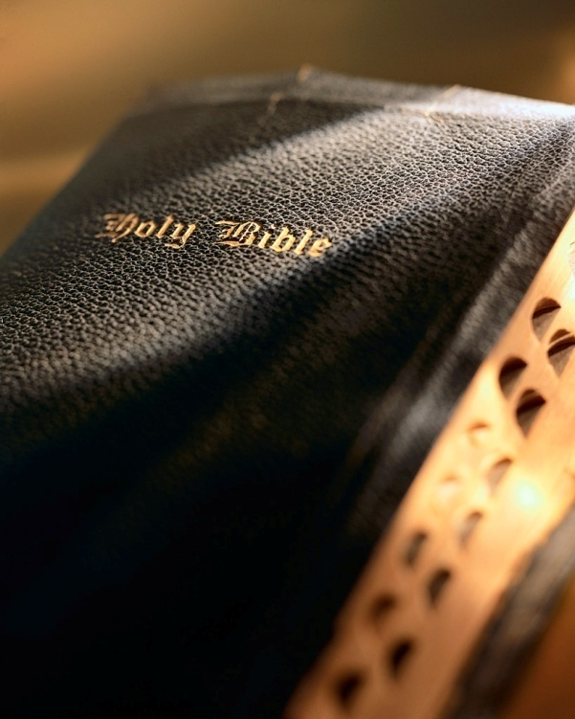

Slide 2
Introduction
We need to see the “big picture”; see the Bible as one unified theme.
Bible written by ~40 men over a period of 1,500 years:
Highly educated to no education; fishermen to kings.
Different nationalities (Hebrew, Greek).
Diverse cultures (e.g., herdsmen, kings, govt. officials).
Different languages (Hebrew, Aramaic, Greek).
66 books (39 Old Testament, 27 New Testament): law, poetry, history, narrative, prophecy.
One unique theme: God’s amazing scheme of redemption!

Slide 3
God’s Amazing Scheme of Redemption
Ephesians 1:3-5

Slide 4
Only one gospel
The Great Commission: Mk. 16:15-16
God’s power to save: Rom. 1:16; 2 Thess. 2:13-14; 1 Cor. 15:1-2
Lost without it: 2 Thess. 1:7-10; 1 Jn. 2:3-5
Beware of false gospels: Gal. 1:6-9; Matt. 7:13-16; Jn. 16:13; Eph. 3:1-5; 1 Jn. 4:1, 6; Eph. 4:4-6; Jude 3; Matt. 15:14
Will the real gospel please stand up: Gal. 3:24; Rom. 15:4; 1 Cor. 10:11; 2 Tim. 3:15
God’s Scheme of Redemption

Slide 5
God is holy
“The god of this century no more resembles the Sovereign of Holy Writ than does the dim flickering candle the glory of the midday sun. The god who is talked about in the average pulpit, spoken of in the ordinary Sunday school, mentioned in much of the religious literature of the day, and preached in most of the so-called Christian conferences, is a figment of human imagination, an invention of maudlin sentimentality. The heathen outside the pale of Christendom form gods of wood and stone, while millions of heathen inside Christendom manufacture a god out of their carnal minds. In reality, they are but atheists, for there is no other possible alternative between an absolutely supreme God, and no God at all. A ‘god’ whose will is resisted, whose designs are frustrated, whose purpose is checkmated, possesses no title to Deity, and so far from being a fit object of worship, merits naught but contempt.” (Arthur Pink, Gleanings in the Godhead, pp. 28-29)
All biblical understand absolutely depends upon us knowing God: 1 Jn. 2:3-5
Who is He?
What are His characteristics?
What are His attributes?
One cannot truly understand the gospel until he knows and understands God.
God only reveals Himself and His will in the Bible: 1 Cor. 2:4-13
God’s character is defined by holiness: Psa. 5:4; 1 Jn. 1:5; Psa. 99:5; 145:3; Ex. 15:11; Psa. 99:9; Isa. 57:15
God’s holy demand: 1 Pet. 1:14-16
God’s Scheme of Redemption

Slide 6
Sin is terrible
God absolutely abhors sin, any sin, all sin! 1 Jn. 3:4
Sin separates us from God: Isa. 59:2; Hab. 1:13; Eph. 2:1, 5; Col. 2:13; Rom. 6:23; 1 Tim. 5:6
God’s holiness seen in His justice and love: Psa. 33:4-5; 89:14; Gen. 2 & 3; 6:5-7; 2 Pet. 2:5; Gen. 6:8-9; 2 Pet. 3:9
All have sinned: Rom. 3:23
God’s Scheme of Redemption

Slide 7
God’s justice demands life
The consequences of sin: Gen. 3:16-19; 1 Cor. 15:21-22
Sin separates us from God: Gen. 2:16-17; Rom. 3:23; 6:23; Jas. 1:14-15; Isa. 59:2
Forgiveness requires shedding of blood: Heb. 9:22; Lev. 17:11; Gen. 3:21
We are all in a desperate situation we cannot rectify on our own! Rom. 3:23; 6:23
God’s Scheme of Redemption

Slide 8
God’s love provides mercy
Atonement: Eph. 2:4-5; Heb. 9:22; Lev. 16:30; Rom. 3:21-26
Blood: Lev. 17:11; Heb. 9:22; Lev. 22:21-25; Eph. 2:5, 8
Blood represents Life
Innocent life atones for Sinner
Innocent life represents Guilty life
God’s Scheme of Redemption

Slide 9
Faith responds
Faith: Heb. 9:22; 11:6
Faith in the Old Testament: Heb. 11:4, 7, 8, 17
“by faith Abel offered unto God a more excellent sacrifice” (vs. 4).
“by faith Noah…moved with fear, prepared an ark” (vs. 7).
“by faith Abraham…obeyed…and went out…” (vs. 8).
“by faith Abraham…offered up Isaac…” (vs. 17).
Living faith vs. dead faith (belief-based action): Jas. 2:14, 26; Deut. 8:2; 2 Kgs. 5:1-14
God’s Scheme of Redemption

Slide 10
Lesson #1
There is only one gospel: Mk. 16:15-16; Rom. 1:16; 2 Thess. 2:13-14; 1:7-10; Gal. 1:6-9; Matt. 7:13-16
God is holy: Psa. 99:3; 1 Jn. 1:5; 1 Pet. 1:14-16
Sin is terrible: Isa. 59:2; Rom. 3:23; 6:23
God’s justice demands life (blood): Lev. 17:11; Gen. 3:16-19
God’s love provides mercy: Eph. 2:4-5; Heb. 9:22
Faith responds: Jas. 2:26; Gal. 5:6; 2 Kgs. 5
God’s Scheme of Redemption

Slide 11
Jesus is God’s sacrificial lamb
Animal sacrifices existed for thousands of years.
Climactic time in history when John paved the way for Jesus Christ: Matt. 3:3
John recognized who Jesus was, “Behold! The Lamb of God who takes away the sin of the world.” Jn. 1:29
John’s statement is God’s scheme of redemption distilled into one statement: 1 Jn. 2:1-2; 2 Cor. 5:18-21; 1 Jn. 4:14; Eph. 3:10-11
Jesus was perfect and took the place of animal sacri-fices: Matt. 26:28; 20:28; Heb. 4:15; 9:14; 10:1-4; Lev. 16; Rom. 5:6-8; Eph. 2:5, 8; Rom. 3:24; Isa. 53
God’s Scheme of Redemption

Slide 12
Jesus paid the price owed by the sinner
Jesus’ innocent life qualified Him to stand in for the guilty…YOU and ME! 1 Pet. 2:24
Christ’s death results in the death of the believer: 1 Pet. 2:24; Col. 3:3
Christ’s role is summed up in: 2 Cor. 5:21; Heb. 7:26-28
Jesus came as a man and as Deity to offer the perfect sacrifice for our sins and reconciled us to God: Eph. 2:13-16; Col. 1:21-23
By dying with Christ, we can have our sins forgiven, share His victory over death, and have the hope of eternal life: 1 Pet. 2:24; Rom. 6:6, 8
God’s Scheme of Redemption

Slide 13
The believer must die with Christ
The primary action in the scheme of redemption is our death with Jesus Christ.
Christ’s death symbolizes the death of the believer: 2 Tim. 2:11; Rom. 6:8; Col. 2:20; 3:3; Gal. 2:20; 2 Cor. 5:14; Rom. 6:7
How and when do I die with Christ? Rom. 6:3-23
Have you died with Christ?
God’s Scheme of Redemption

Slide 14
What the apostles taught
Baptism (Gr. = immersion) is the point where our sins are cleansed by faith in Christ’s blood—where we die with Christ.
Baptism is where we are united with Christ’s death by faith and, is when our sins are removed and we stand sanctified, justified, and righteous (acquitted) before God: Rom. 6 (chart)
God’s Scheme of Redemption

Slide 15
What the apostles taught
The apostles taught that baptism was the point WHEN:
We are justified by faith: Gal. 3:26-27
We are saved by faith in Christ’s work: Col. 2:12
We are saved by baptism: 1 Pet. 3:21
God’s Scheme of Redemption

Slide 16
What the apostles taught
There is only one gospel, hence, only one baptism: Eph. 4:4-6
Baptism is the act of faith, and the point at which one’s sins are removed: Rom. 6:6, 7, 11, 18, 22; Acts 22:16
“…that the body of sin might be done away with…” Rom. 6:6
“For he who has died has been freed from sin.” Rom. 6:7
“…reckon yourselves to be dead indeed to sin, but alive to God in Christ Jesus our Lord” Rom. 6:11
“…having been set free from sin…” Rom. 6:18
“…now having been set free from sin…” Rom. 6:22
God’s Scheme of Redemption

Slide 17
What the apostles practiced
What the apostles practiced is powerful and valuable: Jn. 16:13; Mk. 16:15-16; Matt. 28:18-20
Baptism commanded “for the remission of sins” : Acts 2:38
Baptism included in“preaching Christ” : Acts 8:5, 12
Baptism included in“preaching Jesus” : Acts 8:35-39
Baptism is when and where the Lord added one “to the church” : Acts 2:41, 47
The conversion of Saul: Acts 9, 22
The figure of baptism: Acts 22:16; Titus 3:5; Jn. 3:3-5; Rom. 6:4, 8, 23; 1 Pet. 3:21; Col. 2:12
God’s Scheme of Redemption

Slide 18
The command of Jesus
Remember the “Great Commission”? Mk. 16:15-16; Matt. 28:19
As we understand God’s plan of redemption, we can see why Christ commanded baptism for believers of the gospel and why belief in the gospel is a prerequisite to baptism.
What about belief alone? Jn. 3:16
“believe” is a synecdoche; where a part represents the whole.
Here “belief”, a part, is used to represent the whole; or ALL that is involved in salvation (confession, Rom. 10:10; repentance, Acts 17:30; and baptism, Mk. 16:16; 1 Pet. 3:21).
James explodes the notion “belief alone” saves: Jas. 2:19, 24; Col. 2:12; Gal. 5:6; Col. 1:13; Acts 2:41, 47; Matt. 28:18-20; Col. 3:17
God’s Scheme of Redemption

Slide 19
Conclusion
God desires all men to be saved: 1 Tim. 2:4; 2 Pet. 3:9
God makes provision for all men to be saved: Rom. 3:24-26; 1:16; 1 Cor. 15:1-2; Acts 10:34-35; Rev. 22:17
Man has a responsibility: Eph. 2:8; Heb. 11:6; Jas. 2:24, 26; Rom. 5:1-2
Hear the gospel: Rom. 10:17
Believe the gospel: Rom. 1:16; Heb. 11:16
Confess belief in the gospel: Matt. 10:32; Rom. 10:9-10; Acts 8:37
Repent of our sins: Acts 2:38; Rom. 6:3-11; 2 Pet. 3:9
Baptized for remission of sins: Acts 2:38; Rom. 6:3-11; 1 Pet. 3:21; Col. 2:12
Live faithfully: Rev. 2:10; 2 Pet. 3:17; Matt. 16:27; Col. 1:21-23; 1 Cor. 15:58
God’s Scheme of Redemption

