Slide 1
"THE GLORY
OF GOD"
PSALM 19
[By Ron Halbrook]

Slide 2
THE GLORY OF GOD
Introduction:
1. Psalms: poems, songs, prayers
2. Ps. 19 praises “the glory of God:”
Power, wisdom, superiority, dignity, authority, nobility, splendor, magnificence, extraordinary excellence
Worthy of praise, honor, & veneration

Slide 3
THE GLORY OF GOD
Introduction:
3. God’s glory declared:
Creation’s splendor
Scripture’s excellence
4. The glory of God inspires us to worship & serve Him!

Slide 4
THE GLORY OF GOD
I. Ps. 19:1-6 Creation’s Splendor Declares God’s Glory

Slide 5
1 The heavens declare the glory of God; and the firmament sheweth his handywork.
2 Day unto day uttereth speech, and night unto night sheweth knowledge.
3 There is no speech nor language, where their voice is not heard.
4 Their line is gone out through all the earth, and their words to the end of the world. In them hath he set a tabernacle for the sun,
5 Which is as a bridegroom coming out of his chamber, and rejoiceth as a strong man to run a race.
6 His going forth is from the end of the heaven, and his circuit unto the ends of it: and there is nothing hid from the heat thereof.

Slide 6
THE GLORY OF GOD
I. Ps. 19:1-6 Creation’s Splendor Declares God’s Glory
A. Vs. 1 The Heavens Like All Creation Proclaim God’s Glory
1 The heavens declare the glory of God; and the firmament sheweth his handywork.

Slide 7
THE GLORY OF GOD
I. Ps. 19:1-6 Creation’s Splendor Declares God’s Glory
A. Vs. 1 The Heavens Like All Creation Proclaim God’s Glory
The vast heavens: inexhaustible evidence of God’s greatness

Slide 8
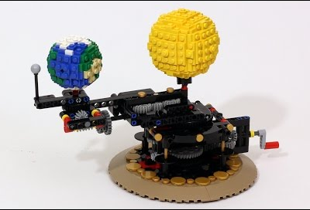
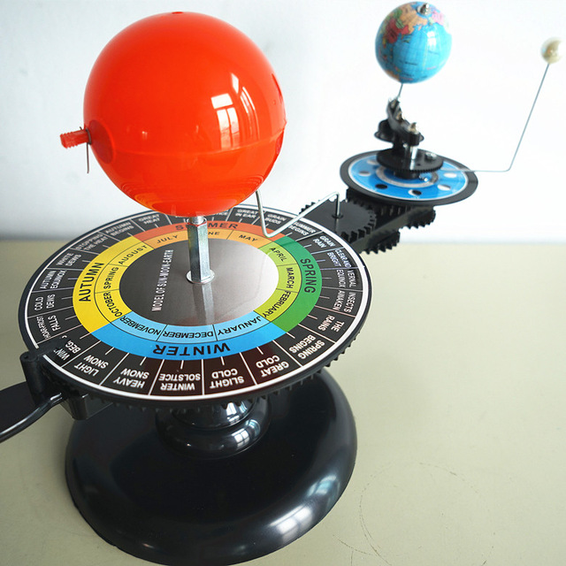
THEY PROCLAIM THEIR MAKER!
Could a chance explosion & evolution
produce these models?

Slide 9
THEY PROCLAIM THEIR MAKER!
Could a chance explosion & evolution
produce the real thing?

Slide 10
THE GLORY OF GOD
I. Ps. 19:1-6 Creation’s Splendor Declares God’s Glory
A. Vs. 1 The Heavens Like All Creation Proclaim God’s Glory
Reliable heavenly bodies: flawless performance of purpose (space travel)
Solar system sustains our lives: constant testimony of God’s goodness

Slide 11
THE GLORY OF GOD
I. Ps. 19:1-6 Creation’s Splendor Declares God’s Glory
B. Vv. 2-3 Day & Night People of All Nations Can See God’s Glory
2 Day unto day uttereth speech, and night unto night sheweth knowledge.
3 There is no speech nor language, where their voice is not heard.

Slide 12
THE GLORY OF GOD
C. Vv. 4-6 All the Heavens, Notably the Sun, Shout God’s Glory
4 Their line is gone out through all the earth, and their words to the end of the world. In them hath he set a tabernacle for the sun,
5 Which is as a bridegroom coming out of his chamber, and rejoiceth as a strong man to run a race.
6 His going forth is from the end of the heaven, and his circuit unto the ends of it: and there is nothing hid from the heat thereof.

Slide 13
The Sun’s Grandeur!
Light & heat sustain life
Most prominent body in our solar system
109 earths fit across its disk, 1.3 million in its interior
11,000 F degrees (6,093 C) hot at surface, 27,000,000 F (14,999,982 C) at core
Surface eruptions of 5,000,000 tons of matter into energy per second

Slide 14
The Sun’s Grandeur!
Solar flares produce magnetic storms
which we see as auroras.

Slide 15
The Sun’s Grandeur!
Solar flares produce magnetic storms
which we see as auroras.

Slide 16
Like a bridegroom or a strong man,
the sun outshines them all!

Slide 17
The sun dwarfs the earth
& other planets!
Earth

Slide 18
The sun a dot next to other stars!

Slide 19
The earth a dot next to the sun!

Slide 20
Like a bridegroom or a strong man,
the sun outshines them all!

Slide 21
The numberless stars praise God’s glory!
Sloan Digital Sky Survey: Astronomers
mapping 100 million celestial objects
200-400 billion stars in our galaxy
Our galaxy (Milky Way): 1 of billions
3,000 million billion stars in universe
NASA: incalculable number of stars

Slide 22
The beauty of the heavens
praise the glory of God!
Hubble Telescope: Starburst Galaxy M-82
View 1

Slide 23
The beauty of the heavens
praise the glory of God!
Hubble Telescope: Starburst Galaxy M-82
View 2

Slide 24
Bluish Disk:
Shows young,
hot stars
Nucleus:
Star-forming
clumps
Outer Region:
Stars &
gas plumes

Slide 25
THE GLORY OF GOD
D. Many “Universes” Declare God’s Glory
Ps. 139:14 Human body: a universe of many universes within the universe
14 I will praise thee; for I am fearfully and wonderfully made: marvellous are thy works; and that my soul knoweth right well.

Slide 26
Vascular system
fearfully & wonderfully
made to God’s glory!
Adult body: 100,000 miles
of blood vessels

Slide 27
The eye: fearfully & wonderfully made to God’s glory!
Created by God
Copied by man

Slide 28
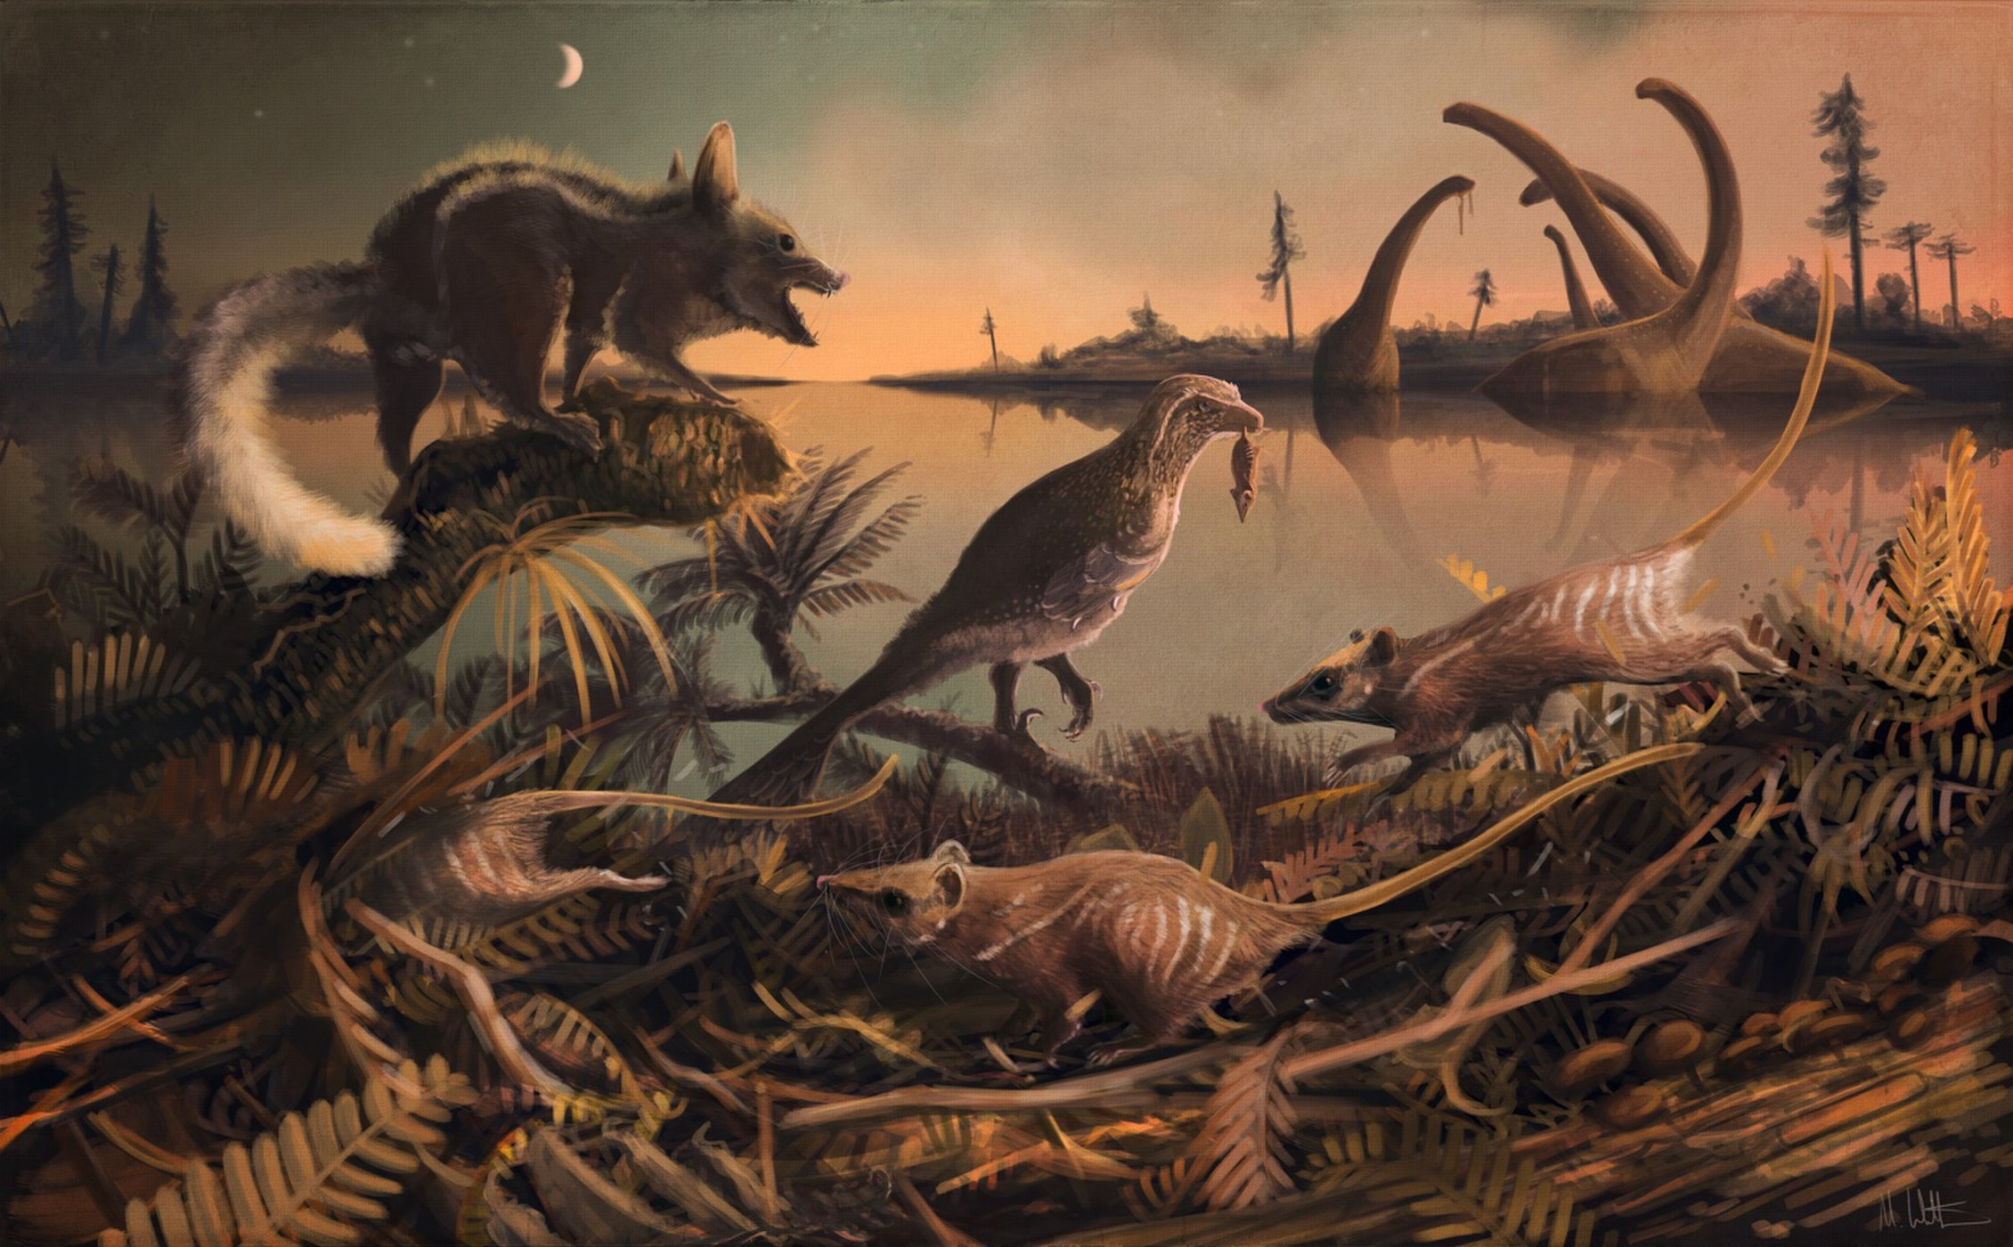
Or did man climb from slime & descend from rats?
“These Rodent-Like Creatures Are the Earliest Known Ancestor of Humans, Whales and Shrews”
By Charles Q. Choi, Live Science Contributor | November 8, 2017
https://www.livescience.com/60888-rat-creatures-were-earliest-eutherian-mammal-ancestors.html
Astounding evidence:
“two quite remarkable teeth”
The earliest ancestors of eutherian mammals were small rat-like creatures (depicted in this illustration) that lived 145 million years ago in the shadow of the dinosaurs. Credit: Mark Witton/University of Portsmouth

Slide 29
THE GLORY OF GOD
II. Ps. 19:7-11 Scripture’s Excellence Declares God’s Glory

Slide 30
7 The law of the LORD is perfect, converting the soul: the testimony of the LORD is sure, making wise the simple.
8 The statutes of the LORD are right, rejoicing the heart: the commandment of the LORD is pure, enlightening the eyes.
9 The fear of the LORD is clean, enduring for ever: the judgments of the LORD are true and righteous altogether.

Slide 31
10 More to be desired are they than gold, yea, than much fine gold: sweeter also than honey and the honeycomb.
11 Moreover by them is thy servant warned: and in keeping of them there is great reward.

Slide 32
THE GLORY OF GOD
II. Ps. 19:7-11 Scripture’s Excellence Declares God’s Glory
A. The Grandeur of the Spiritual World Exceeds That of the Physical

Slide 33
THEY PROCLAIM THEIR MAKER!
Scripture proclaims God’s glory
more than the universe!

Slide 34
THE GLORY OF GOD
II. Ps. 19:7-11 Scripture’s Excellence Declares God’s Glory
B. The Nature & Effect of Scripture Prove Its Excellence
Presented in 6 couplets

Slide 35
THE GLORY OF GOD
II. Ps. 19:7-11 Scripture’s Excellence Declares God’s Glory
C. Vs. 7 God’s Word Is Perfect & Sure
7 The law of the LORD is perfect, converting the soul: the testimony of the LORD is sure, making wise the simple.

Slide 36
THE GLORY OF GOD
II. Ps. 19:7-11 Scripture’s Excellence Declares God’s Glory
C. Vs. 7 God’s Word Is Perfect & Sure
Perfect: complete, whole
Effect: restore the soul to God
Sure: fixed, firm, faithful
Effect: instructs, guides the humble

Slide 37
THE GLORY OF GOD
II. Ps. 19:7-11 Scripture’s Excellence Declares God’s Glory
D. Vs. 8 God’s Word Is Right & Pure
8 The statutes of the LORD are right, rejoicing the heart: the commandment of the LORD is pure, enlightening the eyes.

Slide 38
THE GLORY OF GOD
II. Ps. 19:7-11 Scripture’s Excellence Declares God’s Glory
D. Vs. 8 God’s Word Is Right & Pure
Right: straight, upright
Effect: fills the heart with joy
Pure: spotless, clean
Effect: gives light, understanding

Slide 39
THE GLORY OF GOD
II. Ps. 19:7-11 Scripture’s Excellence Declares God’s Glory
E. Vs. 9 God’s Word Is Clean, & True & Righteous
9 The fear of the LORD is clean, enduring for ever: the judgments of the LORD are true and righteous altogether.

Slide 40
THE GLORY OF GOD
II. Ps. 19:7-11 Scripture’s Excellence Declares God’s Glory
E. Vs. 9 God’s Word Is Clean, & True & Righteous
Clean: unadulterated, morally pure
Effect: abiding, incorruptible (sustains)
True: certain, trustworthy
Righteous: straight, upright
Effect implied: manifestly just, unimpeachable

Slide 41
THE GLORY OF GOD
II. Ps. 19:7-11 Scripture’s Excellence Declares God’s Glory
F. Vv. 10-11 God’s Word Merits the Most Intense Desire & Attention
10 More to be desired are they than gold, yea, than much fine gold: sweeter also than honey and the honeycomb.
11 Moreover by them is thy servant warned: and in keeping of them there is great reward.

Slide 42
THE GLORY OF GOD
II. Ps. 19:7-11 Scripture’s Excellence Declares God’s Glory
F. Vv. 10-11 God’s Word Merits the Most Intense Desire & Attention
Risk all for wealth—truth more valuable
Honey delights the taste—truth more
Warns, guards, protects
Rewards for time & eternity

Slide 43
THE GLORY OF GOD
II. Ps. 19:7-11 Scripture’s Excellence Declares God’s Glory
G. Scripture More Than Creation Declares God’s Glory
Natural causes explain neither
The creation accommodates earthly life, Scripture eternal life
The universe will pass away, spiritual values endure for eternity

Slide 44
THE GLORY OF GOD
III. Ps. 19:12-14 The Glory of God Inspires Us to Worship & Serve Him!

Slide 45
12 Who can understand his errors? cleanse thou me from secret faults.
13 Keep back thy servant also from presumptuous sins; let them not have dominion over me: then shall I be upright, and I shall be innocent from the great transgression.
14 Let the words of my mouth, and the meditation of my heart, be acceptable in thy sight, O LORD, my strength, and my redeemer.

Slide 46
THE GLORY OF GOD
III. Ps. 19:12-14 The Glory of God Inspires Us to Worship & Serve Him!
A. Vs. 12 Pray for More Understanding and Cleansing
12 Who can understand his errors? cleanse thou me from secret faults.

Slide 47
THE GLORY OF GOD
III. Ps. 19:12-14 The Glory of God Inspires Us to Worship & Serve Him!
A. Vs. 12 Pray for More Understanding and Cleansing
Flaws, fumbles, & faults unknown to us are known to God
God’s Word enlightens (vv. 7-11)
God’s mercy forgives

Slide 48
THE GLORY OF GOD
III. Ps. 19:12-14 The Glory of God Inspires Us to Worship & Serve Him!
B. Vs. 13 Pray to Escape Presumptuous Sin
13 Keep back thy servant also from presumptuous sins; let them not have dominion over me: then shall I be upright, and I shall be innocent from the great transgression.

Slide 49
THE GLORY OF GOD
III. Ps. 19:12-14 The Glory of God Inspires Us to Worship & Serve Him!
B. Vs. 13 Pray to Escape Presumptuous Sin
Presumptuous: arrogant, insolent, willful
Humble heart hardened—sin habitual— forge chains of bondage, no escape
King Saul (1 Sam. 13:11-13; 15:17-23)
God’s Word & providence restrain us as we see His glory

Slide 50
THE GLORY OF GOD
III. Ps. 19:12-14 The Glory of God Inspires Us to Worship & Serve Him!
C. Vs. 14 Pray God’s Help to Guide Our Thoughts & Words
14 Let the words of my mouth, and the meditation of my heart, be acceptable in thy sight, O LORD, my strength, and my redeemer.

Slide 51
THE GLORY OF GOD
III. Ps. 19:12-14 The Glory of God Inspires Us to Worship & Serve Him!
C. Vs. 14 Pray God’s Help to Guide Our Thoughts & Words
Origin, direction of conduct
God helps thru His Word & providence

Slide 52
THE GLORY OF GOD
III. Ps. 19:12-14 The Glory of God Inspires Us to Worship & Serve Him!
D. Vs. 14 Give God Glory: “Oh Lord, My Strength and My Redeemer”
Focus our faith in God, not self or man
God is a great rock of strength, always able to help
God redeems or delivers from Satan

Slide 53
THE GLORY OF GOD
IV. Jesus Christ Is the Full & Final Revelation of God’s Glory!
A. Jn. 17:1 God’s Glory Is Revealed in His Death, Resurrection, Ascension, & Coronation
1 These words spake Jesus, and lifted up his eyes to heaven, and said, Father, the hour is come; glorify thy Son, that thy Son also may glorify thee:

Slide 54
IV. Jesus Christ Is the Full & Final Revelation of God’s Glory!
B. Heb. 1:3 God’s Glory Is Revealed in the Deity of Jesus Christ
3 Who being the brightness of his glory, and the express image of his person, and upholding all things by the word of his power, when he had by himself purged our sins, sat down on the right hand of the Majesty on high

Slide 55
THE GLORY OF GOD
IV. Jesus Christ Is the Full & Final Revelation of God’s Glory!
C. Ja. 2:1 We Dare Not Exalt Men But Jesus Christ, “the Lord of Glory”
1 My brethren, have not the faith of our Lord Jesus Christ, the Lord of glory, with respect of persons.

Slide 56
THE GLORY OF GOD
IV. Jesus Christ Is the Full & Final Revelation of God’s Glory!
D. Rev. 5:11-14 Heaven & Earth Ring with Praise to Him
12 Saying with a loud voice, Worthy is the Lamb that was slain to receive power, and riches, and wisdom, and strength, and honour, and glory, and blessing.

Slide 57
THE GLORY OF GOD
Invitation:
1. Meditate on Ps. 19, God’s glory declared:
Creation’s splendor
Scripture’s excellence
2. The glory of God inspires us to worship & serve Him!

Slide 58
THE GLORY OF GOD
Invitation:
3. Sin dishonors God, but God forgives thru Christ:
Acts 8:22 When a Christian repents & prays
22 Repent therefore of this thy wickedness, and pray God, if perhaps the thought of thine heart may be forgiven thee.

Slide 59
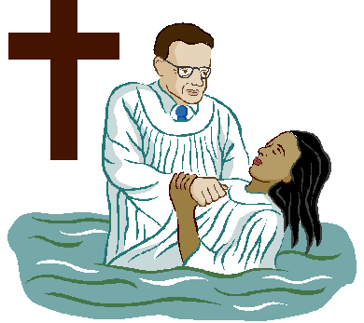
THE GLORY OF GOD
Invitation:
3. Sin dishonors God, but God forgives thru Christ:
Acts 2:38 When a sinner repents & is baptized
38 Then Peter said unto them, Repent, and be baptized every one of you in the name of Jesus Christ for the remission of sins…

