Slide 1
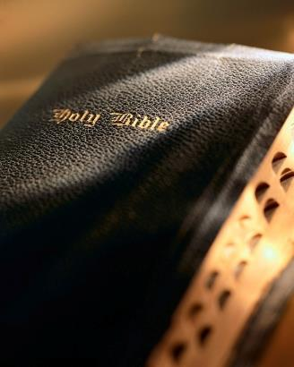

Slide 2
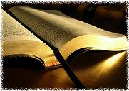
Introduction
Paul wrote; “Rejoice in the Lord always; again I will say rejoice!” Philippians 4:4
The epistle to the Philippians is often described as the “epistle of rejoicing,” or the “epistle of joy.”
The words “joy” or “rejoice” are found 14 times in the epistle.
Amazing contrast! Paul wrote this epistle from a Roman prison!
Paul wants the Philippians (and all Christians) to experience the same joy he was experiencing.

Slide 3
Rejoice Always!
Philippians 4:4

Slide 4
Joy vs. Happiness
Joy and happiness are not necessarily the same:
Happiness is based on what happens to you.
The word “joy” in the New Testament comes from Greek word chara meaning “joy, delight” (Vine).
It is true we experience “joy” when we are happy.
Vine says “joy” is related to Greek chairo meaning “to rejoice.”
Bible “joy” doesn’t just depend on external circumstances; “joy” in this sense can come from internal circumstances.
That’s why Paul could experience “joy” even in a Roman prison: Phil. 1:3-5; 2:2-4; Acts 16:22-25
Rejoice Always!

Slide 5
Happiness is short-lived
Despair lifts and joy is
restored when we focus on:
Joint-heirs w/Christ: Romans 8:16-17
No separation from God’s love: Romans 8:35-39
God’s grace sufficient: 2 Corinthians 12:9-10; Ephesians 3:20
Trials of life but a light affliction: 2 Corin-thians 4:16-17
Happiness is short-lived, but joy is deep & abiding.
Jesus addressed this in the Beatitudes: Matt. 5:3-12
Blessedness does not depend on external circumstances: Phil 4:6-7
Inner peace dependent upon our walking with God: 1 Jn. 1:5-9; 1 Pet. 3:12
If we feel down and “joyless” doesn’t mean we are a bad person; it just means we need to change our focus: 2 Cor. 1:8; 1:9-10; 1 Pet. 1:8-9; 2 Tim. 4:6-8
Joy runs deep and brings inner peace and satis-faction: Jas. 1:2; Acts 5:41; 1 Pet. 4:13-14; Matt. 5:10-12; Phil. 4:6-7
Rejoice Always!

Slide 6
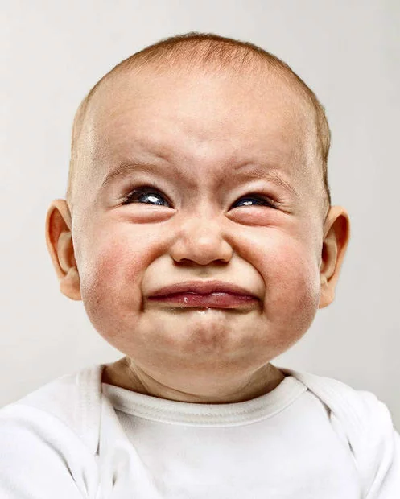
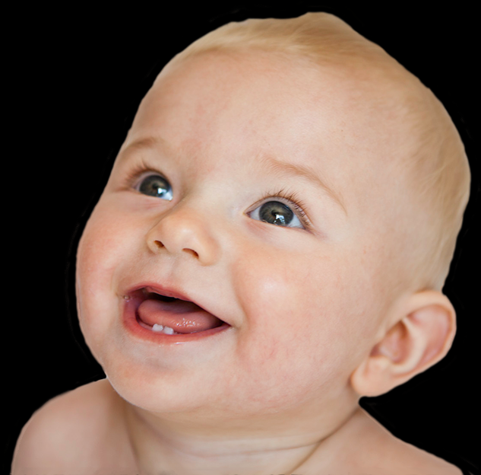
Joyful people a blessing
Are you a joyful person?
Which best describes you?
Rejoice Always!

Slide 7
Reasons for joy
Impossible to be joyful 100% of the time.
Paul : 2 Cor. 1:8
Elijah : 1 Kgs. 19:4
David : Psa. 55:4-7
Solomon : Eccl. 2:20-21
Jesus : Matt. 26:38-39
Satan has many tools to drain your life of joy.
Lack of joy is not a sin; lack of joy doesn’t mean you’re a bad person.
Rejoice Always!

Slide 8
Reasons for joy
Restoring joy to your life:
Joy is a choice : Philippians; Prov. 23:7
Think good thoughts : Phil. 4:8
You are a Christian! Rom. 5:8
Christ died for you! 1 Pet. 1:18-19; Jn. 3:16
Greatest problem solved! Heb. 2:14-18; 4:15-16
God has adopted you! Rom. 8:15-17; 1 Pet. 1:3-4
Greatest privilege granted! 1 Cor. 6:20; Rev. 5:13-14
Greatest work given! Matt. 16:26; 1 Cor 3:9
Rejoice Always!

Slide 9
Reasons for joy
Restoring joy to your life:
Joy is a choice : Philippians; Prov. 23:7
Think good thoughts : Phil. 4:8
All God’s power available to you! Eph. 3:20; 1:18-23
You are heaven bound! Phil. 3:20-21; Heb. 11:13-16; Jn. 14:1-4; 2 Pet. 3:13; Jas. 4:14
Words cannot describe what all this truly means.
God brings more joy to bear in our lives than words can describe; the only limit to our joy is us.
Rejoice Always!

Slide 10
Conclusion
Are you joyful? Do you agree with Paul? Phil. 4:4
Are you confident in the Lord? Phil. 4:6-7
We need to rejoice and be filled with joy!
We are the most blessed people!
We have an enormously important work to busy ourselves doing!
We have a destination truly out of this world!
Rejoice Always!

