Slide 1
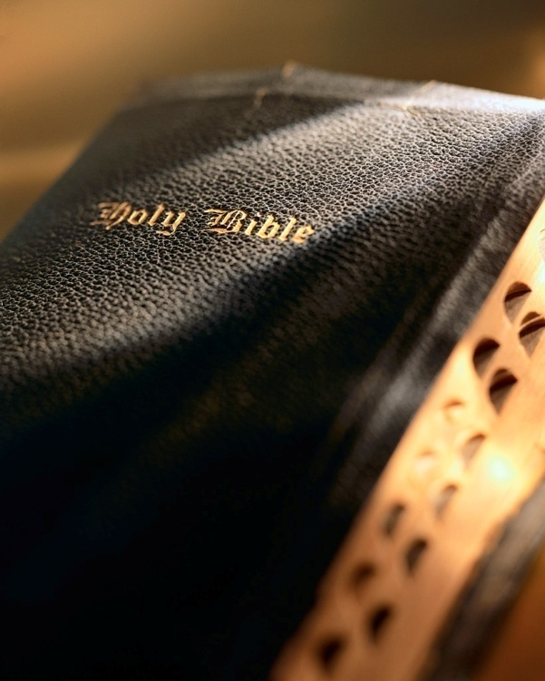

Slide 2
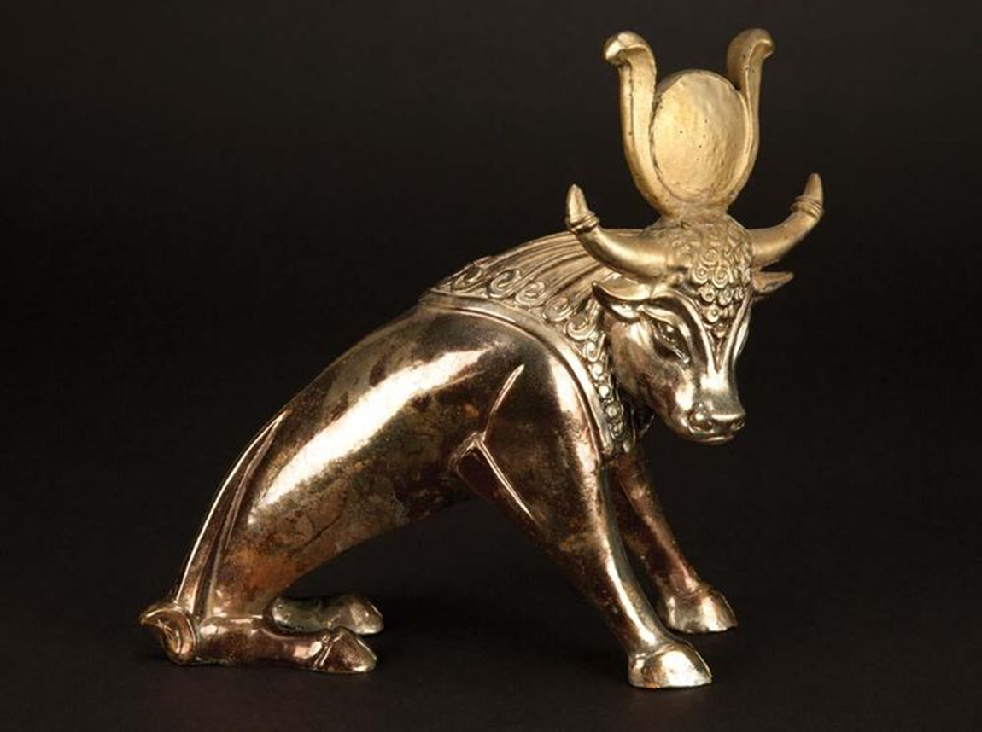
Introduction
Idolatry plagued ancient Israel.
God punished Israel for their idolatry.
They knew better! Ex. 20:1-5a
It is difficult for us today to appreciate the attrac-tion of idolatry to the ancients.
To us idolatry is totally illogical.

Slide 3
Introduction
What was the appeal of ancient idolatry?
Guaranteed
Logical
Selfish
Pleasing
Easy
Indulgent
Convenient
Sensual
Normal

Slide 4
Introduction
Now, can you see the attraction of idolatry?
“I want a spirituality that gets me lots, costs me little, is easy to see, easy to do, has few ethical or doctrinal boundaries, guarantees me success, feels good, and doesn’t offend those around me.”
That will preach and attract a lot of people!
People today essentially want the same things the ancients wanted.

Slide 5
Introduction
Idolatry is alive and well today!
Idolatry is doing its best to draw all of us away from God.
Idolatry has captured all the denominations and our liberal/institutional brethren.
If not careful, it can capture us too! 2 Cor. 13:5

Slide 6
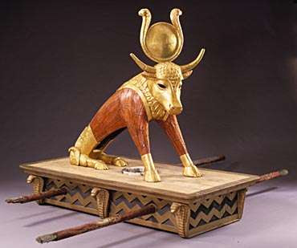
Modern Day Idols
Exodus 20:1-4

Slide 7
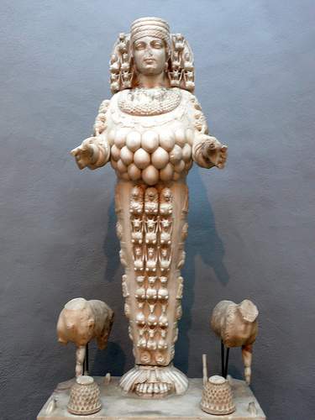
Modern Day Idols
Politics: Psalm 2; Acts 28:30-31
Sports: Jer. 32:35; 1 Cor. 9:24-27
Sex: 1 Thess. 4:3-5
Recreation: Ex. 20:3,5; Matt. 5:6; 6:33
Education: Gen. 10:25; Psa. 19; Rom. 1:20; 2 Pet. 3:3-4; 1 Pet. 3:15
Modern Day Idols

Slide 8
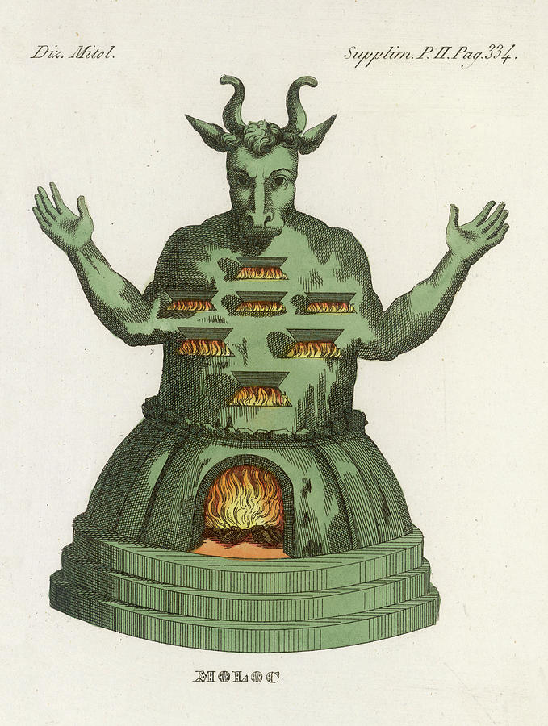
Modern Day Idols
Money: Eccl. 5:10; 1 Tim. 6:10; Lk. 18:24-25; 1 Tim. 6:17-19; Lk. 12: 15-21; Col. 3:5; Lk. 12:21
Job/career: 1 Tim. 5:8; Col. 3:22-24; Eph. 4:28
Religion: Ex. 32:4; Matt. 15:9; Gal. 1:6-9; Matt. 7:21-23
Family: Matt. 10:34-37
Self: Matt. 10:38-39; Rom. 12:1-2; Matt. 5:6; 6:33; Lk. 9:23
Modern Day Idols

Slide 9
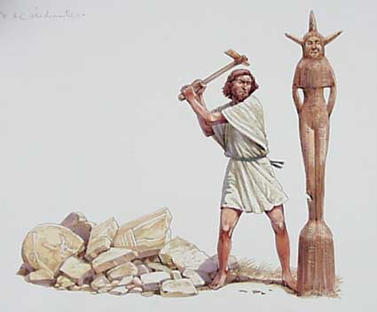
Conclusion
Do you have idols in your life?
More common than you think!
So easy to let them slip into our life!
Let’s imitate the good king Josiah: 2 Kgs. 23:24-25
In the end idols are worthless, empty and separate us from God.
If you have any idols in your life; throw them out NOW!
Modern Day Idols

Slide 10
“And Elijah came to all the people, and said, ‘How long will you falter between two opinions? If the Lord is God, follow Him; but if Baal, follow him.’”
1 Kings 18:21

