Slide 1
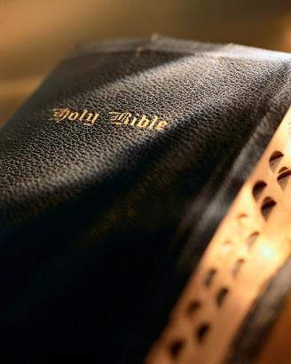

Slide 2
Introduction
Satan is always scheming to seduce us to abandon God and the truth: 1 Pet. 5:8-9
Satan does not fight fair; he uses every “trick in the book” to seduce us: 2 Cor. 11:3
Satan often employs that which is not sinful in and of itself to lead us into temptation and sin: 2 Cor. 2:11
We must always be prepared to battle him! Eph. 6:11-13
Satan is open for business even on holidays.

Slide 3
Tis the Season for Temptation
1 Peter 5:8-9

Slide 4
Be sober, be vigilant…
Influence of false religion: Rom. 15:4; Deut. 19:16-20; 1 Kgs. 12:28-33; Jn. 4:24; Rom. 6:14; Matt. 15:8-9; 26:26-29; Acts 20:7; 1 Cor. 11:26; Jn. 16:13; Lk. 2:8; 1 Cor. 2:9-11
Tis the Season For Temptation

Slide 6
Be sober, be vigilant…
Influence of false religion: Rom. 15:4; Deut. 19:16-20; 1 Kgs. 12:28-33; Jn. 4:24; Rom. 6:14; Matt. 15:8-9; 26:26-29; Acts 20:7; 1 Cor. 11:26; Jn. 16:13; Lk. 2:8; 1 Cor. 2:9-11; 1 Thess. 5:22
Compromise with Satan’s agenda: Deut. 14:1-2; 2 Cor. 6:14-7:1; Eph. 4:15; Matt. 15:9-14; Eph. 5:19: Col. 3:16; 1 Pet. 4:11; Prov. 20:1; Matt. 5:14-16; Prov. 23:7; 4:23; 2 Cor. 6:17-18
Materialism: Lk. 12:13-21; 2 Cor. 9:5-7; Mal. 3:8; Matt. 10:37-39; Heb. 10:24-25
Tis the Season For Temptation

Slide 7
Conclusion
I’m not trying to be a “Scrooge.”
But the “Holiday Season” does present dangers to our walk with Christ.
We always need to be on guard: 1 Pet. 5:8-9
The “Holiday Season” is a time Satan uses to his advantage:
Influence of false religion
Compromise with Satan’s agenda
Materialism
Saved on the Road?

