Slide 1
Faces of Faith
Hebrews 12:1
A Saving Faith
Luke 7:50
Hebrews 11:1

Slide 2
Faces of Faith
Hebrews 12:1
Sin
“for all have sinned”
“there is none righteous, no, not one”
“for the wages of sin is death,”
“while we were still sinners, Christ died for us.”
Miss the mark

Slide 3
Faces of Faith
Hebrews 12:1
Saving…
Rescue from harm, danger or loss
Redeeming or compensating
Tending or serving to save; rescuing; preserving.

Slide 4
Faces of Faith
Hebrews 12:1
A Saving Faith
Luke 7:50
Hebrews 11:1

Slide 5
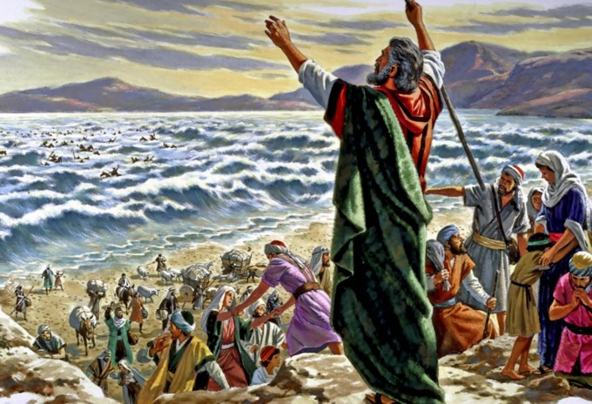
By Faith…They Crossed the Red Sea
Hebrews 11:29
Exodus 14
A Saving Faith

Slide 6
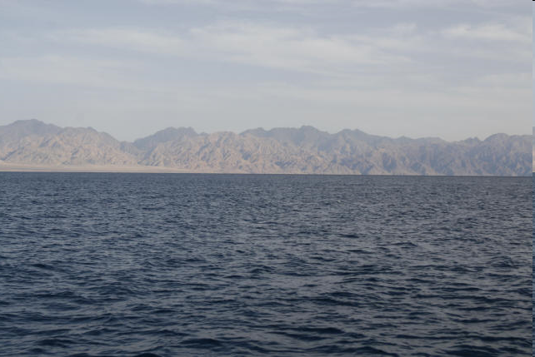

Slide 7
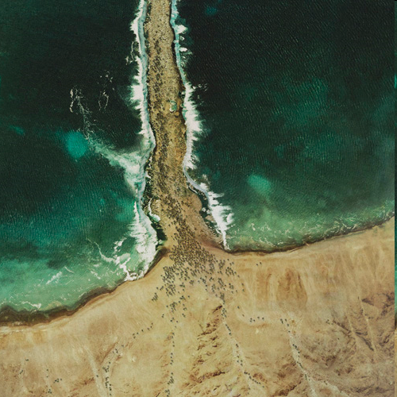

Slide 8
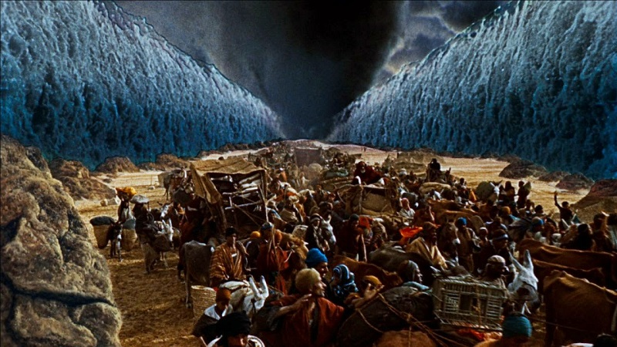
By Faith…They Crossed the Red Sea
Hebrews 11:29
Exodus 14
A Saving Faith
Moves Forward

Slide 9
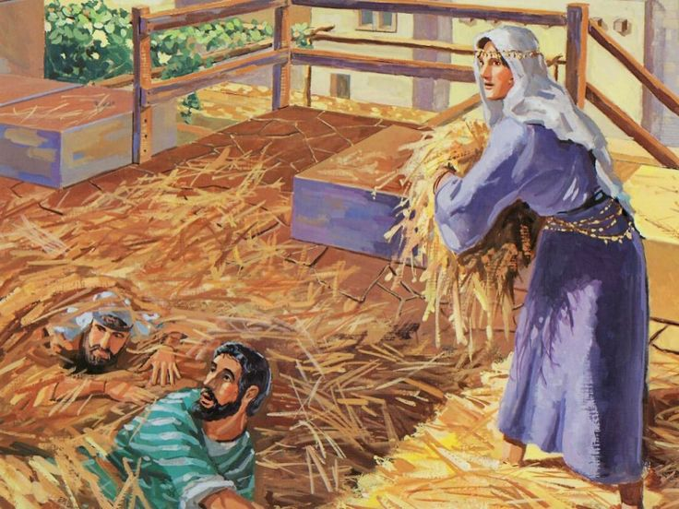
By Faith…Rahab Perished Not
Hebrews 11:31
James 2:25-26
Joshua 2
A Saving Faith
Believes in God

Slide 10
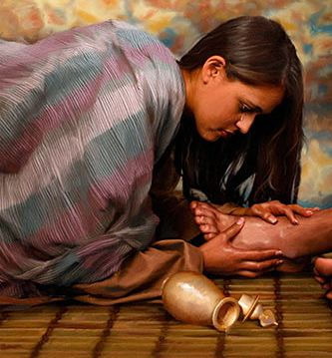
By Faith…The Woman, a Sinner
Luke 7:36-50
A Saving Faith
Loves the Lord Very Much

Slide 11
Faces of Faith
Hebrews 12:1
A Saving Faith
Luke 7:50
Moves Forward
Believes in God
Loves the Lord Very Much

Slide 12
Faces of Faith
Hebrews 12:1
A Saving Faith
Luke 7:50
Hebrews 11:1

