Slide 1
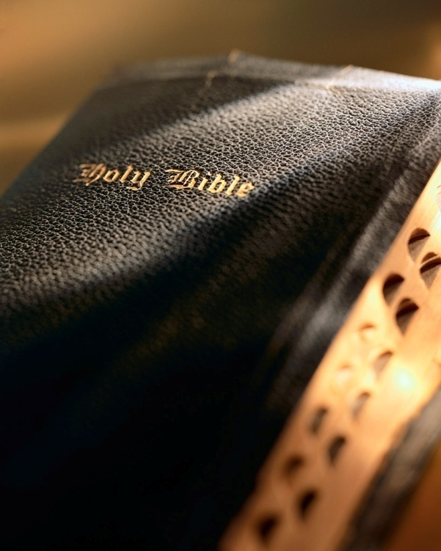

Slide 2
Introduction
Paul’s letters to Ephesus, Philippi, and Colossae, along with the letter to Philemon, are sometimes called
the “prison epistles.”
Written in ad 60-62 while Paul was a prisoner in Rome.
He spent two years in Rome under house arrest: Acts 28:16
Paul expressed his desire to visit Rome earlier in the epistle to the Romans written on his third preaching journey (Corinth): Rom. 16:23

Slide 3
Introduction
In the epistle to the Romans Paul expressed his desire to visit Rome: Rom. 1:10
At the time, little did Paul know the amazing chain of events God’s providence would unleash that ultimately fulfilled his prayer (Rom. 8:28).

Slide 4
Introduction
Paul’s journey to Rome began in Acts 21:
Paul is almost killed by a Jewish mob in Jerusalem: Acts 21:26-31
Rescued by Roman soldiers, but arrested: Acts 21:31-33
Defended himself before the Jews and Roman authorities in Judea and appealed to Caesar: Acts 24, 25, 26; 9:15; 26:17; Rom. 8:28
Voyage to Rome (Acts 27) which included a shipwreck on Malta (27:39-44), an encounter with a poisonous snake (28:3-6), and several miraculous healings (28:8-9).

Slide 5
Introduction
God’s providence brought Paul to Rome: Acts 28
Spends “two whole years” under house arrest; but continued teaching: Acts 28:17-29, 30-31
Even interacted with “the saints…who are of Caesar’s household” : Phil. 4:22
What an amazing journey and result were accom-plished through God’s providence! Rom. 8:28

Slide 6
Introduction
We must learn from their evil example and be determined not to repeat it!
1 Corinthians 10:1-13
“Now all these things happened to them as examples, and they were written for our admonition, upon whom the ends of the ages have come.” (v. 11)
Man has always had a difficult time trusting God:
Adam & Eve: Gen. 3:1-6
Israelites:
Deliverance from Egyptian bondage: Ex. 5-12
Red Sea crossing: Ex. 14:11-12
Bitter waters of Marah: Ex. 15:22-27
Manna: Ex. 16:3
Water at Rephidim: Ex. 17:1-7; Num. 20:1-13
Refusal to enter Canaan: Num. 14:1-4
Failure to heed the warnings of the prophets: Lev. 26; Deut. 28; Jer. 6:16; Matt. 23:37-38

Slide 7
The Power That Works in Us
Ephesians 3:20

Slide 8
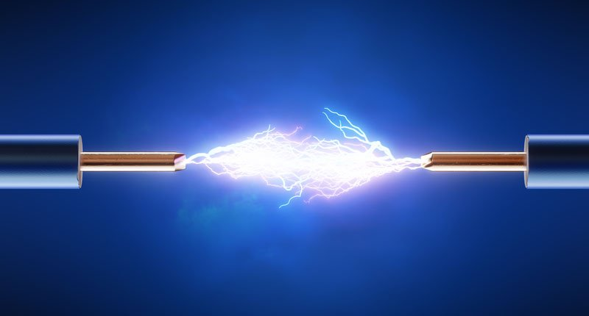
Paul: joyful optimist
With the exception of Christ,
Paul was the most unjustly treated person in history: 2 Cor. 11:22-29
“in labors more abundant” : vs. 23
“in stripes above measure” : vs. 23
“in prisons more frequently” : vs. 23
“in deaths often” : vs. 23
“five times I received forty stripes minus one” : vs. 24
“Three times I was beaten with rods” : vs. 25
“once I was stoned” : vs. 25
God's Mighty Power

Slide 9
Paul: joyful optimist
With the exception of Christ,
Paul was the most unjustly treated person in history: 2 Cor. 11:22-29
“three times I was shipwrecked” : vs. 25
“a night and day I have been in the deep” : vs. 25
“in journeys often” : vs. 26
“in perils of waters” : vs. 26
“in perils of robbers” : vs. 26
“in perils of my own countrymen” : vs. 26
“in perils of the Gentiles” : vs. 26
God's Mighty Power

Slide 10
Paul: joyful optimist
With the exception of Christ,
Paul was the most unjustly treated person in history: 2 Cor. 11:22-29
“in perils in the city” : vs. 26
“in perils in the wilderness” : vs. 26
“in perils in the sea” : vs. 26
“in perils among false brethren” : vs. 26
“in weariness and toil” : vs. 27
“in sleeplessness often” : vs. 27
“in hunger and thirst” : vs. 27
God's Mighty Power

Slide 11
Paul: joyful optimist
With the exception of Christ,
Paul was the most unjustly treated person in history: 2 Cor. 11:22-29
“in fastings often” : vs. 27
“in cold and nakedness” : vs. 27
“besides the other things, what comes upon me daily: my deep concern for all the churches” : vs. 28
But that’s not all!
Thorn in the flesh: 2 Cor. 12:7-10
First and second Roman imprisonments: Acts 28; 2 Tim. 4:6-8
God's Mighty Power

Slide 12
Paul: joyful optimist
In view of Paul’s sufferings the
prison epistles are truly amazing! They are filled with positive and upbeat passages:
Confidence to boldly “speak the word without fear” despite his “chains” : Phil. 1:14
“For to me, to live is Christ, and to die is gain” : Phil. 1:21
Determined to reach “forward to thoses things which are ahead” and “press toward the goal for the prize of the upward call of God in Christ Jesus” : Phil. 3:13-14
“Rejoice in the Lord always. Again I will say, rejoice!” : Phil. 4:4
“Be anxious for nothing…the peace of God, which surpasses all understanding” : Phil. 4:6-7
God's Mighty Power

Slide 13
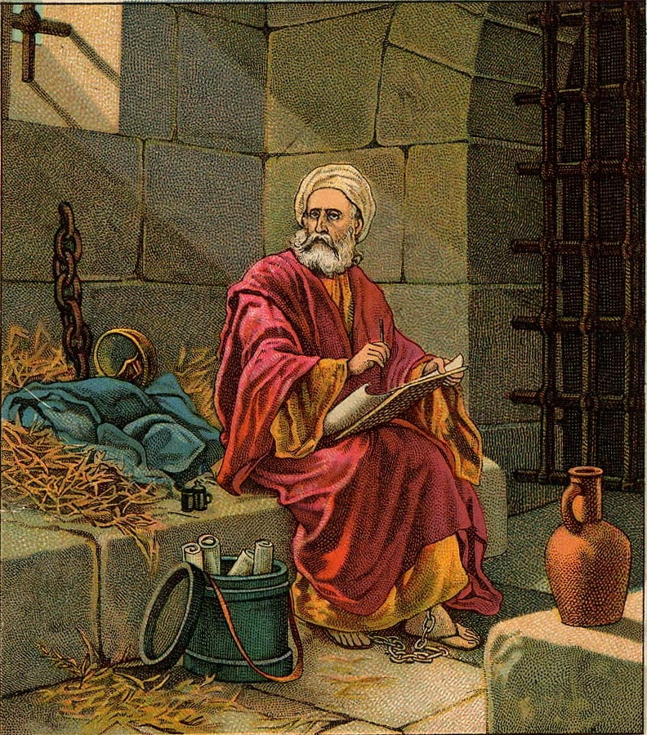
Troubles don’t always go away
When Paul wrote the prison epistles his
future was still very uncertain. More prison? Torture? Execution?
Paul imitated Christ’s example: 1 Cor. 11:1; Heb. 12:1-5
Like Paul, we can overcome any obstacle: sin, tempta-tion, persecution, trials.
God may not alleviate our suffering: Lk. 22:44; Matt. 26:42; 2 Cor. 12:8-10
But God can get us through anything life and/or Satan throws at us: 2 Cor. 1:3; 2 Tim. 4:6-8
God's Mighty Power

Slide 14
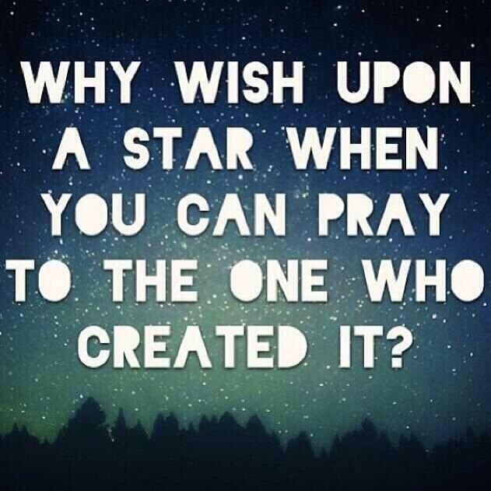
God’s great ability
“Now to Him who is able to do exceedingly abundantly above all that we ask or think, according to the power that works in us.”
Ephesians 3:20
How could Paul be so joyfully optimis-
tic despite having such major problems?
He kept his faith and trust in God! But how?
There is so much in life that beats us down and challenges our faith: Satan never rests! 1 Pet. 5:8
God is not just “able” to help us; His ability is “exceed-ingly, abundantly, above all that we ask or think” !
No matter what Satan throws at us God is able to completely sustain and comfort us! Matt. 6:13
God's Mighty Power

Slide 15
God’s great ability
How is this possible?
God “is able to do” these things “according to the power that works in us.”
What “power” is that? It is “the exceeding greatness of His power toward us who believe, according to the working of His mighty power” : Eph. 1:19
Imagine that! God’s “mighty power” works for us and “works in us” ! 24/7, 365 days a year!
God's Mighty Power

Slide 16
God’s great ability
Ephesians 1:20-23 describes this power:
It is the power “which He [Father] worked in Christ when He raised Him from the dead”
It is the power which “seated Him [Christ] at His right hand in the heavenly places, far above all principality and power and might and dominion, and every name that is named, not only in this age but also in that which is to come.”
God's Mighty Power

Slide 17
God’s great ability
Do we really appreciate the tremendous power God can bring to bear in our lives?
Ephesians 1:20-23 describes this power:
It is the power which “put all things under His [Christ’s] feet” (cf. Matt. 28:18)
It is the power which “gave Him [Christ] to be head over all things to the church, which is His body, the fullness of Him who fills all in all.”
God's Mighty Power

Slide 18
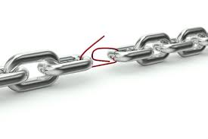
Conclusion
There is only one potentially weak link in this powerful chain: you and me!
Do you and I have the faith to believe and rely on “the working of His mighty power” ?
Let us pray for the faith to rely on “His mighty power” which “works in us who believe” !
Let us meditate daily on this great power, take hold of it, and apply it to our lives!
Christ promises to be with us “always, even to the end of the age” : Matt. 28:20

