Slide 2
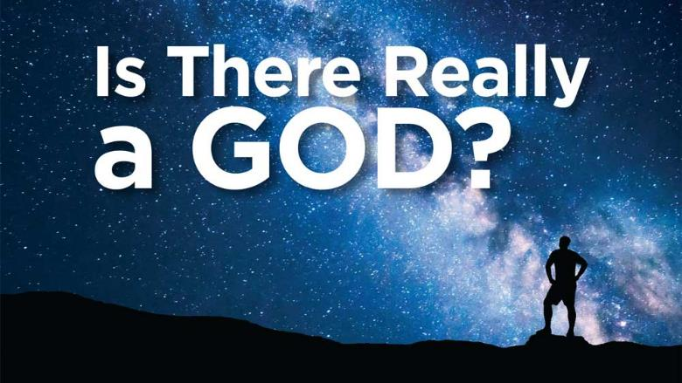
Life’s Most Basic Questions
Acts 17:22-31

Slide 3
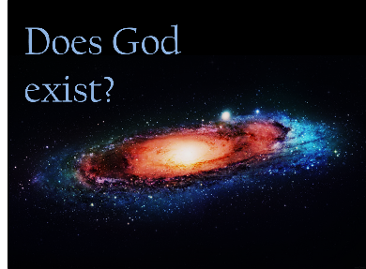
Introduction
Purpose of our lesson to answer life’s three most basic questions:
How did I get here?
Why am I here?
Where am I going?

Slide 4
Introduction
The Law of Causality : every material effect has an
antecedent or simultaneous adequate cause.
The First Law of Thermodynamics : law of the conservation of mass and energy.
The Second Law of Thermodynamics : law of decreasing order.

Slide 5
Introduction
Eternal Universe? No!
Universe from nothing? No!
God created the Universe? Yes! Gen. 1:1; Heb. 3:4; Psa. 33:6, 9; Heb. 1:10-12

Slide 6
Introduction
Who created God?
God is not material, but spiritual: Jn. 4:24
He exists independent of space, time and matter; He originated them! Psa. 90:2; 33:6-9
He is the Chief Builder, the Great uncaused Cause: Heb. 3:4

Slide 7
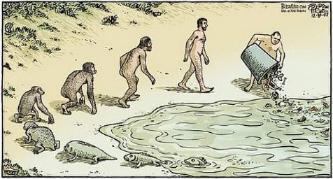
Why am I here?
Majority of society subscribes to the philoso-phy of scientific naturalism.
“The Cosmos is all that is or was or ever will be.”
—Carl Sagan
Man was created in God’s image: Gen. 1:26-27
Man was created to glorify God: Isa. 43:7
Man was created to have fellowship with God: Eph. 2:19-22
Life's Three Most Basic Questions

Slide 8
Why am I here?
“You don't choose to choose what you choose in life!”
—Sam Harris
“Free will is an illusion. Our wills are simply not of our own making…. We do not have the freedom we think we have.”
—Sam Harris
“You will do whatever it is you do, and it is meaningless to assert that you could have done otherwise.”
—Sam Harris
“’You,’ your joys and your sorrows, your memories and your ambitions, your sense of personal identity and free will, are in fact no more than the behavior of a vast assembly of nerve cells and their associated molecules.”
—Francis Crick, Nobel Prize winner, in The Astonishing Hypothesis
“We have no more free will than a bowl of sugar.”
—Anthony Cashmore, biology professor,
University of Pennsylvania
The philosophy of scient-ific naturalism has dire consequences.
Determinism: if matter is all there is, then there is no such thing as free will, choice is only an illusion.
“DNA neither cares nor knows. DNA just is. And we dance to its music.” —Richard Dawkins
“I regard the brain as a computer which will stop working when its components fail. There is no heaven or afterlife for broken down computers; that is a fairy story for people afraid of the dark.” —Stephen Hawking
Life's Three Most Basic Questions

Slide 9
Why am I here?
Striking ironies to the philosophical position of atheists:
Why write books and engage in debates seeking to persuade others to follow atheism?
Why seek to persuade others to change their mind if they cannot possibly do so?
If there is no “free will,” what point is there in trying to show the superiority of the “no-free-will” position?
Life's Three Most Basic Questions

Slide 10
“Naturalistic evolution has clear consequences that Charles Darwin understood perfectly. 1) No gods worth having exist; 2) No life after death exists; 3) No ultimate foundation for ethics exists; 4) No ultimate meaning in life exists; and 5) Human free will is nonexistent.”
—William Provine
“No inherent moral or ethical laws exist, nor are there any absolute guiding principles for human society. The universe cares nothing for us and we have no ultimate meaning in life.”
—William Provine
“[A]n individual cannot be held responsible for either his genes or his environment. From this simple analysis, surely it follows that individuals cannot logically be held responsible for their behavior.”
—Anthony Cashmore, biology professor,
University of Pennsylvania
“Almost all of you here don’t believe in moral responsibility. Think about that. …I don’t consider myself morally responsible, because I don’t have a choice.”
—Jerry Coyne, University of Chicago
Why am I here?
Scientific naturalism has no objective basis for ethics and morality.
Life's Three Most Basic Questions

Slide 11
Why am I here?
If scientific naturalism is true, we are merely a bag of chemicals thrown together by pure chance.
We are not responsible for our behavior, we only think, do and say what chemistry and physics dictate.
Atheists sometimes don’t like the moral implications of atheism, but have no rational basis to deny it.
If morality (and consciousness) is due to the random collision of molecules there is no rational basis for an objective moral standard (e.g., biblical morality).
Life's Three Most Basic Questions

Slide 12
Why am I here?
Natural consequences of scientific naturalism and atheism:
Nazi Germany & Imperial Japan: 75-80 M dead.
Stalin: ~1.2 M murdered in purges, ~1.7 M died in gulags, ~7 M died from starvation.
Mao: ~55 M died of starvation in the “Great Leap Forward” (1958-61); ~2 M cultural revolution (1966-76).
Pol Pot: ~2.5 M executed, starvation, disease (1975-79).
Life's Three Most Basic Questions

Slide 13
Why am I here?
Atheism leads to determinism, leads to no “free will”; no objec-tive moral standard.
“No inherent moral or ethical laws exist, nor are there any absolute guiding principles for human society. The universe cares nothing for us and we have no ultimate meaning in life.”
—William Provine
If true, no rational basis to condemn the actions of Hitler, Stalin or Mao for murdering millions!
Abolish the criminal justice system! No one is guilty of sin! Rom. 3:23
Life's Three Most Basic Questions

Slide 14
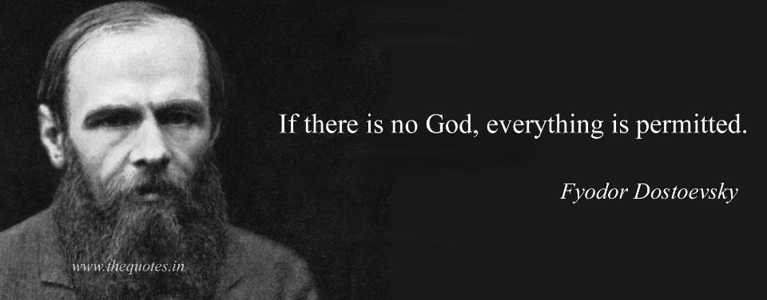
Why am I here?
“It starts by giving up an active deity, then it gives up the hope that there is any life after death. When you give those two up, the rest of it follows fairly easily. You give up the hope that there is an imminent morality. And finally, there’s no human free will. If you believe in evolution, you can’t hope for there being any free will. There’s no hope whatsoever in there being any deep meaning in life. We live, we die, and we’re gone.”
—William Provine
“The fool has said in his heart,
‘There is no God.’
They are corrupt,
They have done abominable works,
There is none who does good.
The Lord looks down from heaven upon the children of men,
To see if there are any who understand, who seek God.
They have all turned aside,
They have together become corrupt;
There is none who does good,
No, not one.”
Psalm 14:1-3
Determinism and the atheism that leads to it are total nonsense!
Life's Three Most Basic Questions

Slide 15
Where am going?
“I don't believe in an afterlife, so I don't have to spend my whole life fearing hell, or fearing heaven even more. For whatever the tortures of hell, I think the boredom of heaven would be even worse.” —Isaac Asimov
“My belief system is that when this is over, it’s over. That you don’t look down from heaven and wait for your loved ones to join you... your molecules continue and in due time become something else.”
—William Shatner
“I would love to believe that when I die I will live again, that some thinking, feeling, remembering part of me will continue. But as much as I want to believe that, and despite the ancient and worldwide cultural traditions that assert an afterlife, I know of nothing to suggest that it is more than wishful thinking.”
—Carl Sagan
The majority assume one of three things about this question:
Everybody is going to heaven.
Deny existence of an “afterlife.”
Just aren’t paying attention.
Life's Three Most Basic Questions

Slide 16
Where am going?
“For since the creation of the world His invisible attributes are clearly seen, being understood by the things that are made, even His eternal power and Godhead, so that they are without excuse,”
Romans 1:20
“But if our gospel be hid, it is hid to them that are lost: 4 In whom the god of this world hath blinded the minds of them which believe not, lest the light of the glorious gospel of Christ, who is the image of God, should shine unto them.”
2 Corinthians 4:34
“The heavens declare the glory of God;
And the firmament shows His handiwork.
2 Day unto day utters speech,
And night unto night reveals knowledge.
3 There is no speech nor language
Where their voice is not heard.
4 Their line has gone out through all the earth,
And their words to the end of the world.”
Psalm 19:1-4
So, why are so many not Christians?
Has God failed to provide adequate evidence for His existence?
“Extraordinary claims require extraordinary evidence.”
—Carl Sagan
God has left “extraordinary evidence” for His existence!
Life's Three Most Basic Questions

Slide 17
Where am going?
“For we shall all stand before the judgment seat of Christ. 11 For it is written:
‘As I live, says the Lord,
Every knee shall bow to Me,
And every tongue shall confess to God.’
12 So then each of us shall give account of himself to God.”
Romans 14:10-12
“…the righteous judgment of God, 6 who ‘will render to each one according to his deeds’: 7 eternal life to those who by patient continuance in doing good seek for glory, honor, and immortality; 8 but to those who are self-seeking and do not obey the truth, but obey unrighteousness — indignation and wrath, 9 tribulation and anguish, on every soul of man who does evil, of the Jew first and also of the Greek; 10 but glory, honor, and peace to everyone who works what is good, to the Jew first and also to the Greek. 11 For there is no partiality with God.”
Romans 2:5-11
“And as it is appointed for men to die once, but after this the judgment,”
Hebrews 9:27
“This is the message which we have heard from Him and declare to you, that God is light and in Him is no darkness at all. 6 If we say that we have fellowship with Him, and walk in darkness, we lie and do not practice the truth. 7 But if we walk in the light as He is in the light, we have fellowship with one another, and the blood of Jesus Christ His Son cleanses us from all sin. 8 If we say that we have no sin, we deceive ourselves, and the truth is not in us. 9 If we confess our sins, He is faithful and just to forgive us our sins and to cleanse us from all unrighteousness. 10 If we say that we have not sinned, we make Him a liar, and His word is not in us.”
1 John 1:5-10
So, where are we headed?
There is an objective moral standard. God’s moral standard!
God will hold us responsible and accountable to His standard.
Life's Three Most Basic Questions

Slide 18
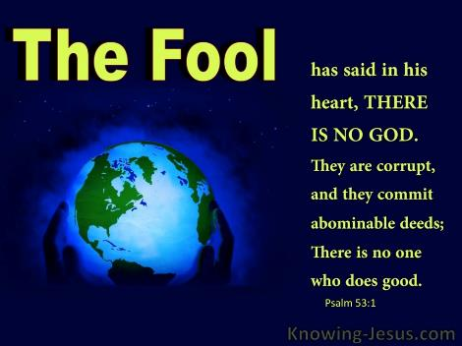
Conclusion
I’ve presented logical, cogent answers to life’s three most basic question:
How did I get here? Gen. 1:1, 26-27; Rom. 1:20
Why am I here? Isa. 43:7; Eph. 2:19-22
Where am I going? Heb. 9:27; 2 Cor. 5:10
It is now “decision time.” What will your answer be? Eccl. 12:13-4
Life's Three Most Basic Questions

Slide 19
