Slide 1
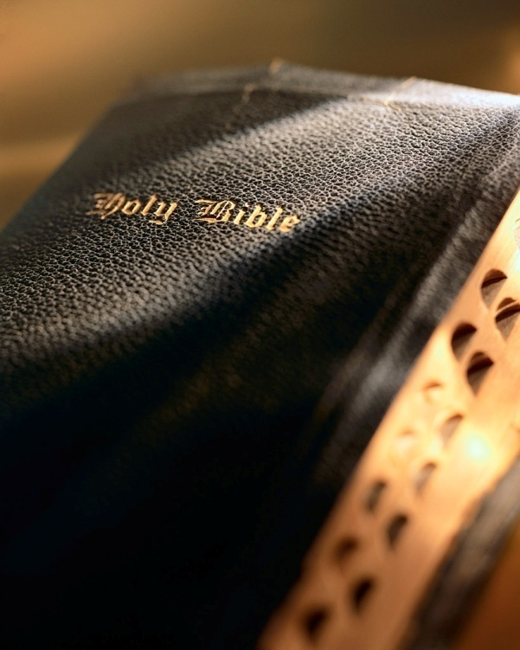

Slide 2
“The highest science, the loftiest speculation, the mightiest philosophy, which can ever engage the attention of a child of God, is the name, the nature, the person, the work, the doings, and the existence of the great God whom he calls his Father.” (C. H. Spurgeon)
“It is my opinion that the Christian conception of God current in these middle years of the twentieth century is so decadent as to be utterly beneath the dignity of the Most High God and actually constitute for professed believers something amounting to a moral calamity.” (A. W. Tozer)
Introduction
Knowledge of God is a major determinant of faithfulness: Hos. 4:6
Impossible to spend too much time and effort in searching God’s book in order to know Him! 1 Cor. 2:6-13
“And this is eternal life, that they may know You, the only true God, and Jesus Christ whom You have sent.” John 17:3

Slide 3
Knowing God: Introduction
John 17:3

Slide 4
Importance
General reasons:
Humbles the mind: Psa. 18:27; 25:9
Expands the mind: Psa. 119:15; 8:3-4
Consoles the mind: Psa. 23:1-6
Corrects our misconceptions of God:
Knowing God: Introduction

Slide 5
Importance
Corrects our misconcep-tions of God:
Doting grandfather
Impersonal scientist
Merlin the magician
Cosmic bug zapper
Celestial Santa Claus
Knowing God: Introduction

Slide 6
“The god of this century no more resembles the Sovereign of Holy Writ than does the dim flickering candle the glory of the midday sun. The god who is talked about in the average pulpit, spoken of in the ordinary Sunday school, mentioned in much of the religious literature of the day, and preached in most of the so-called Christian conferences, is a figment of human imagination, an invention of maudlin sentimentality. The heathen outside the pale of Christendom form gods of wood and stone, while millions of heathen inside Christendom manufacture a god out of their carnal minds. In reality, they are but atheists, for there is no other possible alternative between an absolutely supreme God, and no God at all. A ‘god’ whose will is resisted, whose designs are frustrated, whose purpose is checkmated, possesses no title to Deity, and so far from being a fit object of worship, merits naught but contempt.” (Arthur Pink, Gleanings in the Godhead, pp. 28-29)

Slide 7
Importance
The correct concept of God affects our perception of:
The world and how we relate to it: Phil. 3:8-10
All our relationships: Lk. 14:26; Matt. 19:9-10; Eph. 5:25, 28; Rom. 13:1-7; Eph. 6:1-6, 5-9; 1 Pet. 1:22
Insight into God’s Word: Psa. 119:14-20
Our goals and aim in life: Phil. 1:21
Knowing God: Introduction

Slide 8
Importance
Specific reasons:
Eternal life: Jn. 17:3; 1 Jn. 5:20
Delights God: Jer. 9:23-24
Foundation:
Faith, hope: Heb. 11:6; Rom. 5:3-5
Evangelism: Mt. 16:26; 1 Pet. 2:9
Prayer & worship: Psa. 54:2; Rev. 4:8
Bible study: Psa. 1:1-2; 119; 2 Tim. 2:15
Perspective on life: Phil. 1:21; 3:8-10
Knowing God: Introduction

Slide 9
Themes
Godhead of God: Rom. 1:20; Psa. 50:21; Job 38-42; Isa. 55:8-9
Self-existence: Ex. 3:11-14; Psa. 90:2
Infinite: Heb. 1:10-12
Unchangeable: Num. 23:19; Psa. 102:27; Mal. 3:6; Heb. 13:8
Knowing God: Introduction

Slide 10
Themes
Powers of God:
Omnipotence: Dan. 2:20-22; Job 38-42
Omniscience: Psa. 147:5; Rom. 4:17; Heb. 4:12-13
Omnipresence: Psa. 139:3-10
Knowing God: Introduction

Slide 11
Themes
Perfections of God:
Holiness: Rev. 4:8
Love & mercy: 1 Jn. 4:8
Truthfulness: Psa. 31:5; Ex. 34:6
Faithfulness: 1 Pet. 4:19
Goodness: Ex. 33:19; Psa. 33:5
Patience & longsuffering: 2 Pet. 3:9
Justice: Psa. 89:14; 111:7
Wrath: Psa. 21:8-9; 38:1; Jer. 10:10
Knowing God: Introduction

Slide 12
How
We need to understand and appreciate five basic truths:
God has spoken: 1 Cor. 2:9-11; 2 Tim. 3:14-17
God is sovereign: 1 Tim. 6:15-16; Phil. 2:9-11
God is Savior: Rom. 5:8; 8:16-17; Jn. 14:6; Acts 4:12
God is triune: Eph. 3:10-11; 1:7; 3:3-5
Godliness required: Psa. 119:10-12; 1 Tim. 2:2; 4:7-8; 2 Pet. 1:3-8; 2 Cor. 6:16-7:1
Knowing God: Introduction

Slide 13
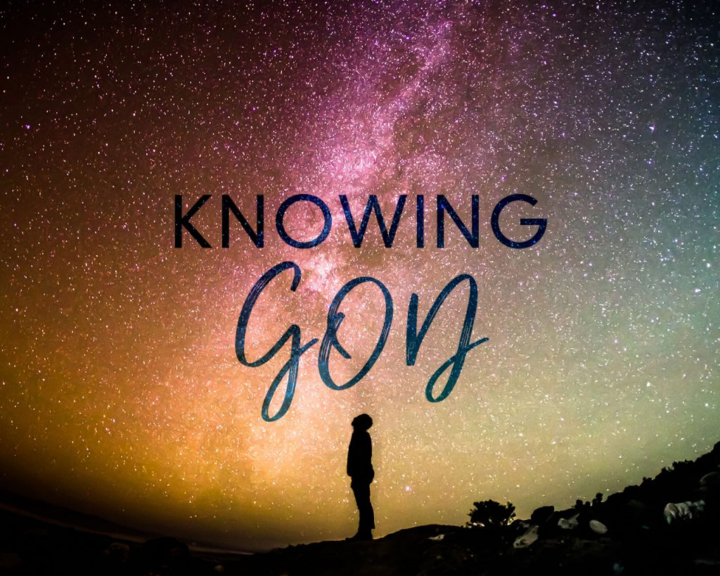
Goal
We hope to achieve six things in our study:
Draw nearer: Heb. 11:5
Deeper faith & hope: Heb. 11:6; Rom. 5:3-5; Titus 2:13; 2 Tim. 4:6-8
Overcome trials: Psalms; Jn. 10:10; 2 Cor. 4:16-5:1
Immunize against unbelief: Heb. 3:12-4:2
Spiritual maturity: Phil. 1:21; 3:8-10
Readiness: Jn. 17:3; Eccl. 12:13-14; 2 Cor. 5:10; 2 Thess. 1:7-10
Knowing God: Introduction

Slide 14
Conclusion
Take notes, review the outlines, etc.
Read the passages and meditate upon them: Prov. 23:7; Phil. 4:8; Deut. 6:6-9
Pray! 1 Thess. 5:17; Jas. 1:5; Col. 4:2
Knowing God: Introduction

