Slide 1
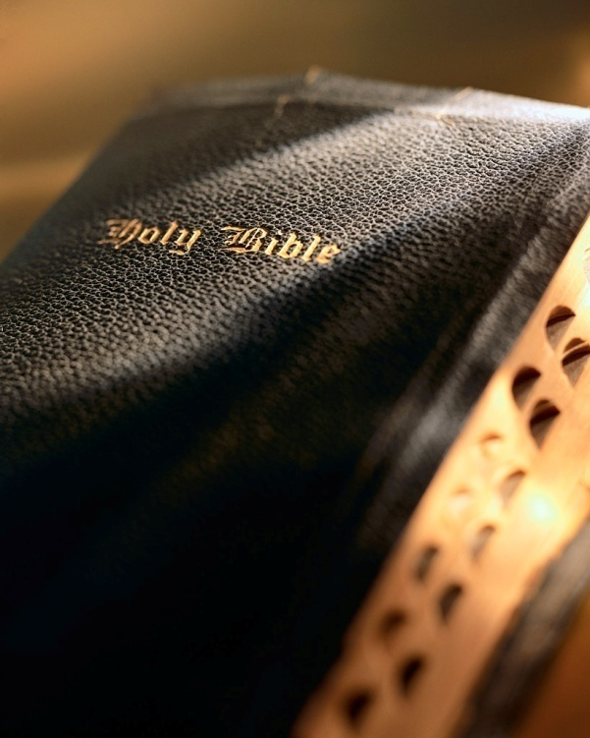

Slide 2
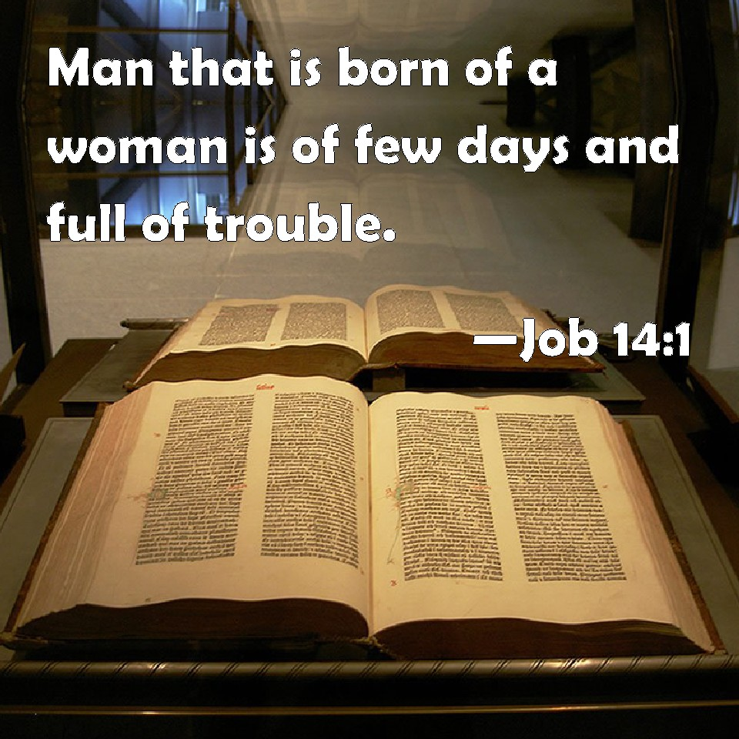
Introduction
Life is tough: Job 14:1; Eccl. 2:17; 12:1-8; 9:11; Gen. 3:17-19; 1 Pet. 3:1-2; 4:3-4; 2 Tim. 3:12; 2 Cor. 1:8-9
Problems can cause despair: Job 10:18-22
Need a godly strategy to deal with difficult times: 1 Pet. 5:7; Psa. 34:15; 56:8

Slide 3
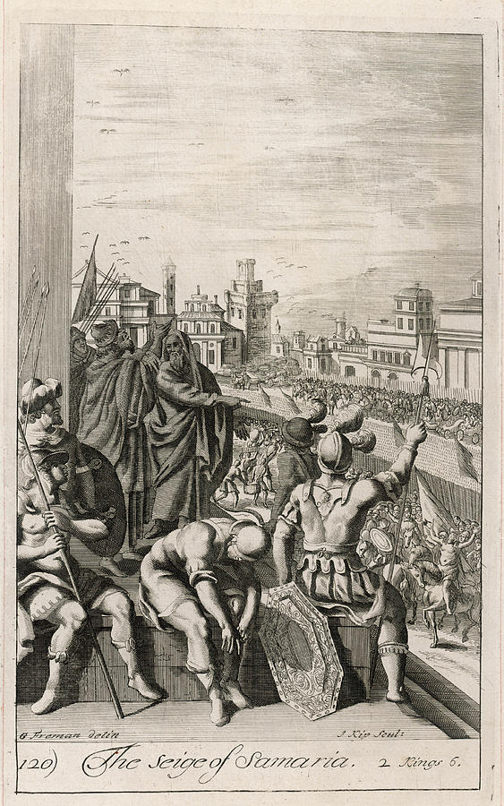
Introduction
Historical background: 2 Kgs. 6:8-23
Elisha was Elijah’s successor: 2 Kgs. 2
850-840 b.c. during the time of the divided kingdom
Elisha prophecies to Israel (Samara) which is ruled by Ahab’s evil son, Joram.
God miraculously warns of Syria’s war plans via Elisha.
Syria’s king (Ben-hadad II) seeks to kill Elisha as a result.

Slide 4
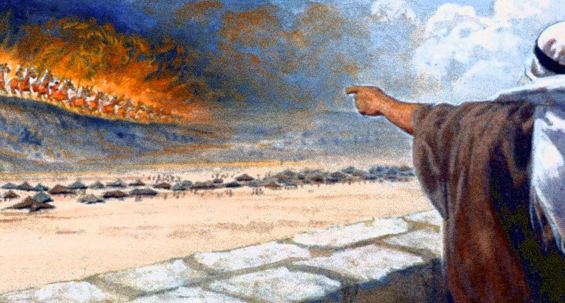
Chariots of Fire
2 Kings 6:8-23

Slide 5
We’re surrounded by the enemy
Like Elisha, we are surrounded by the enemy! Jn. 3:19-20; 2 Pet. 2:7-8
Rampant and blatant sin, false
teaching, etc. Satan is relentless! 1 Pet. 5:8; Job 1:7; Eph. 6:11; Psa. 119:104; 1 Jn. 4:1; Eph. 4:11-14; 5:11
Elisha’s servant asked what we all ask, “Alas…what shall we do?” v. 15 Turn to carnal ‘solutions’? Quit and give up?
Chariots of Fire

Slide 6
We’re surrounded by the enemy
Double-down on your faith!
“When you come to the end of your rope, tie a knot and hang on.”
—Franklin D. Roosevelt
“Accept responsibility for your life. Know that it is you who will get you where you want to go, no one else.”
—Les Brown
Only one answer…Christ! Acts 4:12; Matt. 11:28-30; Phil. 4:7
Put on whole armor of God: Eph. 6:11-18
Remain faithful/obedient: Heb. 5:9; Matt. 7:24-27
Love Him: Jn. 14:15; 1 Jn. 4:19; 2:3-5
Rely/lean on Him 100%: 1 Pet. 5:7; Rom. 8:31-32; Eph. 3:20; Heb. 4:16; 2 Cor. 1:3-4; Psa. 46:1-3
Run the race with patience: Heb. 12:1-4; 2 Tim. 4:7-8; Heb. 10:35ff
Rely on His grace: 2 Cor. 12:9; Psa. 23:4
Devote yourself to prayer & Bible study: Rom. 10:17 1 Thess. 5:17; Col. 4:2; Lk. 18:1-8
Chariots of Fire

Slide 7
God is greater than the enemy
Barne’s Notes
“How many arrangements may there be in progress designed to answer our prayers of which we know nothing! How many agents may be employed to bring about an answer! What mighty obstacles may be in a process of removal, and what changes may be made, and what influences exerted, while we are suffered to pray, and fast, and weep, amidst many discouragements, and many trials of our faith and patience!”
—Albert Barnes
Elisha’s servant was dismayed, because he didn’t include God: 1 Jn.
1 Jn. 4:4
There is more to the material universe than we can see, touch, smell, hear, or taste: 2 Cor. 4:16-5:1; cf. Dan. 10
We can’t always see God’s providential care with our physical senses: Isa. 45:22; Jn. 6:68; Heb. 7:25; Rom. 8:31-39; Matt. 6:25-33; 2 Kgs. 19:14
God helps us handle every difficult situation if we walk by faith: Phil. 4:13; 2 Cor. 11:23-28; Psa. 23:4; 2 Cor. 12:9; 5:1; 1 Cor. 15; 2 Tim. 4:6-8
Chariots of Fire

Slide 8
God will deliver us
I will lift up my eyes to the hills —
From whence comes my help?
2 My help comes from the Lord,
Who made heaven and earth.
3 He will not allow your foot to be moved;
He who keeps you will not slumber.
4 Behold, He who keeps Israel
Shall neither slumber nor sleep.
5 The Lord is your keeper;
The Lord is your shade at your right hand.
6 The sun shall not strike you by day,
Nor the moon by night.
7 The Lord shall preserve you from all evil;
He shall preserve your soul.
8 The Lord shall preserve your going out and your coming in
From this time forth, and even forevermore.
Trust: 2 Kgs. 6:16; Isa. 40:1-31; Psa. 121
Pray: 2 Kgs. 6:17; 1 Pet. 3:12; Jas. 1:6-8; 5:16; Lk. 18:1-8; 1 Thess. 5:22; Eph. 3:20; 1:19-22
Faith: 2 Kgs. 6:17; Mk. 11:22-23; Lk. 18:8; Rom. 10:17; 2 Pet. 1:5-11; Heb. 10:24-25; 1 Cor. 10:13
Obedience: Jas. 2:18-26; Matt. 7:24-27
Chariots of Fire

Slide 9
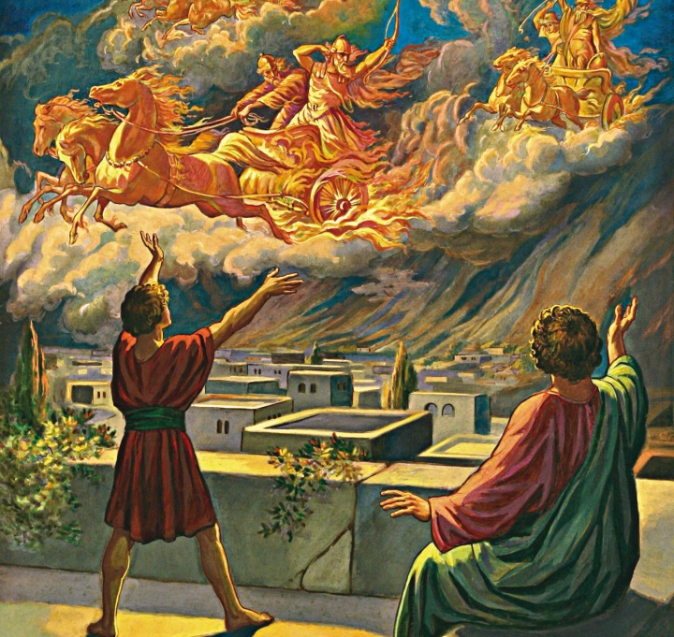
Conclusion
How did Elisha’s difficult time turn out? 2 Kgs. 6:18-23; 8:15
We too can weather ‘hard times’ if we “wait on the Lord” : Psa. 27:14
Are you prepared for ‘hard times’? Jas. 1:6-8
Trust?
Pray?
Faith?
Obedient?
Chariots of Fire

