Slide 1
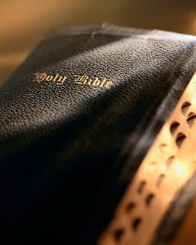

Slide 2
Introduction
General theme: “growing in grace and knowledge of the Lord” : 2 Pet. 3:18
It is critical to establish a foundation of basic knowledge/skills to achieve spiritual success; we cannot remain “babes” ! 1 Pet. 2:2; 1 Cor. 14:20; 2 Pet. 3:1; Matt. 6:33; 2 Pet. 1:5-11
Christians must put “first things first”: Matt. 6:33
Christians must diligently strive for spiritual maturity: 2 Pet. 1:3-11
Christians must reject worldliness: Jas. 1:27; 4::4

Slide 3
Introduction
Baptism isn’t the end of Christianity, it’s the beginning:
Rom. 6:1-4, 12-14, 16-18
To be saved eternally a baptized believer must remain faithful: Col. 1:21-23a; 1 Cor. 15:58; Rev. 2:10
Don’t equate faithfulness with sinless perfection; God has a “second law of pardon” : 1 Jn. 2:1-2; 1:8, 9; Acts 8:22

Slide 4
Growing in the Grace and Knowledge of the Lord (4):
Faithfulness
Colossians 1:21-23

Slide 5
Worshiping God
Every Christian must be faithful in worship: Acts 2:42; 1 Pet. 2:5
It is an absolute necessity to “come together” with
the local church and
worship: 1 Cor. 11:17-18; Heb. 10:23-31; Jn. 4:24; Matt. 15:9; Jn. 17:17; Col. 3:17; Mal. 1:13, 10
Faifthfulness

Slide 6
Worshiping God
Worshiping God “in spirit and truth” : Jn. 4:24
Lord’s Supper: 1 Cor. 11:23-26; Matt. 26:17-30; Ex. 12:15; Acts 20:7; 2:42; 2:1; Lev. 23:15-16; 1 Cor. 11:27-29
Giving: 1 Cor. 16:1-2; Mk. 12:41-44; 2 Cor. 9:7; Rom. 12:8; Lk. 6:38
Preaching/teaching: Acts 2:42; 2 Tim. 4:1-2; Acts 2:27; 7:54; 20:26-27; Eph. 4:15; Gal. 4:16
Faifthfulness

Slide 7
Worshiping God
Worshiping God “in spirit and truth” : Jn. 4:24
Prayer: Jn. 15:16; Jas. 1:6; 1 Jn. 5:14; Jn. 9:31; 1 Thess. 5:17; Lk. 18:1-8; 1 Tim. 2:1; Matt. 5:44; Jas. 5:16
Singing: Eph. 5:19; Col. 3:16; Mal. 1
Faifthfulness

Slide 8
Moral purity
We live in a world saturated with immorality of all kinds!
Living “in the world” is not the problem; living “like the world” is! 1 Tim. 5:22; Titus 2:11-12
The three-fold nature of sin: 1 Jn. 2:15-17; Gal. 5:19-21
God demands we live separate from the “world”; that we live lives of “holiness” : 2 Cor. 6:16-7:1
Faifthfulness

Slide 9
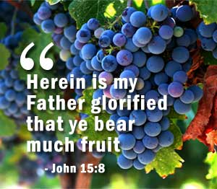
Bearing fruit
An apple tree bearing no fruit is worthless; so are Christians! Jn. 15:1-8
To bear fruit involves:
Lead others to Christ: 2 Tim. 2:2
Restore unfaithful Christians: Gal. 6:1-2
Live righteously: Gal. 5:22-24
Zealous for good works: Titus 2:14; Matt. 25:31-46
Work for the Lord: Eph. 4:16; 1 Cor. 15:58
Our responsibility is in proportion to our ability: Matt. 25:14-30
Faifthfulness

Slide 10
Conclusion
Many reasons why Christians become unfaithful: 2 Cor. 13:5
The picture of an un-
faithful Christian isn’t pretty: 2 Pet. 2:20-22
Even though we are Christians doesn’t mean we can’t be lost! Heb. 10:35-39
Faifthfulness

