Slide 1
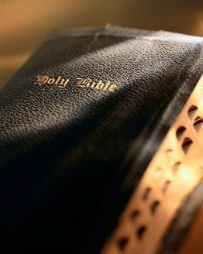

Slide 2
Introduction
General theme: “growing in grace and knowledge of the Lord” : 2 Pet. 3:18
It is critical to establish a foundation & not remain “babes” ! 1 Pet. 2:2; 1 Cor. 14:20; 2 Pet. 3:1; Matt. 6:33; 2 Pet. 1:5-11
Christians must put “first things first”: Matt. 6:33
Christians must diligently strive for spiritual maturity: 2 Pet. 1:3-11
Christians must reject worldliness: Jas. 1:27; 4::4
Christians must remain faithful: Rev. 2:10

Slide 3
Introduction
All plants and animals need proper nourishment to grow, the same is true for
Christians: Rom. 10:17; 1 Pet. 2:2;
Heb. 10:25
The Bible is the greatest book ever written and with the proper attitude can be understood: Eph. 3:3-4; 2 Tim. 2:15

Slide 4
Growing in the Grace and Knowledge of the Lord (5):
Whereby When Ye Read
Ephesians 3:3-4

Slide 5
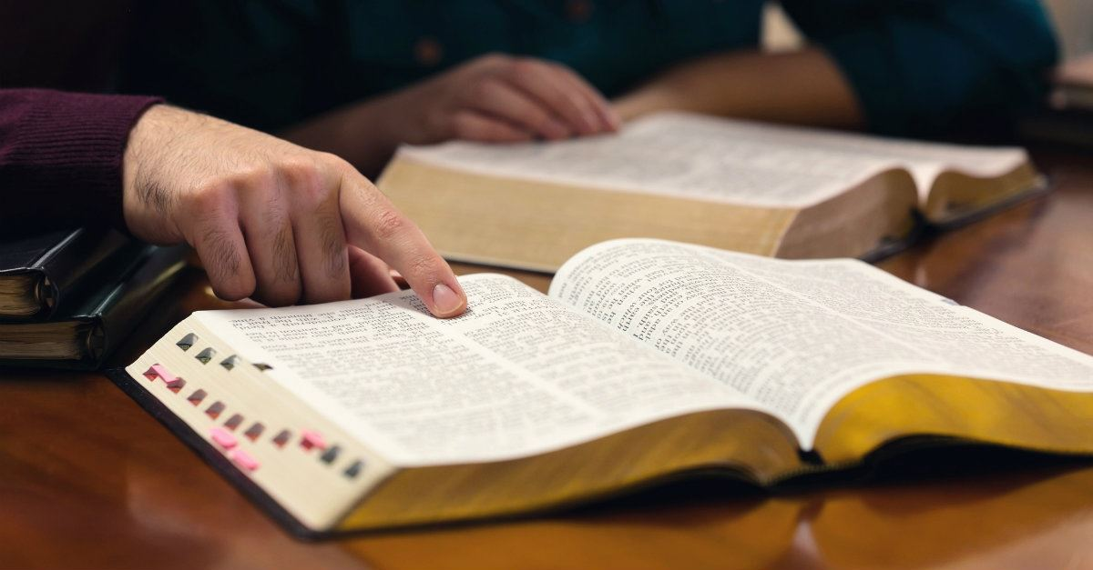
Bible study
God has always re-quired His people to study and know His will: Neh. 8:8-9; Jn. 8:32
Rightly dividing the word is essential to under-stand it: 2 Tim. 2:15
Means to “hold a straight course”; “plow a straight furrow.”
Can’t “cut corners” in Bible study!
Whereby When Ye Read

Slide 6
Bible study
Bible study is unique in at least two aspects:
Inspiration has serious ramifications: 1 Cor. 2:9-13
Bible study is useless unless we apply and obey: 2 Tim. 3:16-17
Whereby When Ye Read

Slide 7
What is “study”?
To “study” involves effort & diligence!
Bible study is hard work, and many are not willing to put in the proper work! Eccl. 12:12
Diligent Bible study brings a good kind of “weariness” ; it is well worth the effort in the dividends it pays! 2 Tim. 3:15; Jn. 6:68
Whereby When Ye Read

Slide 8
Why study?
Promotes spiritual growth: 2 Pet. 3:18; 1:3, 5; 1 Pet. 2:2; Heb. 5:12-
14
Scriptures are profitable: 2 Tim. 3:16-17; 1 Pet. 1:3
To be approved of God: 2 Tim. 2:15
To recognize false teaching: Eph. 4:11-14; 1 Jn. 4:1; Matt. 4:6; Acts 17:11
The Word will judge us: Jn. 12:48; Rom. 2:16
Whereby When Ye Read

Slide 9
Why people fail
Too busy: Matt. 13:22; Eph. 5:15-16
Don’t like to study: Matt. 5:6; Jn. 6:68; Psa. 19:7-11
Don’t know how to study: Eph. 5:17; Mk. 4:24; Lk. 8:18
Don’t love the truth: 2 Thess. 2:9-11-12
Whereby When Ye Read

Slide 10
Principles of study
Consider who is speaking: Gen. 2:16-17; 3:4; Job 2:9; Matt. 11:19
Understand who is being spoken to: Jn. 16:13; Jas. 1:27
Understand goal of writer: 1 Cor. 1:14, 10-15; Acts 18:8
Understand setting of passage: Jn. 6:44-45; Rom. 10:13-17
Read all God says on the subject: Psa. 119:160; Eph. 2:8-10; Jas. 2:24-25
Whereby When Ye Read

Slide 11
Principles of study
Respect silence of the Scriptures: Heb. 7:12-14; 1 Pet. 4:11
Recognize figurative language: Rev. 14:1, 3; 7:4-10; 20:4; Mk. 9:1; Acts 2; Col. 1:13
Must study with a desire to obey: Jn. 7:16-17; Lk. 8:15; Matt. 7:9-13
Must know proper divisions of the Bible: Rom. 7:1-6; Heb. 9:16-17; 10:9; Gal. 5:4; Rom. 15:4; 1 Cor. 10:11
Whereby When Ye Read

Slide 12
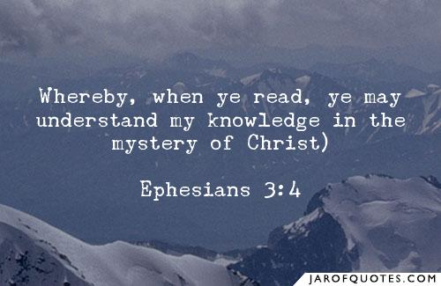
Conclusion
Let us heed 2 Tim. 2:15
As we read the Bible, let us never forget it is indeed the Word of God! 1 Thess. 2:13-14
Let us never forget the power of God’s Word! Heb. 4:11-12; Jn. 12:48
Whereby When Ye Read

